Slide 1
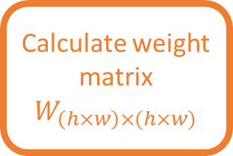


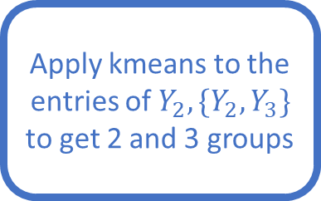

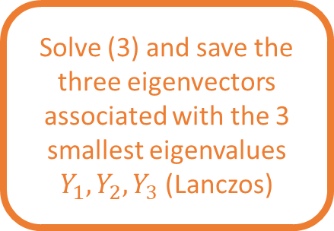
Read image in matrix $M_{h×w}$
Preprocess $M_{h×w}$ and get $M$
Calculate weight matrix $W_{\left(h×w\right)×(h×w)}$
Solve (3) and save the three eigenvectors associated with the 3 smallest eigenvalues $Y_{1},Y_{2}, Y_{3}$ (Lanczos)
Apply kmeans to the entries of $Y_{2},\{Y_{2},Y_{3}\}$ to get 2 and 3 groups
Apply groups to $M$

