Slide 1

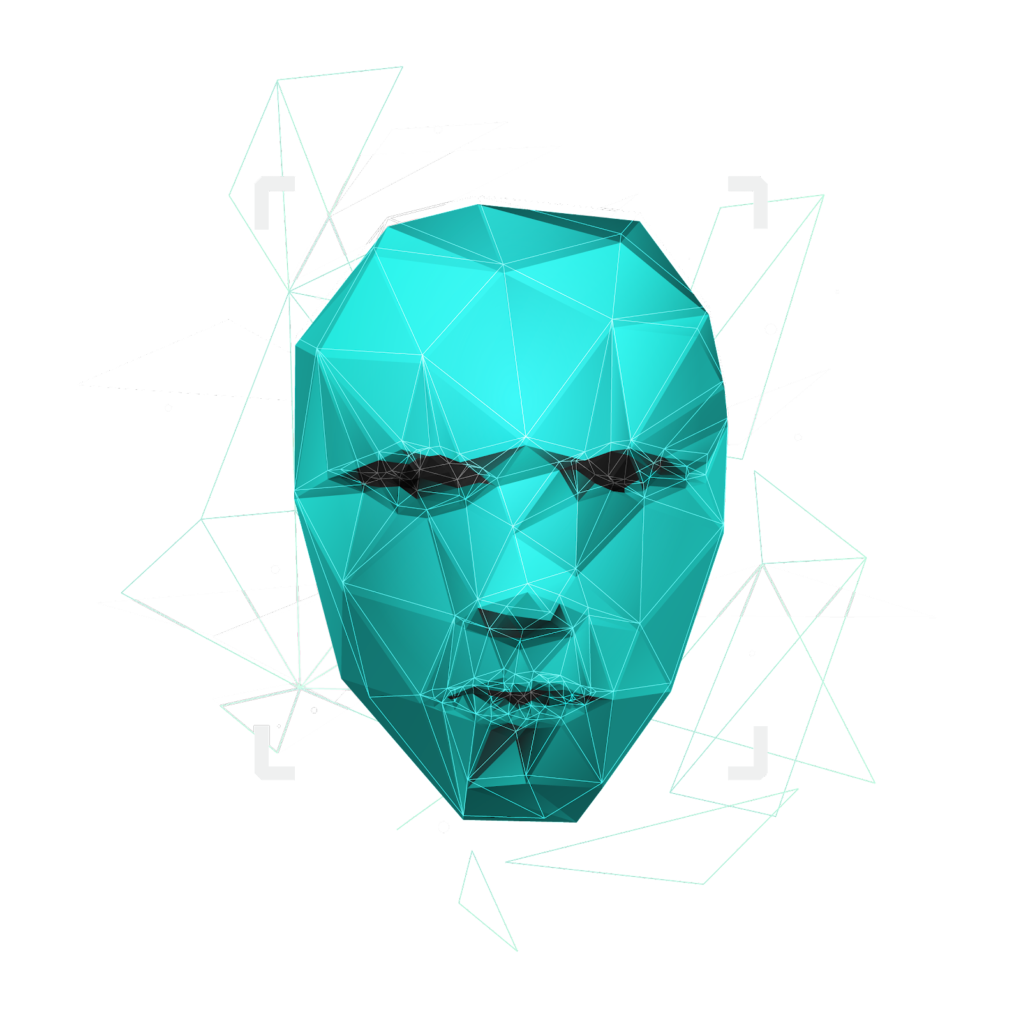
Café Chatbot
Welcome Everyone to our Presentation

Slide 2

Introduction
Analysis & Visualization
03
01
About Chatbot
Demo Chatbot
04
02
Table of Content
Team Members.
Why we make a coffee Chatbot?
Scope of Chatbot.
Our Dataset.
Applied methods.
Applied Models.
Dataset Exploration.
Tool Used
Concepts.
Pipelines
Advantages.
DisAdvantages.
Stories, and Enitities.
Intents, Action, and Lookup.
Execution of our Chatbot.
Chatbot Visulization
Conclusion.

Slide 3

Introduction
01
Let’s begin our Presentation

Slide 4



Team Member
1. Ibrahim Khurfan | 218110082 Leader
2. Fouad Majd Alkadri | 218110075 Assistants
3. Abdullah Rajoub | 218110141 Assistants
4. Abdulaziz Alowain | 219110119 Assistants

Slide 5




Why we make a coffee Chatbot?
Save Time
Save Effort
Save Money
Evolution Trend

Slide 6

Scope
What are the features that’ll be included in our chatbot.

Slide 7
Feature of our Chatbot
Remove order from the customers
Provides offers
Take Orders from the customers.
provide helpful contact information on command (e.g., support team email).
Provide a list of items.
Take complaints
The chatbot will be able to provide suggestion to the customer.
The chatbot will be able to respond to greetings.

Slide 8

Datasets
What are the Dataset that’ll be used.

Slide 9



Our Dataset
- We found Four datasets.
- The 3 datasets includes many files, but we mostly used a file called conversation which contains questions and answers.
- We trained our model using examples from the datasets which we found relevant to our project.
We also used our own examples.
The Fourth dataset is our own dataset and that will used 100% of it and it’ll be combined between all three dataset

Slide 10
About Chatbot
02
What you need to know about chatbot

Slide 11

Tool Used
The tool that will be used is Rasa.
Rasa is an open-source machine learning framework for building AI assistants and chatbots. Mostly you don’t need any programming language experience to work in Rasa.
Rasa can be used to build contextual AI chat bots, meaning that the chat bot will be capable of providing responses that fits the context. For example, if I’m ordering a coffee, and the chatbot wants to confirm my order, the chatbot should response with “do you want to confirm your coffee purchase? “

Slide 12

Concepts
Definitions

Slide 13
Overview of pipelines
- A pipeline is a set of components that are used to train the model by passing the training data through them.
- There are two preconfigured pipelines in RASA:
1. Pretrained_embeddings_Spacy: this pipeline uses the spaCy library which provides word embeddings.
2. Supervised_embeddings: this pipeline trains the data from scratch.

Slide 14




Overview of pipelines cont.
Models
Datasets
Smart Chatbot
Pipeline
1. Pretrained_embeddings_Spacy:
2. Supervised_embeddings:

Slide 15
Components
Supervised_embeddings:
WhitespaceTokenizer: this component is a tokenizer that uses white spaces as delimiters to separate
tokens. In our case, we would not use the tokenizer Jieba which is for specific languages such as
Chinese.
CRFEntityExtractor and DucklingHttpExtractor: Both components are used to extract entities.
DucklingHttpExtractor is a specialized component used to extract specific entities, such as, dates, numbers, and distances.

Slide 16
Components
Supervised_embeddings:
Regex_featurizer: this component can be added before CFREntityExtractor to assist with entity
extraction if you’re using regular expressions. For example, 10-digit phone numbers.
CountVectorsFeaturizer (Featurizer) and EmbeddingIntentClassifier (Intent Classifier): the
CountVectorsFeaturizer creates a bag-of-words with the number of times a word appears in a text.
This bag-of-words is used as input for EmbeddingIntentClassifer to predict the intent of the user’s
input.

Slide 17
Components
Pretrained_embeddings_Spacy
SpacyNLP: used for word embeddings. This means that this component must be placed at the
beginning.
SpacyTokenezier: This component is a tokenizer that splits the text into smaller chunks called
tokens.

Slide 18
Components
Pretrained_embeddings_Spacy
SpacyEntityExtractor: this component is used to extract entities from the user input. For
example, if the user says, “The Dunkin store at Abu Bakr Road gave me a cappuccino instead of
an americano.” Then the model should identify “Dunkin store” as a coffee shop, “Abu Bakr
Road” as a street, “cappuccino” and “americano” as a drink.
SpacyFeaturizer (Featurizer) and SklearnIntentClassifier (Intent Classifier): These two
components are used Together to classify intents. The output of the model is the top-ranked
intent and an array of other possible intents.

Slide 19
Advantages/Disadvantages of each Pipeline
Pretrained_embeddings_Spacy:
Supervised_embeddings:
Advantage
Advantage
Training is fast
Better at learning domain-specific words
Training less data
Handling multiple intents.
Disadvantage
Disadvantage
Domain-specific words are not captured easily
Needs more training data

Slide 20
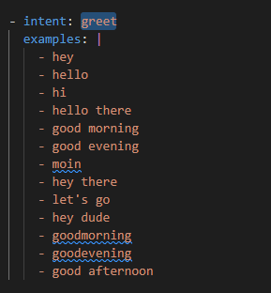
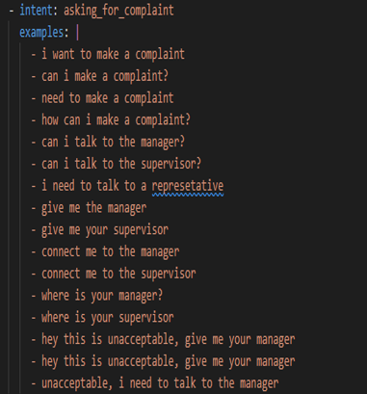
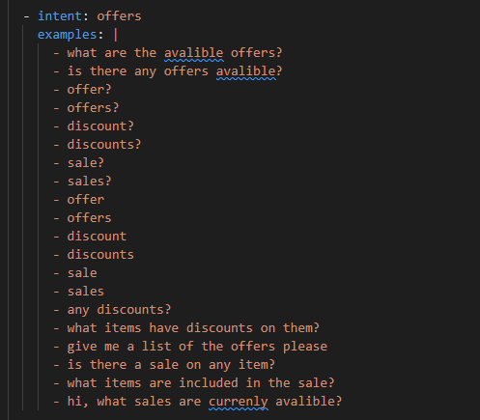
Intents
- Intents are labels that represent the meaning or goal of a user's specific input.

Slide 21
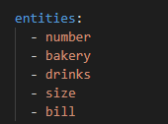
Entities
- Entities are important keywords that an assistant should take note of.
- For example, "I want black coffee" has the entity drinks.
- the entities are useful for allowing us to make the chatbot respond effectively.

Slide 22
Actions
- After each user message, the model will predict an Action that the assistant should perform next.
- The two types of actions we used are:
1. responses: a message the assistant will send back to the user.

Slide 23
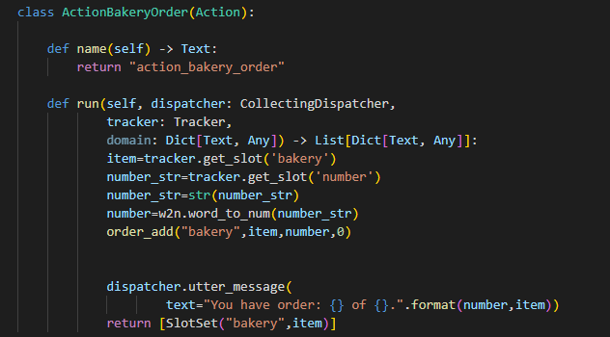
Actions
2. custom actions: is an action that runs any code you want.

Slide 24
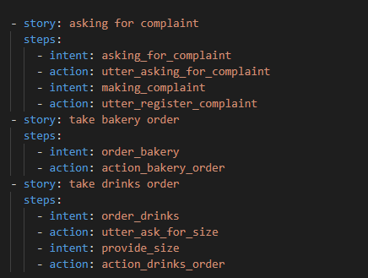
Stories
-A story is a representation of a conversation between the user and the AI assistant, where the user's messages are represented as intents and the AI's responses are represented as actions.

Slide 25
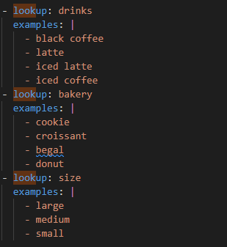
Lookup Tables
- Lookup tables are a list of words used to generate case-insensitive regular expression patterns.
- we used lookup tables to specify our menu items and the sizes of drinks.

Slide 26
Analysis & Visualization
03
What we’ve explored through this journey. And brief analysis to know what’s going on .

Slide 27
Applied Methods
What are the applied methods.

Slide 28


Applied Methods for our Analysis
Rasa Chatbot
Users Feedback
asking real coffee shop customers, if they’re satisfied with the chatbot or not.
Rasa Shell NLU
By using the command (-rasa shell nlu). That shows how the chatbot are choose or predicting the output with the confidence measure of this model.

Slide 29
Users Feedback
Technical Feedback
Name: Faisal Alagla
Major: Software Engineer
Feedback: It’s impressive, the chatbot detects mistakes and gets the right response corresponding to the question of the user. And I like the idea of feeding the chatbot input teach him the right to respond.

Slide 30
Applied Models
What are the methods applied

Slide 31
Applied models
So far, we’ll perform 2 of the techniques. And we’ll use 2 types of models or processing pipelines that are the following:
Pretrained_embedding_spacy.
Custom model: Custom Components.

Slide 32
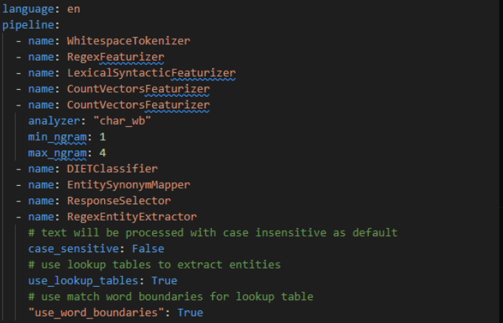
Custom Model
Components

Slide 33
Results
Example: I want to order a black coffee
Percentage of Confidence | 0.99945 | 0.99969 | 0.77425
Predicted | Intent: order_drinks | Entity: drinks | Entity: number
Example: I want to order a cookie
Percentage of Confidence | 0.99997 | 0.99981 | 0.99951
Predicted | Intent: order_bakery | Entity: bakery | Entity: number

Slide 34
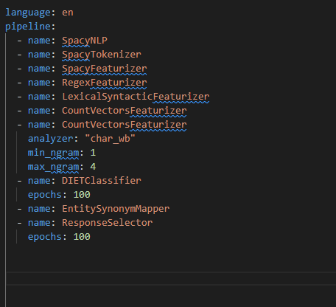
Pretrained_embedding_spacy Model.
Components

Slide 35
Results
Example: I want to order a black coffee
Percentage of Confidence | 0.99945 | 0.99969 | 0.77425
Predicted | Intent: order_drinks | Entity: drinks | Entity: number
Example: I want to order a cookie
Percentage of Confidence | 0.99997 | 0.99981 | 0.99951
Predicted | Intent: order_bakery | Entity: bakery | Entity: number

Slide 36
Dataset Exploration
Going Deeply to our datasets

Slide 37

Exploration Dataset
We’ve 4 Dataset as follows:
The First Dataset :
a. Item_to_id file: good for knowing the items menu that’s used.
b. Conversation file: good for conversations between the café staff and the customers
Questions/Answers.
The second Dataset:
a. Café data: will help us to know what is the most ordered food item in these invoices.
The third Dataset:
a. Ratting_and_sentiments: This file contains ratings for several coffee shops.
Note: Our goal from studying of these datasets to get most valuable information that’ll be build our chatbot And built examples from scratch that’ll suit our chatbot.

Slide 38
Exploration Dataset
Fourth Dataset: the dataset contains most important information that have been collected from the first 3 dataset with extra examples for our chatbot
For each category we’ll represent how many training data we’ve as follows:
Approximately :
Intent: 25 intents.
Entity: 11 Entities
Actions: 20 action.
Story: 21 stories
Lookup: 4 lookups.
Synonym: 3 synonyms.
Rule: 10 rules .
Response: 19 responses.

Slide 39
Dataset Visualization
Going Deeply to our datasets

Slide 40
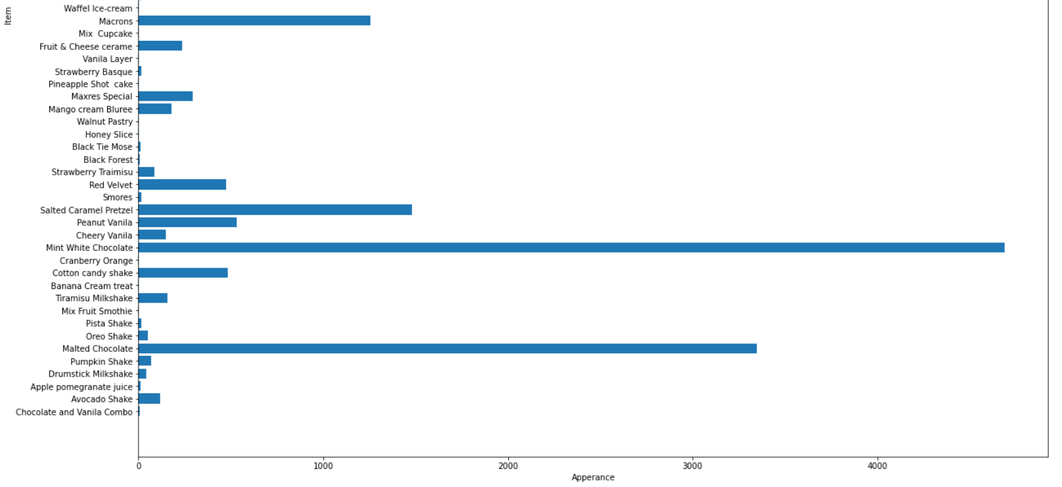
Visualization
The First Dataset:
Item_to_id file
Seeing which item has been appearing frequently

Slide 41
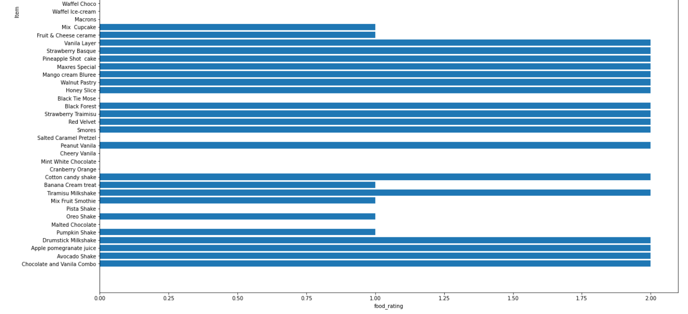
Visualization
The First Dataset:
Item_to_id file
Seeing each item rating

Slide 42
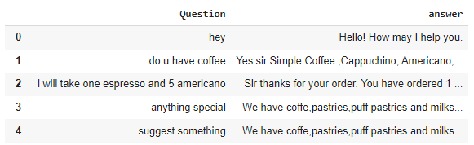
Visualization
The First Dataset:
Conversation file:
Conversation table Q/A

Slide 43
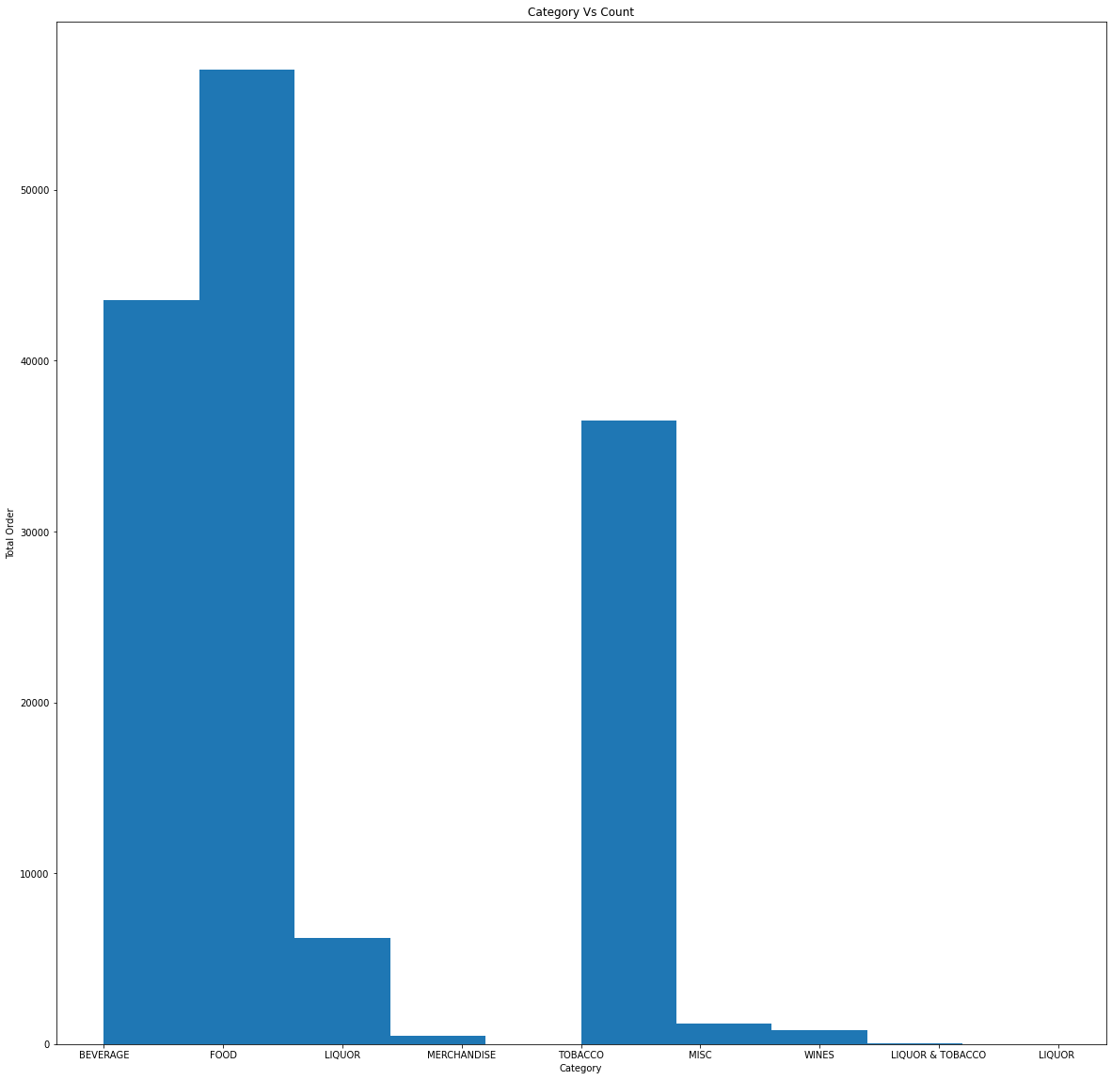
Visualization
The Second Dataset:
Café data:
Seeing which Category has been appearing frequently
Approximately
Top 1: Food 59k
Top 2: Beverage 43k
Top 3: Tobacco 38k

Slide 44
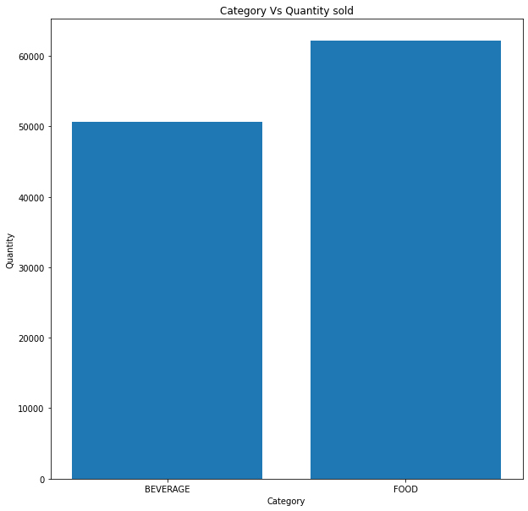
Visualization
The Second Dataset:
Café data:
Seeing Which Category Selling more

Slide 45
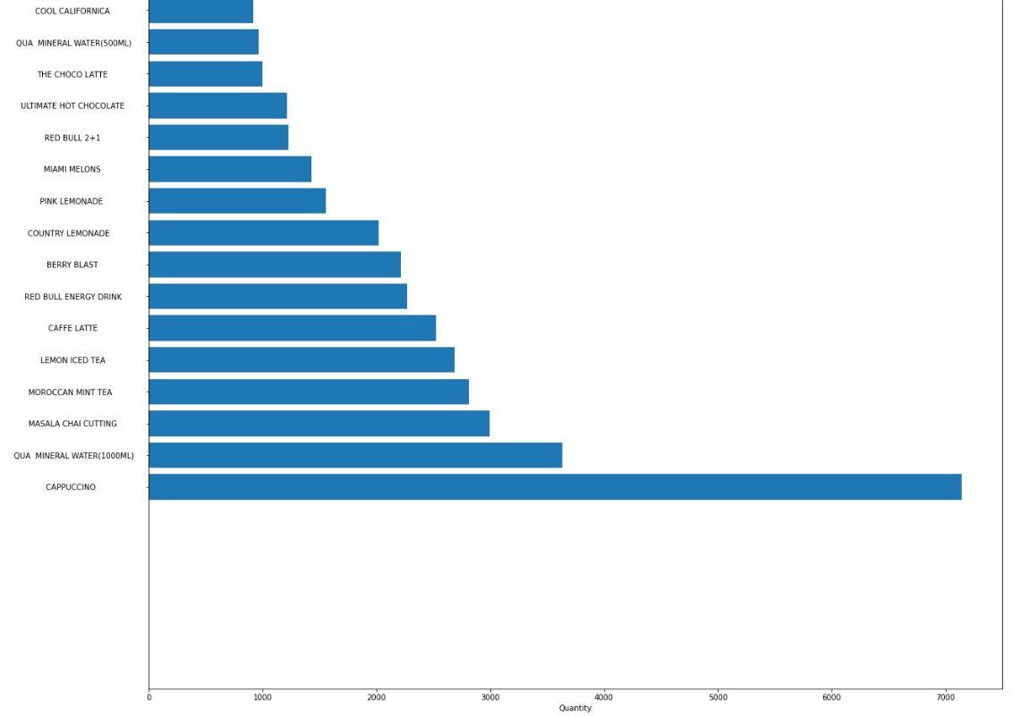
Visualization
The Second Dataset:
Café data:
Seeing which item from BEVERAGE is selling more
Approximately
Top 1: Cappuccino 7k
Top 2: Water 3.5k
Top 3: Masala Chai Cutting 3.1k
Top 1: Cappuccino 7k
Top 2: Water 3.5k
Top 3: Masala Chai Cutting 3.1k

Slide 46
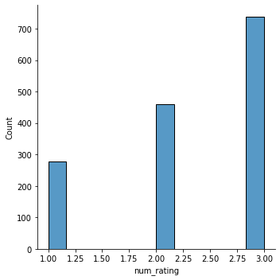
Visualization
The Third Dataset :
Ratting_and_sentiments
people rate coffee shops on a scale from 1 to 5 (min and max)
Distribution for rating

Slide 47
Demo Chatbot
04
Running Our Chatbot

Slide 48
Any Questions??

Slide 49
THANK YOU FOR LISTENING

