Slide 1
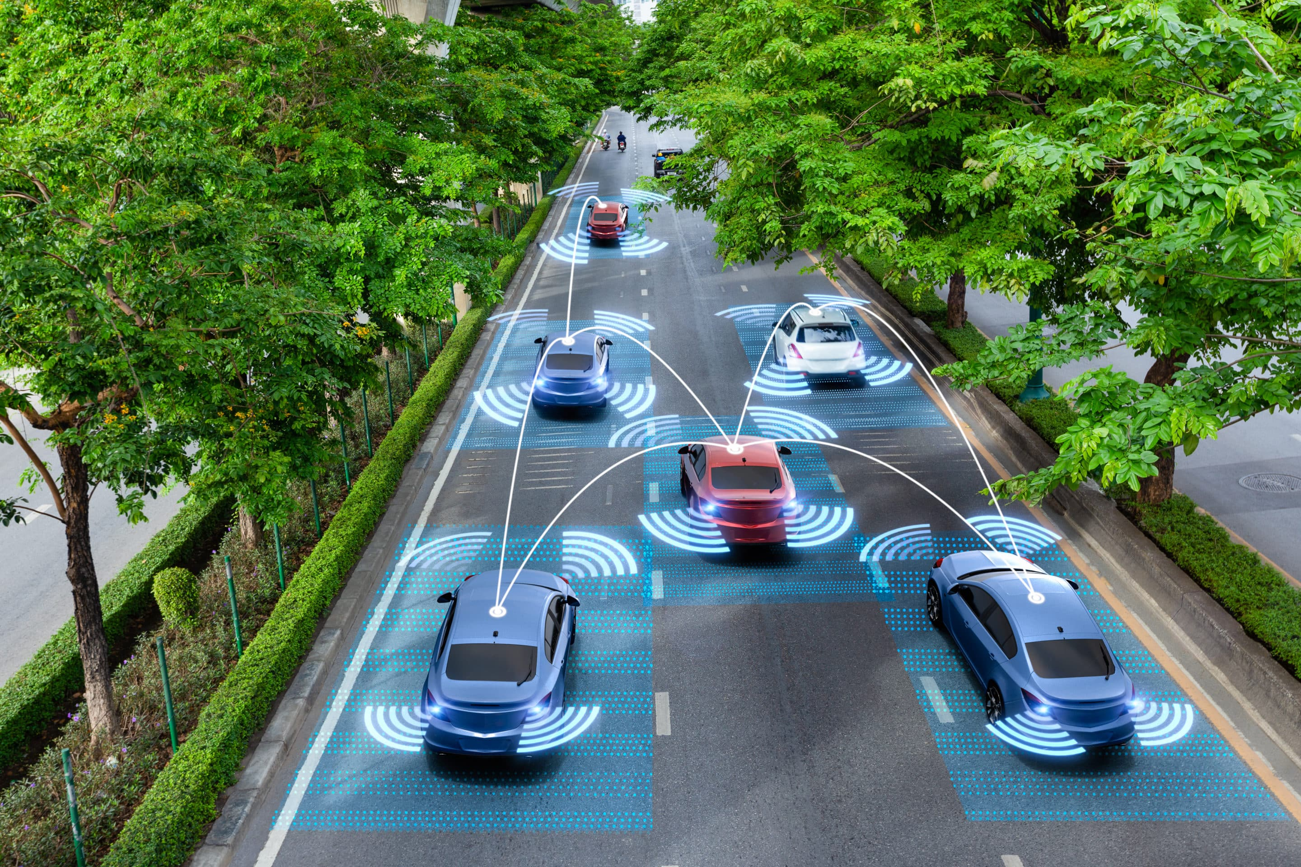
Autonomous car

Slide 2
Autonomous car Project
Group: Nasr 37
1-Hadeer Ashraf Hassan
2-Fouad Adel Fouad

Slide 3
This project aims to implement a self-driving Car that can avoid the obstacles with very fast response
Component used in this project:
1. Ultrasonic HC- SR04.
2. Servo motor.
3. L293D.
4. DC Motors.
5. LCD 16x2.
6. Chassis
7-atmega 32
8-batteries (12 v)

Slide 4
Block diagram
LCD
At-MEGA 32
Ultrasonic sensor
Servo motor
DC motors
H-Bridge

Slide 5
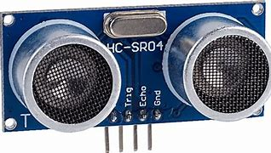
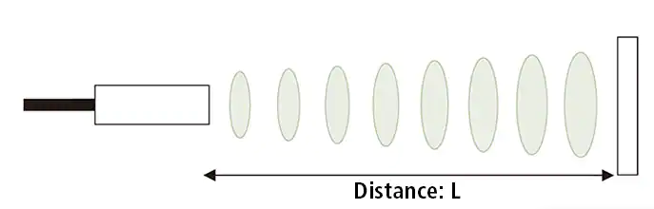
Ultrasonic HC- SR04.
An ultrasonic sensor is an instrument that measures the distance to an object using ultrasonic sound waves.
The distance can be calculated with the following formula:
Distance L = 1/2 × T × C
where L is the distance, T is the time between the emission and reception, and C is the sonic speed. (The value is multiplied by 1/2 because T is the time for go-and-return distance.)

Slide 6
Interfacing ultrasonic sensor with At-MEGA 32
We need DIO,timer2 and external interrupt (INT1) peripherals.
Ultrasonic sensor has 4 pins
1-vcc
2-ground
3-trig
4-echo
Echo must be input to AT-MEGA 32 and TRIG must be output.
Echo is connected to PORTD/PIN3 (INT1) and must be input pull up.
The trigger pin works as an output pin PORTD/PIN2. This Trig pin has to be kept high for 10 µs to sending ultrasonic waves from the Transmitter part.

Slide 7
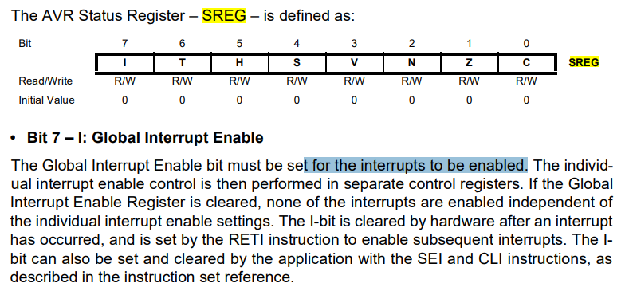
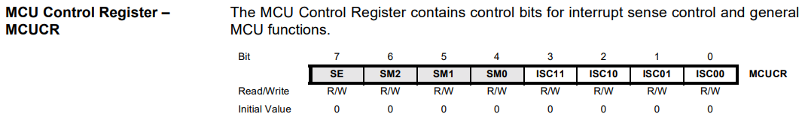
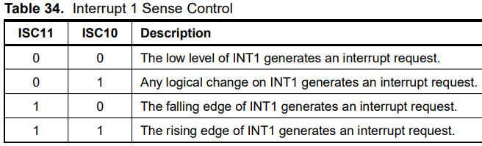
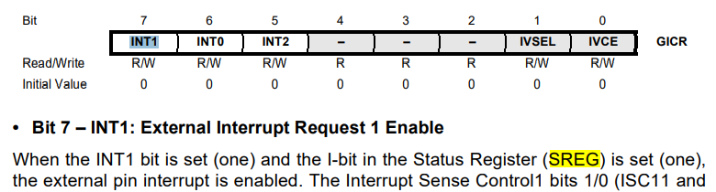
We enable global interrupt , we set bit no 7 at SREG REG t for the interrupts to be enabled.
We enable EXT INT 1 by setting bit no 2 ISC10 and clearing bit no 3 ISC11 at REG MCU Control Register – MCUCR and setting bit no 7 INT1 at REG General Interrupt Control Register – GICR

Slide 8
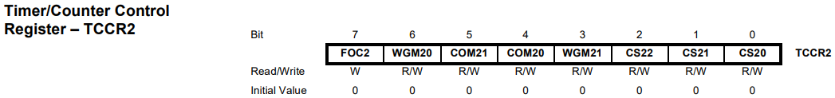

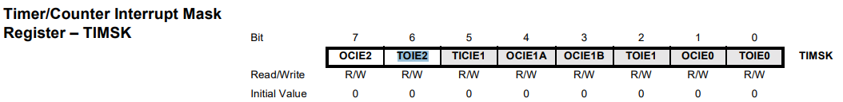
We use timer-2 to calculate the time taken between rising and falling edge of pulse.
To use normal mode , we clear bits no 3,6 (WGM21,WGM20) at TCCR2 REG and set bit no 6 (TOIE2) at TIMSK REG .
Then we set 64 pre-scaler value by setting bit no 0,1 (CS20/ CS21) and clear bit no 2 (CS22)at TCCR2 REG .

Slide 9
Timer calculations
CPU clock-frequency =16MHZ
Frequency after pre-scaler = 0.25 MHZ
Tick Time =1/0.25MH =0.000004 seconds
Distance calculations
Distance in cm =1/2 × T × C C=34300 and tick time =0.000004 seconds
Distance in cm =0.0686*((no overflows*256)+no of ticks on TCNT2 REG )

Slide 10
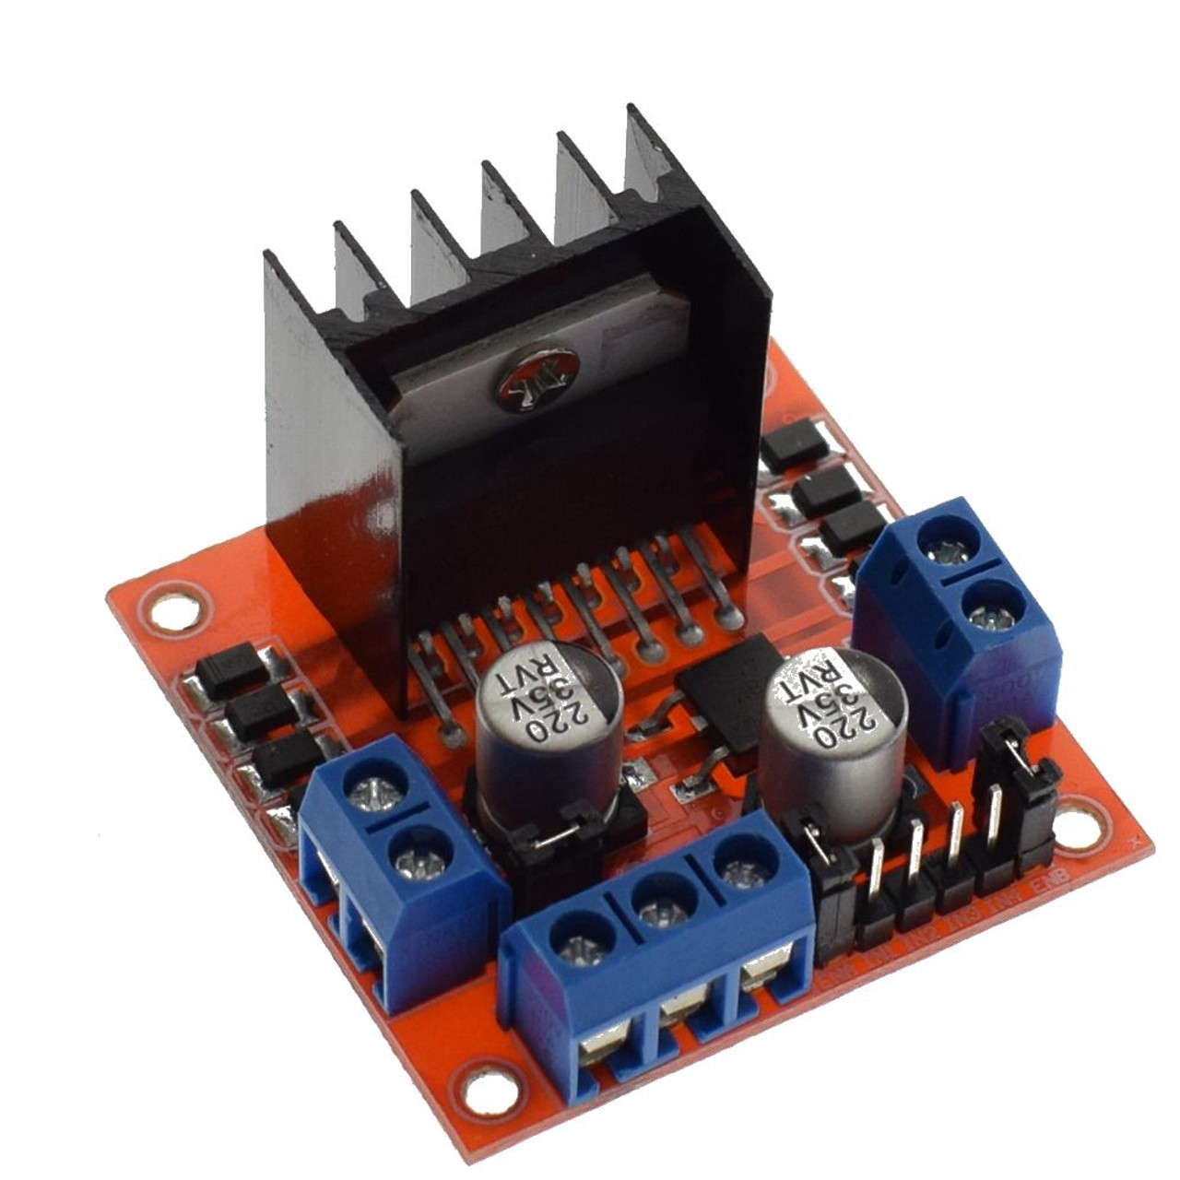
Interfacing dc motor using H-BRIDGE
We use timer-0 to generate PWM to control H-BRIDGE to control speed and direction of dc motors
We connect ENA and ENB to PORTB/PIN3 (OC0) PIN and setting it as output pin
To use PWM mode , we clear bits no 3,6 (WGM01,WGM00) at TCCR0 REG and set bit no 1 (OCIE0) at TIMSK REG .
We select mode (Clear OC0 on compare match, set OC0 at TOP)
Then we set a 64 pre-scaler value by setting bit no 0,1 (CS00/ CS01) and clear bit no 2 (CS02)at TCCR0 REG .
We control speed by write any number from 0 to 255 at OCR0 REG
We control direction of dc motor by change INT1 AND INT2
INT 1 -> HIGH INT 2 ->LOW any direction
IINT 1 -> LOW INT 2 -> HIGH opposite direction
IINT 1 -> LOW INT 2 -> LOW motor stop
INT 3,4 same as INT1,2

Slide 11

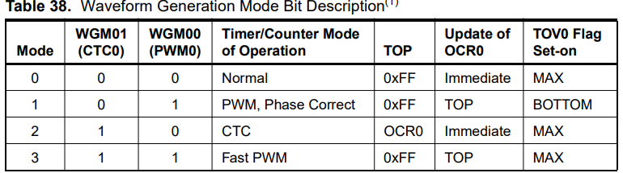
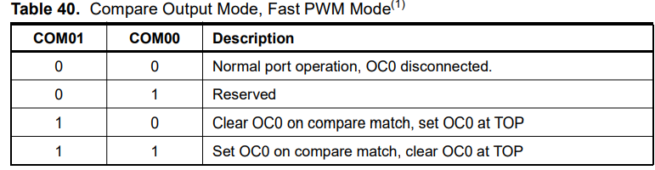

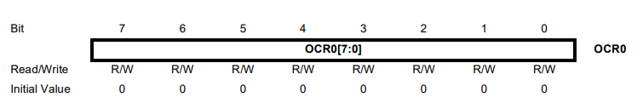

Slide 12
Control servo motor using timer 1
The most common servos works at 50 Hz frequency. This means that the period is 20ms.
So , we will use mode 14(fast PWM) at timer 1 to control servo motor.
We have a CPU clock 16MHZ , using 64 pre-scaler so
Frequency =0.25MHZ Tick time =0.000004 seconds
But we need frequency F= 50HZ , periodic time T=0.02 seconds.
No of tics =0.02/0.000004=5000 ticks. ICR-REG=no of ticks-1
By writing 4999 at ICR_REG we will get 50 HZ frequency.
We control duty cycle and generate PWM by OCR1A-REG,so we will control servo-motor.

Slide 13
The pulse width sent to servo ranges as follows:
• Minimum: 1 millisecond ---> Corresponds to 0 rotation angle.
OCR1A=(0.001/0.00004)-1=249 duty cycle =5%
• Maximum: 2 millisecond ---> Corresponds to 180 rotation angle.
OCR1A=(0.002/0.00004)-1=499 duty cycle=10%
By interpolation we can get any angle between 0 and 180
90 rotation angle :
(180-0)/(2-1)=(180-90)/(2-X) X =1.5 millisecond
OCR1A=(0.0015/0.00004)-1=374 duty cycle =7.5%

Slide 14
We connect signal-pin of servo to PORTD/PIN5 (OC1A)
Fast PWM selection(mode 14):
Setting bit no 3,4 (WGM12, WGM13) at TCCR1B_REG
Clearing bit no 0 (WGM11) at TCCR1A_REG
Setting bit no 1 (WGM11) at TCCR1A_REG
Writing at ICR_REG to get 50HZ frequency
ICR1_REG=4999
We select mode (Clear OC1A/OC1B on compare match, set OC1A/OC1B at TOP) by:
Setting bit no 7 (COM1A1) at TCCR1A_REG.
Clearing bit no 6 (COM1A1) at TCCR1A_REG.
Then we set a 64 pre-scaler value by :
setting bit no 0,1 (CS10/ CS11) at TCCR1B REG
clearing bit no 2 (CS12) at TCCR1B REG .
BY writing at OCR1A_REG we can get any angle of servo motor.

Slide 15

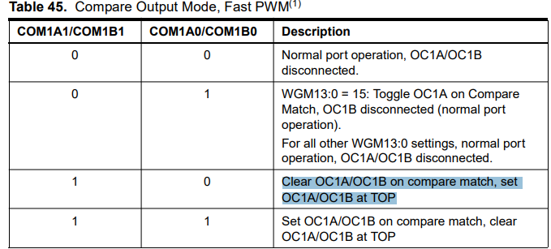

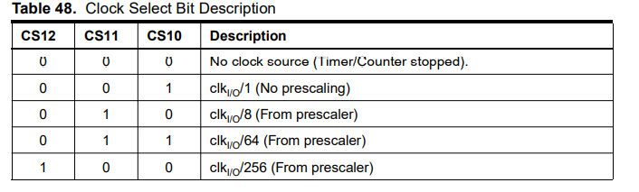
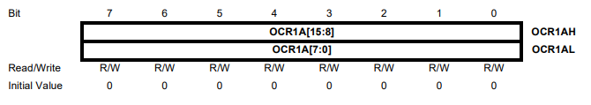
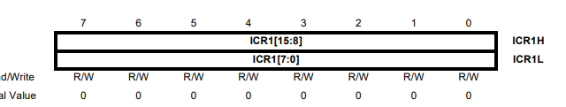

Slide 16
LCD 16x2 interfacing
Pin Description
Control pins
Data pins
Power pins
RS
VSS
D0->D7
RW
VDD
E
VEE

Slide 17
VSS connected with the ground.
VDD connected with high volt (5volt).
VEE Max voltage contrast is at low voltage.
RS High to send data /Low to send command.
RW High to read data /Low to write data.
E used to enable writing and reading operations on data pins.
D0->D7 Pins is used to send or receive one byte to or from LCD

Slide 18
There are two modes to interface with lcd :
8-bit mode.
4-bit mode.
We will use 4-bit mode, this means that we will use only 4 pins from lcd and ATMEGA-32 .
We will send or receive data or command In two phases , so we will divide data or command into two sections.(HIGH/LOW)nipples .

