Slide 1
DATA analysis

Slide 2
The team :
Corentin Grépilloux
Hugo Dardill

Slide 3
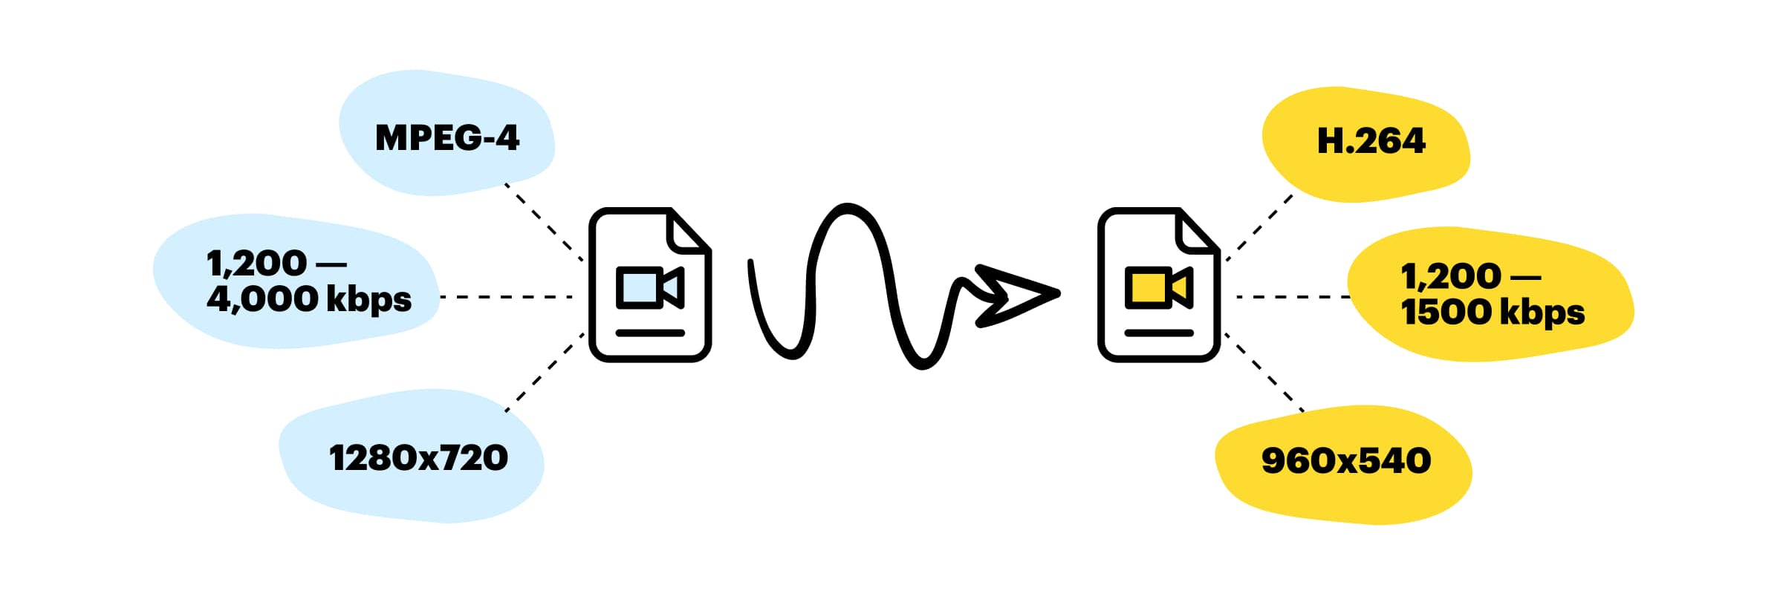
What is the data about ?

Slide 4
The data and its features
Dataset 1 :
Name youtube_videos.tsv
Description : dataset containing the characteristic of 169 000 youtube video
Feature of the dataset:
Id, duration, bitrate, bitrate(video) , height, width, frame rate, frame rate(est.), codec, category, url.
Dataset 2 :
Name : transcoding_mesurment.tsv
Description : dataset containing the characteristic of 169 000 youtube video
Feature of the dataset:
Id, duration, codec, width, height, bitrate, framerate, I, p, b ,frames,i_size, p_size, b_size, size,
o_codec, o_bitrate, o_framerate, o_width, o_height, umem, utime.

Slide 5
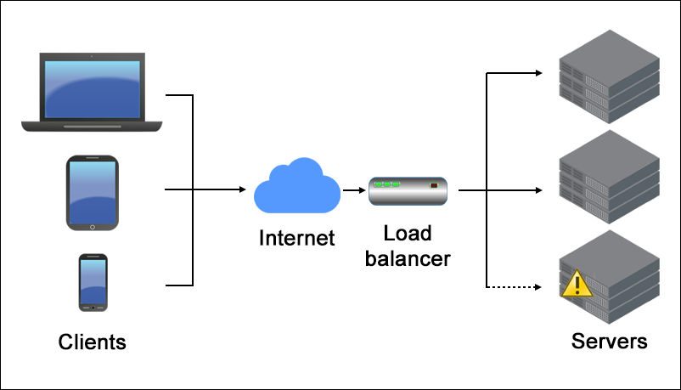
Problem
Predicting the transcoding time based on the input and output features of the videos
Transcoding interest :
Convert unsupported video formats into supported ones.
Unsupported is relative the device on which they are being played.
Transcoding prediction can be used by the service provider to better optimize their load balancing. Thus enable better processing overall.

Slide 6
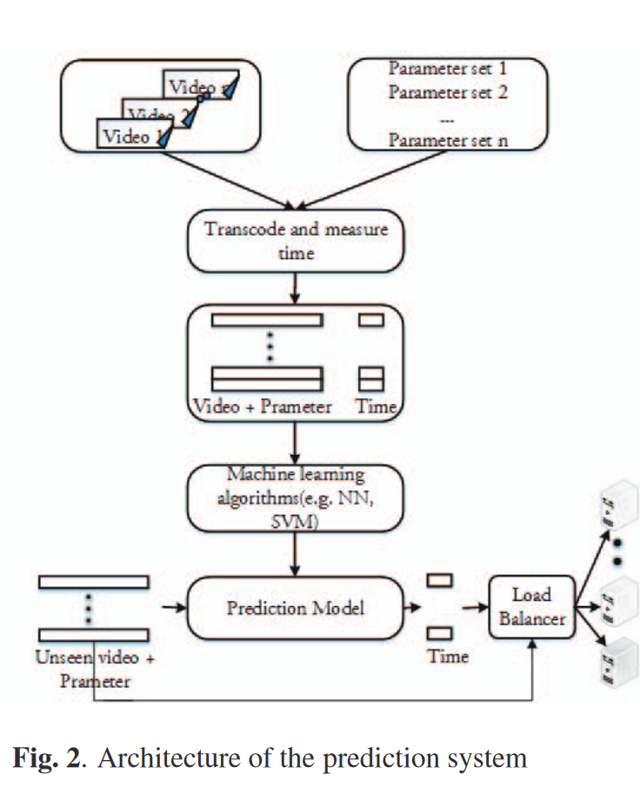
How was the data extracted

Slide 7
Data selection

Slide 8
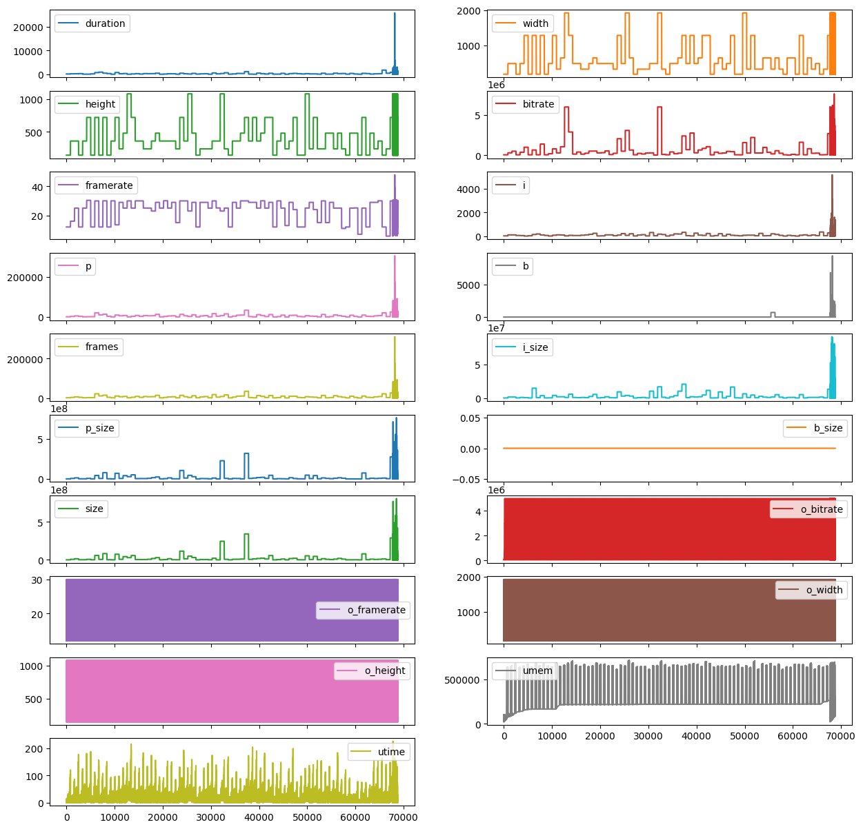
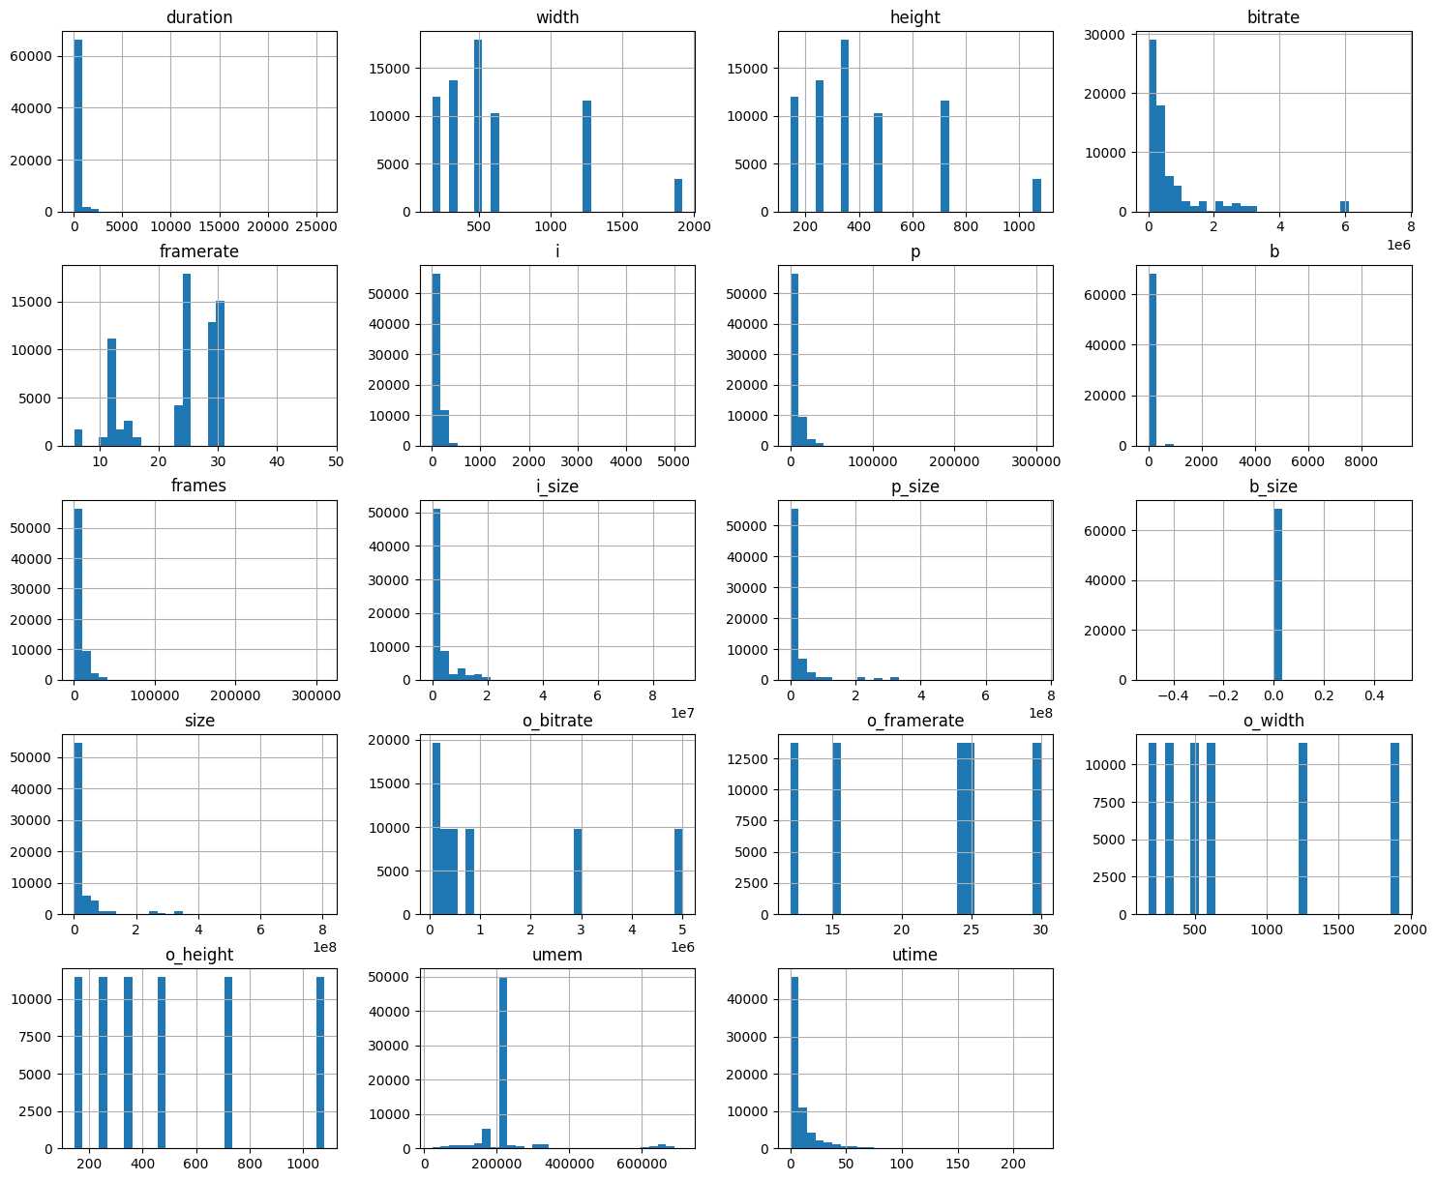
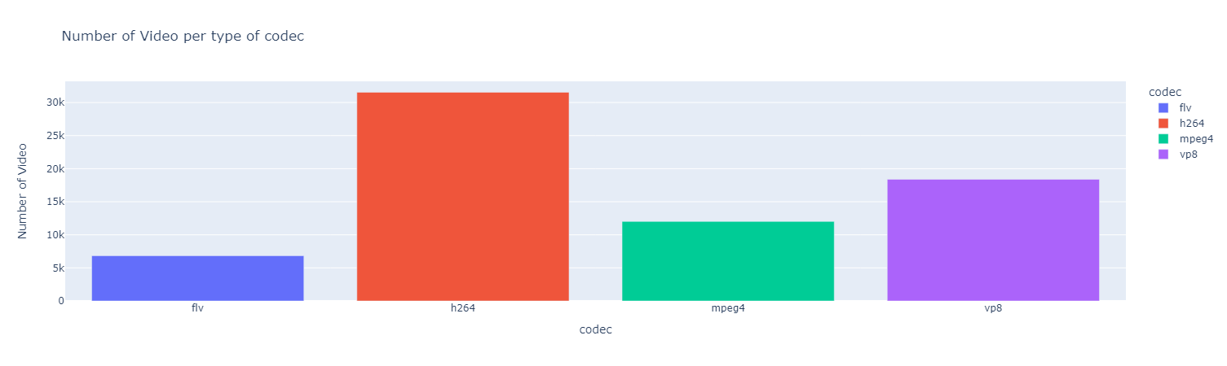
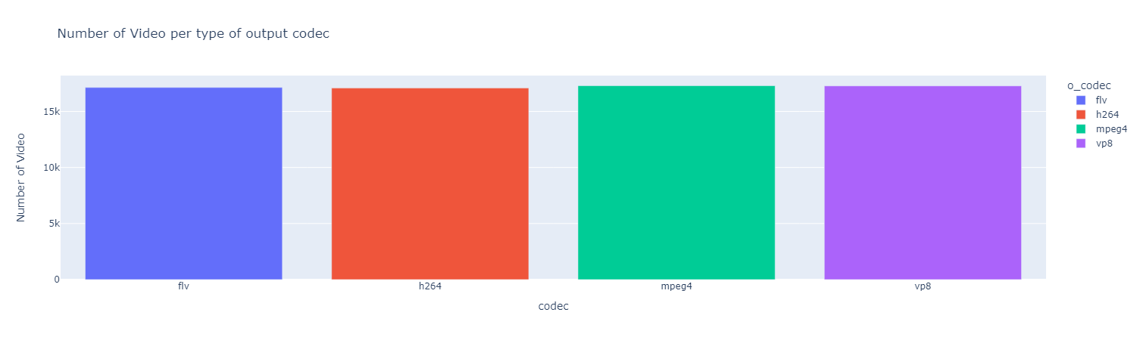
What does the data look likes

Slide 9
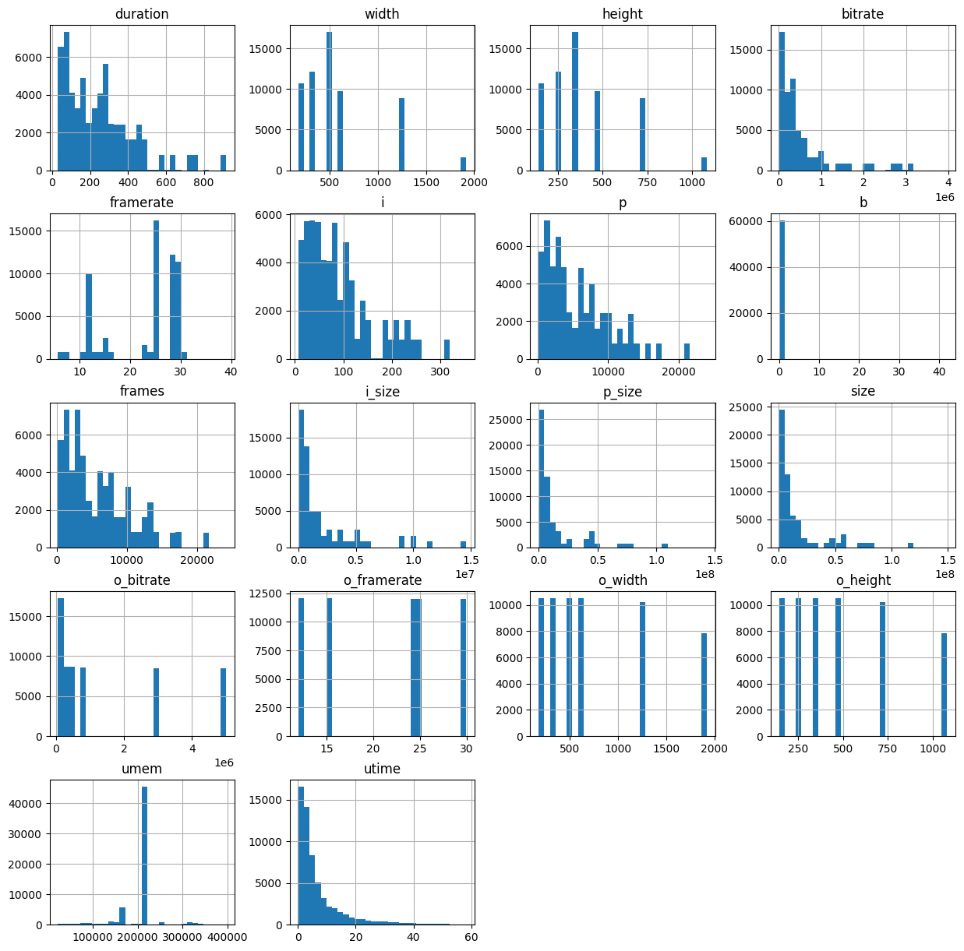
Less outlier histogram

Slide 10
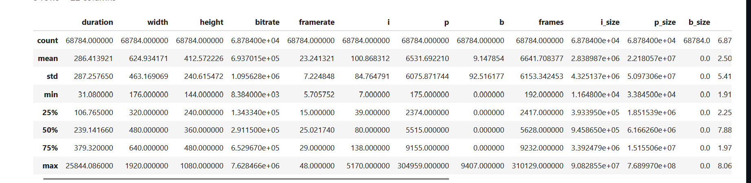
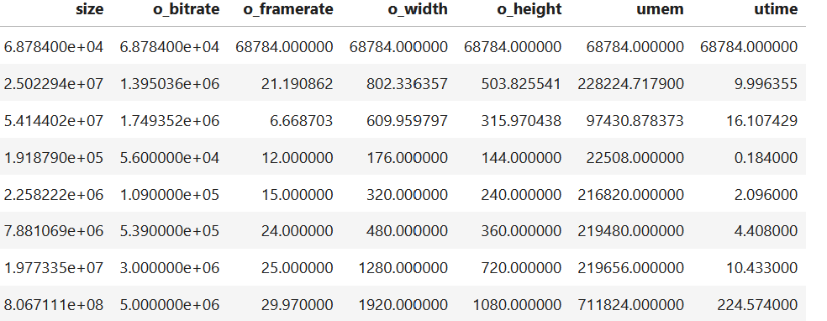
data description
There no missing data in any columns

Slide 11
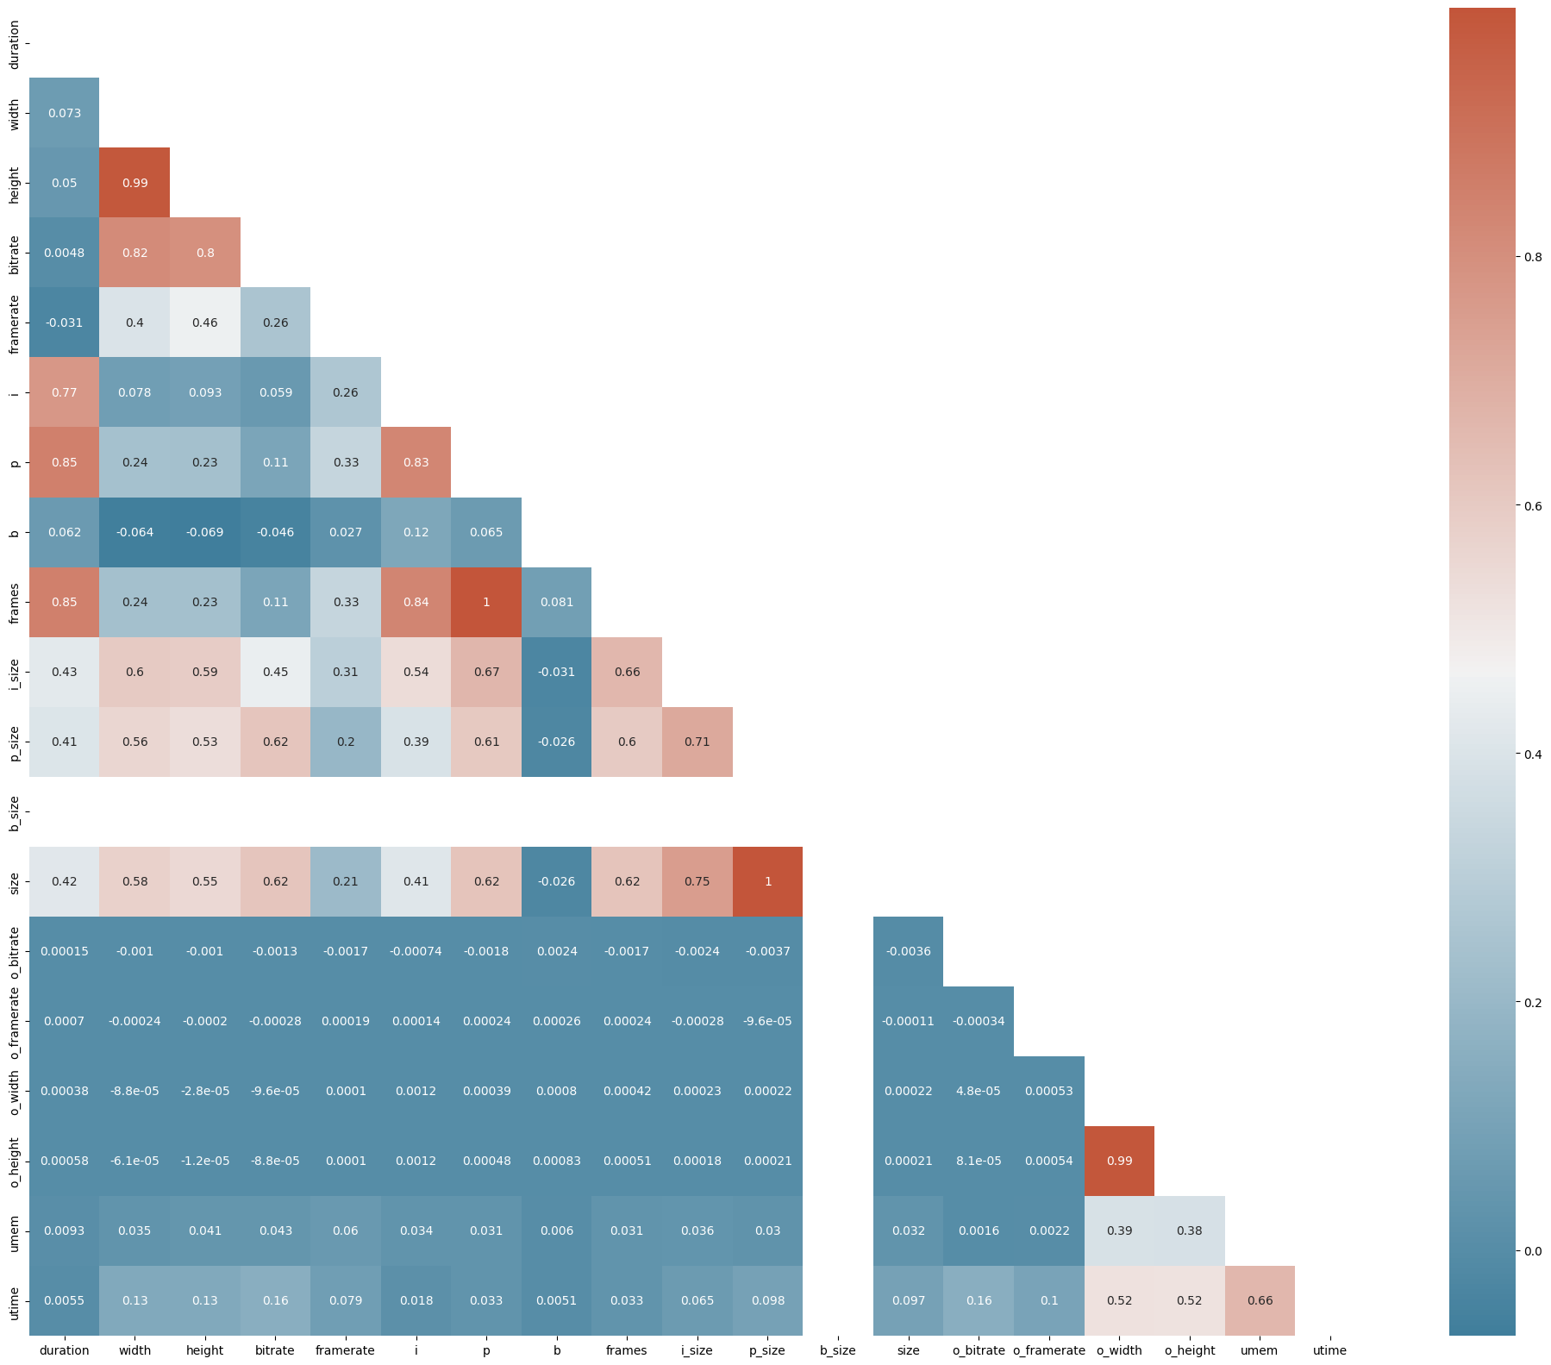
Correlation matrix

Slide 12
What feature can be encoded or transformed
Codec encoding:
We encode the caterogical feature codec and o_codec with one hot
encoding considering that there are only 4 different type of codec for each feature. As a result we get 6 more columns
Resolution :
We combine the input and output widths heights into resolution using the formula Resolution = Width x Height
As a result we have 2 columns less

Slide 13
Data pre processing deletion
We decide to get rid of ID column has it is not possible to derive data from
We decide to get rid of b size as all the data from this columns is zero

Slide 14
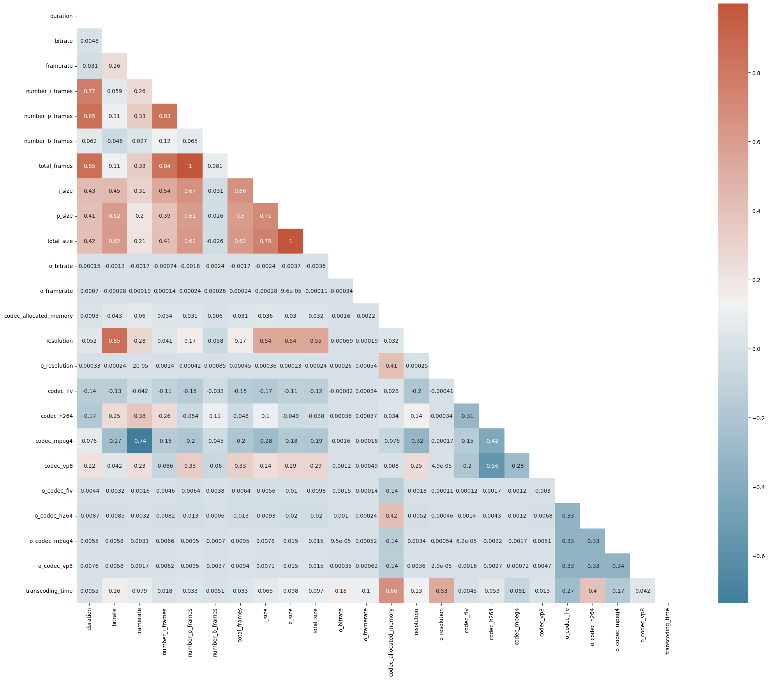
Post processing correlation matric

Slide 15
Models and training
The data we try to predict is the transcoding time thus are problem is a regression one
In this project we decided to train 3 different model:
Linear regression
Random forest
SVR (support vector regression)

Slide 16
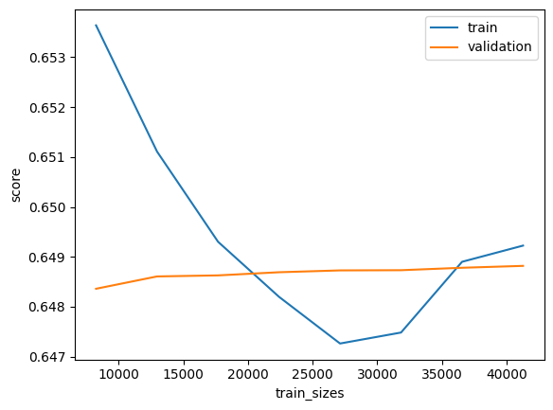
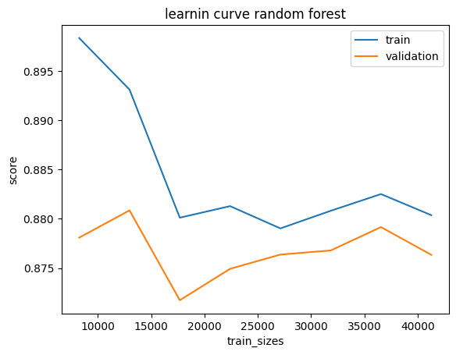
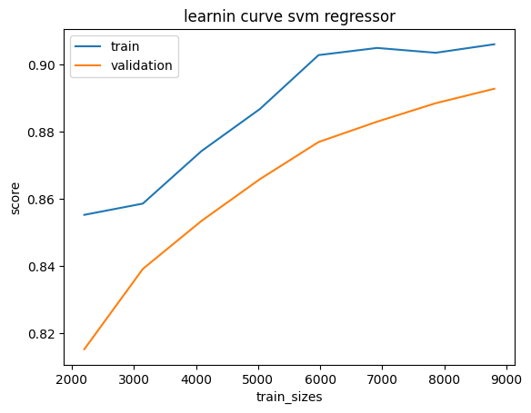
Learning curve after data preprocessing
Training time :
-linear regression : less than 2s
-random forest : less than 10s
-SVR : less than 2 mins

Slide 17
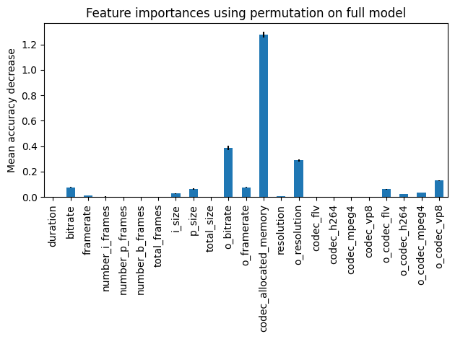
Feature selection

Slide 18
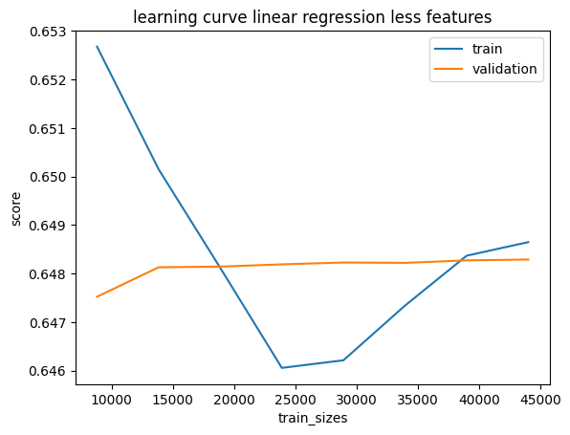
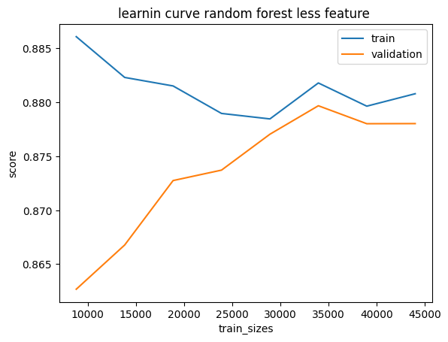
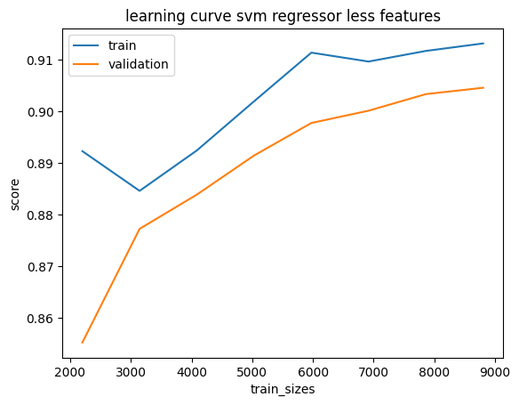
post feature selection learning curve

Slide 19
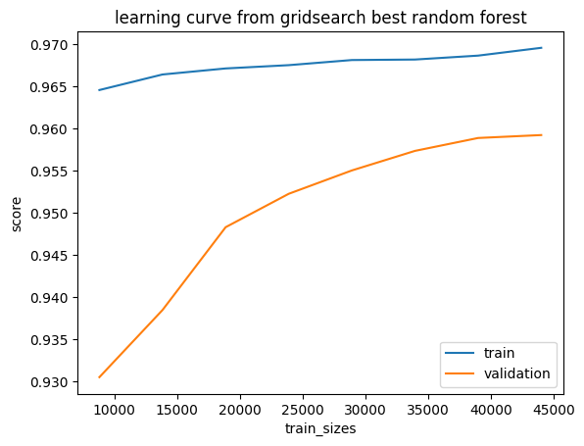
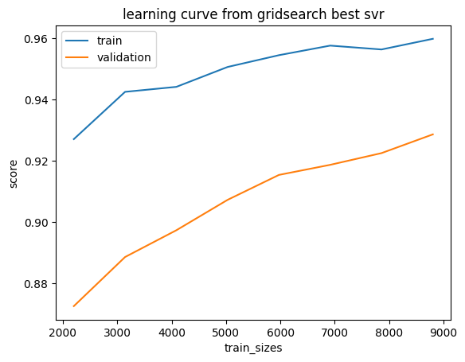
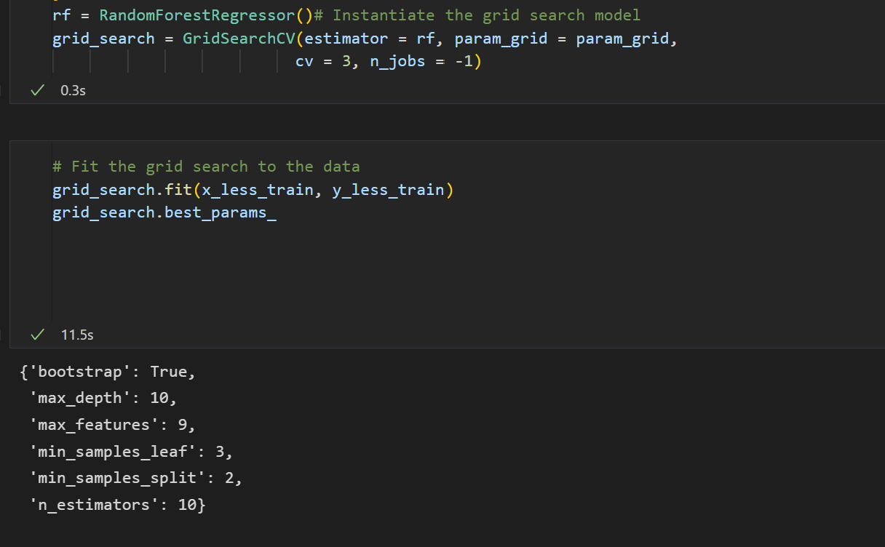
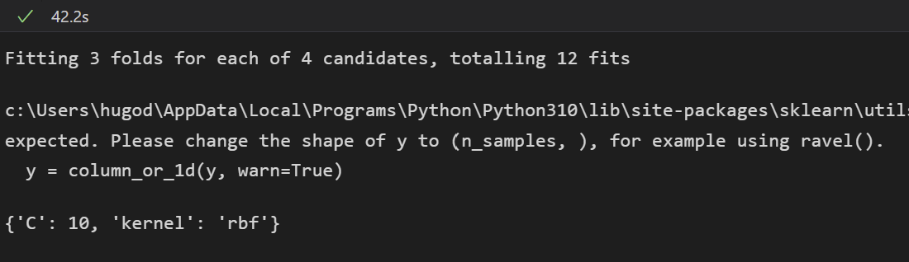
Grid search cv

Slide 20
conclusion

