Slide 1

Code for Good
Challenge
Knowledge Session
Exotel
2015-07-25
30 Minutes
Presenters:
Nilitha Sequeira
Pandurang Kamath

Slide 2


Exotel is a cloud telephony service provider for small and medium enterprises in India.
It provides virtual phone numbers and telephony applications to businesses.

Slide 3
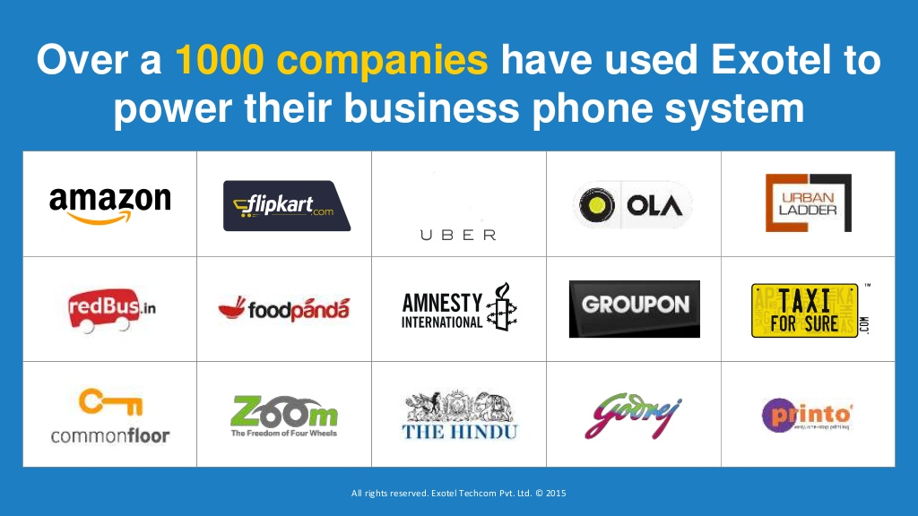

Slide 4


Slide 5
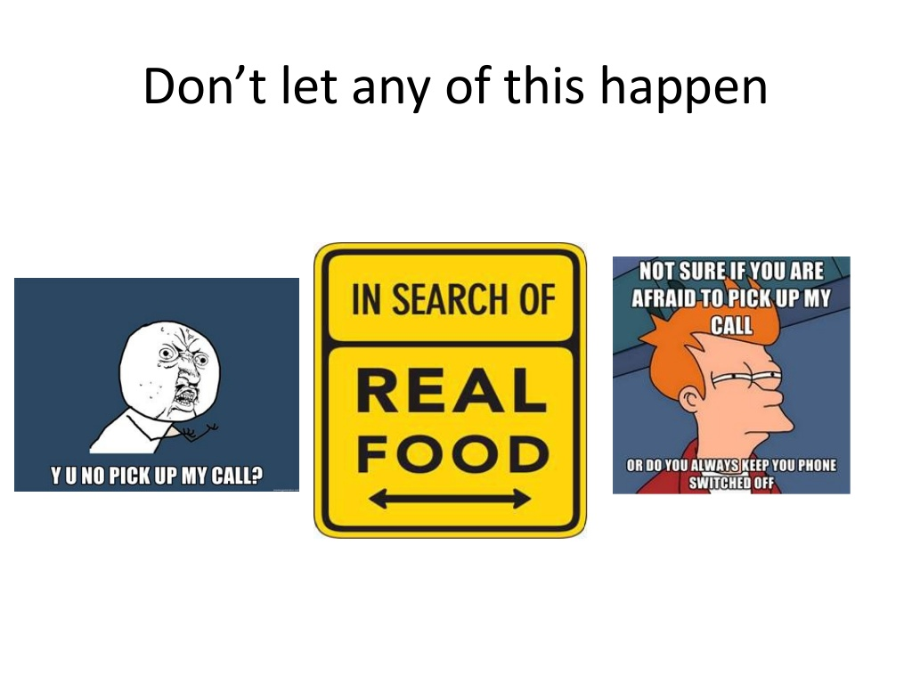

Slide 6
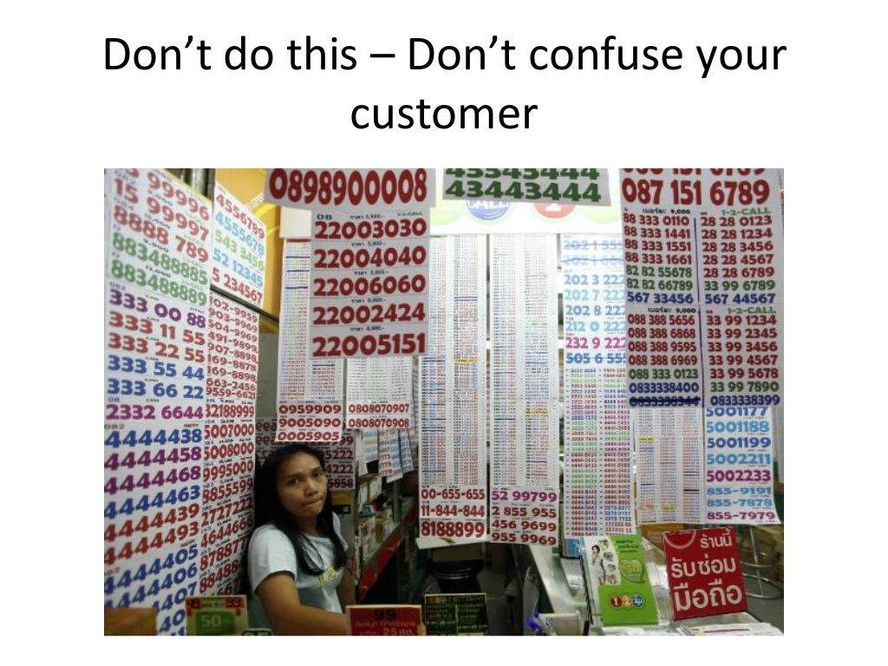

Slide 7
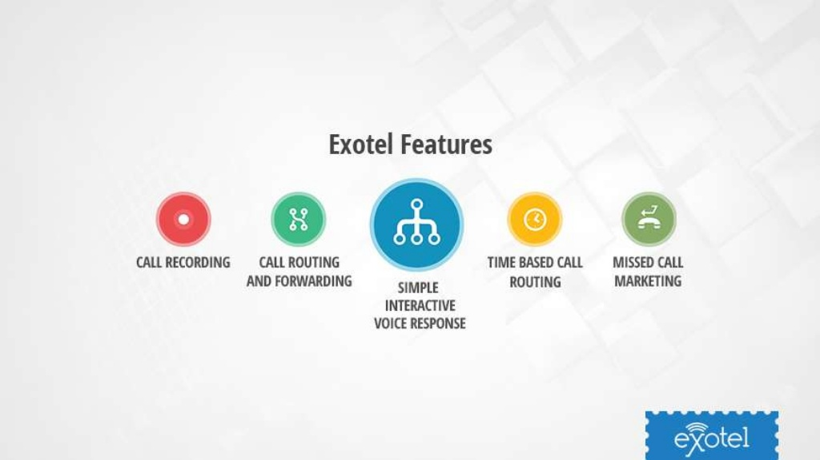

Slide 8
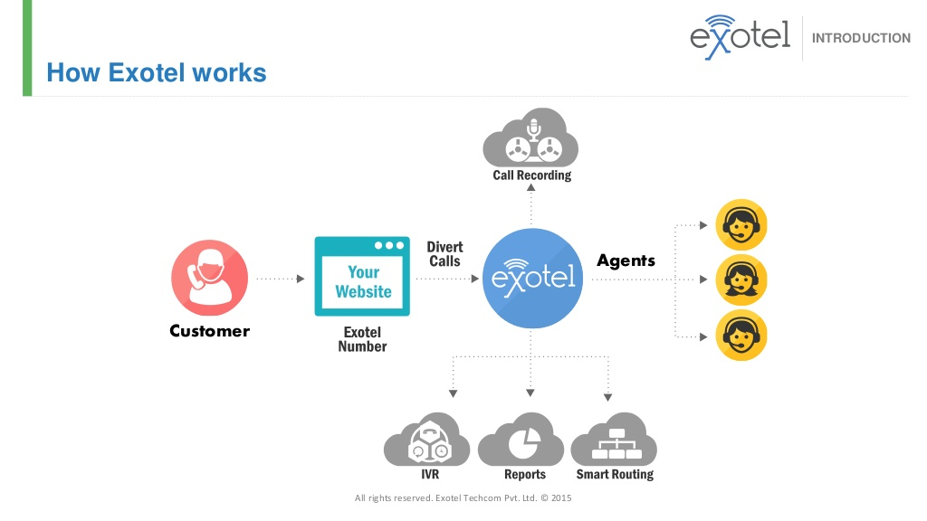

Slide 9
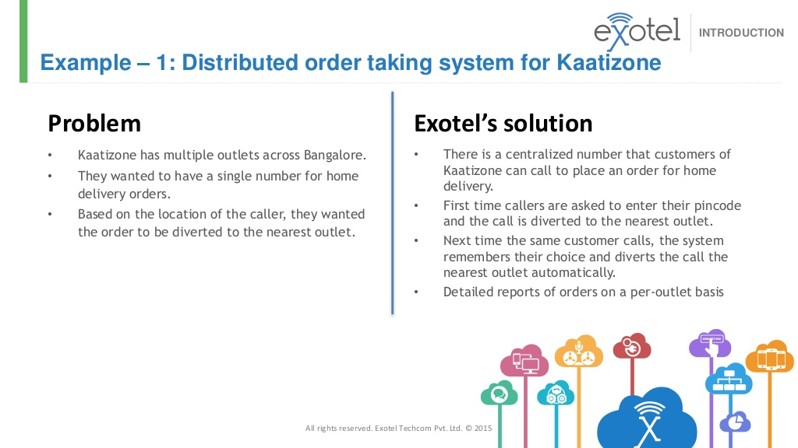

Slide 10
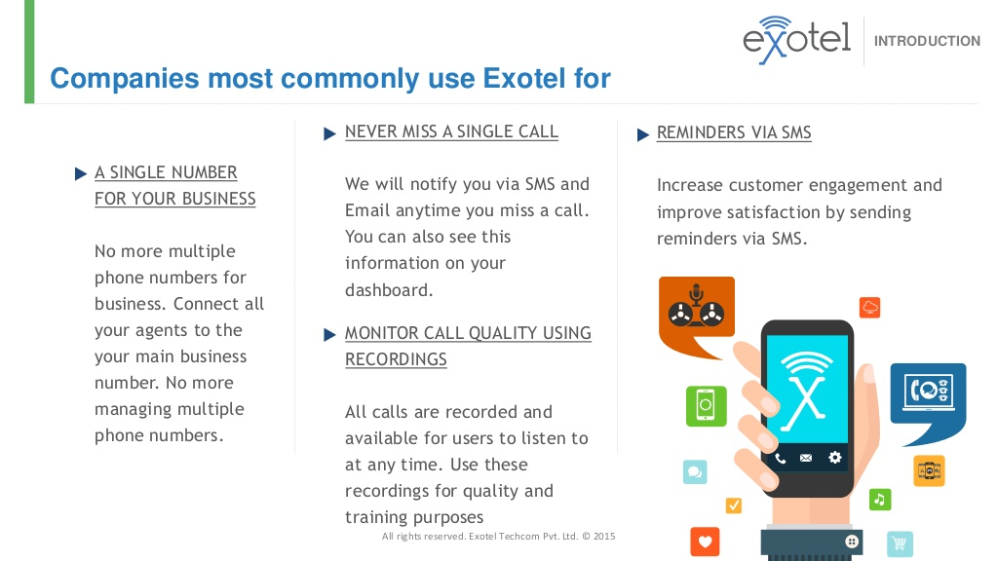

Slide 11
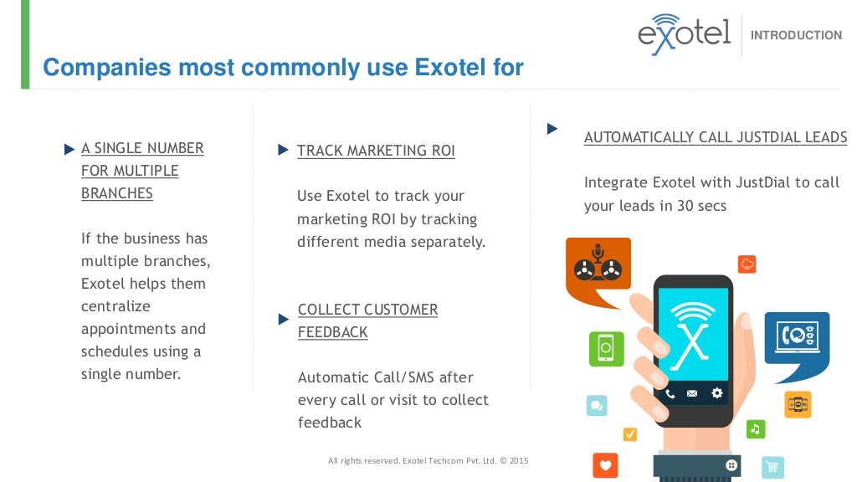

Slide 12
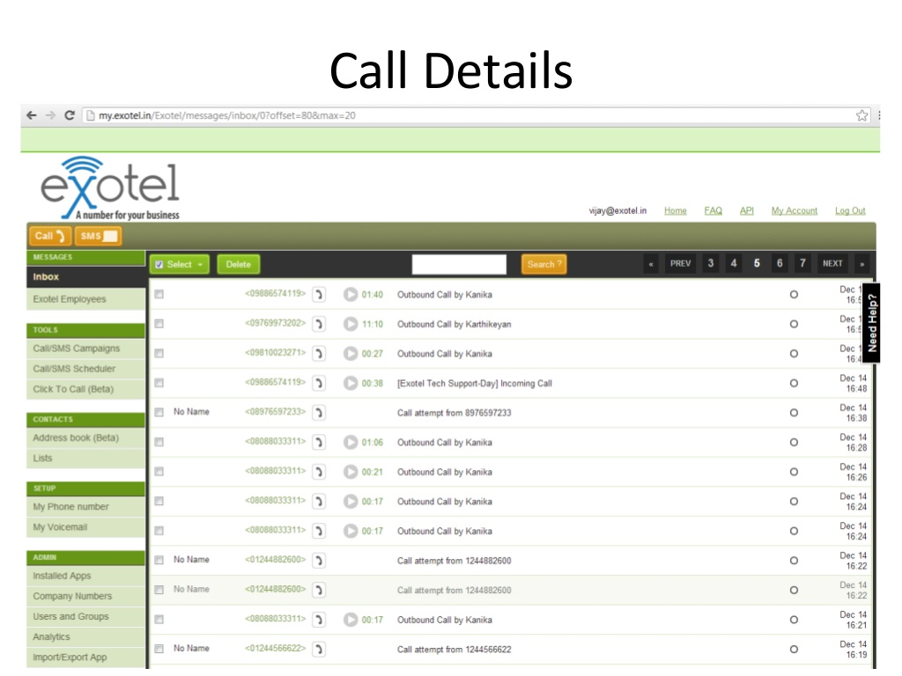

Slide 13
So what you can do (on a trial account)?
Send / Process incoming SMS and Calls.
Working with your trial number
Trial number is a common number for everyone (all customers) at exotel to test how stuff works.
This number is free and is available in every account.
Whenever you install a new app or change something in your call or SMS flow, you can test it using by connecting it on this number.

Slide 14
Send a SMS Reply in response to an Incoming SMS
UseCase-1: You receive an incoming SMS, and you want to send a dynamic reply to the sender.
UseCase-2: You receive an incoming SMS and you just want to get details of an incoming SMS at your server - without having to send back a reply SMS.

Slide 15
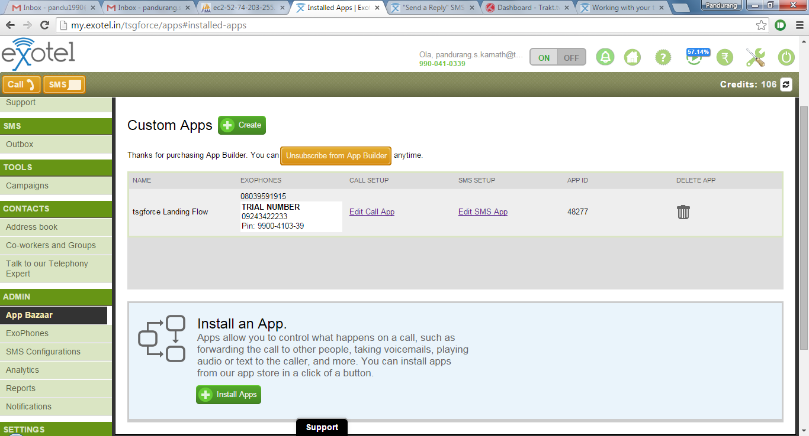
In the App Bazaar page, corresponding to your app, click on "Edit SMS app"

Slide 16
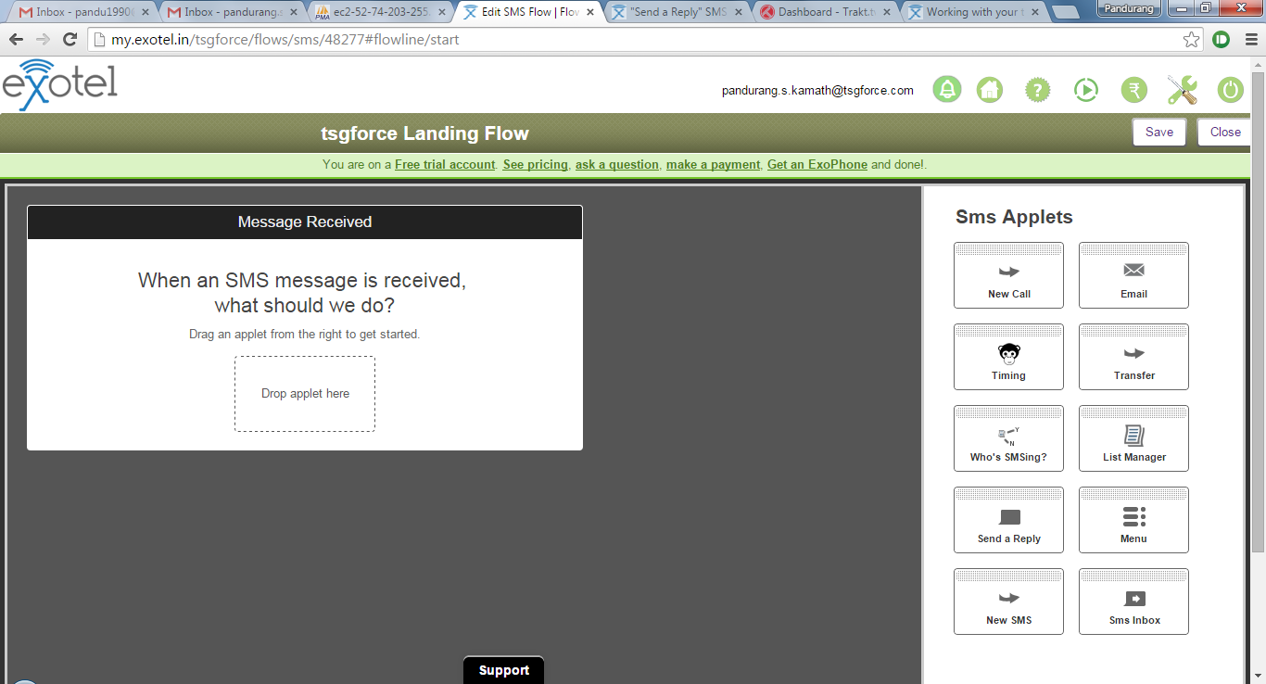
2. Drag and drop the "Send a Reply" applet in to the app you are building

Slide 17
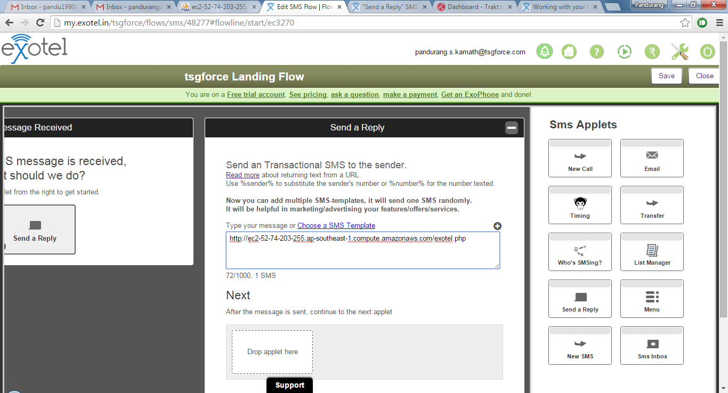
3. In the text box, you can enter a URL (instead of static text).

Slide 18
Testing an inbound SMS
Send an SMS like this to 09243422233
9900410339 I am testing this SMS
After a little while, You will see an SMS in your inbox
If you send an SMS like this, for instance:
I am testing this SMS
It will not show up in your inbox nor will you app work. The system did receive this SMS, but it does not know to which account it belongs to.

Slide 19
Resources
Exotel API on Github
Exotel Support
https://github.com/exotel/ExotelAPI
Exotel's Call and SMS API sample code
http://support.exotel.in/support/home
Exotel’s knowledge base

