Slide 1

Snow Shovel
Four new idea

Slide 2
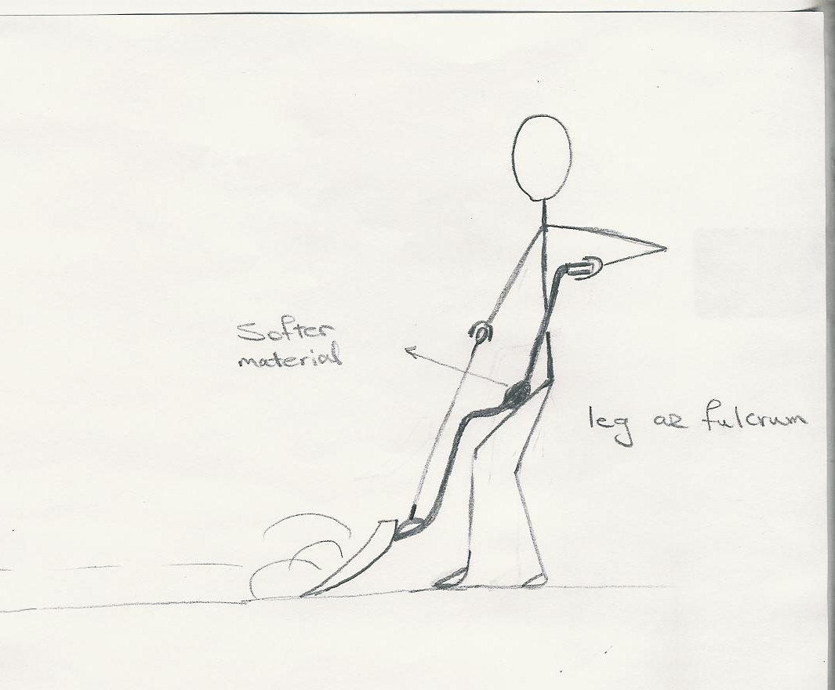
1st Idea

Slide 3
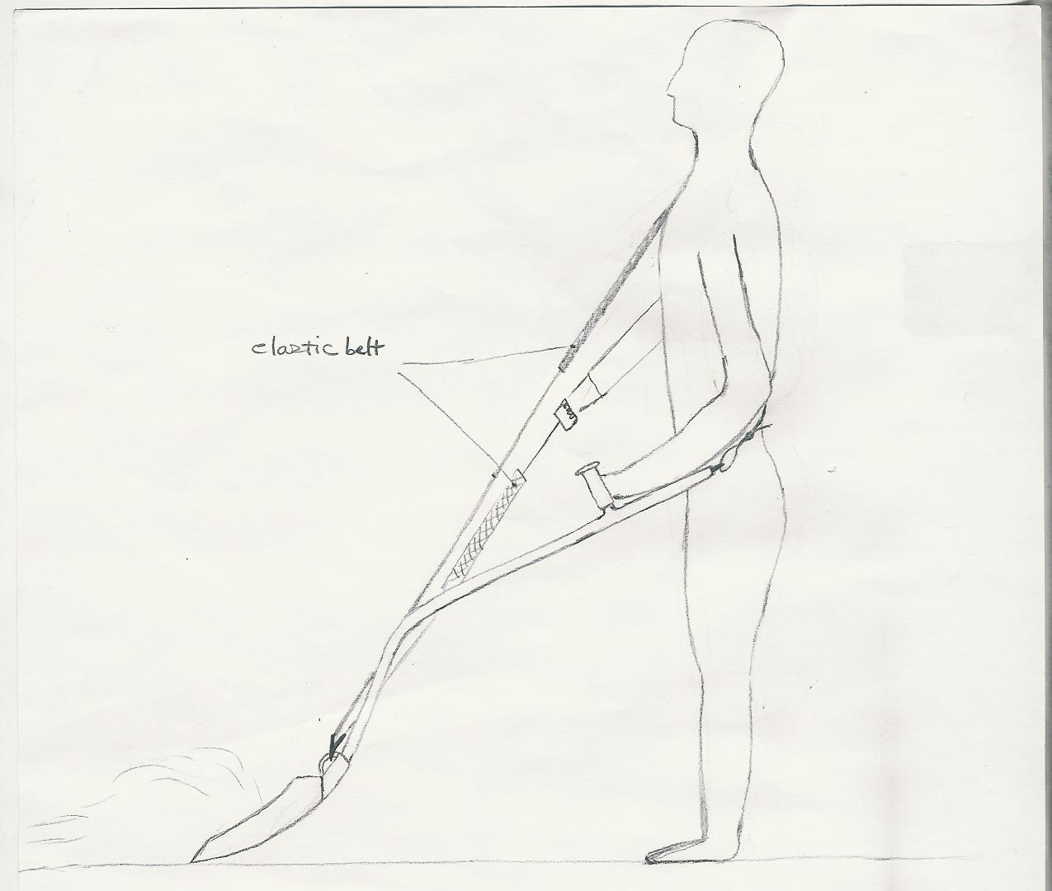
2nd Idea

Slide 4
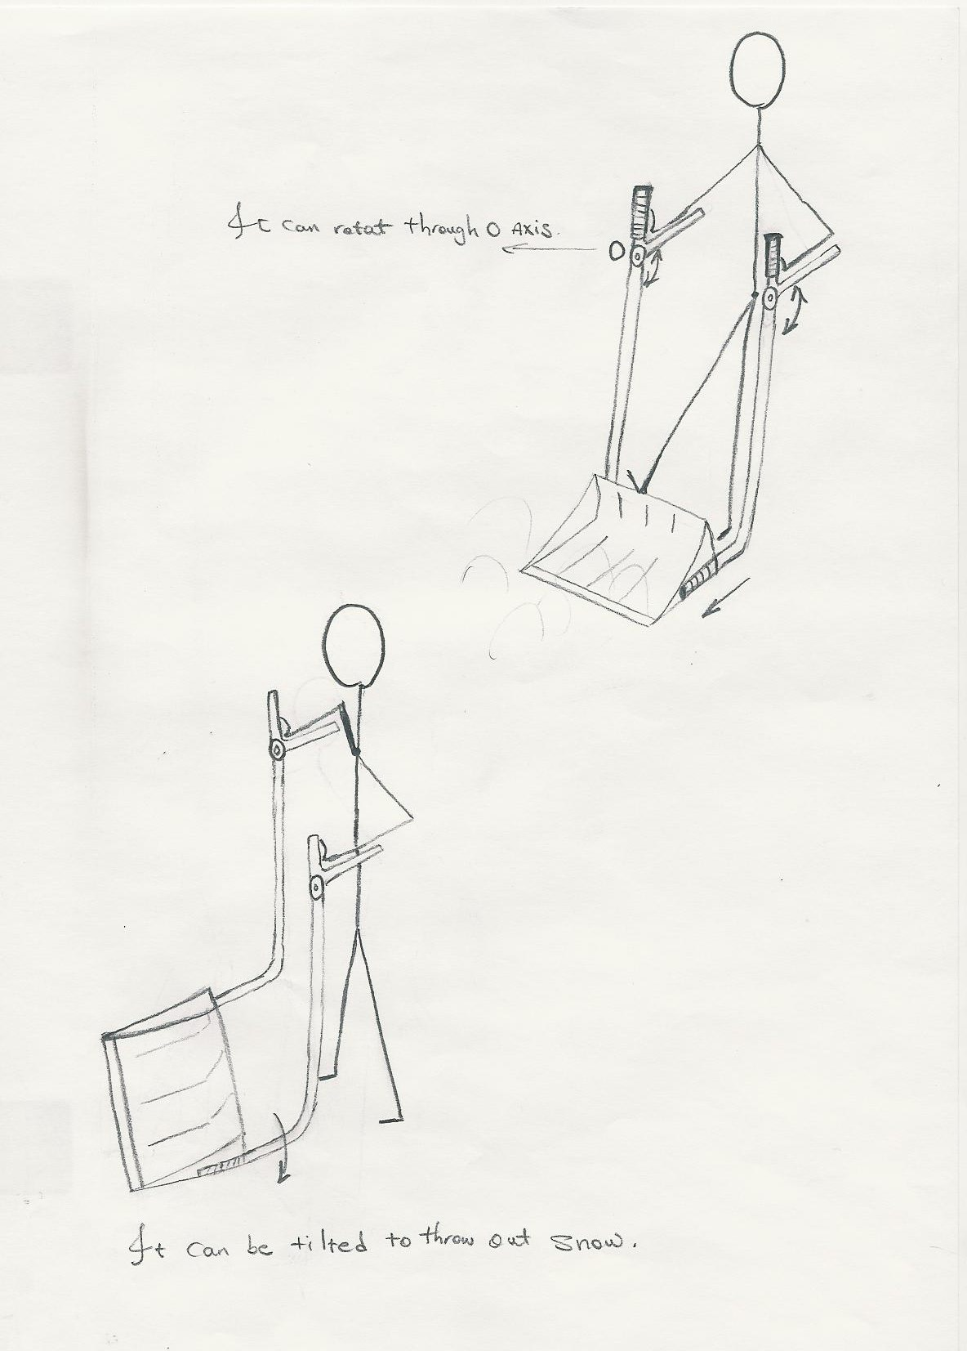
3rd Idea

Slide 5
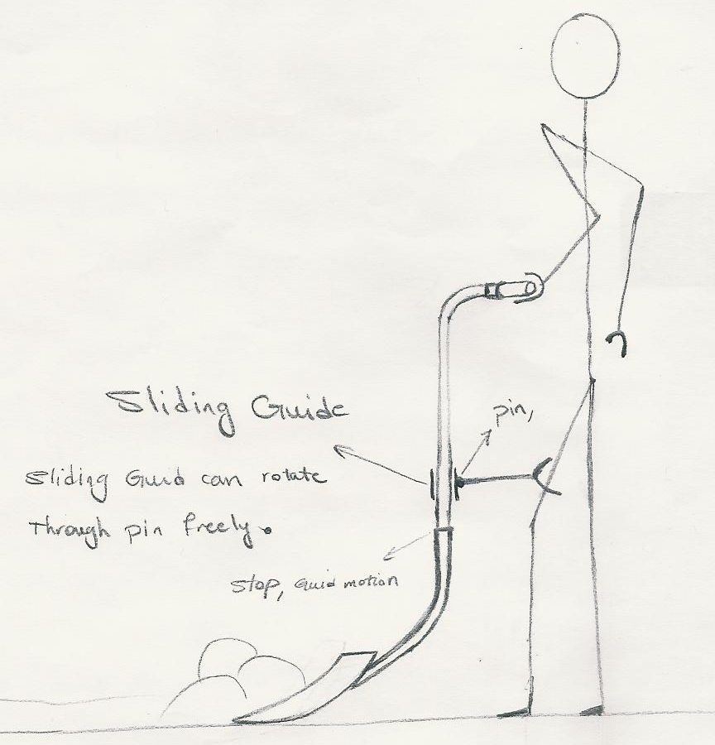
4th Idea

Slide 6
Snow Shovel
Four new idea

