Slide 1
4ormIQ
A brokerage builds a file that can be re-performed
She is selling in Calgary and buying in Kelowna, with six months left on her mortgage. Twelve screens, in order, from her first question to her broker’s answer.
Demo data. Invented figures. Estimates, not lender quotes.

Slide 2
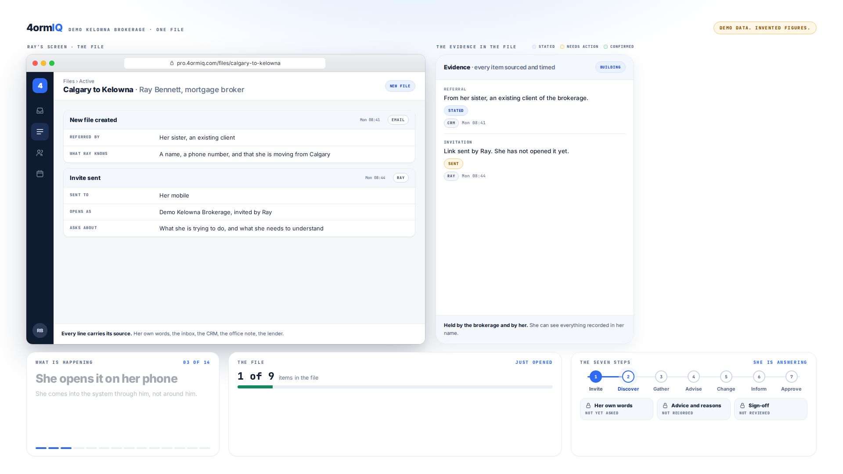
Step 1 of 12
He invites her, from his own file
The link goes out under the brokerage’s name. She comes in through him, not around him.
Notes:
The link goes out under the brokerage’s name. She comes in through him, not around him.

Slide 3
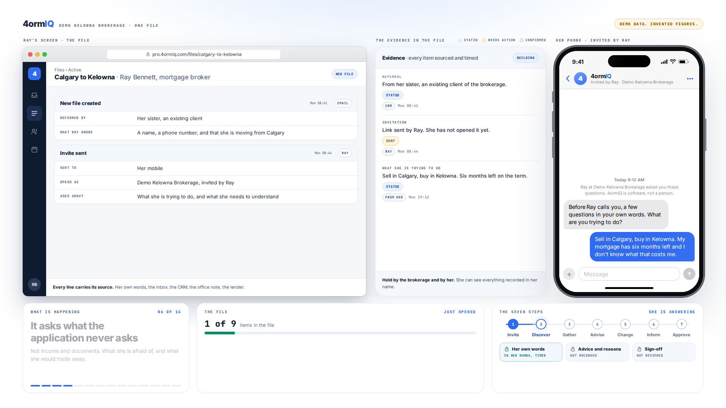
Step 2 of 12
She answers on her phone
The questions are asked by software, so the answers are hers, not his.
Notes:
The questions are asked by software, so the answers are hers, not his.

Slide 4
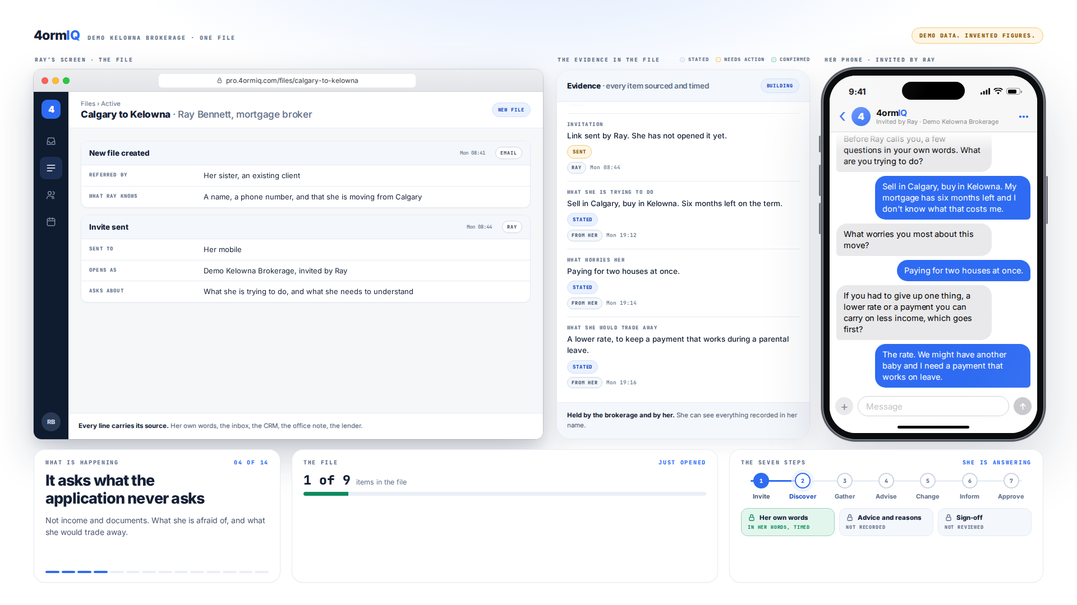
Step 3 of 12
The question no application asks
What worries her, and which of two things she would give up first.
Notes:
What worries her, and which of two things she would give up first.

Slide 5
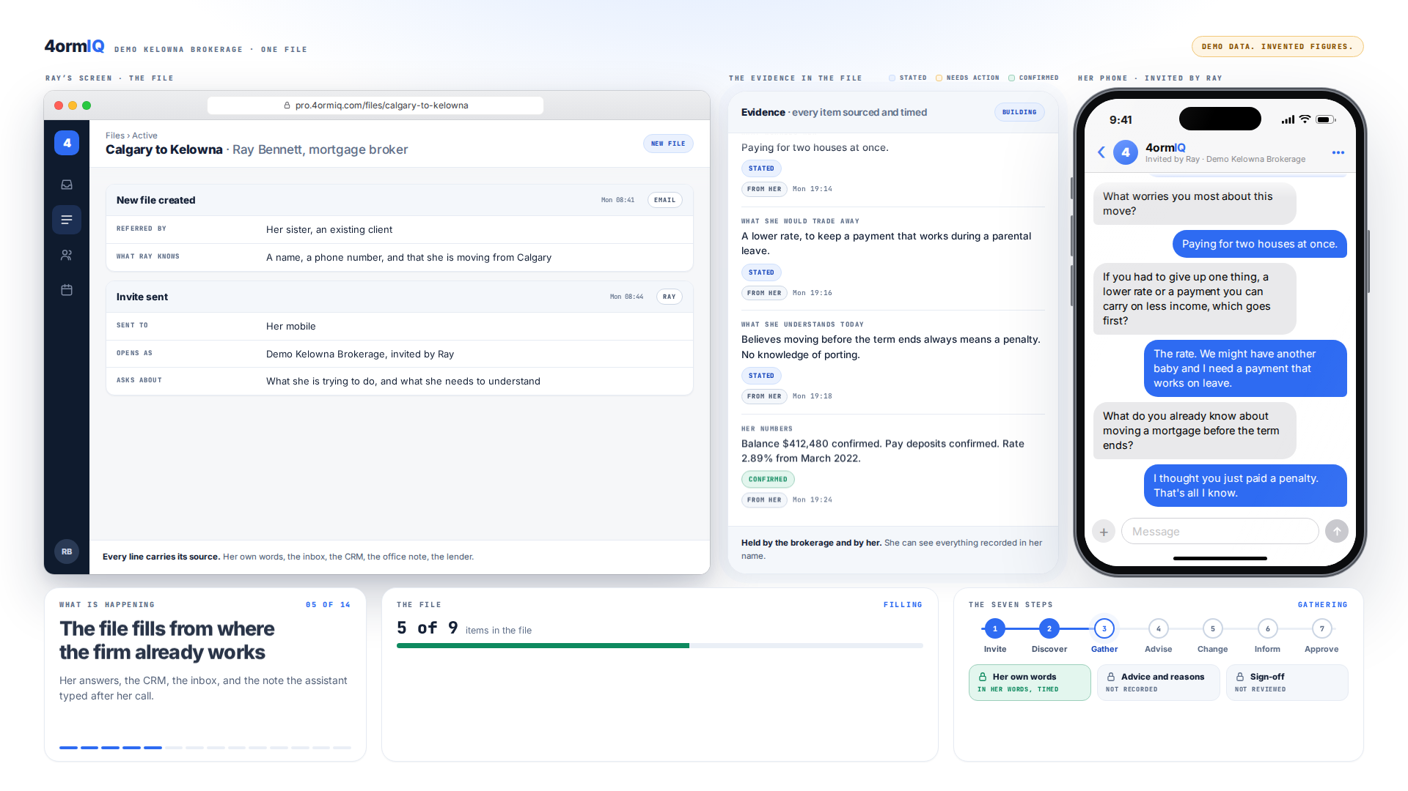
Step 4 of 12
What she understands today
She believes moving always means a penalty. That sentence is now in the file, in her words.
Notes:
She believes moving always means a penalty. That sentence is now in the file, in her words.

Slide 6
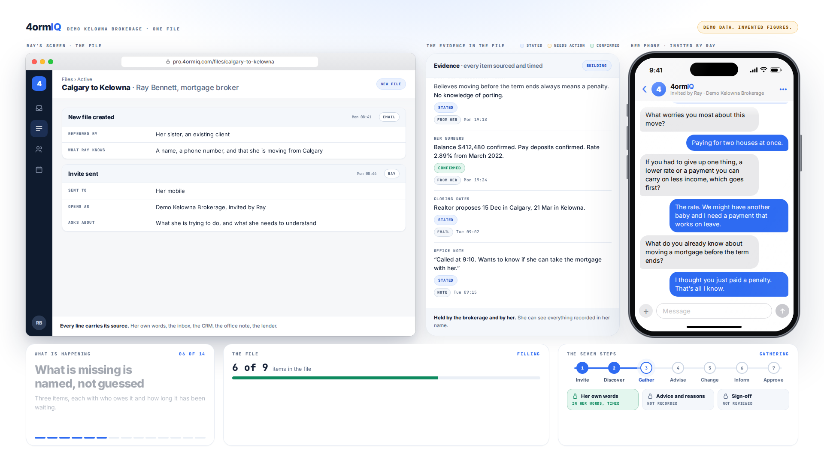
Step 5 of 12
The file fills from where the firm already works
Her answers, the CRM, the inbox and the assistant’s note, each stamped with where it came from.
Notes:
Her answers, the CRM, the inbox and the assistant’s note, each stamped with where it came from.

Slide 7
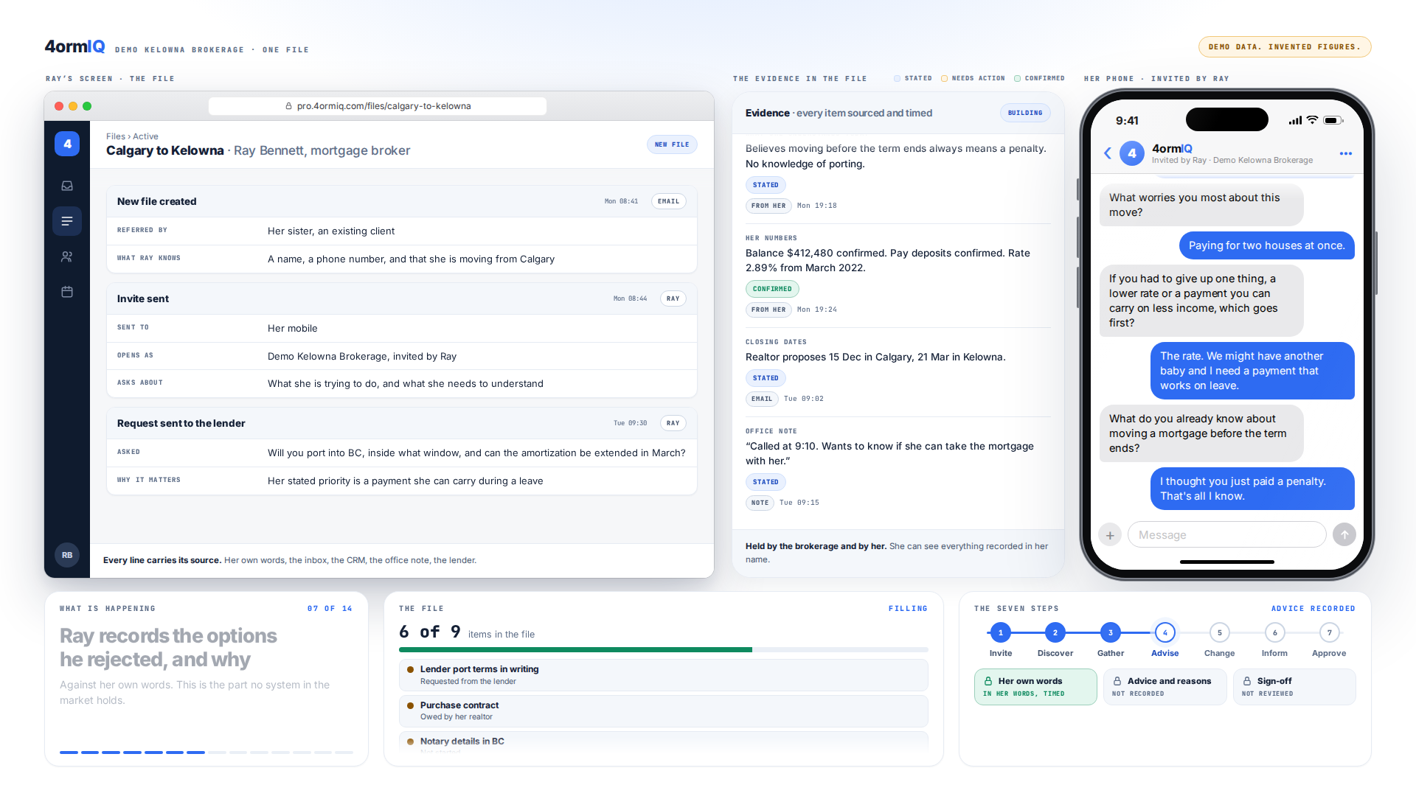
Step 6 of 12
Missing items are named
Three of them, each with who owes it and how long it has been waiting.
Notes:
Three of them, each with who owes it and how long it has been waiting.

Slide 8
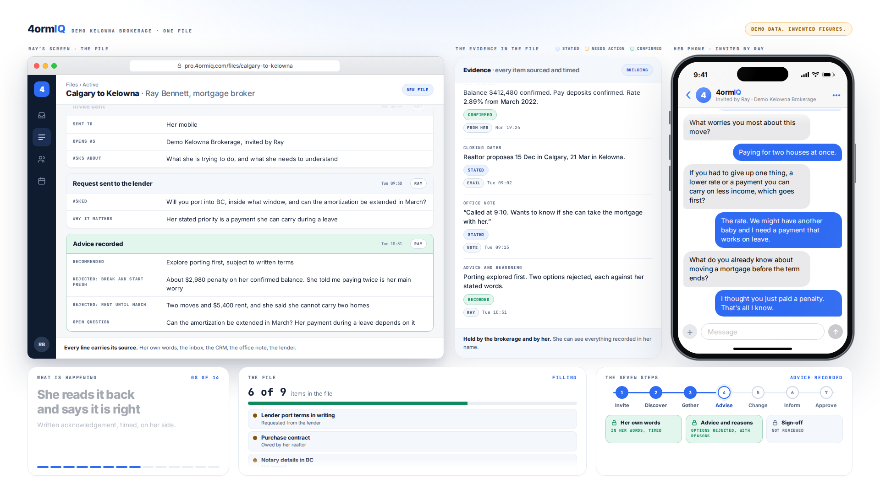
Step 7 of 12
The options he rejected, and why
Recorded against her own words. This is the part no system in the market holds.
Notes:
Recorded against her own words. This is the part no system in the market holds.

Slide 9
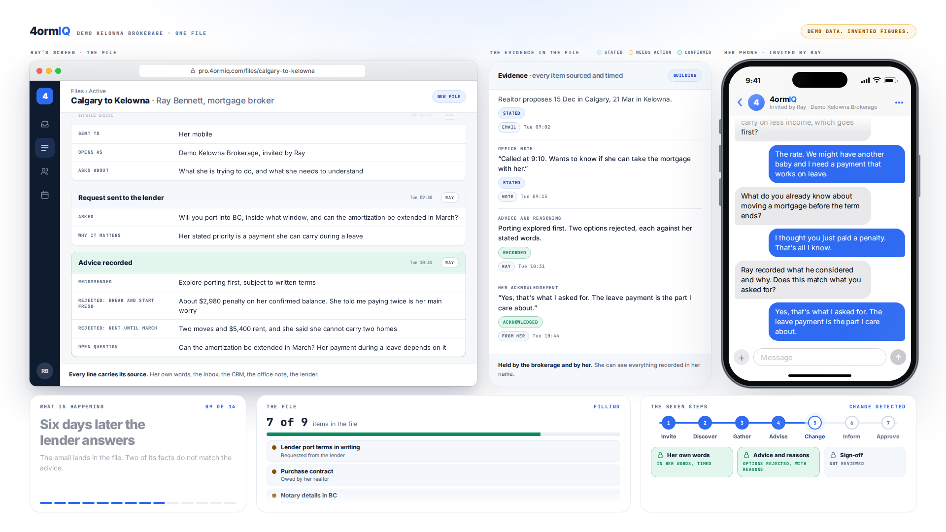
Step 8 of 12
She confirms it is right
Written, timed, from her side. British Columbia asks for this from 13 October.
Notes:
Written, timed, from her side. British Columbia asks for this from 13 October.

Slide 10
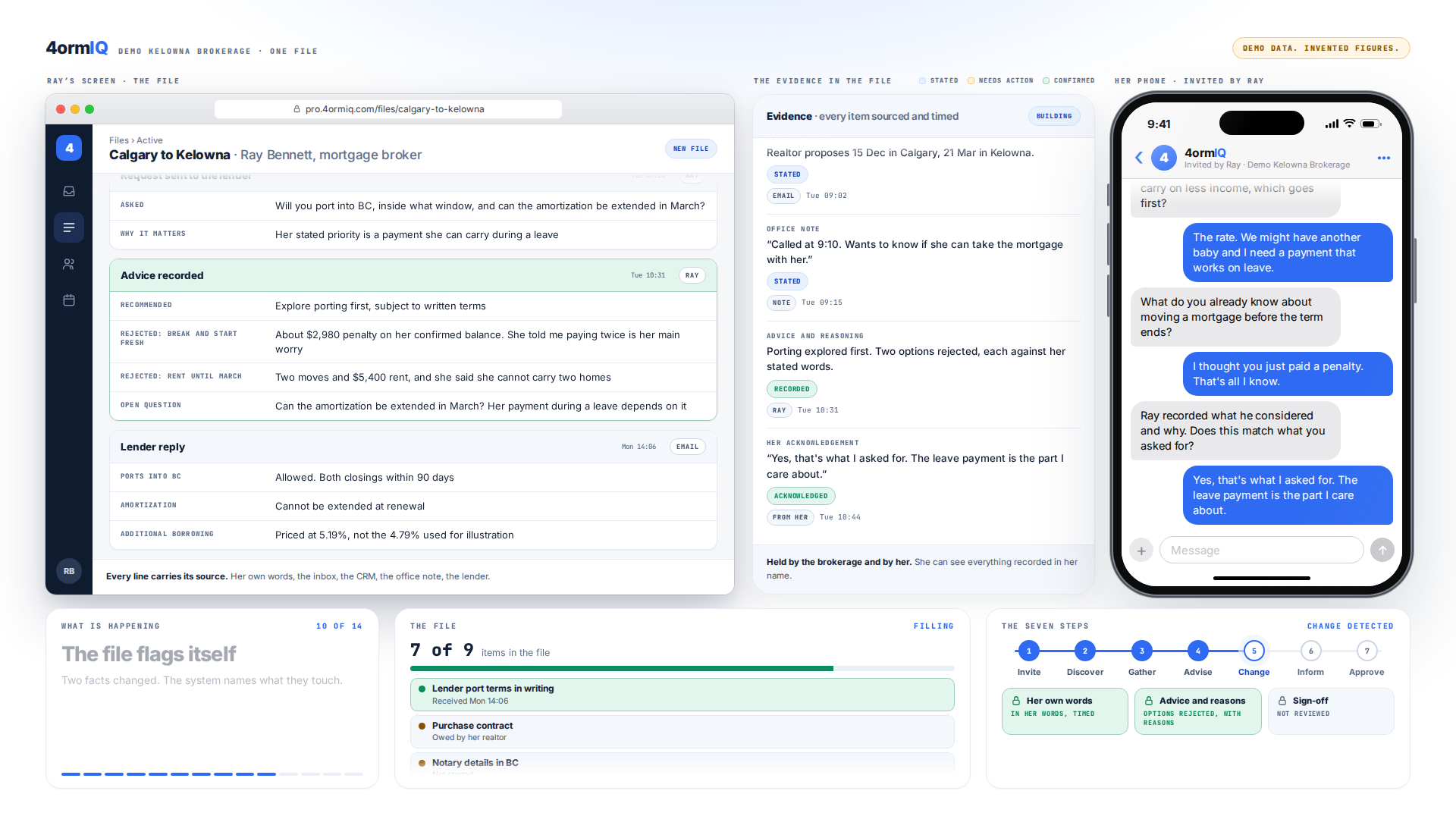
Step 9 of 12
The lender’s email lands in the file
Two of its facts do not match the advice already given.
Notes:
Two of its facts do not match the advice already given.

Slide 11
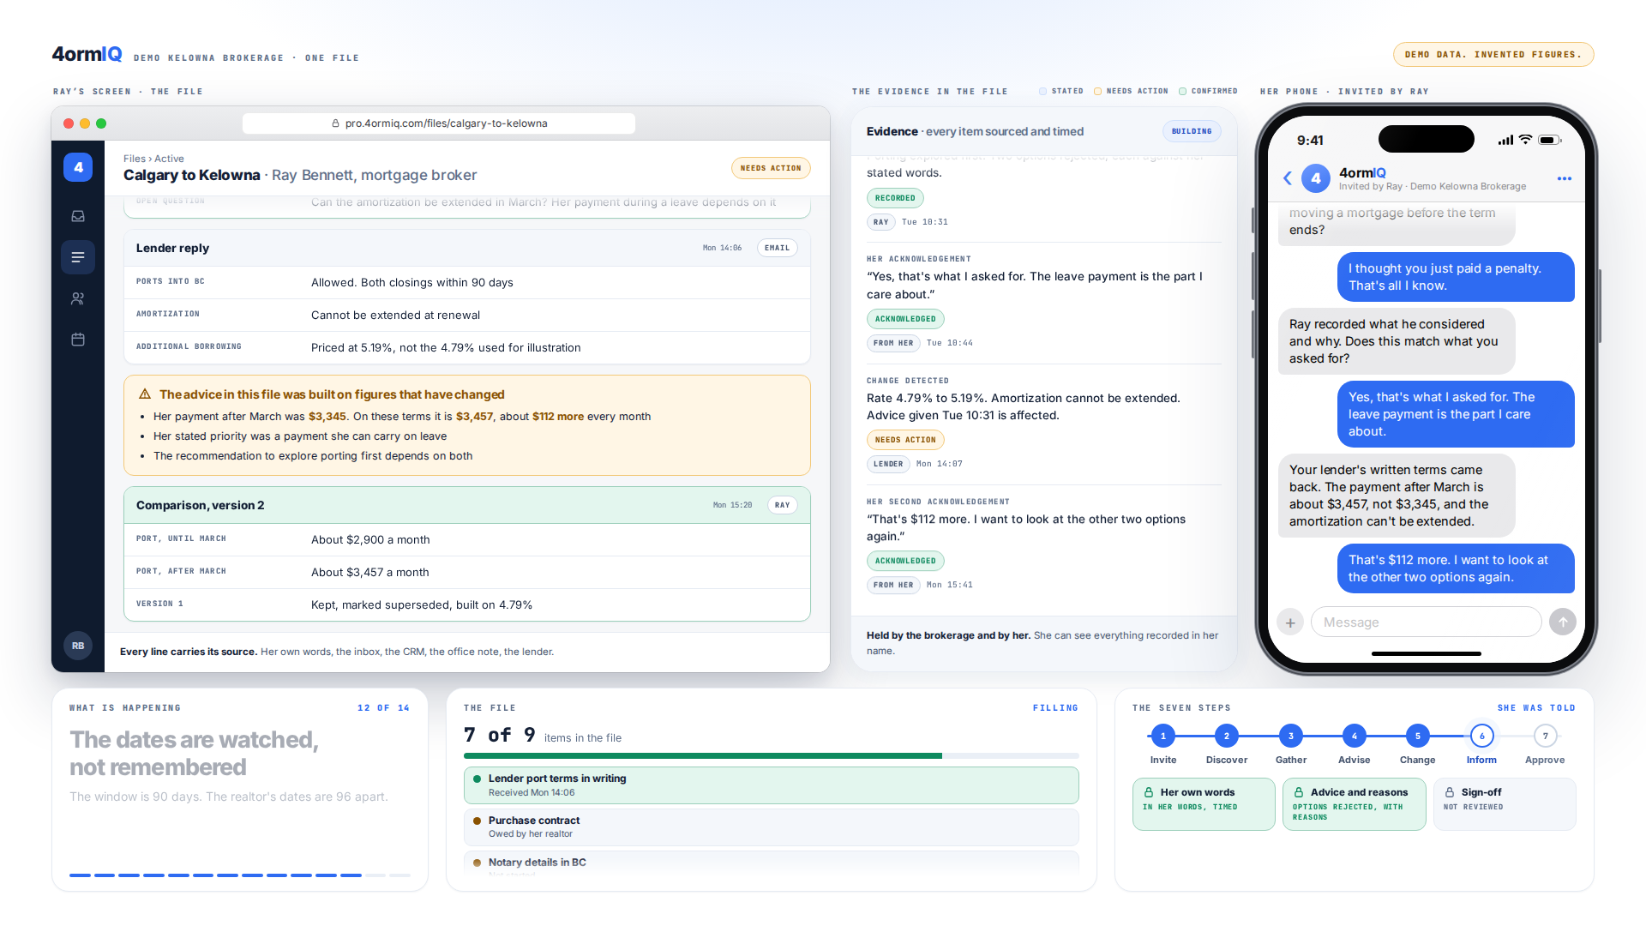
Step 10 of 12
The file flags itself
$3,345 becomes $3,457. About $112 a month she has to hear about.
Notes:
$3,345 becomes $3,457. About $112 a month she has to hear about.

Slide 12
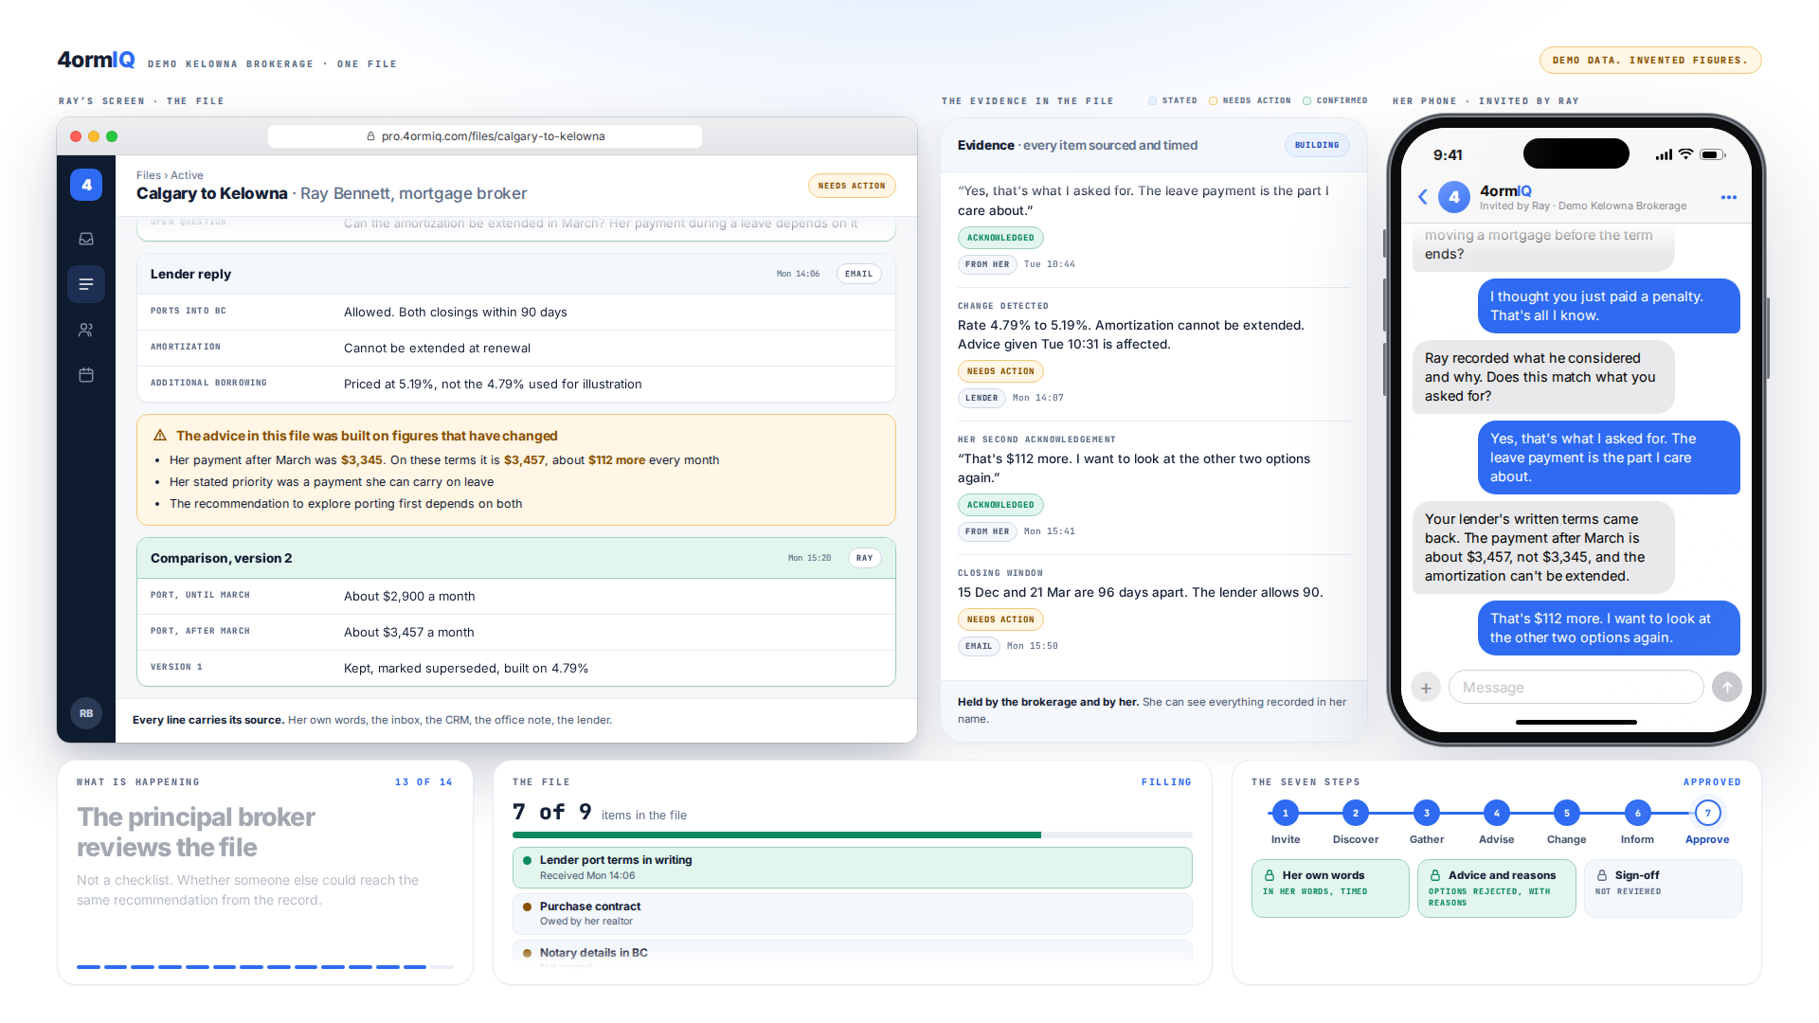
Step 11 of 12
Dates watched, not remembered
The two closings are 96 days apart. The lender allows 90.
Notes:
The two closings are 96 days apart. The lender allows 90.

Slide 13
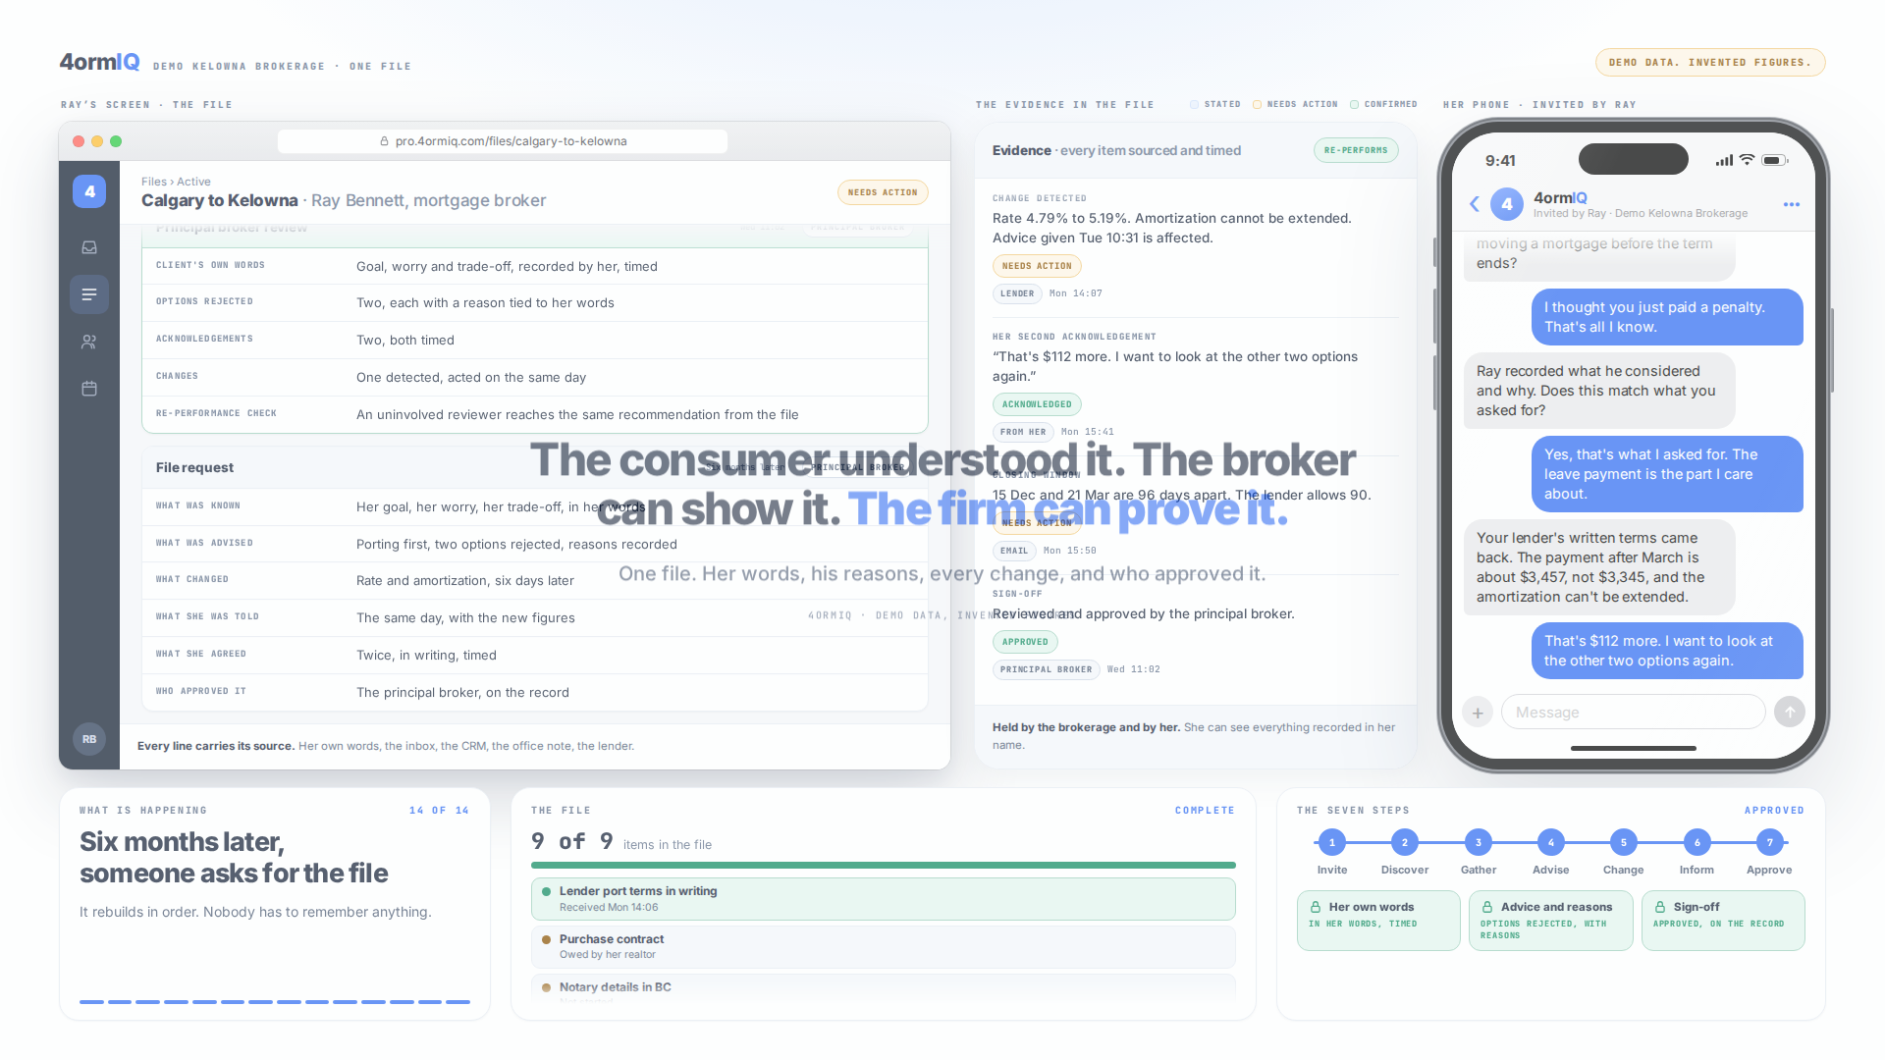
Step 12 of 12
Could someone else reach the same answer?
That is the test the regulator applies. The file answers it from the record alone.
Notes:
That is the test the regulator applies. The file answers it from the record alone.

Slide 14
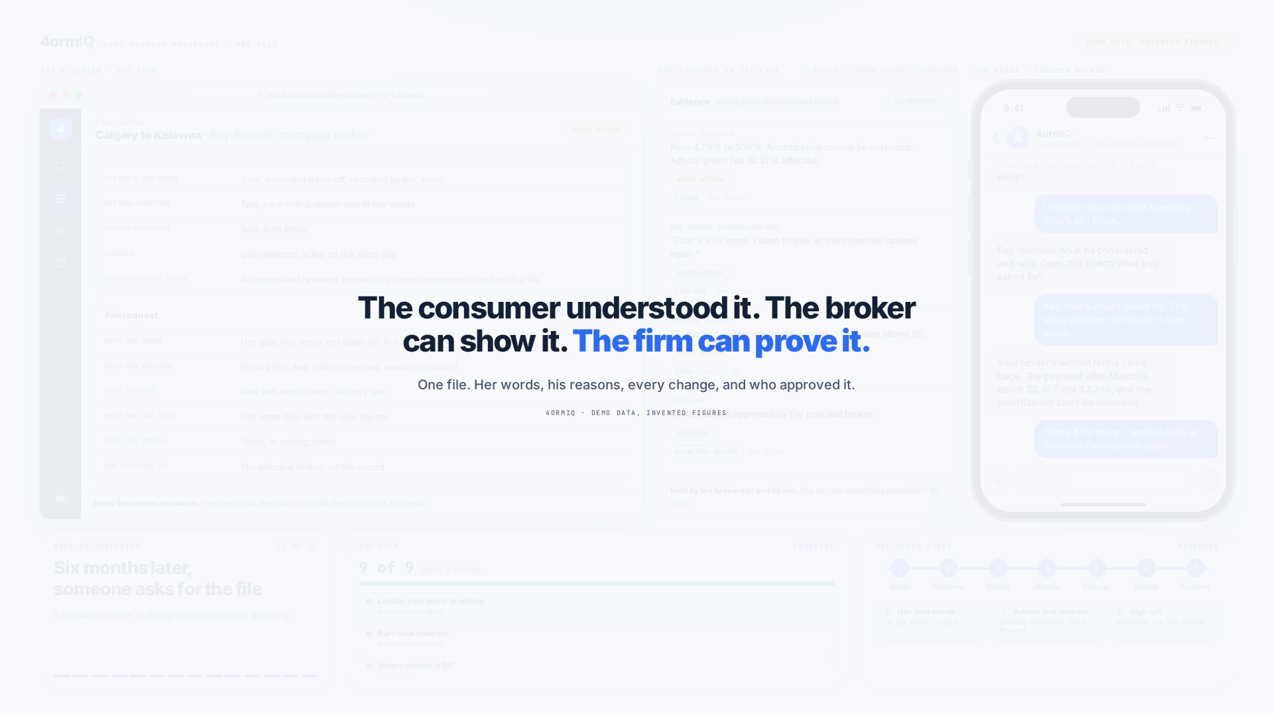
What the firm has at the end
The consumer understood it. The broker can show it. The firm can prove it.

