Slide 1
4ormIQ
A homeowner works out what to do with her mortgage
She is selling in Calgary and buying in Kelowna, with six months left on her mortgage. Every screen, in order, from her first question to her broker’s answer.
Demo data. Invented figures. Estimates, not lender quotes.

Slide 2
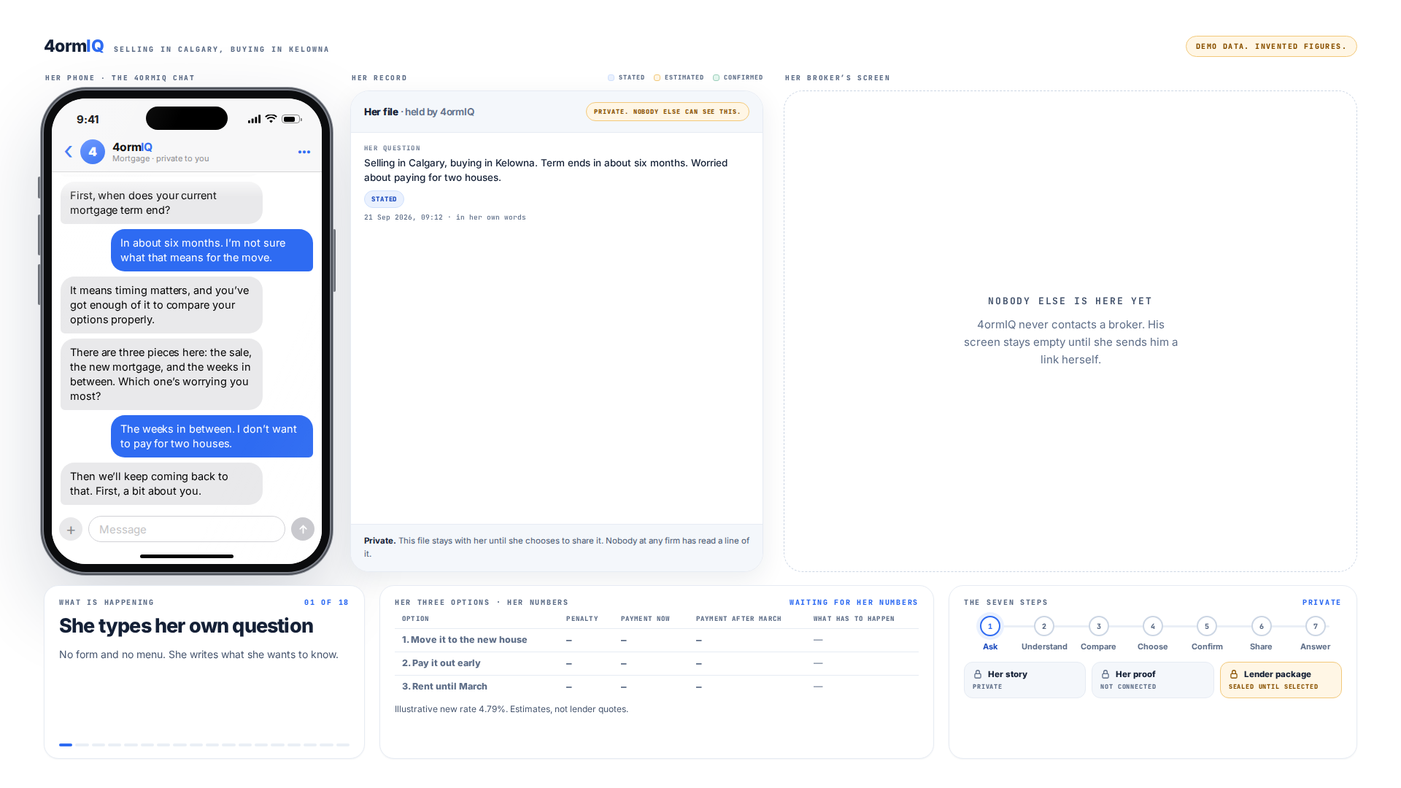
Step 1 of 13
She types her own question
No form and no menu. She writes what she wants to know, and 4ormIQ answers with questions of its own.
Notes:
She types her own question. No form and no menu. She writes what she wants to know.

Slide 3
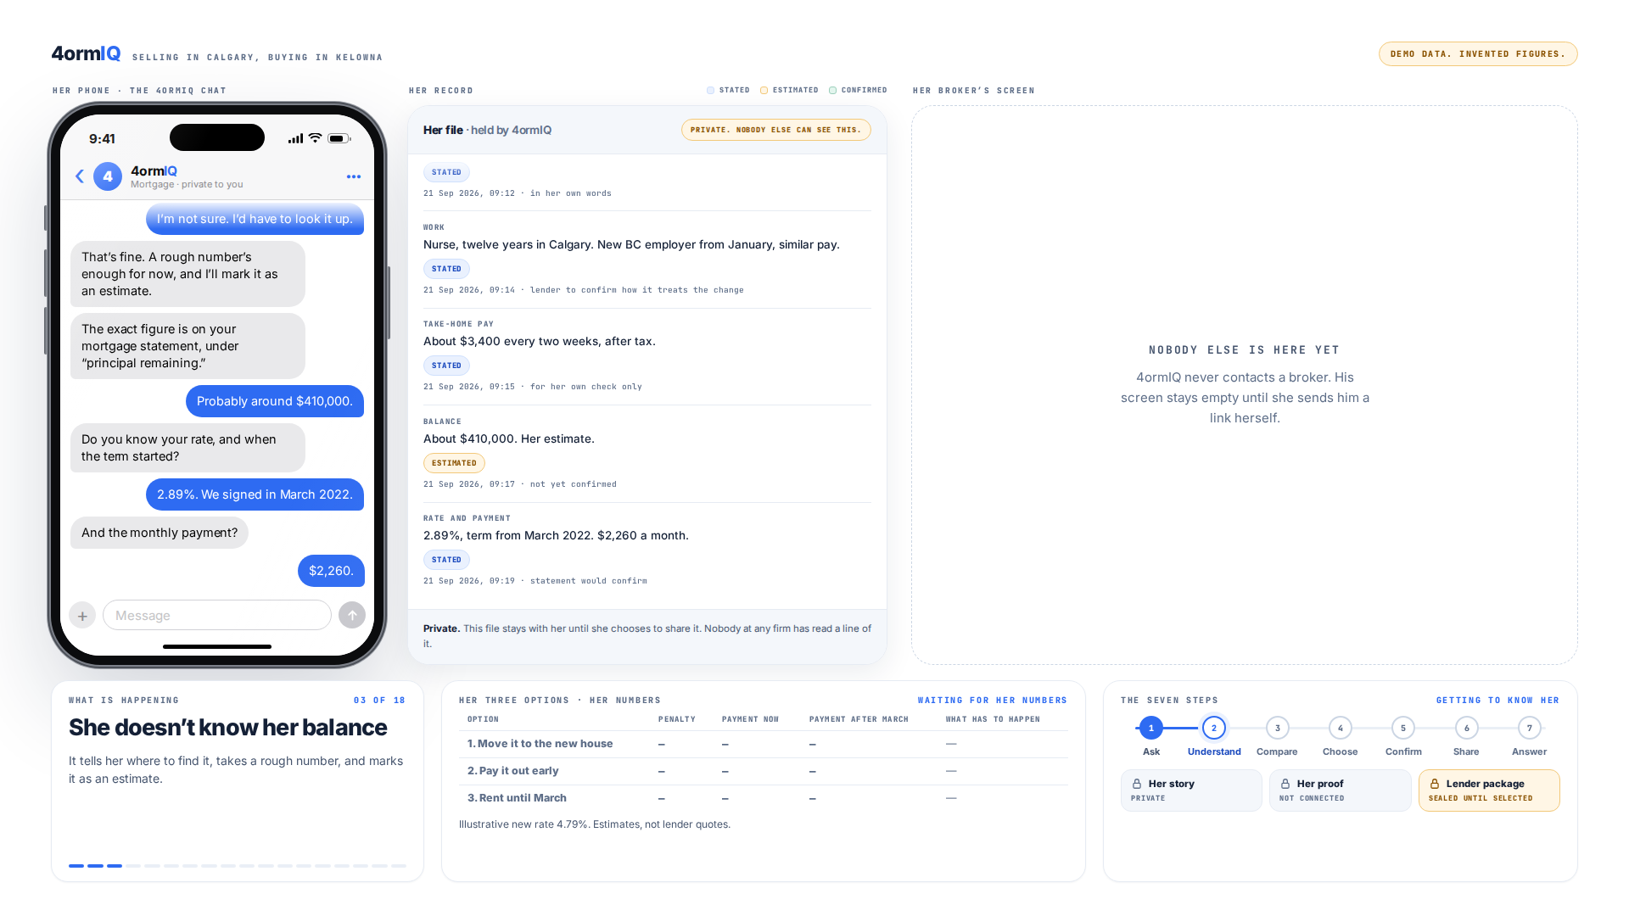
Step 2 of 13
A rough number is fine
She doesn’t know her balance. It says where to find it and marks $410,000 as an estimate in her record.
Notes:
She doesn’t know her balance. It tells her where to find it, takes a rough number, and marks it as an estimate.

Slide 4
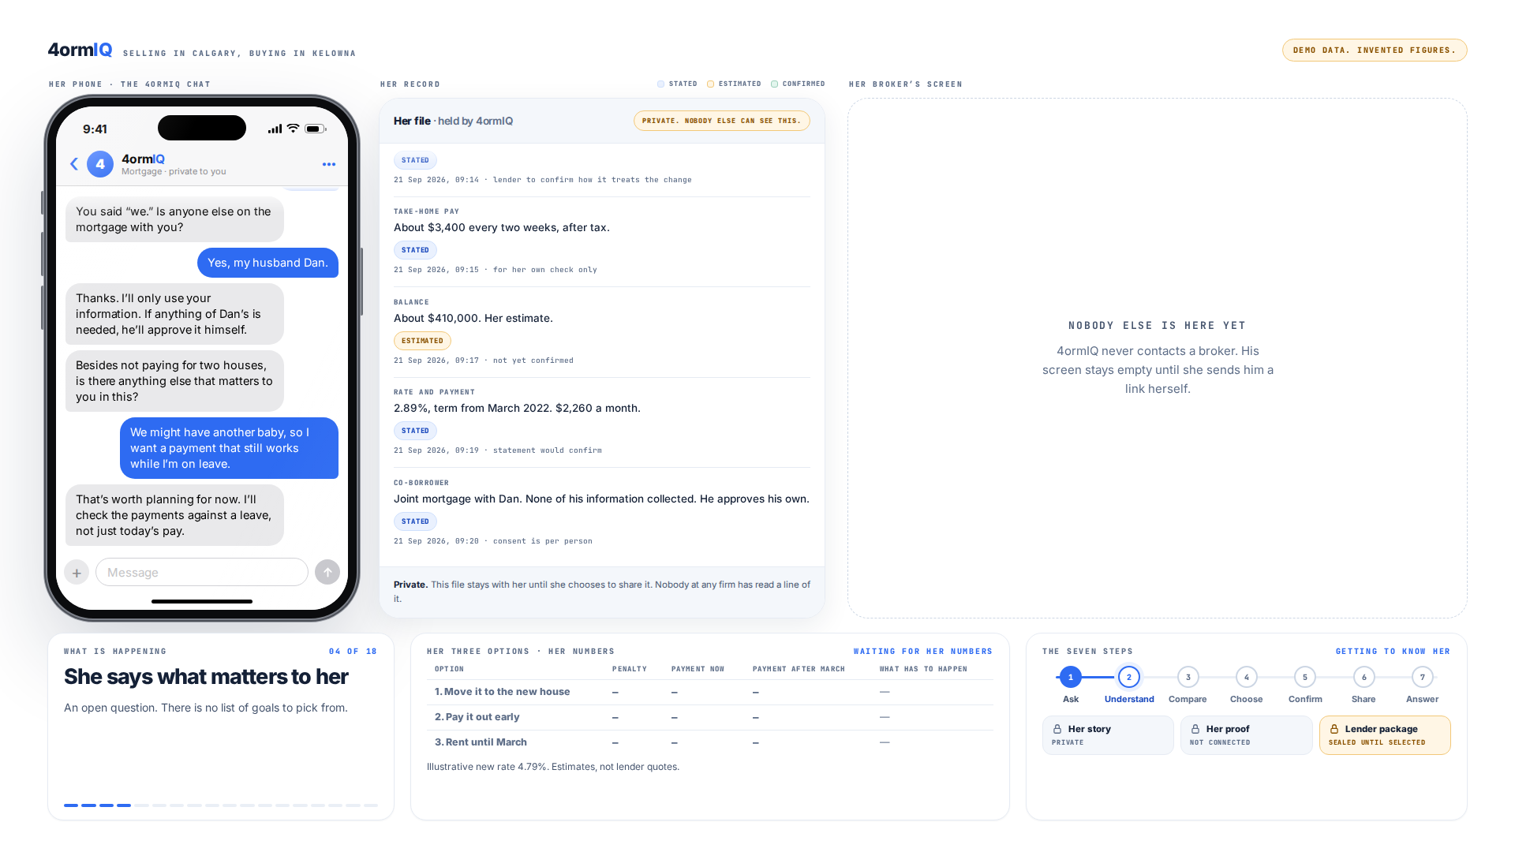
Step 3 of 13
It waits for her to say it
She said “we,” so it asks who else is on the mortgage. Her husband Dan’s information stays his.
Notes:
She says what matters to her. An open question. There is no list of goals to pick from.

Slide 5
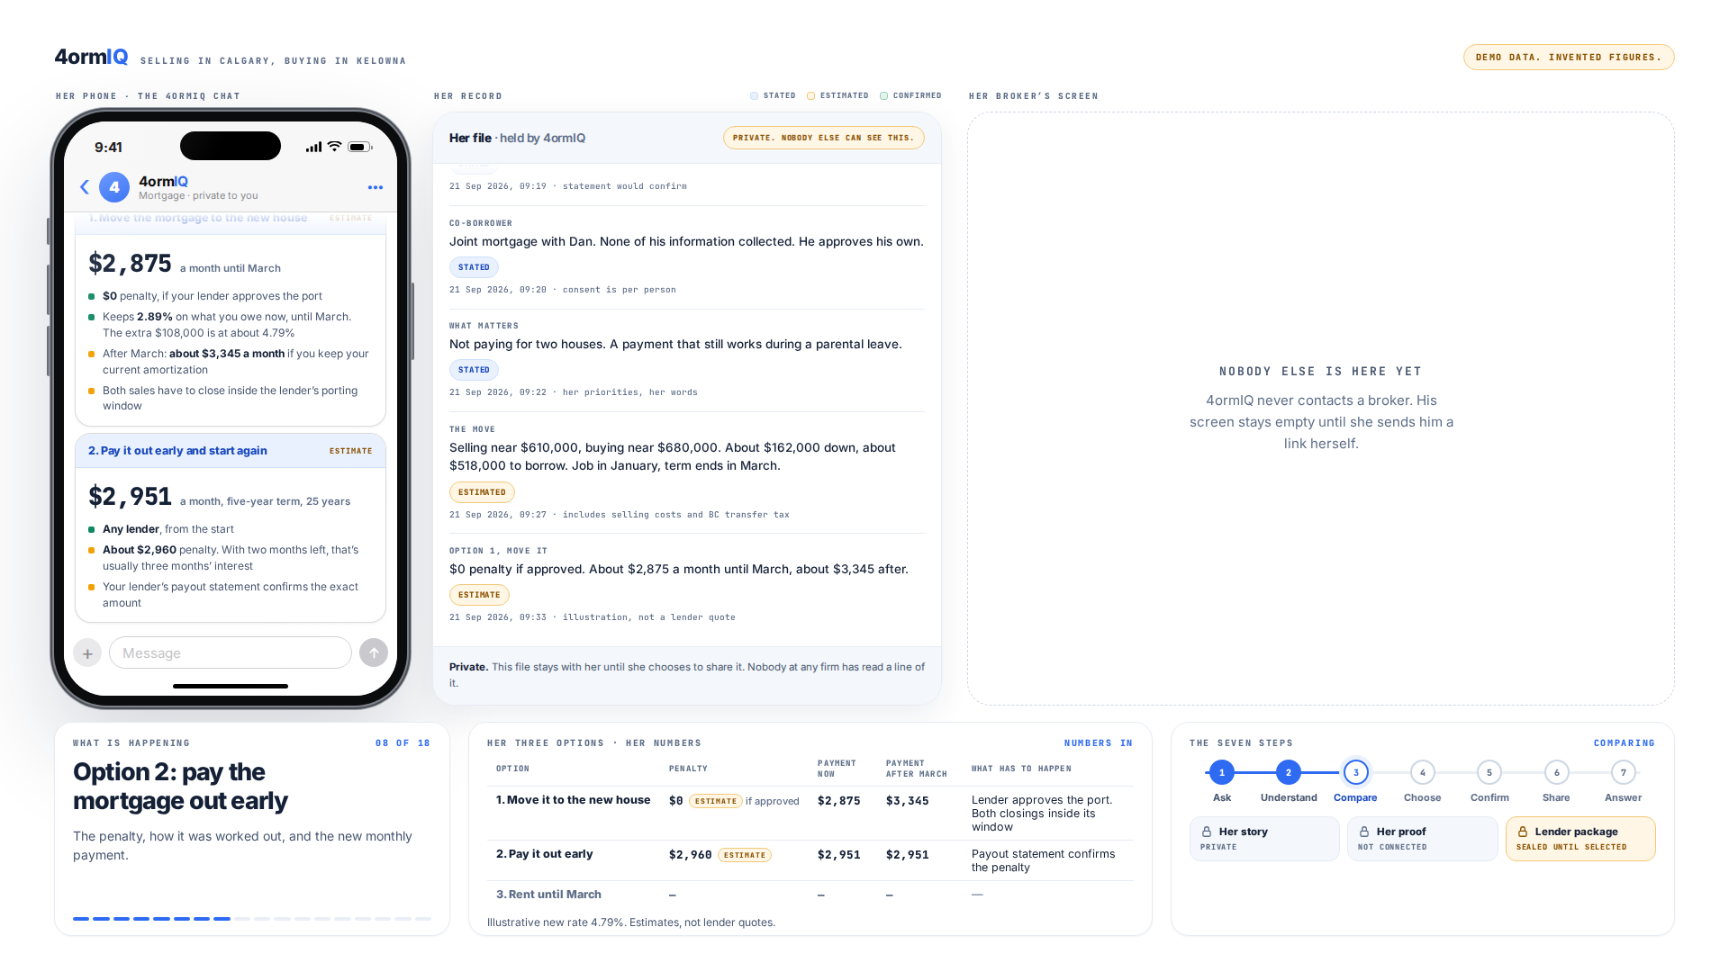
Step 4 of 13
Three options, using her numbers
Each cost lands in the table below as it is worked out, marked as an estimate.
Notes:
Option 2: pay the mortgage out early. The penalty, how it was worked out, and the new monthly payment.

Slide 6
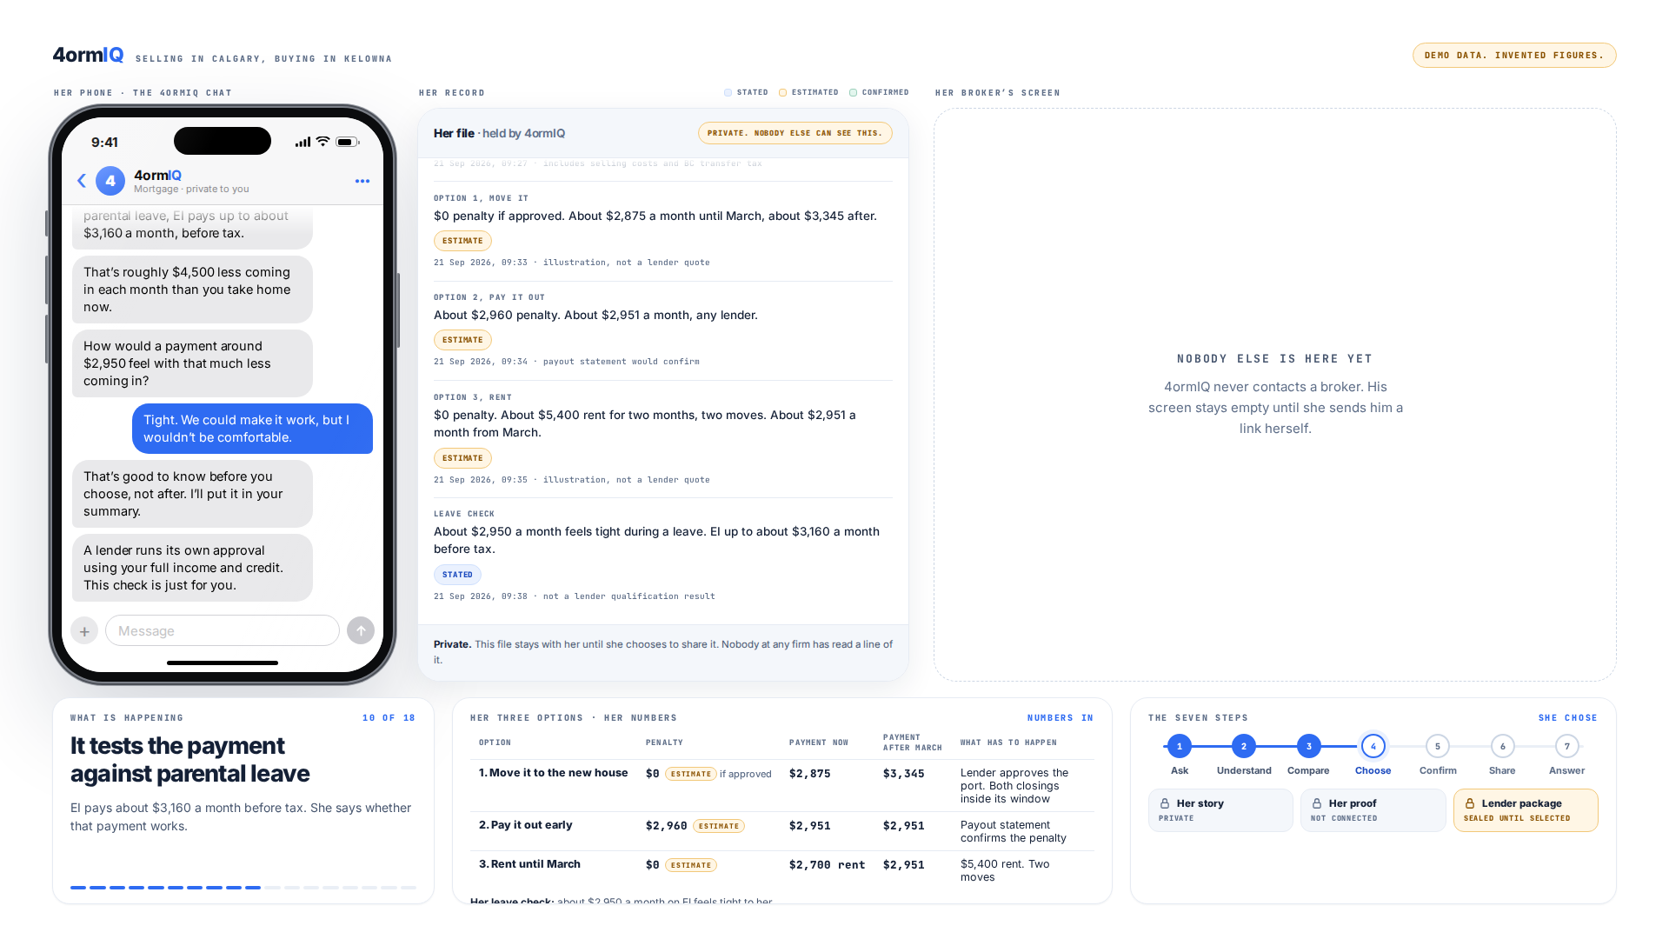
Step 5 of 13
The payment during parental leave
EI pays about $3,160 a month before tax. She says whether a $2,950 payment works for her.
Notes:
It tests the payment against parental leave. EI pays about $3,160 a month before tax. She says whether that payment works.

Slide 7
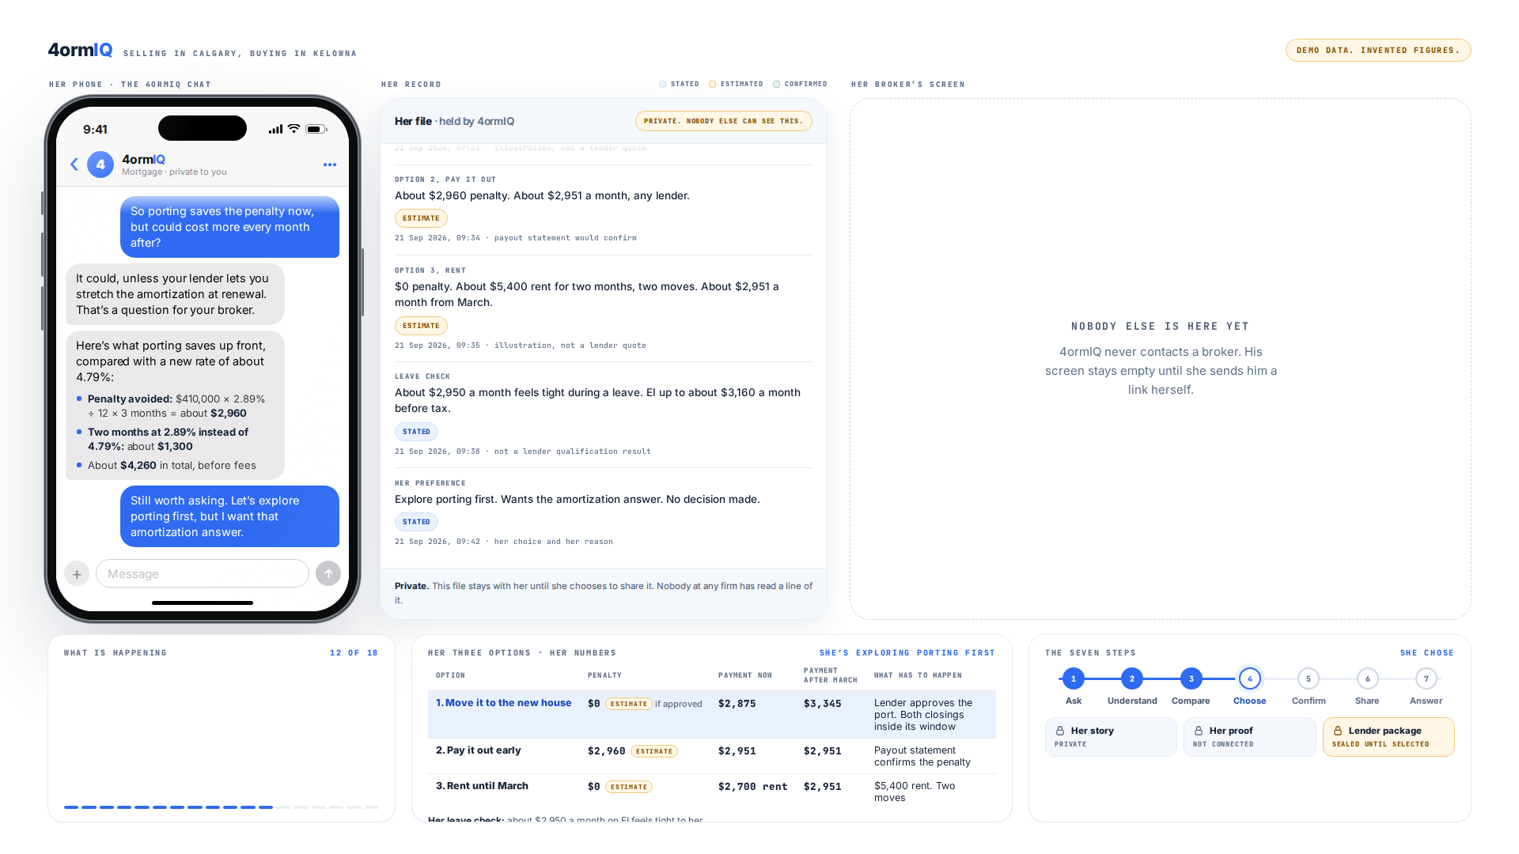
Step 6 of 13
She spots the catch
Moving the mortgage avoids the penalty now. Her payment jumps in March, and she says that first.
Notes:
She spots the catch herself. One question from 4ormIQ, and she works out that her payment jumps in March.

Slide 8
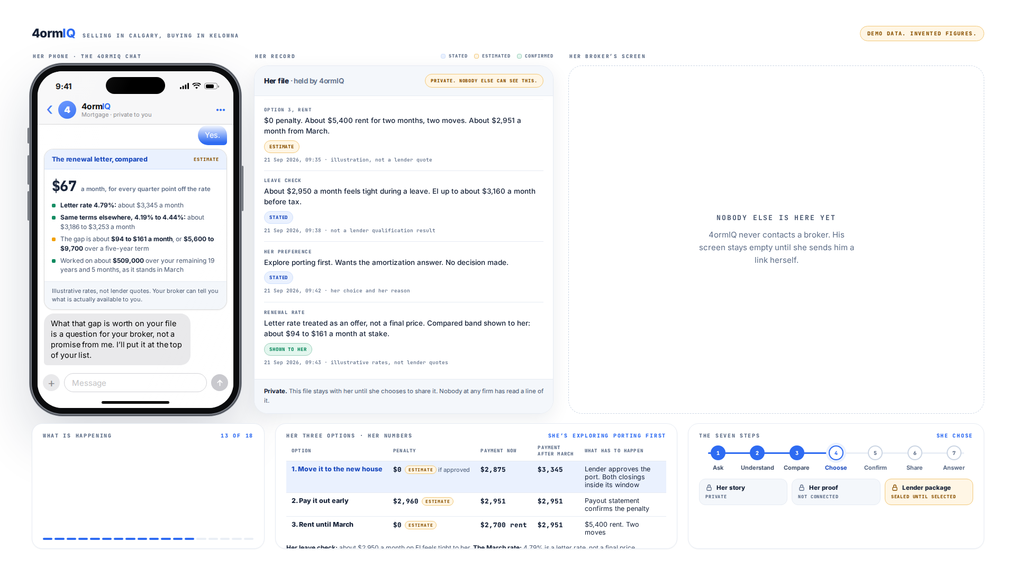
Step 7 of 13
The renewal rate is an offer
The rate printed on a renewal letter is not a final price. She sees the letter rate beside what else is going, in dollars.
Notes:
It treats the renewal rate as an offer. Her March payment rides on a rate nobody has given her yet. She picks where she stands, and no answer on the list is the wrong one.

Slide 9
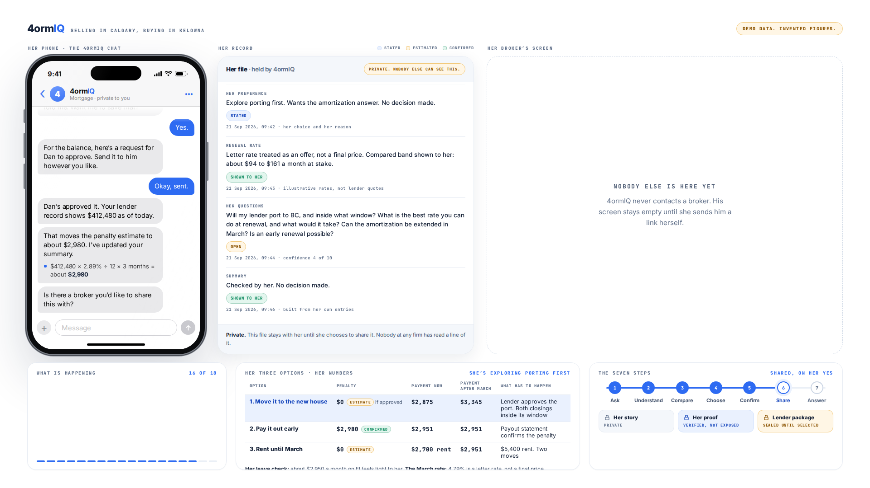
Step 8 of 13
Dan approves his own part
The balance is his information too, so he approves it. Her $410,000 estimate becomes a confirmed $412,480.
Notes:
She can confirm her numbers. Read-only, so it can’t move money. Dan approves the joint balance himself.

Slide 10
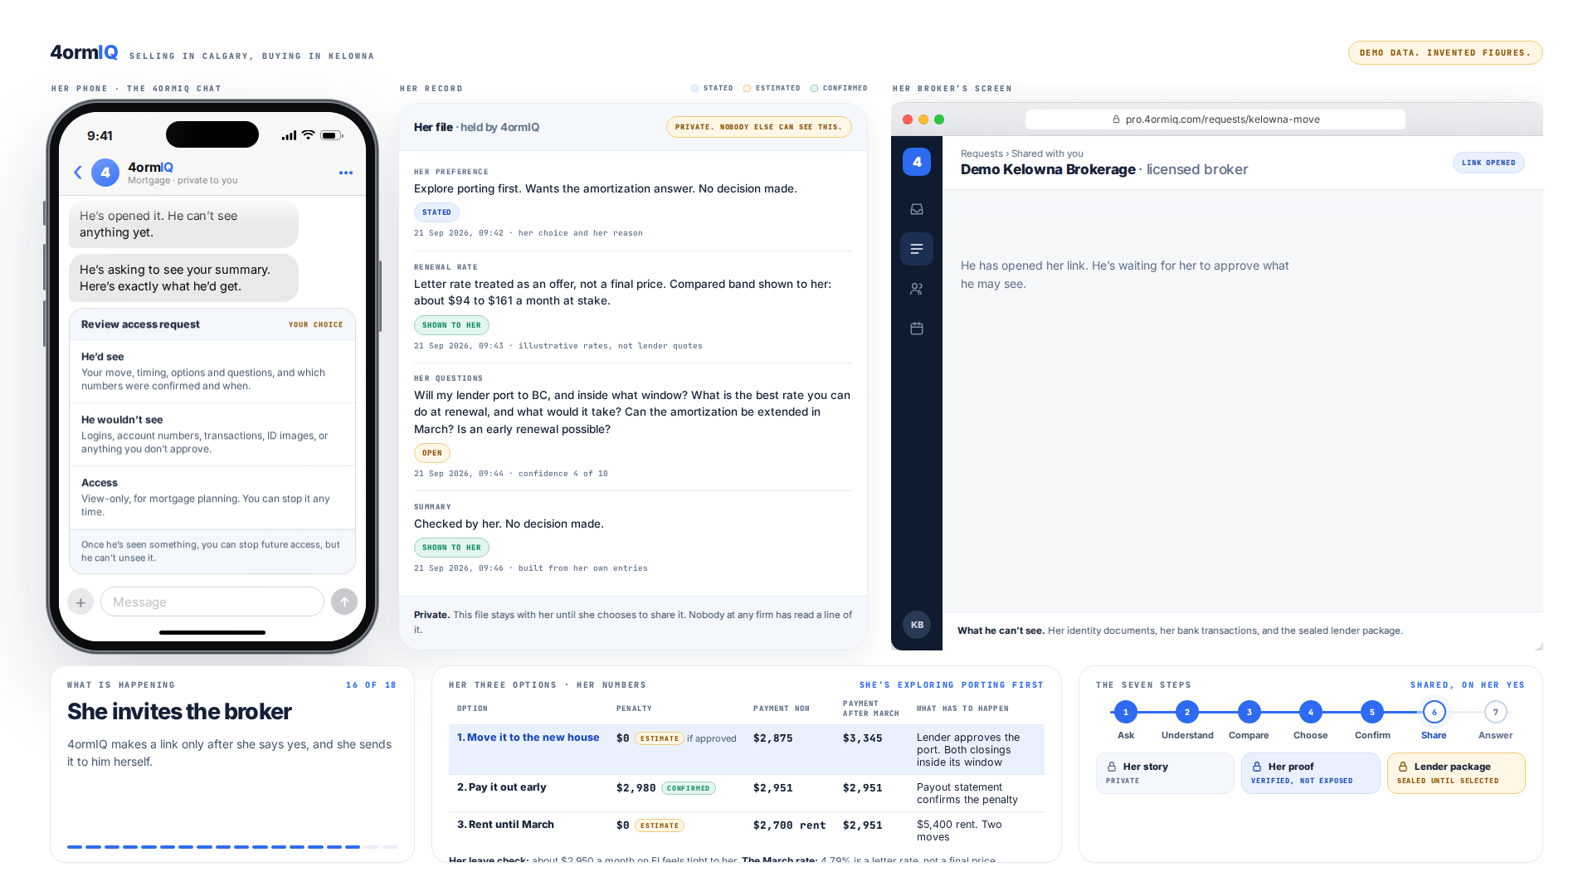
Step 9 of 13
She sends the link, not 4ormIQ
The broker’s screen stays empty until she invites him herself.
Notes:
She invites the broker. 4ormIQ makes a link only after she says yes, and she sends it to him herself.

Slide 11
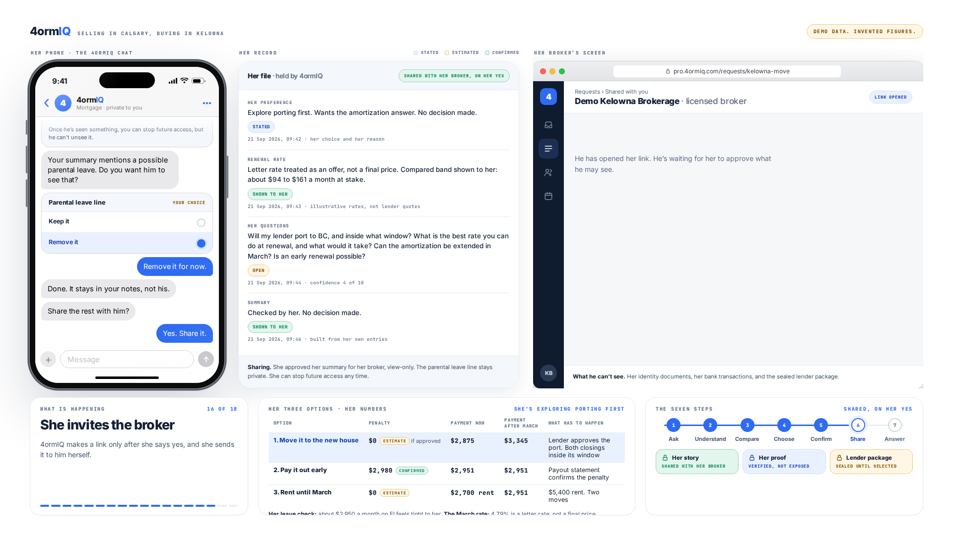
Step 10 of 13
She chooses what he sees
She keeps the line about parental leave out of what she shares.
Notes:
She invites the broker. 4ormIQ makes a link only after she says yes, and she sends it to him herself.

Slide 12
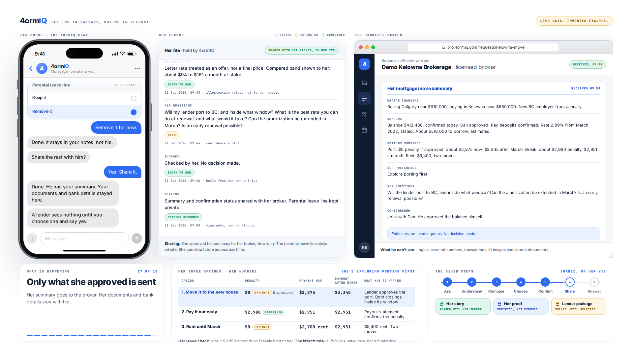
Step 11 of 13
Only her summary is sent
Her logins, statements and bank details stay on her side.
Notes:
Only what she approved is sent. Her summary goes to the broker. Her documents and bank details stay with her.

Slide 13
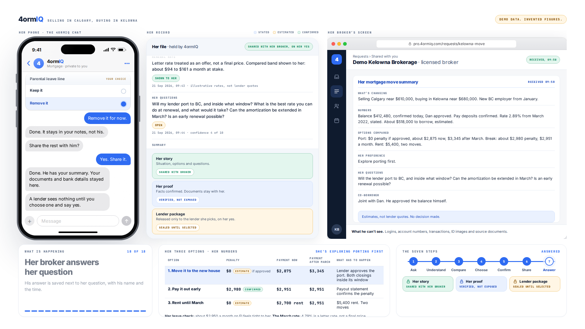
Step 12 of 13
Three locks
Her summary is shared. Her numbers are confirmed without showing the documents. Her full file stays sealed until she picks a lender.
Notes:
Her broker answers her question. His answer is saved next to her question, with his name and the time.

Slide 14
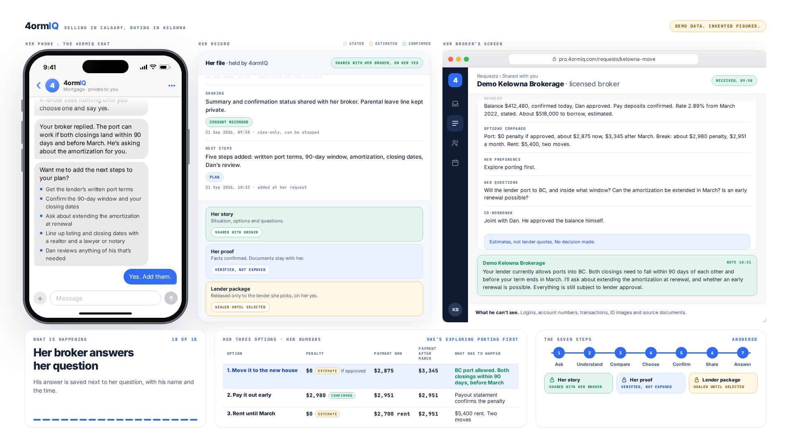
Step 13 of 13
His answer lands on her question
The broker replies, and it is saved in her record with his name and the time.
Notes:
Her broker answers her question. His answer is saved next to her question, with his name and the time.

Slide 15
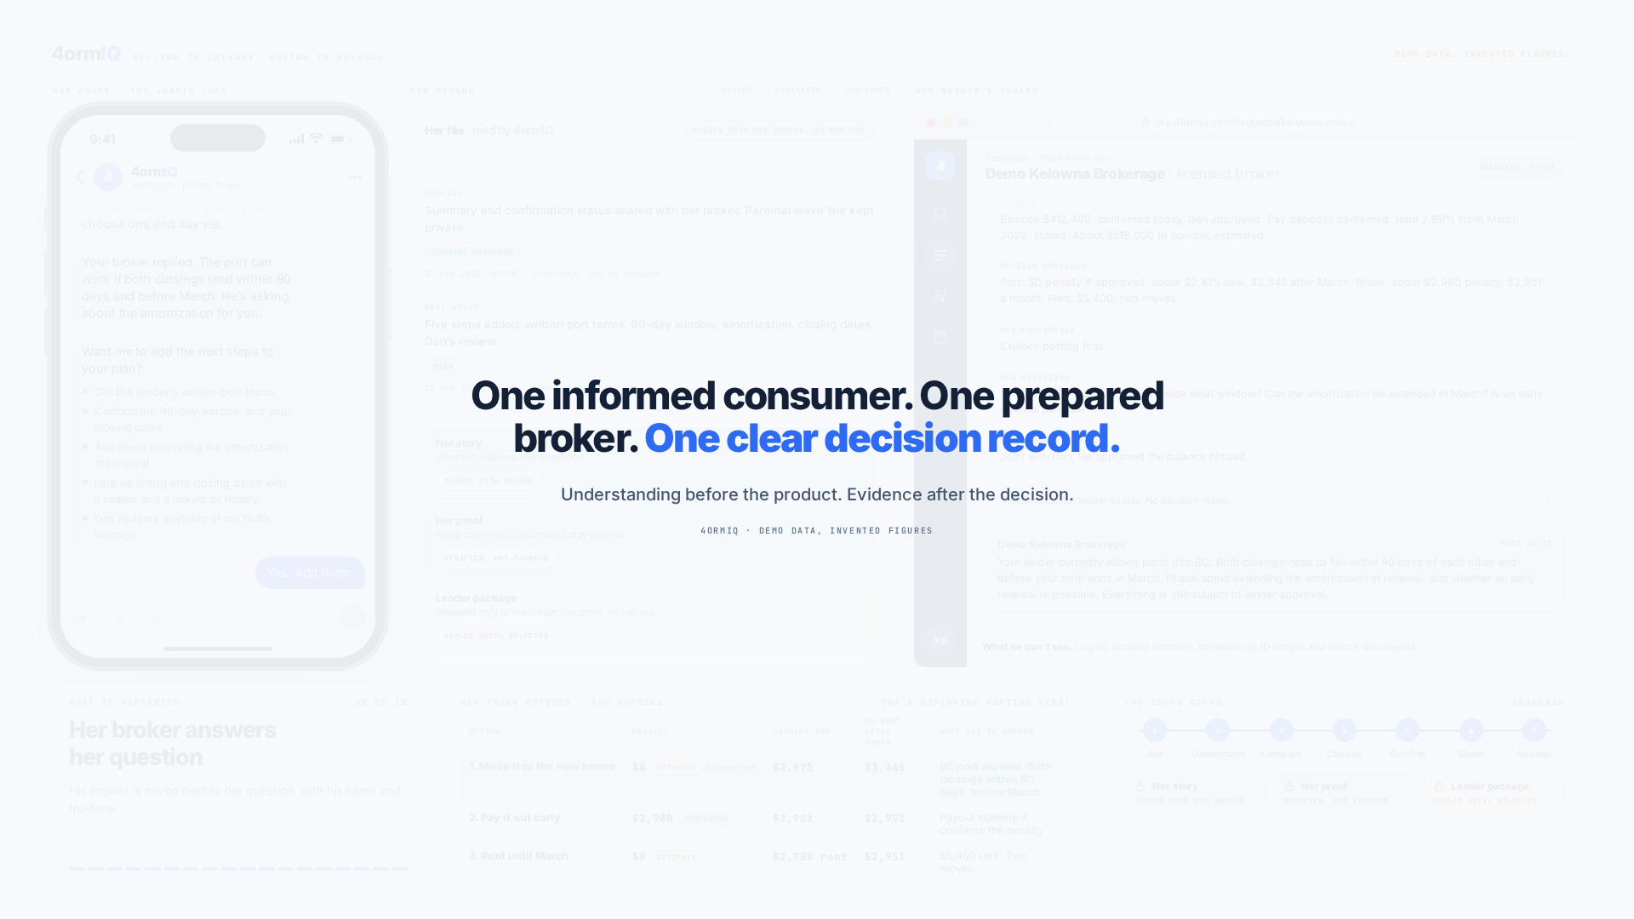
What she has at the end
One informed consumer. One prepared broker. One clear decision record.

