Slide 1
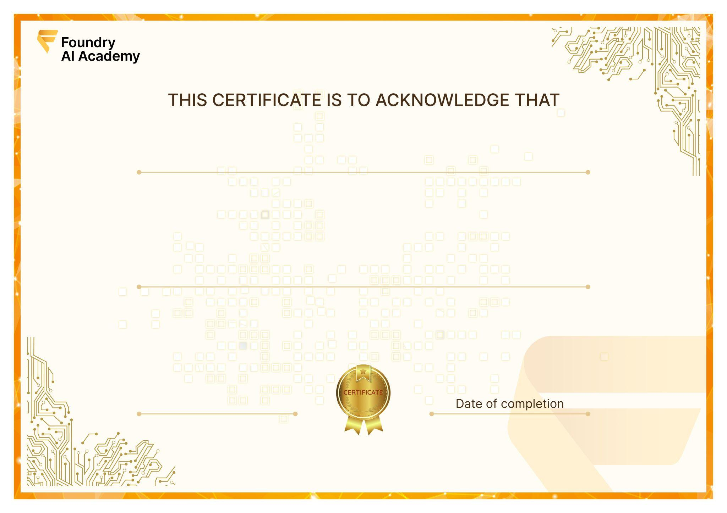

Nguyen Dang Tu
has successfully completed the 5-month
Data and AI Engineering Course
CEO - Foundry AI Academy
January 24, 2026
ID: FA-C002

