Slide 1
Miscellaneous Commands
alias | Create a command shortcut
wc (-lwc) | Word count. (Also counts lines and bytes.)
echo (-n) | Print text back to the screen (-n suppresses \n )
history | Display previous commands you have typed
man | Display help pages for a command
Notes:
1

Slide 2
Miscellaneous Commands
alias | Create a command shortcut
wc (-lwc) | Word count. (Also counts lines and bytes.)
echo (-n) | Print text back to the screen (-n suppresses \n )
history | Display previous commands you have typed
man | Display help pages for a command
woman | ?
No, not that kind of man. It stands for manual.
Notes:
2

Slide 3
Miscellaneous Commands
alias | Create a command shortcut
wc (-lwc) | Word count. (Also counts lines and bytes.)
echo (-n) | Print text back to the screen (-n suppresses \n )
history | Display previous commands you have typed
man | Display help pages for a command
Notes:
3

Slide 4
alias
You can define default flags with alias: alias rm='rm –I'
Now, when the user types “rm” the UNIX operating system automatically adds the “-I”
You can also do more than just set flags:
alias cdNshow='cd; ls'
Now both things happen if you type “cdNshow”
But how to make it the automatic default whenever you turn on the computer?
Add it into the startup file: ~/.bashrc
Remember: it starts with “.”, so it is “hidden”
The “;” indicates a separator between independent commands (just like it would in C.)
All of these single-quote symbols are necessary. (Note that the single-quote is found near the “enter” key on your keyboard. It is not near the “esc” key.)

Slide 5
Miscellaneous Commands
alias | Create a command shortcut
wc (-lwc) | Word count. (Also counts lines and bytes.)
echo (-n) | Print text back to the screen (-n suppresses \n )
history | Display previous commands you have typed
man | Display help pages for a command
Notes:
5

Slide 6
Miscellaneous Commands
alias | Create a command shortcut
wc (-lwc) | Word count. (Also counts lines and bytes.)
echo (-n) | Print text back to the screen (-n suppresses \n )
history | Display previous commands you have typed
man | Display help pages for a command
Notes:
6

Slide 7
Miscellaneous Commands
alias | Create a command shortcut
wc (-lwc) | Word count. (Also counts lines and bytes.)
echo (-n) | Print text back to the screen (-n suppresses \n )
history | Display previous commands you have typed
man | Display help pages for a command
Notes:
7

Slide 8
Miscellaneous Commands
alias | Create a command shortcut
wc (-lwc) | Word count. (Also counts lines and bytes.)
echo (-n) | Print text back to the screen (-n suppresses \n )
history | Display previous commands you have typed
man | Display help pages for a command
Notes:
8

Slide 9
Command Coordination ; && ||
9

Slide 10
Command Coordination ; && ||
command1 ; command2
The semicolon links two commands that are executed by the shell in simple sequential order. Linking commands with semicolons is like executing them as separate commands:
cd ~/public_html ; ls *.html
is equivalent to:
cd ~/public_html
ls *.html
10

Slide 11
Command Coordination ; && ||
command1 && command2
Command1 always executes, but command2 only executes if command1 was successful.
Q: Why is a && used for this?
A: It is the idea of short circuit evaluation, whereby the evaluation of a logical expression must stop early, if the result becomes known.
11

Slide 12
Short circuit evaluation?
Consider this C++ function to compute a boolean expression:
bool TestAllTrue(bool A, bool B, bool C, bool D)
{ return A && B && C && D;
}
Also, consider that A = B = true, C = false, D=whatever
To evaluate the expression, we first do A&& B.
→This gives true && true = true.
We next take that result and && it with C.
→ This gives true && false = false.
Now, here is the point:
Once we know that A && B && C = false, we no longer care what D is, because we know that the final answer is false.
And so, because C/C++ enforce short circuit evaluation, you know that D will not be tested.
12

Slide 13
Short circuit evaluation?
Consider this C++ function to compute a boolean expression:
bool TestAllTrue(bool A, bool B, bool C, bool D)
{ return A && B && C && D;
}
Also, consider that A = B = true, C = false, D=whatever
To evaluate the expression, we first do A && B.
→This gives true && true = true.
13

Slide 14
Short circuit evaluation?
Consider this C++ function to compute a boolean expression:
bool TestAllTrue(bool A, bool B, bool C, bool D)
{ return A && B && C && D;
}
Also, consider that A = B = true, C = false, D=whatever
To evaluate the expression, we first do A && B.
→This gives true && true = true.
We next take that result and && it with C.
→ This gives true && false = false.
14

Slide 15
Short circuit evaluation?
Consider this C++ function to compute a boolean expression:
bool TestAllTrue(bool A, bool B, bool C, bool D)
{ return A && B && C && D;
}
Also, consider that A = B = true, C = false, D=whatever
To evaluate the expression, we first do A && B.
→This gives true && true = true.
We next take that result and && it with C.
→ This gives true && false = false.
Now, here is the point:
Once we know that A && B && C = false, we no longer care what D is, because we know that the final answer is false.
15

Slide 16
Short circuit evaluation?
Consider this C++ function to compute a boolean expression:
bool TestAllTrue(bool A, bool B, bool C, bool D)
{ return A && B && C && D;
}
Also, consider that A = B = true, C = false, D=whatever
To evaluate the expression, we first do A && B.
→This gives true && true = true.
We next take that result and && it with C.
→ This gives true && false = false.
Now, here is the point:
Once we know that A && B && C = false, we no longer care what D is, because we know that the final answer is false.
And so, because C/C++ enforce short circuit evaluation, you know that D will not be tested.
In fact, programmers often depend on the guarantee of short-circuit evaluation. Consider the follow C conditional expression:
if ((X!=NULL)&&(*X==3)) …
The above C instruction is always safe, because the pointer will only be de-referenced if it is legal to do so.
The reverse conditional is, of course, a bug:
if ((*X==3) &&(X!=NULL)) …
16

Slide 17
Command Coordination ; && ||
command1 && command2
Command1 always executes, but command2 only executes if command1 was successful.
Q: Why is a && used for this?
A: It is the idea of short circuit evaluation, whereby the evaluation of a logical expression must stop early, if the result becomes known.
(command1’s failure means that the we know that the whole expression fails – without needing to evaluate command2. )
So: cp /file ~/mycopy && cat mycopy
Will only print the file if you were able to copy it. (ie, if you had read permission on it)
17

Slide 18
Command Coordination ; && ||
command1 || command2
Command1 always executes, but command2 only executes if command1 failed.
(command1’s success means that the we know that the whole expression is true – without our needing to even evaluate command2. )
So:
cp /file ~/mycopy || echo "sorry, you don't have permission"
Will only print the message if you were not able to copy.
18

Slide 19
Input/Output (I/O) and Redirection
Input may come from the command line, or a file:
./a.out < inputfile
19
Notes:
19

Slide 20
Input/Output (I/O) and Redirection
Be careful! This will overwrite any information that was previously in the out.file file – and it won’t ask before it overwrites it!
Input may come from the command line, or a file:
./a.out < inputfile
Outputs to the screen, unless redirected to a file:
echo "hi there" > out.file
20
Notes:
20

Slide 21
Input/Output (I/O) and Redirection
Input may come from the command line, or a file:
./a.out < inputfile
Outputs to the screen, unless redirected to a file:
echo "hi there" > out.file
• To append at the end of a file:
echo "hi back at you" >> out.file
21
Notes:
21

Slide 22
Input/Output (I/O) and Redirection
Input may come from the command line, or a file:
./a.out < inputfile
Outputs to the screen, unless redirected to a file:
echo "hi there" > out.file
• To append at the end of a file:
echo "hi back at you" >> out.file
• To also send error messages (stderr) to the file:
ehco "hi back at you" >& out.file
The mis-spelling would have put an error message on the screen.
22
Notes:
22

Slide 23
Input/Output (I/O) and Redirection
Input may come from the command line, or a file:
./a.out < inputfile
Outputs to the screen, unless redirected to a file:
echo "hi there" > out.file
• To append at the end of a file:
echo "hi back at you" >> out.file
• To also send error messages (stderr) to the file:
ehco "hi back at you" >& out.file
• To send only the error messages to the file:
ehco "hi back at you" 2> out.file
23
Notes:
23

Slide 24
An Example Using Redirection
% -o square.x square.c
% ./square.x
Enter a number
12
The square of your number is 144
% cat inputfile
25
% ./square.x < inputfile
Enter a number
The square of your number is 625
%
Throughout this course, we will use the “%” symbol for the command-line prompt.
Your actual command line prompt is different. It might include your user name. But, if you wanted to, you could change your prompt. Some people actually do have a “%” symbol as their prompt.
Notes:
24

Slide 25
An Example Using Redirection
% cat square.c
#include <stdio.h>
main()
{ int x; printf("Enter a number\n"); scanf("%d",&x);
printf ("The square of your number is %d\n",x*x); }
% gcc -o square.x square.c
% ./square.x
Enter a number
12
The square of your number is 144
% cat inputfile
25
% ./square.x < inputfile
Enter a number
The square of your number is 625
%
It doesn’t take much effort to see that this is a program to print the square of a number.
Notes:
25

Slide 26
An Example Using Redirection
% cat square.c
#include <stdio.h>
main()
{ int x; printf("Enter a number\n"); scanf("%d",&x);
printf ("The square of your number is %d\n",x*x); }
% gcc -o square.x square.c
% ./square.x
Enter a number
12
The square of your number is 144
% cat inputfile
25
% ./square.x < inputfile
Enter a number
The square of your number is 625
%
It doesn’t take much effort to see that this is a program to print the square of a number.
Have you used gcc before? The -o flag tells gcc to name the executable as “square.x”
Notes:
26

Slide 27
An Example Using Redirection
% cat square.c
#include <stdio.h>
main()
{ int x; printf("Enter a number\n"); scanf("%d",&x);
printf ("The square of your number is %d\n",x*x); }
% gcc -o square.x square.c
% ./square.x
Enter a number
12
The square of your number is 144
% cat inputfile
25
% ./square.x < inputfile
Enter a number
The square of your number is 625
%
When you want to run a program, you need to tell the computer the path of the program. Since we just created this executable within the present working directory, we use a “./” to indicate the path to this executable.
Have you used gcc before? The -o flag tells gcc to name the executable as “square.x”
Notes:
27

Slide 28
An Example Using Redirection
% cat square.c
#include <stdio.h>
main()
{ int x; printf("Enter a number\n"); scanf("%d",&x);
printf ("The square of your number is %d\n",x*x); }
% gcc -o square.x square.c
% ./square.x
Enter a number
12
The square of your number is 144
% cat inputfile
25
% ./square.x < inputfile
Enter a number
The square of your number is 625
%
When you want to run a program, you need to tell the computer the path of the program. Since we just created this executable within the present working directory, we use a “./” to indicate the path to this executable.
It is waiting for you to enter a number.
Notes:
28

Slide 29
An Example Using Redirection
% cat square.c
#include <stdio.h>
main()
{ int x; printf("Enter a number\n"); scanf("%d",&x);
printf ("The square of your number is %d\n",x*x); }
% gcc -o square.x square.c
% ./square.x
Enter a number
The square of your number is 144
% cat inputfile
25
% ./square.x < inputfile
Enter a number
The square of your number is 625
%
Maybe you decide to enter a “12”
It is waiting for you to enter a number.
Notes:
29

Slide 30
An Example Using Redirection
% cat square.c
#include <stdio.h>
main()
{ int x; printf("Enter a number\n"); scanf("%d",&x);
printf ("The square of your number is %d\n",x*x); }
% gcc -o square.x square.c
% ./square.x
Enter a number
12
The square of your number is 144
% cat inputfile
25
% ./square.x < inputfile
Enter a number
The square of your number is 625
%
Maybe you decide to enter a “12”
Notes:
30

Slide 31
An Example Using Redirection
% cat square.c
#include <stdio.h>
main()
{ int x; printf("Enter a number\n"); scanf("%d",&x);
printf ("The square of your number is %d\n",x*x); }
% gcc -o square.x square.c
% ./square.x
Enter a number
12
The square of your number is 144
% cat inputfile
25
% ./square.x < inputfile
Enter a number
The square of your number is 625
%
Maybe you decide to enter a “12”
So, the program prints the square and then goes back to the prompt.
Notes:
31

Slide 32
An Example Using Redirection
% cat square.c
#include <stdio.h>
main()
{ int x; printf("Enter a number\n"); scanf("%d",&x);
printf ("The square of your number is %d\n",x*x); }
% gcc -o square.x square.c
% ./square.x
Enter a number
12
The square of your number is 144
% cat inputfile
25
% ./square.x < inputfile
Enter a number
The square of your number is 625
%
No surprises so far. But let us now consider that there is a file named “inputfile” stored in my current directory.
So, the program prints the square and then goes back to the prompt.
Notes:
32

Slide 33
An Example Using Redirection
% cat square.c
#include <stdio.h>
main()
{ int x; printf("Enter a number\n"); scanf("%d",&x);
printf ("The square of your number is %d\n",x*x); }
% gcc -o square.x square.c
% ./square.x
Enter a number
12
The square of your number is 144
% cat inputfile
25
% ./square.x < inputfile
Enter a number
The square of your number is 625
%
No surprises so far. But let us now consider that there is a file named “inputfile” stored in my current directory.
Notes:
33

Slide 34
An Example Using Redirection
% cat square.c
#include <stdio.h>
main()
{ int x; printf("Enter a number\n"); scanf("%d",&x);
printf ("The square of your number is %d\n",x*x); }
% gcc -o square.x square.c
% ./square.x
Enter a number
12
The square of your number is 144
% cat inputfile
25
% ./square.x < inputfile
Enter a number
The square of your number is 625
%
No surprises so far. But let us now consider that there is a file named “inputfile” stored in my current directory.
The “inputfile” contains the number 25.
Note: it also contains a '\n'. We know this because the prompt didn’t appear on the same line as the “25” (ie, “25%”).
Notes:
34

Slide 35
An Example Using Redirection
% cat square.c
#include <stdio.h>
main()
{ int x; printf("Enter a number\n"); scanf("%d",&x);
printf ("The square of your number is %d\n",x*x); }
% gcc -o square.x square.c
% ./square.x
Enter a number
12
The square of your number is 144
% cat inputfile
25
% ./square.x < inputfile
Enter a number
The square of your number is 625
%
The “inputfile” contains the number 25.
Note: it also contains a '\n'. We know this because the prompt didn’t appear on the same line as the “25” (ie, “25%”).
Notes:
35

Slide 36
An Example Using Redirection
% cat square.c
#include <stdio.h>
main()
{ int x; printf("Enter a number\n"); scanf("%d",&x);
printf ("The square of your number is %d\n",x*x); }
% gcc -o square.x square.c
% ./square.x
Enter a number
12
The square of your number is 144
% cat inputfile
25
% ./square.x < inputfile
Enter a number
The square of your number is 625
%
When we run the program with redirection, it takes its input from the file
25² = 625
Notice that the “25” didn’t display
Notes:
36

Slide 37
Connecting commands by redirection
Suppose we want to count the number of files beginning with “A”
The ls command can list these files, but it can’t count them:
% ls A*
ABCD Afile APROG.c AZZZ
ABD.txt AFILE2 APROG.x
ACE AFILE3 Aqrs.txt
The wc command counts things, but how to make it count these things?
% wc –l ????
• We can solve this by redirection:
% ls A* > tempfile
% wc –l < tempfile
10
%
37
Notes:
37

Slide 38
Connecting commands by redirection
Suppose we want to count the number of files beginning with “A”
The ls command can list these files, but it can’t count them:
% ls A*
ABCD Afile APROG.c AZZZ
ABD.txt AFILE2 APROG.x
ACE AFILE3 Aqrs.txt
The wc command counts things, but how to make it count these things?
% wc –l ????
• We can solve this by redirection:
% ls A* > tempfile
% wc –l < tempfile
10
%
38
Notes:
38

Slide 39
Connecting commands by redirection
Suppose we want to count the number of files beginning with “A”
The ls command can list these files, but it can’t count them:
% ls A*
ABCD Afile APROG.c AZZZ
ABD.txt AFILE2 APROG.x
ACE AFILE3 Aqrs.txt
The wc command counts things, but how to make it count these things?
% wc –l ????
• We can solve this by redirection:
% ls A* > tempfile
% wc –l < tempfile
10
%
39
Notes:
39

Slide 40
Connecting commands by redirection
Suppose we want to count the number of files beginning with “A”
The ls command can list these files, but it can’t count them:
% ls A*
ABCD Afile APROG.c AZZZ
ABD.txt AFILE2 APROG.x
ACE AFILE3 Aqrs.txt
The wc command counts things, but how to make it count these things?
% wc –l ????
• We can solve this by redirection:
% ls A* > tempfile
% wc –l < tempfile
10
%
Notice that ls is unique among common UNIX commands, in that the output is different when redirected than when sent to the screen: each file goes on its own line.
Notice that this “<” was not actually needed, because wc will allow a file name as an argument. Some UNIX commands work like this, but others don’t.
40
Notes:
40

Slide 41
% ls A*
ABCD Afile APROG.c AZZZ
ABD.txt AFILE2 APROG.x
ACE AFILE3 Aqrs.txt
% ls A* > tempfile
% cat tempfile
ABCD
ABD.txt
ACE
Afile
AFILE2
AFILE3
APROG.c
APROG.x
Aqrs.txt
AZZZ
%
And that difference of ls’s behavior explains why wc -l gave an answer of 10, rather an answer of 3.
41
Notes:
41

Slide 42
Lets do some more redirection
% ls A* > tempfile
% wc -l < tempfile
10
% rm -f tempfile
% history > tempfile2
% tail -5 tempfile2 > tempfile3
% cat tempfile3
ls A* > tempfile
wc -l < tempfile
rm -f tempfile
history > tempfile2
% head -4 tempfile3 > tempfile4
%
42
Notes:
42

Slide 43
Lets do some more redirection
The history command lists all of the commands that you have typed
% ls A* > tempfile
% wc -l < tempfile
10
% rm -f tempfile
% history > tempfile2
% tail -5 tempfile2 > tempfile3
% cat tempfile3
ls A* > tempfile
wc -l < tempfile
rm -f tempfile
history > tempfile2
% head -4 tempfile3 > tempfile4
%
43
Notes:
43

Slide 44
Lets do some more redirection
% ls A* > tempfile
% wc -l < tempfile
10
% rm -f tempfile
% history > tempfile2
% tail -4 tempfile2 > tempfile3
% cat tempfile3
ls A* > tempfile
wc -l < tempfile
rm -f tempfile
history > tempfile2
% head -4 tempfile3 > tempfile4
%
By using tail you will get just the last 4 lines that you typed
44
Notes:
44

Slide 45
Lets do some more redirection
% ls A* > tempfile
% wc -l < tempfile
10
% rm -f tempfile
% history > tempfile2
% tail -4 tempfile2 > tempfile3
% cat tempfile3
135 ls A* > tempfile
136 wc -l < tempfile
137 rm -f tempfile
138 history > tempfile2
% head -4 tempfile3 > tempfile4
%
Your numbers would be different, because your history will be of a different length.
45
Notes:
45

Slide 46
Lets do some more redirection
% ls A* > tempfile
% wc -l < tempfile
10
% rm -f tempfile
% history > tempfile2
% tail -4 tempfile2 > tempfile3
% cat tempfile3
135 ls A* > tempfile
136 wc -l < tempfile
137 rm -f tempfile
138 history > tempfile2
% head -3 tempfile3 > tempfile4
%
By using head, we can throw away the line that ran “history”
46
Notes:
46

Slide 47
Lets do some more redirection
% wc -l < tempfile
10
% rm -f tempfile
% history > tempfile2
% tail -4 tempfile2 > tempfile3
% cat tempfile3
135 ls A* > tempfile
136 wc -l < tempfile
137 rm -f tempfile
138 history > tempfile2
% head -3 tempfile3 > tempfile4
% cut --complement -c1-7 tempfile4>tempfile5
%
Let’s use “cut” to get rid of those numbers on the front.
(I didn’t teach you cut (yet) but you can understand what it does.)
47
Notes:
47

Slide 48
Lets do some more redirection
% tail -4 tempfile2 > tempfile3
% cat tempfile3
135 ls A* > tempfile
136 wc -l < tempfile
137 rm -f tempfile
138 history > tempfile2
% head -3 tempfile3 > tempfile4
% cut --complement -c1-7 tempfile4>tempfile5
% cat tempfile5
ls A* > tempfile
wc -l < tempfile
rm -f tempfile
%
You may not realise it, but we have just created a script!
See, we took out the line numbers.
48
Notes:
48

Slide 49
Lets do some more redirection
% cat tempfile3
135 ls A* > tempfile
136 wc -l < tempfile
137 rm -f tempfile
138 history > tempfile2
% head -3 tempfile3 > tempfile4
% cut --complement -c1-7 tempfile4>tempfile5
% cat tempfile5
ls A* > tempfile
wc -l < tempfile
rm -f tempfile
% mv tempfile5 count_A_files
%
Let us give our script a more-descriptive name
49
Notes:
49

Slide 50
What is a Script?
Any of the commands that we have been typing on the command line (eg, echo, cat, ls, wc, etc.) can, instead, be run from a file
This allows us to:
1.First, prepare a script containing a series of commands to accomplish some task
2.Then, use the script whenever I want to perform the task, without the need of retyping all of the steps
In other words, a script is a program

Slide 51
How, then to use our new script?
The count_A_files file is a script, but we have not yet made it an executable file
UNIX can only run executable files
I have seen times where Cygwin, however, did allow you to run a non-executable file.
Well, that is irrelevant, because we are studying UNIX, not Cygwin – make your files be executables
Yes, but what is an executable file?
And how do we change a file to be executable?
The following slides will explain how…

Slide 52
What does it mean to be executable?
Currently, there are just two files that list as executables
% ls -lrt
total 122
-rw- r- - r- - 1 English None 134 Mar 3 22:07 square.c
-rwxr-xr-x 1 English None 50209 Mar 3 22:07 square.x
-rw- r- - r- - 1 English None 5 Mar 3 22:09 AZZZ
-rw- r- - r- - 1 English None 6 Mar 3 22:09 Aqrst.txt
-rw- r- - r- - 1 English None 7 Mar 3 22:09 AFILE3
-rw- r- - r- - 1 English None 7 Mar 3 22:09 AFILE2
-rw- r- - r- - 1 English None 6 Mar 3 23:09 Afile
-rw- r- - r- - 1 English None 4 Mar 3 22:09 ACE
-rw- r- - r- - 1 English None 4 Mar 3 22:09 ABD.txt
-rw- r- - r- - 1 English None 5 Mar 3 22:09 ABCD
-rw - r- - r- - 1 English None 55 Mar 3 22:10 APROG.c
-rwxr-xr-x 1 English None 49786 Mar 3 22:10 APROG.x
-rw- r- - r- - 1 English None 2925 Mar 3 22:14 tempfile2
-rw- r- - r- - 1 English None 94 Mar 3 22:14 tempfile3
-rw- r- - r- - 1 English None 68 Mar 3 22:15 tempfile4
-rw- r- - r- - 1 English None 47 Mar 3 22:16 count_A_files
-rw- r- - r- - 1 English None 47 Mar 3 22:18 count_files
52
Notes:
52

Slide 53
What does it mean to be executable?
% ls -lrt
total 122
-rw- r- - r- - 1 English None 134 Mar 3 22:07 square.c
-rwxr-xr-x 1 English None 50209 Mar 3 22:07 square.x
-rw- r- - r- - 1 English None 5 Mar 3 22:09 AZZZ
-rw- r- - r- - 1 English None 6 Mar 3 22:09 Aqrst.txt
-rw- r- - r- - 1 English None 7 Mar 3 22:09 AFILE3
-rw- r- - r- - 1 English None 7 Mar 3 22:09 AFILE2
-rw- r- - r- - 1 English None 6 Mar 3 23:09 Afile
-rw- r- - r- - 1 English None 4 Mar 3 22:09 ACE
-rw- r- - r- - 1 English None 4 Mar 3 22:09 ABD.txt
-rw- r- - r- - 1 English None 5 Mar 3 22:09 ABCD
-rw - r- - r- - 1 English None 55 Mar 3 22:10 APROG.c
-rwxr-xr-x 1 English None 49786 Mar 3 22:10 APROG.x
-rw- r- - r- - 1 English None 2925 Mar 3 22:14 tempfile2
-rw- r- - r- - 1 English None 94 Mar 3 22:14 tempfile3
-rw- r- - r- - 1 English None 68 Mar 3 22:15 tempfile4
-rw- r- - r- - 1 English None 47 Mar 3 22:16 count_A_files
-rw- r- - r- - 1 English None 47 Mar 3 22:18 count_files
They were created from C programs using gcc. In other words, gcc automatically makes its output file to be an executable.
53
Notes:
53

Slide 54
What does it mean to be executable?
% ls -lrt
total 122
-rw- r- - r- - 1 English None 134 Mar 3 22:07 square.c
-rwxr-xr-x 1 English None 50209 Mar 3 22:07 square.x
-rw- r- - r- - 1 English None 5 Mar 3 22:09 AZZZ
-rw- r- - r- - 1 English None 6 Mar 3 22:09 Aqrst.txt
-rw- r- - r- - 1 English None 7 Mar 3 22:09 AFILE3
-rw- r- - r- - 1 English None 7 Mar 3 22:09 AFILE2
-rw- r- - r- - 1 English None 6 Mar 3 23:09 Afile
-rw- r- - r- - 1 English None 4 Mar 3 22:09 ACE
-rw- r- - r- - 1 English None 4 Mar 3 22:09 ABD.txt
-rw- r- - r- - 1 English None 5 Mar 3 22:09 ABCD
-rw - r- - r- - 1 English None 55 Mar 3 22:10 APROG.c
-rwxr-xr-x 1 English None 49786 Mar 3 22:10 APROG.x
-rw- r- - r- - 1 English None 2925 Mar 3 22:14 tempfile2
-rw- r- - r- - 1 English None 94 Mar 3 22:14 tempfile3
-rw- r- - r- - 1 English None 68 Mar 3 22:15 tempfile4
-rw- r- - r- - 1 English None 47 Mar 3 22:16 count_A_files
-rw- r- - r- - 1 English None 47 Mar 3 22:18 count_files
But, see, my new script is not listed as an executable.
54
Notes:
54

Slide 55
What does it mean to be executable?
This spot indicates if it is a directory. (None of these are)
% ls -lrt
total 122
-rw- r- - r- - 1 English None 134 Mar 3 22:07 square.c
-rwxr-xr-x 1 English None 50209 Mar 3 22:07 square.x
-rw- r- - r- - 1 English None 5 Mar 3 22:09 AZZZ
-rw- r- - r- - 1 English None 6 Mar 3 22:09 Aqrst.txt
-rw- r- - r- - 1 English None 7 Mar 3 22:09 AFILE3
-rw- r- - r- - 1 English None 7 Mar 3 22:09 AFILE2
-rw- r- - r- - 1 English None 6 Mar 3 23:09 Afile
-rw- r- - r- - 1 English None 4 Mar 3 22:09 ACE
-rw- r- - r- - 1 English None 4 Mar 3 22:09 ABD.txt
-rw- r- - r- - 1 English None 5 Mar 3 22:09 ABCD
-rw - r- - r- - 1 English None 55 Mar 3 22:10 APROG.c
-rwxr-xr-x 1 English None 49786 Mar 3 22:10 APROG.x
-rw- r- - r- - 1 English None 2925 Mar 3 22:14 tempfile2
-rw- r- - r- - 1 English None 94 Mar 3 22:14 tempfile3
-rw- r- - r- - 1 English None 68 Mar 3 22:15 tempfile4
-rw- r- - r- - 1 English None 47 Mar 3 22:16 count_A_files
-rw- r- - r- - 1 English None 47 Mar 3 22:18 count_files
55
Notes:
55

Slide 56
What does it mean to be executable?
These spots indicate the owner’s permisions
( Read, Write, eXecute )
% ls -lrt
total 122
-rw- r- - r- - 1 English None 134 Mar 3 22:07 square.c
-rwxr-xr-x 1 English None 50209 Mar 3 22:07 square.x
-rw- r- - r- - 1 English None 5 Mar 3 22:09 AZZZ
-rw- r- - r- - 1 English None 6 Mar 3 22:09 Aqrst.txt
-rw- r- - r- - 1 English None 7 Mar 3 22:09 AFILE3
-rw- r- - r- - 1 English None 7 Mar 3 22:09 AFILE2
-rw- r- - r- - 1 English None 6 Mar 3 23:09 Afile
-rw- r- - r- - 1 English None 4 Mar 3 22:09 ACE
-rw- r- - r- - 1 English None 4 Mar 3 22:09 ABD.txt
-rw- r- - r- - 1 English None 5 Mar 3 22:09 ABCD
-rw - r- - r- - 1 English None 55 Mar 3 22:10 APROG.c
-rwxr-xr-x 1 English None 49786 Mar 3 22:10 APROG.x
-rw- r- - r- - 1 English None 2925 Mar 3 22:14 tempfile2
-rw- r- - r- - 1 English None 94 Mar 3 22:14 tempfile3
-rw- r- - r- - 1 English None 68 Mar 3 22:15 tempfile4
-rw- r- - r- - 1 English None 47 Mar 3 22:16 count_A_files
-rw- r- - r- - 1 English None 47 Mar 3 22:18 count_files
56
Notes:
56

Slide 57
What does it mean to be executable?
These indicate the group’s permisions (several users may share a group )
% ls -lrt
total 122
-rw- r- - r- - 1 English None 134 Mar 3 22:07 square.c
-rwxr-xr-x 1 English None 50209 Mar 3 22:07 square.x
-rw- r- - r- - 1 English None 5 Mar 3 22:09 AZZZ
-rw- r- - r- - 1 English None 6 Mar 3 22:09 Aqrst.txt
-rw- r- - r- - 1 English None 7 Mar 3 22:09 AFILE3
-rw- r- - r- - 1 English None 7 Mar 3 22:09 AFILE2
-rw- r- - r- - 1 English None 6 Mar 3 23:09 Afile
-rw- r- - r- - 1 English None 4 Mar 3 22:09 ACE
-rw- r- - r- - 1 English None 4 Mar 3 22:09 ABD.txt
-rw- r- - r- - 1 English None 5 Mar 3 22:09 ABCD
-r w - r- - r- - 1 English None 55 Mar 3 22:10 APROG.c
-rwxr-xr-x 1 English None 49786 Mar 3 22:10 APROG.x
-rw- r- - r- - 1 English None 2925 Mar 3 22:14 tempfile2
-rw- r- - r- - 1 English None 94 Mar 3 22:14 tempfile3
-rw- r- - r- - 1 English None 68 Mar 3 22:15 tempfile4
-rw- r- - r- - 1 English None 47 Mar 3 22:16 count_A_files
-rw- r- - r- - 1 English None 47 Mar 3 22:18 count_files
57
Notes:
57

Slide 58
What does it mean to be executable?
These indicate the permisions for others
(ie, general permissions)
% ls -lrt
total 122
-rw- r- - r- - 1 English None 134 Mar 3 22:07 square.c
-rwxr-xr-x 1 English None 50209 Mar 3 22:07 square.x
-rw- r- - r- - 1 English None 5 Mar 3 22:09 AZZZ
-rw- r- - r- - 1 English None 6 Mar 3 22:09 Aqrst.txt
-rw- r- - r- - 1 English None 7 Mar 3 22:09 AFILE3
-rw- r- - r- - 1 English None 7 Mar 3 22:09 AFILE2
-rw- r- - r- - 1 English None 6 Mar 3 23:09 Afile
-rw- r- - r- - 1 English None 4 Mar 3 22:09 ACE
-rw- r- - r- - 1 English None 4 Mar 3 22:09 ABD.txt
-rw- r- - r- - 1 English None 5 Mar 3 22:09 ABCD
-r w - r- - r- - 1 English None 55 Mar 3 22:10 APROG.c
-rwxr-xr-x 1 English None 49786 Mar 3 22:10 APROG.x
-rw- r- - r- - 1 English None 2925 Mar 3 22:14 tempfile2
-rw- r- - r- - 1 English None 94 Mar 3 22:14 tempfile3
-rw- r- - r- - 1 English None 68 Mar 3 22:15 tempfile4
-rw- r- - r- - 1 English None 47 Mar 3 22:16 count_A_files
-rw- r- - r- - 1 English None 47 Mar 3 22:18 count_files
58
Notes:
58

Slide 59
(Side bar: links and hidden files)
Sometimes ls will indicate that a directory has symbolic links. (These are called shortcuts in Windows):
A regular directory.
% ls -lrt
total 5
drw-r- -r- - 1 English None 134 Mar 3 22:07 dirA
lrwxr-xr-x 1 English None 2 Mar 3 22:09 dirB -> ..
lrwxr-xr-x 1 English None 7 Mar 3 22:09 f -> ./fileC
-rw- r- - r- - 1 English None 225 Mar 3 22:07 fileC
A symbolic link to a directory.
A symbolic link to a file.
59
Notes:
59

Slide 60
(Side bar: links and hidden files)
Sometimes ls will indicate that a directory has symbolic links. (These are called shortcuts in Windows):
% ls -lrt
total 5
drw-r- -r- - 1 English None 134 Mar 3 22:07 dirA
lrwxr-xr-x 1 English None 2 Mar 3 22:09 dirB -> ..
lrwxr-xr-x 1 English None 7 Mar 3 22:09 f -> ./fileC
-rw- r- - r- - 1 English None 225 Mar 3 22:07 fileC
And sometimes files are hidden, because they start with a “.” These can only be seen with the –A flag:
% ls -lrtA
total 5
drw-r- -r- - 1 English None 134 Mar 3 22:07 dirA
lrwxr-xr-x 1 English None 2 Mar 3 22:09 dirB -> ..
lrwxr-xr-x 1 English None 7 Mar 3 22:09 f -> ./fileC
-rw- r- - r- - 1 English None 225 Mar 3 22:07 fileC
-rw- r- - r- - 1 English None 77 Mar 3 22:07 .fileD
60
Notes:
60

Slide 61
Managing Files and Directories (part 2)
chmod | Change file permissions
ln -s | Create a symbolic link to a file/directory
source | Run a script & maintain state afterwards
find | Search for a file in a directory structure
tar -cvf -xvf | Combine a directory structure into one file / eXpand the directory from the file
gzip / gunzip | Compress / uncompress a file
nano, vi, emacs | Text editors that may be on your system (or which you can install).
Notes:
61

Slide 62
Managing Files and Directories (part 2)
chmod | Change file permissions
ln -s | Create a symbolic link to a file/directory
source | Run a script & maintain state afterwards
find | Search for a file in a directory structure
tar -cvf -xvf | Combine a directory structure into one file / eXpand the directory from the file
gzip / gunzip | Compress / uncompress a file
nano, vi, emacs | Text editors that may be on your system (or which you can install).
Notes:
62

Slide 63
Changing File Permissions with chmod
The first argument is the new setting. Next is the filename.
You can add options to a specific category
chmod u+x file → give the user (ie, the owner) execute permission
chmod g+rw file → give the group read and write permission
chmod a+r file → give all 3 catagegories read permission
You can remove options from a specific category.
chmod u-w file → The user (ie, the owner) cannot write to it
chmod o-rw file → General users (ie, others) cannot read or write
chmod a-x file → No catagegory is allowed to execute it
You can also add and remove together by setting everything at once.
This is accomplished by giving a three digit octal number
chmod 777 file → Everyone gets full permissions
chmod 700 file → You get full permissions. Everyone else gets nothing
chmod 644 file → You can read or write, others can just read
Notes:
63

Slide 64
Now, lets run that script!
% ls –l count_A_files
-rw- r- - r- - 1 English None 47 Mar 3 02:16 count_A_files
% chmod u+x count_A_files
% ls –l count_A_files
-rwxr- - r- - 1 English None 15 Mar 2 03:10 count_A_files
% cat count_A_files
ls A* > tempfile
wc -l < tempfile
rm -f tempfile
% ./count_A_files
10
%
64
Notes:
64

Slide 65
Now, lets run that script!
% ls –l count_A_files
-rw- r- - r- - 1 English None 47 Mar 3 02:16 count_A_files
% chmod u+x count_A_files
% ls –l count_A_files
-rwxr- - r- - 1 English None 47 Mar 3 02:16 count_A_files
% cat count_A_files
ls A* > tempfile
wc -l < tempfile
rm -f tempfile
% ./count_A_files
10
%
65
Notes:
65

Slide 66
Now, lets run that script!
% ls –l count_A_files
-rw- r- - r- - 1 English None 47 Mar 3 02:16 count_A_files
% chmod u+x count_A_files
% ls –l count_A_files
-rwxr- - r- - 1 English None 47 Mar 3 02:16 count_A_files
% cat count_A_files
ls A* > tempfile
wc -l < tempfile
rm -f tempfile
% ./count_A_files
10
%
66
Notes:
66

Slide 67
Now, lets run that script!
% ls –l count_A_files
-rw- r- - r- - 1 English None 47 Mar 3 02:16 count_A_files
% chmod u+x count_A_files
% ls –l count_A_files
-rwxr- - r- - 1 English None 47 Mar 3 02:16 count_A_files
% cat count_A_files
ls A* > tempfile
wc -l < tempfile
rm -f tempfile
% ./count_A_files
10
%
67
Notes:
67

Slide 68
Managing Files and Directories (part 2)
chmod | Change file permissions
ln -s | Create a symbolic link to a file/directory
source | Run a script & maintain state afterwards
find | Search for a file in a directory structure
tar -cvf -xvf | Combine a directory structure into one file / eXpand the directory from the file
gzip / gunzip | Compress / uncompress a file
nano, vi, emacs | Text editors that may be on your system (or which you can install).
Notes:
68

Slide 69
Creating a symbolic link with ln
You always use the -s flag. (Don’t forget)
To create the symbolic links from the earlier slide …
…you would type:
ln -s .. dirB
ln -s ./fileC f
The link name goes at the end.
% ls -lrt
total 5
drw-r- -r- - 1 English None 134 Mar 3 22:07 dirA
lrwxr-xr-x 1 English None 2 Mar 3 22:09 dirB -> ..
lrwxr-xr-x 1 English None 7 Mar 3 22:09 f -> ./fileC
-rw- r- - r- - 1 English None 225 Mar 3 22:07 fileC
Notes:
69

Slide 70
Managing Files and Directories (part 2)
chmod | Change file permissions
ln -s | Create a symbolic link to a file/directory
source | Run a script & maintain state afterwards
find | Search for a file in a directory structure
tar -cvf -xvf | Combine a directory structure into one file / eXpand the directory from the file
gzip / gunzip | Compress / uncompress a file
nano, vi, emacs | Text editors that may be on your system (or which you can install).
Use this if you want the changes made in the script to persist after script ends. (Which is precisely what we want to happen in our first homework.)
Notes:
70

Slide 71
Managing Files and Directories (part 2)
chmod | Change file permissions
ln -s | Create a symbolic link to a file/directory
source | Run a script & maintain state afterwards
find | Search for a file in a directory structure
tar -cvf -xvf | Combine a directory structure into one file / eXpand the directory from the file
gzip / gunzip | Compress / uncompress a file
nano, vi, emacs | Text editors that may be on your system (or which you can install).
Notes:
71

Slide 72
find
find is like a recursive ls. It looks for all file matches below the current working directory.
% cd ~/demofiles
% ls myfile
ls: cannot access myfile: No such file or directory
% find . -name myfile
./subdir1/myfile
% ls *y?il*
myfile3
% find . -name "*y?il*"
./myfile3
./subdir1/any_il_
./subdir1/myfile
Throughout this lecture, we will use the demo directory that we just un-tarred.

Slide 73
find
find is like a recursive ls. It looks for all file matches below the current working directory.
% cd ~/demofiles
% ls myfile
ls: cannot access myfile: No such file or directory
% find . -name myfile
./subdir1/myfile
% ls *y?il*
myfile3
% find . -name "*y?il*"
./myfile3
./subdir1/any_il_
./subdir1/myfile
This error message is because there is no file with that name in this directory.

Slide 74
find
find is like a recursive ls. It looks for all file matches below the current working directory.
% cd ~/demofiles
% ls myfile
ls: cannot access myfile: No such file or directory
% find . -name myfile
./subdir1/myfile
% ls *y?il*
myfile3
% find . -name "*y?il*"
./myfile3
./subdir1/any_il_
./subdir1/myfile
There is, however, a file with that name in one of its sub-directories.

Slide 75
find
find is like a recursive ls. It looks for all file matches below the current working directory.
% cd ~/demofiles
% ls myfile
ls: cannot access myfile: No such file or directory
% find . -name myfile
./subdir1/myfile
% ls *y?il*
myfile3
% find . -name "*y?il*"
./myfile3
./subdir1/any_il_
./subdir1/myfile
There is one matching file in my directory.

Slide 76
find
find is like a recursive ls. It looks for all file matches below the current working directory.
Notice that, this time, we need to use quotes ("). This is because we used wildcard symbols (*,?).
ls: cannot access myfile: No such file or directory
% find . -name myfile
./subdir1/myfile
% ls *y?il*
myfile3
% find . -name "*y?il*"
./myfile3
./subdir1/any_il_
./subdir1/myfile
./subdir2/subsubdir/myfile2
./subdir2/subsubdir/yail
%
But there are four more matches in subdirectories (for a total of 5 matches).

Slide 77
Managing Files and Directories (part 2)
chmod | Change file permissions
ln -s | Create a symbolic link to a file/directory
source | Run a script & maintain state afterwards
find | Search for a file in a directory structure
tar -cvf -xvf | Combine a directory structure into one file / eXpand the directory from the file
gzip / gunzip | Compress / uncompress a file
nano, vi, emacs | Text editors that may be on your system (or which you can install).
Notes:
77

Slide 78
tar
tar packs or unpacks a directory or list of files into one file, with a .tar extension on its name.
A file with a .tar extension can be called a tarball (and will be so-called in this class).
To pack:
tar -cvf filename directoryname
tar -cvf filename.tar directoryname
(These are equivalent, because the “.tar” is assumed.)
To unpack:
tar -xvf filename
(Here also, the .tar can be assumed.)

Slide 79
An Example Using tar
% tar –xvf demo.tar
demofiles/
demofiles/abcdfeghijklmno.txt
demofiles/demo2/
demofiles/demo2/ABCD
demofiles/demo2/ABD.txt
demofiles/demo2/ACE
demofiles/demo2/Afile
demofiles/demo2/AFILE2
demofiles/demo2/AFILE3
demofiles/demo2/APROG.c
demofiles/demo2/APROG.x
demofiles/demo2/Aqrst.txt
demofiles/demo2/AZZZ
demofiles/demo2/countFiles
demofiles/demo2/count_A_files
demofiles/demo2/square.c
demofiles/demo2/square.x
demofiles/demo2/tempfile2
…
It creates this new directory, demofiles, because that was the directory that I tarred up on my computer at home.
Notes:
79

Slide 80
Managing Files and Directories (part 2)
chmod | Change file permissions
ln -s | Create a symbolic link to a file/directory
source | Run a script & maintain state afterwards
find | Search for a file in a directory structure
tar -cvf -xvf | Combine a directory structure into one file / eXpand the directory from the file
gzip / gunzip | Compress / uncompress a file
nano, vi, emacs | Text editors that may be on your system (or which you can install).
Notes:
80

Slide 81
You can also create your files under Windows, but then you will have to worry about a confusing difference between UNIX and Windows
A Windows text file is formatted slightly differently than a UNIX text file.
UNIX place a ‘\n’ character at the end of each line
Windows places ‘\r’ and then ‘\n’ at the end of each line
As usual, the UNIX format makes more sense, because you don’t need two characters to do the job of one.
This problem arises if you:
download a text file that is in Windows format
Or if you create the file in Windows, then save it into Cygwin

Slide 82
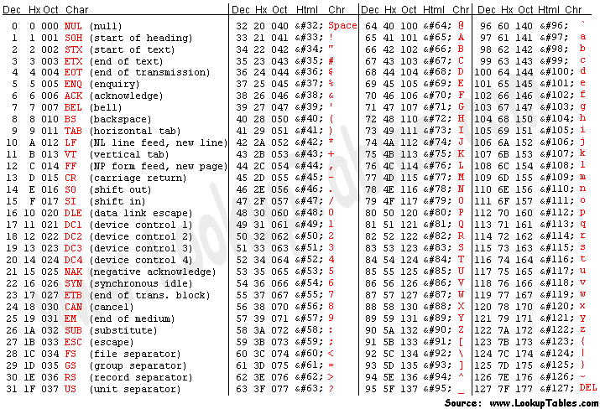
ASCII codes for \n and \r
‘\n’ is also called the line feed character (LF).
‘\r’ is called the carriage return character (CR).
Typewriters once had carriages.
The meaning of CR is: “go to the beginning of the line, but don’t go down a line.”

Slide 83
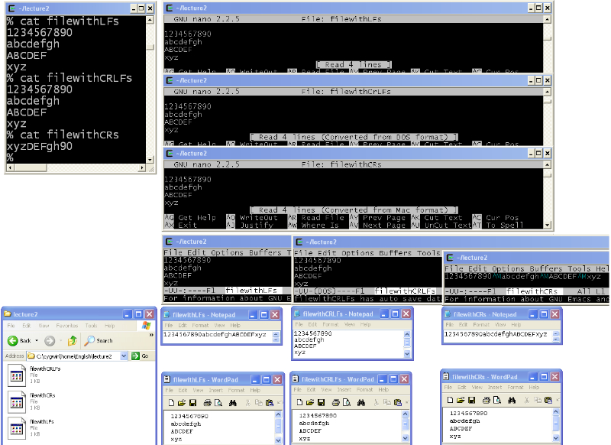
Here we see the contents of three files.
Here we see the contents of three files.
Here we see the contents of three files.
Notepad only displays the DOS-format file (filewithCRLFs) correctly. It just ignores LF and CR when by themselves. (Some versions of Notepad might display them as little black squares).
Now let’s look at the files in Windows…
Here is the folder. Notice its path. Your Cygwin home directory (if you use Cygwin) will be: “C:\cygwin\home\___\”
^M is how emacs indicates a carriage return character (emacs makes this display choice because there is no natural way to show the user that an unprintable character is in the file).
And it says filewithCRs was converted from MAC format.
This final file is not as small as it seems…
Wordpad always displays correctly.
So, if you want to edit you UNIX files in Windows, Wordpad is a good choice to use.
Wordpad always displays correctly.
So, if you want to edit you UNIX files in Windows, Wordpad is a good choice to use…
But look! Nano is displaying a message that filewithCRLFs was converted from DOS (i.e., Windows) format.
Let us see what these three files look like when viewed with nano and with emacs…
Thus, we now understand why the output came out the way it did.
The 3 nano displays all look identical. Each has 4 lines. So, indeed, that third file was not as small as it had seemed.
The 3 nano displays all look identical. Each has 4 lines. So, indeed, that third file was not as small as it had seemed.
The 3 nano displays all look identical. Each has 4 lines. So, indeed, that 3rd file was not as small as it had seemed.
And we also now understand why the file was named “filewithCRs”.
Two of the emacs displays look identical, with 4 lines each.
Two of these emacs displays look identical, with 4 lines each.
But the third is all on one line and has these colorful ^M symbols
83

Slide 84
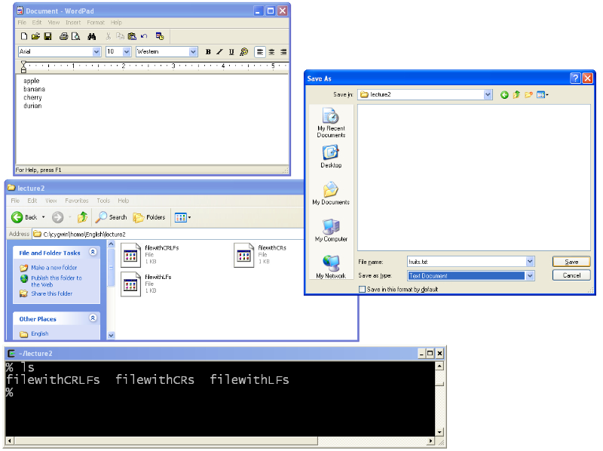
Let’s try it. Create a file with Wordpad.
I have to select Text Document. (When I did so it immediately put a .txt on my file whether I want it or not.)
So, let’s click the save button and then refresh the directory views...
I had to click around to get the desired folder, underneath C:\Cygwin\home\...
I haven’t saved it yet. That is why the file is not showing up in the directory.

Slide 85
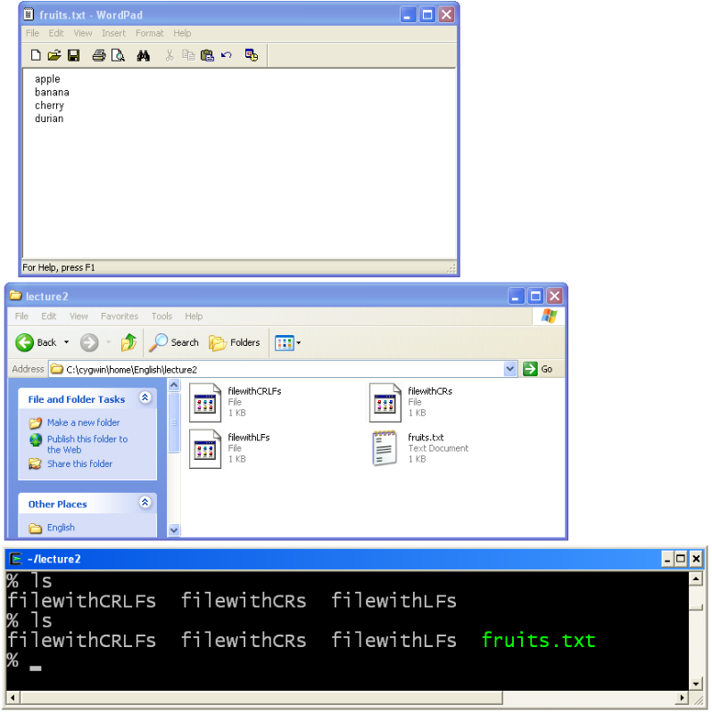
Let’s try it. Create a file with Wordpad.
So it is in the directory now. But it is DOS format and it has the “.txt” in it.

Slide 86
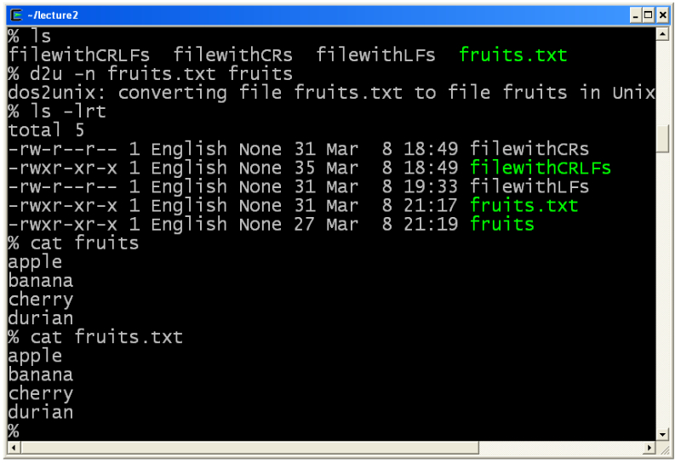
Fixing the format with d2u
But wait! Why does the old one also display correctly? It is because the CR is always immediately follows by an LF.
So there is no chance to do overwriting.
If you installed Cygwin you were told to select the dos2unix tool.
You have to remember the -n flag. The 1st argument is the old filename. The 2nd argument is the new (unix formatted) filename.
So it worked. See how the new file is 4 bytes smaller (because no ‘\r’ symbols).
Yep, it worked. The file displays correctly.

