Slide 1
UNIX
System Programming

Slide 2
Professor: Steve Haga
Office: F9037
Office Hours: Monday 12:00-2:30
Friday 10:00-12:00
Email: stevewhaga@cse.nsysu.edu.tw
(Please write the subject heading in English.)
TA: Shen Chih
Email: xhakman@gmail.com
TA: Blake
Email: ifonly0216@gmail. com

Slide 3
Course Requirements
Midterm
Final
Class Attendance Participation and Quizzes
Programming Assignments

Slide 4
Course Outline
Basic UNIX Commands
  cd, ls, mkdir, rmdir, cp, mv, cat, more, echo, diff, history
Redirection and Pipes
UNIX Prompt Patterns
  *, ?, [ ], ', ", and Environment Variables
Regular Expression Patterns (grep)
Extended Regular Expression Patterns (egrep)
C Shell Programming
The tr Command
The sed Command
The awk Command
Makefiles
The lex and yacc Commands
Bash Shell Programming

Slide 5
There are many reasons to learn UNIX/Linux
Quicker to perform tasks than in Windows
  But harder to learn
Fewer viruses
  Mostly because less popular
More research software
  But less consumer software
Used a lot in:
  Servers, laboratories, embedded systems, low budget systems (its free)

Slide 6
The Unix Philosophy
Provide many tools that each do one thing well
Use these tools together to form more powerful Unix commands
Let these tools communicate through files
  In Unix, everything is treated as a file that can be read from and written to
  Technically, the file communication is sometimes optimized away, by treating files as streams of bytes

Slide 7
Using the Command Line
GUIs (Graphical User Interfaces) are available and often used on Linux systems
But you must know the command line utilities, pipes, and I/O redirection in order to create UNIX script programs
Once you learn the UNIX command line, you often prefer it to the GUI, because it is so flexible and powerful

Slide 8
Introducing Unix Commands
Issue commands from a command prompt
Commands have
  A name
  Optional flags
  Arguments
Commands are typed in lowercase:
cat (concatenate) is different than Cat or CAT
cat filename displays the file

Slide 9
Introducing Unix Commands
Issue commands from a command prompt
Commands have
  A name
  Optional flags
  Arguments
Commands are typed in lowercase:
cat (concatenate) is different than Cat or CAT
cat filename <-- displays the file

Slide 10
Introducing Unix Commands
Issue commands from a command prompt
Commands have
  A name
  Optional flags
  Arguments
Commands are typed in lowercase:
cat (concatenate) is different than Cat or CAT
cat filename <-- displays the file

Slide 11
Viewing Files
cat <filename> - display a file on screen
cat -n <filename> - display with line numbers
more <filename> - to see a screenful at a time
less <filename> - a better version of more
(Because, in life, less is often better than more.)
head <filename> - display the first 10 lines of a file.
head -n <filename> - displays the first n lines.
tail <filename> - display the last 10 lines of a file.
tail -n <filename> - displays the last n lines.
This is the actual letter “n”
But these are places where you put a number. (That is why they are shown here in italics.)

Slide 12
File Names
CaSe sEnSiTiVe
It is unwise to make file names that use:
  spaces ( )
  commas (,)
  question marks (?)
  stars (*)
  dollars ($)
  forward slashes (/)
  backwards slashes (\)

Slide 13
A Simple Unix
Directory Structure
/
usr
etc
home
bin
var
...
local
bin
...
bill
steve
alice
...
subdir1
subdir2
...
Notes:
Hierarchy - parent/child relationship
Pwd
Cd allows us to move within this hierarchy

Slide 14
Special Directories
The Root Directory
/
The Home Directory (These are all equivalent) :
  /home/steve
  ~steve
  ~
A user generally has permission to access files within the home directory and its children.
Users start with their home directory as their current directory when they login.

Slide 15
Absolute & Relative Paths
Absolute:
every file has 1 -- and only 1 -- absolute path
starts with a “/” as the first character
  “/” is the root
  Comparable addressing exists in Windows
can use “~” to start the path at the user level
Relative:
describe path from current working directory
  Single dot (.) is the current directory
  Double dot (..) is the parent directory
  Comparable addressing exists in Windows

Slide 16
Navigating Unix
To move from a child to a parent directory:
cd ..
PARENT
CHILD

Slide 17
Navigating Unix
To move from a grandchild to a parent directory:
cd ../..
PARENT
CHILD
GRANDCHILD

Slide 18
Navigating Unix
To move from one child to a sibling directory:
cd ../child2
PARENT
CHILD1
CHILD2

Slide 19
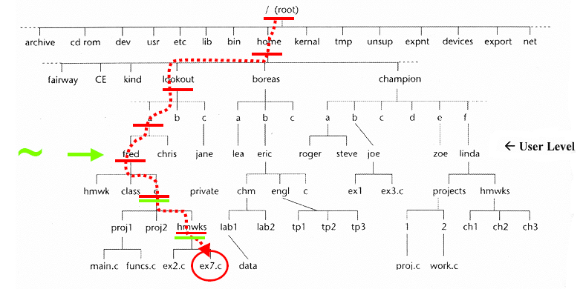
Absolute addressing
Absolute address of file ex7.c: /home/lookout/a/fred/c/hmwrks/ex7.c
With the ~ shortcut: ~/c/hmwrks/ex7.c

Slide 20
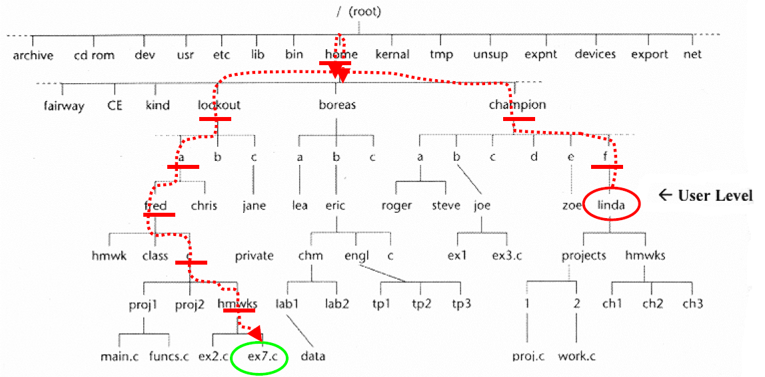
Relative addressing
Relative address, if your working directory is “linda”:
../../../../home/lookout/a/fred/c/hmwrks/ex7.c
or better would be: ../../../lookout/a/fred/c/hmwrks/ex7.c

Slide 21
Changing Directories
cd(Change Directory) is used to change directories
Paths can be relative or absolute
  % cd /home/steve/subdir1 ← an absolute path
  % cd ← equivalent to “cd ~”
  % cd - ← change back to previous
  % cd ~/subdir1 ← a path relative to your home
  % cd ../subdir2 ← a relative path
(“..” is the parent directory.)
pwd (Present Working Directory) shows the current directory
  % pwd
  /home/steve/subdir2
Notes:
Example of relative and absolute paths
Pwd
Cd
.
..

Slide 22
Other Basic Commands
ls | Lists all files in a directory
cp -p | Copies files
mv | Moves files
rm -iIf | Deletes files
mkdir | Makes a directory
rmdir rm -r | Removes a directory (must be empty) Removes directory and everything below it

Slide 23
Other Basic Commands
ls | Lists all files in a directory
cp -p | Copies files
mv | Moves files
rm -iIf | Deletes files
mkdir | Makes a directory
rmdir rm -r | Removes a directory (must be empty) Removes directory and everything below it

Slide 24
The List Command
The list command (ls) shows the contents of a directory
We can add flags to the list command to modify what the command can does
To use more than one flag, concatenate them:
ls -lt

Slide 25
List Command Flags
ls –l shows files in long format, including permissions
ls –a shows hidden files
ls –c shows file listings in a column format
ls –t sorts file listings by last modified date
ls –r reverses the listing order
I often use “ls –lrt”
  It puts the most recently modified files at the bottom, where they are easy to see

Slide 26
Other Basic Commands
ls | Lists all files in a directory
cp -p | Copies files
mv | Moves files
rm -iIf | Deletes files
mkdir | Makes a directory
rmdir rm -r | Removes a directory (must be empty) Removes directory and everything below it
This flag preserves the original file’s date

Slide 27
The Unix Copy Command
cp can be used to make a copy of a file, leaving the original file untouched
Syntax:
cp oldfile [path/]newfile

Slide 28
The Unix Copy Command
To make a copy of a file while both the original and copy are in the same directory:
cp index.html home.html

Slide 29
The Unix Copy Command
To make a copy of a file that results in the copy retaining the original’s name, but being placed in a different directory:
cp index.html ../academic/

Slide 30
The Unix Copy Command
To make a copy of a file that results in the copy having a new name and being placed in a different directory:
cp index.html ../academic/home.html

Slide 31
The Unix Copy Command
To copy multiple files at once, the final argument must be a directory (otherwise it would not make sense):
cp f1 f2 otherfile ../academic/

Slide 32
Specifying filenames with Wildcards
Wildcards are special symbols that can substitute for multiple things
The term comes from poker terminology
  eg, “aces are wild” means that an ace can be substituted for any card you want – it is a wildcard.

Slide 33
The * and ? Wildcards
ls a* All files starting with 'a'
ls *a* All filenames with 'a' in them
ls *a*html All filenames with 'a' in them and ending with html
ls ????? - All 5 character filenames

Slide 34
The […] and [^…] Wildcards
ls [abc]* - All filenames starting with a, b, or c
ls [a-c]* - Same as above but done as a range
ls [^a-c]* - All filenames not starting with a, b, or c

Slide 35
Understanding Wildcards
Suppose we type:
ls f*
and get:
file1 file2 funfile
This tells us that three files in our current directory begin with an “f”
Now, suppose we type:
cp f* f*
then we get:
cp: target `funfile’ is not a directory
We want to understand what just happened. The UNIX operating system has replaced each f* with what it really is

Slide 36
Understanding Wildcards
Suppose we type:
ls f*
and get:
file1 file2 funfile
This tells us that three files in our current directory begin with an “f”
Now, suppose we type:
cp f* f*
then we get:
cp: target `funfile’ is not a directory
We want to understand what just happened. The UNIX operating system has replaced each f* with what it really is

Slide 37
Understanding Wildcards
Suppose we type:
ls f*
and get:
file1 file2 funfile
This tells us that three files in our current directory begin with an “f”
Now, suppose we type:
cp f* f*
then we get:
cp: target `funfile’ is not a directory
We want to understand what just happened. The UNIX operating system has replaced each f* with what it really is

Slide 38
Understanding Wildcards
Suppose we type:
ls f*
and get:
file1 file2 funfile
This tells us that three files in our current directory begin with an “f”
Now, suppose we type:
cp f* f*
then we get:
cp: target `funfile’ is not a directory
We want to understand what just happened. The UNIX operating system has replaced each f* with what it really is

Slide 39
Understanding Wildcards
Suppose we type:
ls f*
and get:
file1 file2 funfile
This tells us that three files in our current directory begin with an “f”
Now, suppose we type:
cp f* f*
then we get:
cp: target `funfile’ is not a directory
We want to understand what just happened.
The UNIX operating system has replaced each f*
with what it really is

Slide 40
Understanding Wildcards
Suppose we type:
ls f*
and get:
file1 file2 funfile
This tells us that three files in our current directory begin with an “f”
Now, suppose we type:
cp f* f*
then we get:
cp: target `funfile’ is not a directory
We want to understand what just happened.
The UNIX operating system has replaced each f*
with what it really is
file1 file2 funfile
f*
f*

Slide 41
Understanding Wildcards
Suppose we type:
ls f*
and get:
file1 file2 funfile
This tells us that three files in our current directory begin with an “f”
Now, suppose we type:
cp f* f*
then we get:
cp: target `funfile’ is not a directory
We want to understand what just happened.
The UNIX operating system has replaced each f*
with what it really is
file1 file2 funfile
file1 file2 funfile
f*
f*

Slide 42
Understanding Wildcards
Suppose we type:
ls a*
and get:
aa ab adirectory
This tells us that three “things” in our current directory begin with an “a”. The third among them is not a file.
Now, suppose we type:
cp a* a*f*
then we get:
cp: omitting directory `a3’
cp: warning: source file `a1’ specified more than once
cp: warning: source file `a2’ specified more than once
Why?

Slide 43
Understanding Wildcards
Suppose we type:
ls a*
and get:
aa ab adirectory
This tells us that 3 “things” in our current directory begin with “a”. The third among them is probably not a file.
Now, suppose we type:
cp a* a*f*
then we get:
cp: omitting directory `a3’
cp: warning: source file `a1’ specified more than once
cp: warning: source file `a2’ specified more than once
Why?

Slide 44
Understanding Wildcards
Suppose we type:
ls a*
and get:
aa ab adirectory
This tells us that 3 “things” in our current directory begin with “a”. The third among them is probably not a file.
Now, suppose we type:
cp a* a*
then we get:
cp: omitting directory `adirectory’
cp: warning: source file `aa’ specified more than once
cp: warning: source file `ab’ specified more than once
Why?

Slide 45
Understanding Wildcards
Suppose we type:
ls a*
and get:
aa ab adirectory
This tells us that 3 “things” in our current directory begin with “a”. The third among them is probably not a file.
Now, suppose we type:
cp a* a*
then we get:
cp: omitting directory `adirectory’
cp: warning: source file `aa’ specified more than once
cp: warning: source file `ab’ specified more than once
Why?

Slide 46
Understanding Wildcards
Suppose we type:
ls a*
and get:
aa ab adirectory
This tells us that 3 “things” in our current directory begin with “a”. The third among them is probably not a file.
Now, suppose we type:
cp a* a*
then we get:
cp: omitting directory `adirectory’
cp: warning: source file `aa’ specified more than once
cp: warning: source file `ab’ specified more than once
Why?

Slide 47
Understanding Wildcards
Suppose we type:
ls a*
and get:
aa ab adirectory
This tells us that 3 “things” in our current directory begin with “a”. The third among them is probably not a file.
Now, suppose we type:
cp aa ab adirectory aa ab adirectory
then we get:
cp: omitting directory `adirectory’
cp: warning: source file `aa’ specified more than once
cp: warning: source file `ab’ specified more than once
Why?

Slide 48
Understanding Wildcards
Suppose we type:
ls a*
and get:
aa ab adirectory
This tells us that 3 “things” in our current directory begin with “a”. The third among them is probably not a file.
Now, suppose we type:
cp aa ab adirectory aa ab adirectory
then we get:
cp: omitting directory `adirectory’
cp: warning: source file `aa’ specified more than once
cp: warning: source file `ab’ specified more than once
Why?

Slide 49
Understanding Wildcards
Suppose we type:
ls a*
and get:
aa ab adirectory
This tells us that 3 “things” in our current directory begin with “a”. The third among them is probably not a file.
Now, suppose we type:
cp aa ab adirectory aa ab adirectory
then we get:
cp: omitting directory `adirectory’
cp: warning: source file `aa’ specified more than once
cp: warning: source file `ab’ specified more than once
Why?

Slide 50

Understanding Wildcards
Suppose we type:
ls a*
and get:
aa ab adirectory
This tells us that 3 “things” in our current directory begin with “a”. The third among them is probably not a file.
Now, suppose we type:
cp aa ab adirectory aa ab adirectory
then we get:
cp: omitting directory `adirectory’
cp: warning: source file `aa’ specified more than once
cp: warning: source file `ab’ specified more than once
Why?
Because it does not make sense to copy a directory (cp only works on files). So cp will ignore this.

Slide 51

Understanding Wildcards
Suppose we type:
ls a*
and get:
aa ab adirectory
This tells us that 3 “things” in our current directory begin with “a”. The third among them is probably not a file.
Now, suppose we type:
cp aa ab adirectory aa ab adirectory
then we get:
cp: omitting directory `adirectory’
cp: warning: source file `aa’ specified more than once
cp: warning: source file `ab’ specified more than once
Why?
Because it does not make sense to copy a directory (cp only works on files). So cp will ignore this.
adirectory

Slide 52
Understanding Wildcards
Suppose we type:
ls a*
and get:
aa ab adirectory
This tells us that 3 “things” in our current directory begin with “a”. The third among them is probably not a file.
Now, suppose we type:
cp aa ab adirectory aa ab adirectory
then we get:
cp: omitting directory `adirectory’
cp: warning: source file `aa’ specified more than once
cp: warning: source file `ab’ specified more than once
Why?

Slide 53

Understanding Wildcards
Suppose we type:
ls a*
and get:
aa ab adirectory
This tells us that 3 “things” in our current directory begin with “a”. The third among them is probably not a file.
Now, suppose we type:
cp aa ab adirectory aa ab adirectory
then we get:
cp: omitting directory `adirectory’
cp: warning: source file `aa’ specified more than once
cp: warning: source file `ab’ specified more than once
Why?
Because you can copy a file twice, if you want, but it has no benefit. The 2nd one is dropped
aa

Slide 54
Understanding Wildcards
Suppose we type:
ls a*
and get:
aa ab adirectory
This tells us that 3 “things” in our current directory begin with “a”. The third among them is probably not a file.
Now, suppose we type:
cp aa ab adirectory aa ab adirectory
then we get:
cp: omitting directory `adirectory’
cp: warning: source file `aa’ specified more than once
cp: warning: source file `ab’ specified more than once
Why?
ab
Same thing.

Slide 55
Understanding Wildcards
Suppose we type:
ls a*
and get:
aa ab adirectory
This tells us that 3 “things” in our current directory begin with “a”. The third among them is probably not a file.
Now, suppose we type:
cp aa ab adirectory aa ab
then we get:
cp: omitting directory `adirectory’
cp: warning: source file `aa’ specified more than once
cp: warning: source file `ab’ specified more than once
So, what is the effect of this command?
adirectory
Well, lets suppose that we then type:
cd adirectory
ls a*
Then we would get:
aa ab

Slide 56
Other Basic Commands
ls | Lists all files in a directory
cp -p | Copies files
mv | Moves files
rm -iIf | Deletes files
mkdir | Makes a directory
rmdir rm -r | Removes a directory (must be empty) Removes directory and everything below it

Slide 57
mv
To move a file from one directory to another:
mv index.html ../friends/
To rename a file (stays in the same directory):
mv index.html home.html
To move a file and rename it at the same time:
mv index.html ../friends/home.html

Slide 58
Other Basic Commands
ls | Lists all files in a directory
cp -p | Copies files
mv | Moves files
rm | Deletes files
mkdir | Makes a directory
rmdir rm -iIfr | Removes a directory (must be empty) Removes directory and everything below it

Slide 59
rm
To delete a directory and all its subdirectories:
rm –r directoryName
Please note that UNIX gives you great power. But Spiderman reminds us that with great power comes great responsibility.
  DO NOT TYPE THIS: rm –r ~
Just 7 characters and now everything is gone (if your system’s rm defaults to -f).
  (Things like this don’t happen in Windows, because Microsoft doesn’t trust you with power.)

Slide 60
rm
Q:How can we change the default settings?
A: Aliases that run at startup
To delete a single file:
rm index.html
(answer Y to confirm delete, if it asks)
(whether it asks depends on your settings)
To guarantee there will be no such asking:
rm –f index.html
To guarantee that you get asked:
rm –i *.html
rm –I *.html
Prompts before every removal
Prompts only once and only when removing 3 or more

Slide 61
Other Basic Commands
ls | Lists all files in a directory
cp -p | Copies files
mv | Moves files
rm -iIf | Deletes files
mkdir | Makes a directory
rmdir rm -r | Removes a directory (must be empty) Removes directory and everything below it

Slide 62
Homework
1. Set up linux on whatever computer you want
  It can be an ssh into a UNIX system
  It can be a boot partition on your computer
  It can be on a bootable USB memory stick
  It can be a Cygwin terminal
    When installing, you will have many options. You should make sure that you select the options to:
      install tcsh (found under “Shells”)
      install ncurses (found under “Utils”)
      Install dos2unix (found under “Utils”)
      install emacs and nano (found under “Editors”)
2. Practice each of the commands discussed in these lecture notes. In particular, try the “ls” command with different flags and the wildcards.
  Note: This also will let you verifying the installation

