Slide 1
SofameHack2019
Data Mining Project
Marvin Fourastié
Patrick Sardinha

Slide 2
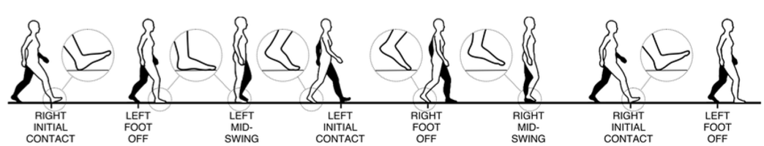
Challenge

Slide 3
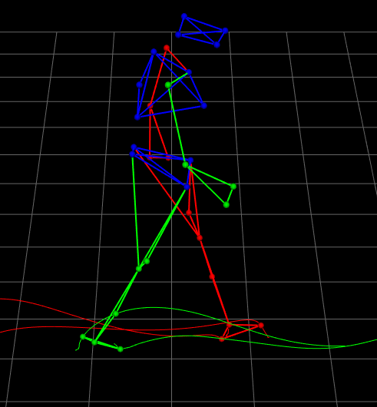
Datas

Slide 4
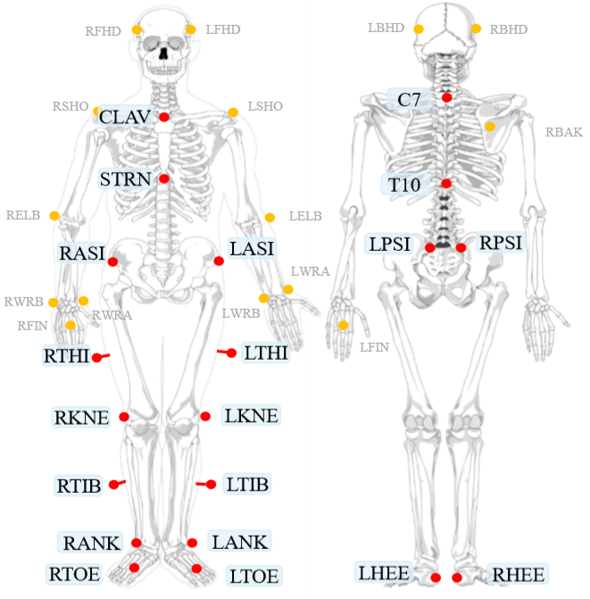

Sensors

Slide 5
Decision Tree Classifier

Slide 6
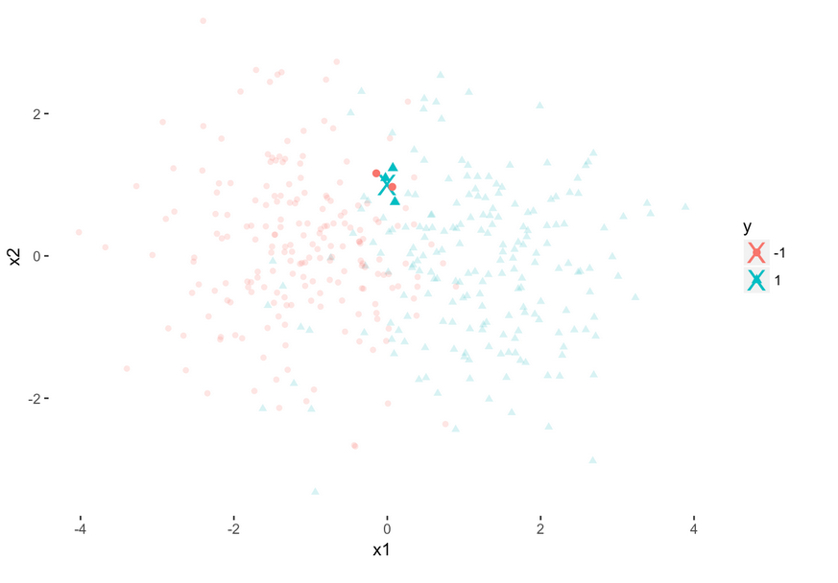
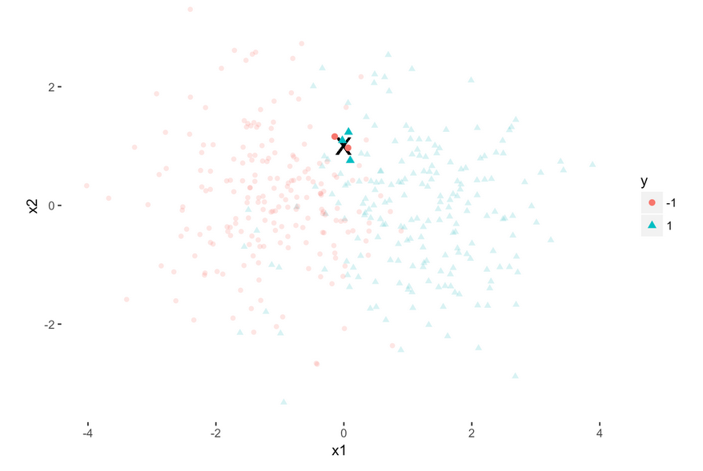
K-nearest-neighbors Classifier

Slide 7
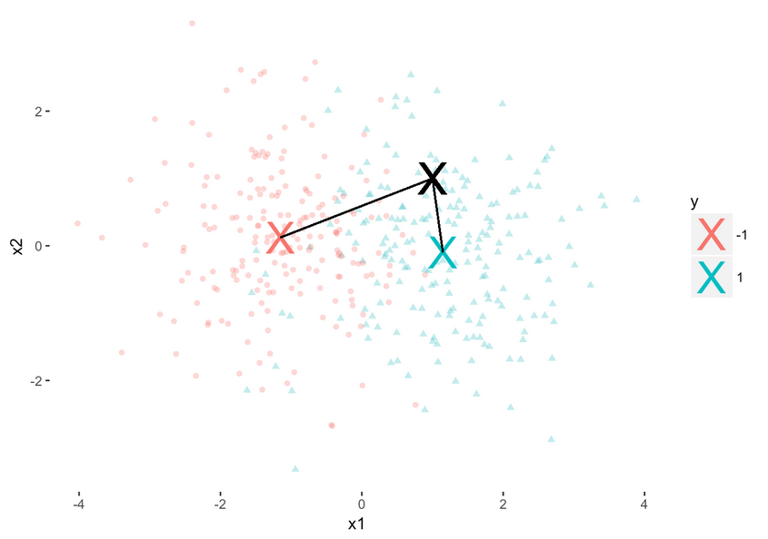
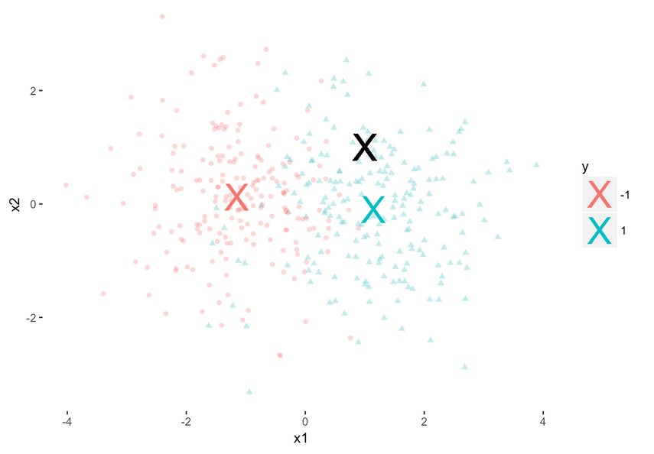
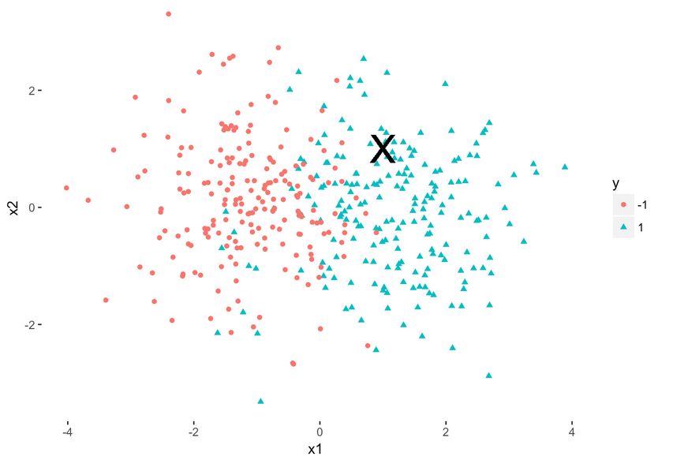
Nearest Centroid Classifier

Slide 8




Explanation of our algorithm
Learn by pathology
Selection of sensors
Get ranges
Annotation according to intervals

Slide 9
Intervals
Foot Off
Foot Off
Foot Strike
Foot Off
Foot Off
Foot Strike
No event
No event
No event
Foot Strike
Foot Off
Foot Off
Foot Strike
Foot Strike
Foot Off
Foot Strike
Foot Strike

Slide 10
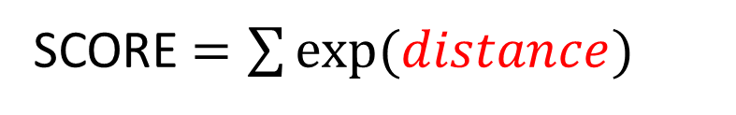
Score
SCORE $=\sum{exp⁡(distance)}$
Predicted event
Real event
distance

Slide 11
Cross validation
TEST
TRAIN
TRAIN
TEST
TRAIN
TRAIN
TEST

Slide 12
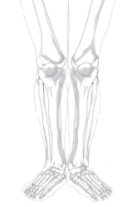
Results CP
 | Permutation 1 | Permutation 2 | Permutation 3
Score FO | 2.35e+17 | 1.21e+06 | 4.76e+05
Score FS | 5.40e+12 | 1.34e+09 | 7.89e+04
Score Global | 2.35e+17 | 1.34e+09 | 5.55e+05
HEE
ANK
LTOE(z) – RTOE(z)
TOE
Mean Score Global :
7.85e+16

Slide 13
Results FD
 | Permutation 1 | Permutation 2 | Permutation 3
Score FO | 8.99e+06 | 2.07e+02 | 6.01e+04
Score FS | 3.44e+03 | 2.17e+02 | 2.38e+03
Score Global | 9.00e+06 | 4.24e+02 | 6.25e+04
HEE
ANK
TOE
Mean Score Global :
3.02e+06

Slide 14
Results ITW
THI
 | Permutation 1 | Permutation 2 | Permutation 3
Score FO | 8.63e+15 | 3.67e+19 | 7.97e+20
Score FS | 4.20e+25 | 2.01e+18 | 1.30e+20
Score Global | 4.20e+25 | 3.87e+19 | 9.27e+20
TIB
HEE
LTOE(z) – RTOE(z)
TOE
Mean Score Global :
1.40e+25

Slide 15


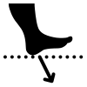
Improvements
Amont of data
Modify sensors for learning
Event predictions

