Slide 1
Make FunBlocks alive
Marvin FOURASTIE
Master project

Slide 2




Motivations
Educational purpose
Imperative paradigm alternative
Based on rewrite systems
FunBlocks
Notes:
Educ purpose :
- concept of programming (data structures, state, calculabilité/complexité)
- Automation of solving a task
Alternative :
- Focus on the nature of the problem (“what”)
- explicit state of the problem
Rewrite system :
- Intuitive model for state transformation
- Declarative -> better look at computability theories

Slide 3
Road Map
February 2021
June 2021
State of the art
Test existing tools
Implementation
Report writing
95 jours
81 jours
2020

Slide 4

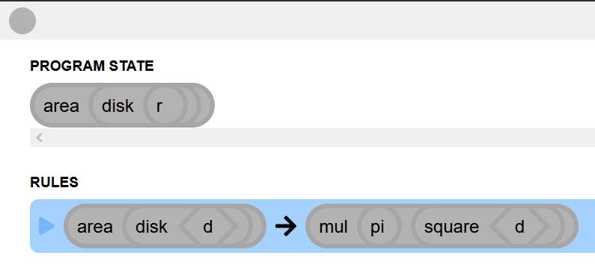
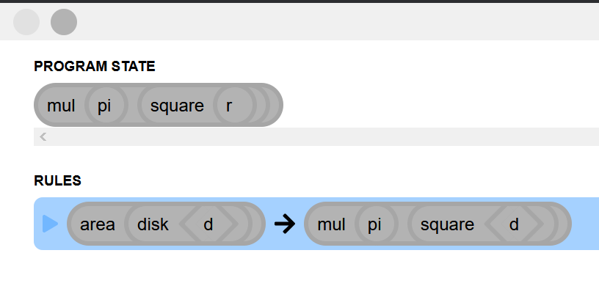
FunBlocks
Notes:
Init -> state of the program
Case -> rewrite system

Slide 5
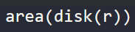

FunBlocks
Declarative paradigm
Based on rewrite systems
Static typing
Notes:
Declarative -> terms (literal/constants, variables, functions)
Rewrite -> steps for state transformations
Static -> untype/typed by function/explicitly typed

Slide 6
Goals
Provide users with valuable insights about their program
Verification of rewrite systems
Notes:
Valuable insights -> indice pour écrire le program correctement

Slide 7
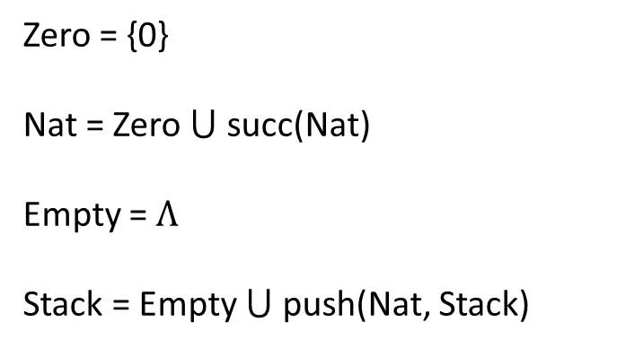
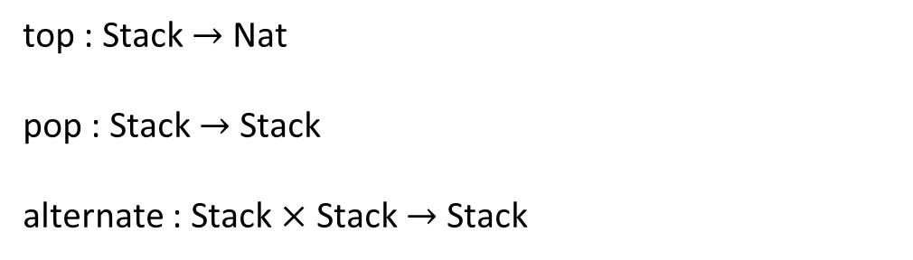
Rewrite systems
Stack operators
Zero = {0}
Nat = Zero $⋃$ succ(Nat)
Empty = $Λ$
Stack = Empty $⋃$ push(Nat, Stack)
top : Stack $→$ Nat
pop : Stack $→$ Stack
alternate : Stack $×$ Stack $→$ Stack
Notes:
Top -> first element
Pop -> remove first
Alternate -> merge 2 stacks

Slide 8
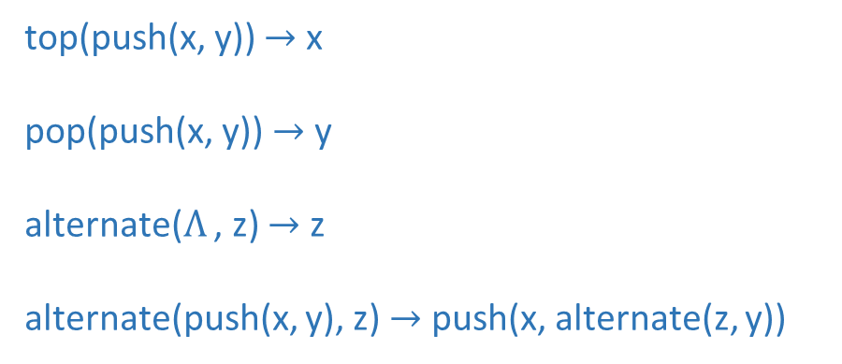
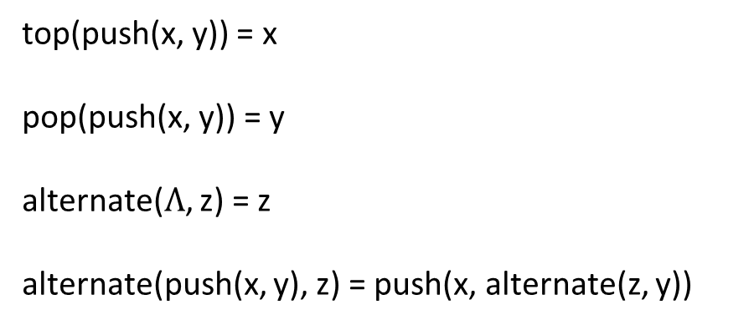
Rewrite systems
Canonical rewrite system
top(push(x, y)) = x
pop(push(x, y)) = y
alternate($Λ$, z) = z
alternate(push(x, y), z) = push(x, alternate(z, y))
top(push(x, y)) $→$ x
pop(push(x, y)) $→$ y
alternate($Λ$ , z) $→$ z
alternate(push(x, y), z) $→$ push(x, alternate(z, y))
Notes:
The central idea of rewriting is to impose directionality on the use of equations in proofs
Evaluer les termes
Pas forcément de mapping direct

Slide 9
Rewrite systems
Termination
Confluence
Soundness
Completeness
Correctness
Undecidable in general
Notes:
Five desirable properties involved in the verification of rewrite systems
are:
(1) termination--no infinite derivations are possible,
(2) confluence--each term has at most one normal form,
(3) soundness--terms are only rewritten to equal terms, (the equation l = r is valid in E)
(4) completeness--equal terms have the same normal form,
(5) correctness--all normal forms satisfy given requirements.

Slide 10
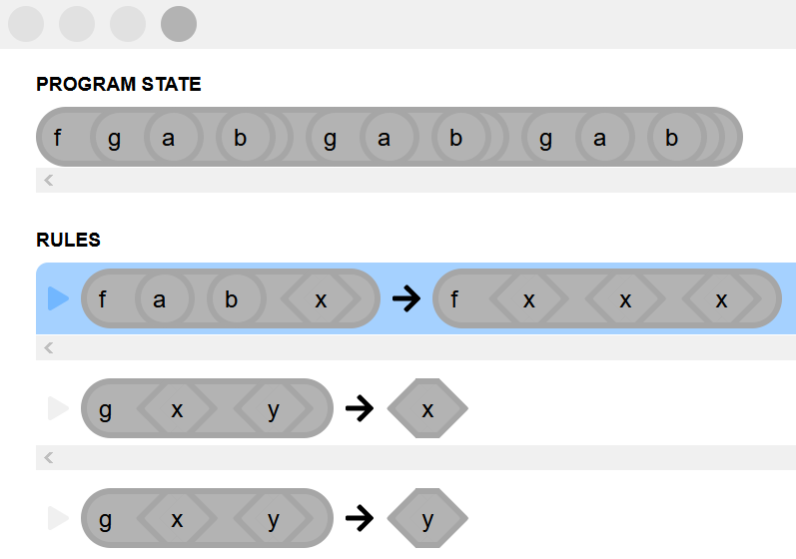
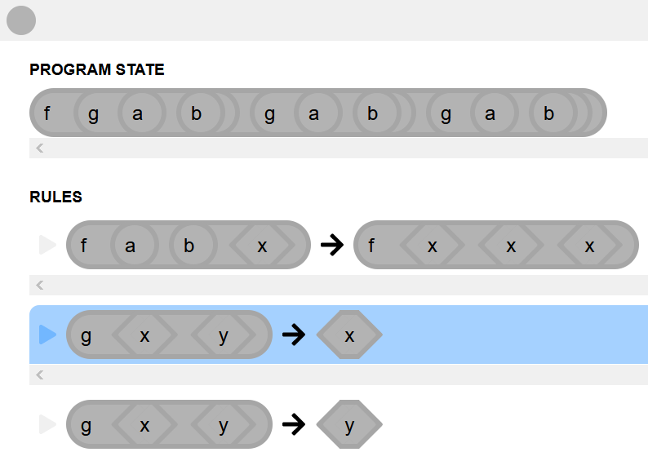
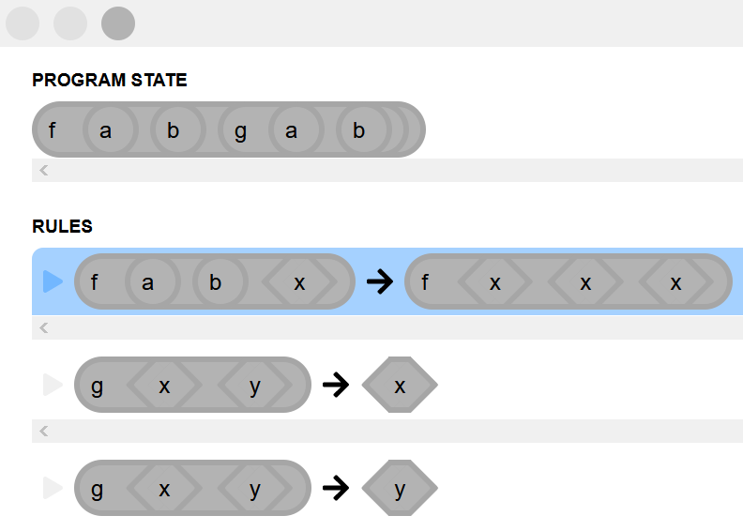
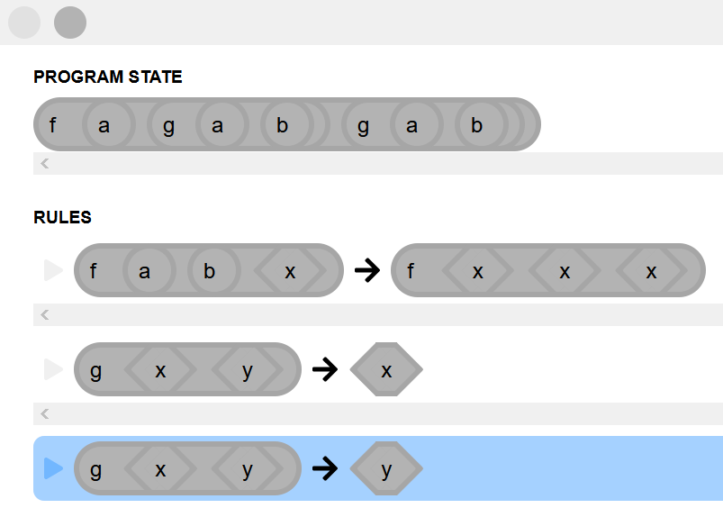
Termination
Initial state

Slide 11
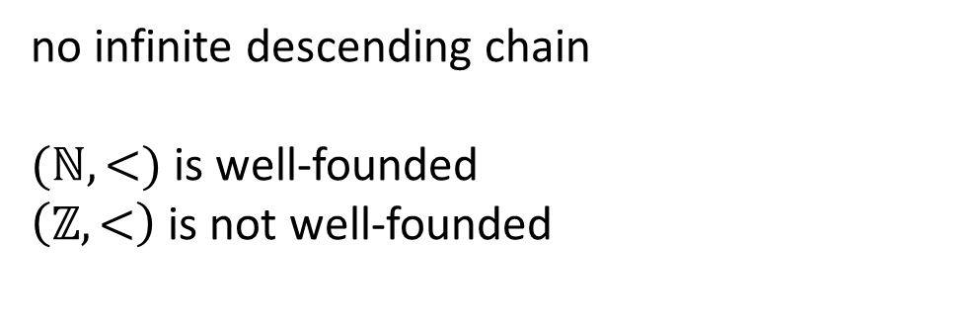
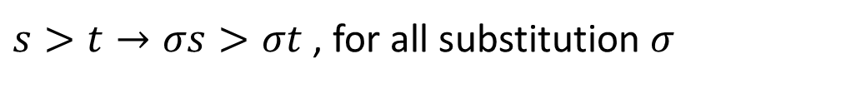
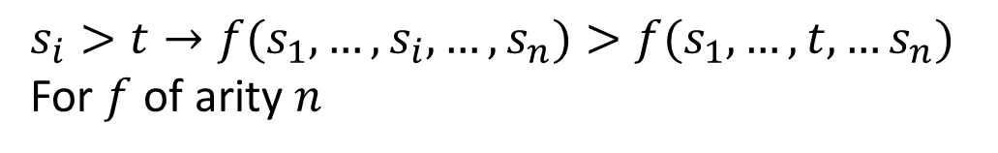
Reduction order
Monotone
Close under substitution
Well-founded
$$s_{i}>t→f(s_{1},…,s_{i},…,s_{n})>f(s_{1},…, t, …s_{n})$$
For $f$of arity $n$
$s>t→σs>σt$ , for all substitution $σ$
no infinite descending chain
$(ℕ, <)$ is well-founded
$\left(ℤ, <\right)$ is not well-founded
Notes:
Well-founded -> toujours comparable et $∃$ plus petit élément (no infinite descending chain)

Slide 12
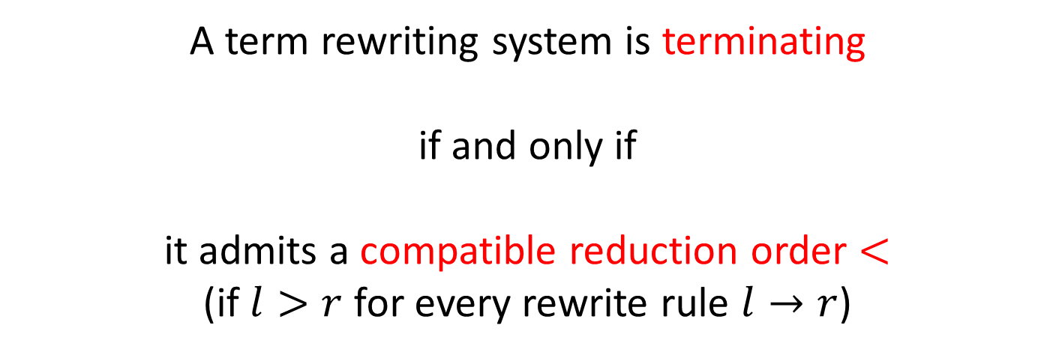
Termination
A term rewriting system is terminating
if and only if
it admits a compatible reduction order $<$
(if $l>r$ for every rewrite rule $l→r$)
Verification of termination

Slide 13
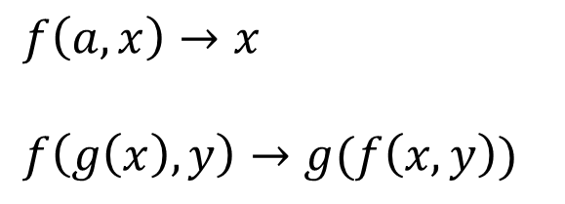
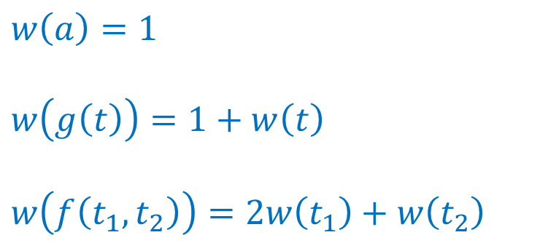
Polynomial interpretation
$$w\left(a\right)=1$$
$$w\left(g\left(t\right)\right)=1+w\left(t\right)$$
$$w\left(f\left(t_{1},t_{2}\right)\right)=2w\left(t_{1}\right)+w\left(t_{2}\right)$$
$$f\left(a,x\right)→x$$
$$f\left(g\left(x\right),y\right)→g(f\left(x,y\right))$$
weight
Notes:
Each term mapping to polynome

Slide 14









Polynomial interpretation
$$f\left(a,x\right)→x$$
$$f\left(g\left(x\right),y\right)→g(f\left(x,y\right))$$
$$w\left(f\left(a,x\right)\right)=2+w(x)$$
$$w(f\left(g\left(x\right),y\right))=2+2w\left(x\right)+w(y)$$
$$w\left(x\right)=w(x)$$
$$w\left(g(f(x,y)\right)=1+2w\left(x\right)+w(y)$$
$$w\left(f\left(a,x\right)\right)>w(x)$$
$$w(f\left(g\left(x\right),y\right))>w(g(f\left(x,y\right))$$
Reduction order $→$ Termination

Slide 15
Algorithms
Recursive Path Ordering
Knuth-Bendix Ordering
Dependency pairs
Order based on the mutisets
Based on weights assigned to operators
Prove innermost termination
Notes:
RPO variante = LPO => ordre lexicographique sur les arguments
compare left-hand sides
with special subterms of the right-hand sides -> create dependency pairs -> detect infinite chaining

Slide 16


Termination
Direct proof
(polynomial, LBO, KBO,…)
Dependency pairs and size-change principle
Notes:
If every infinite computation would give rise to an infinitely decreasing value sequence (according to the size-change graphs), then no infinite computation is possible

Slide 17
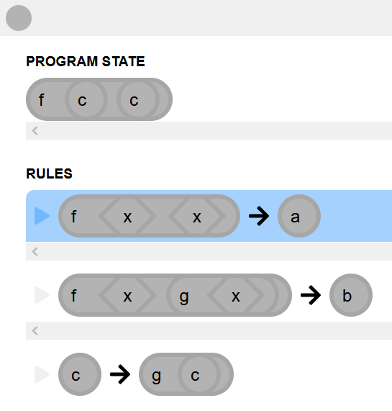
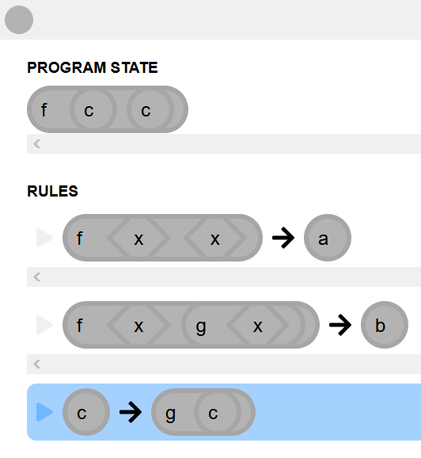
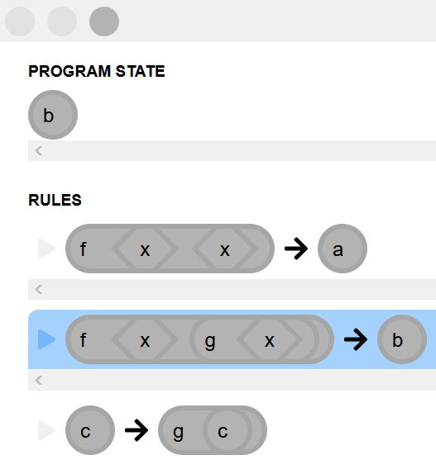
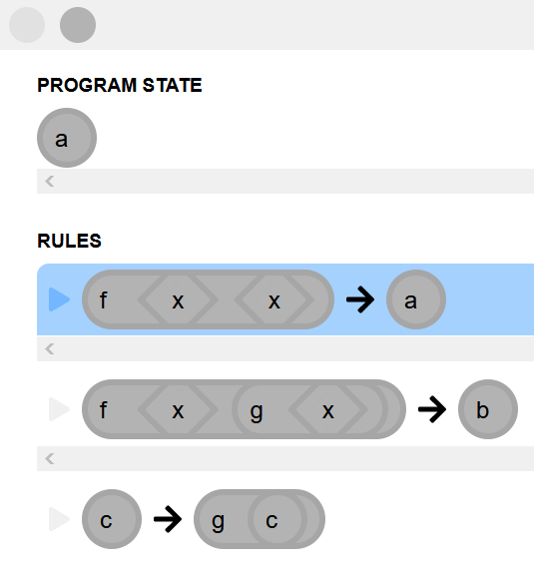
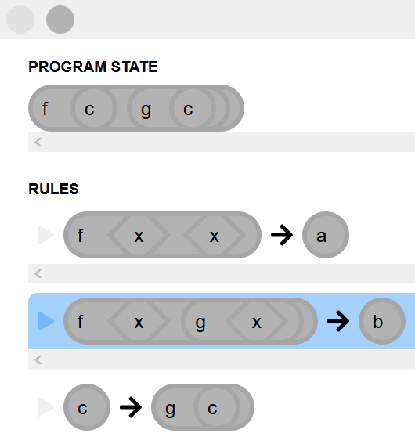
Confluence

Slide 18
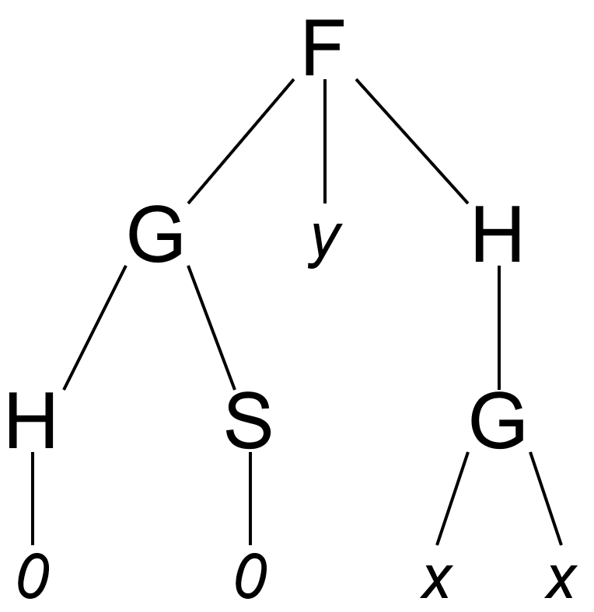
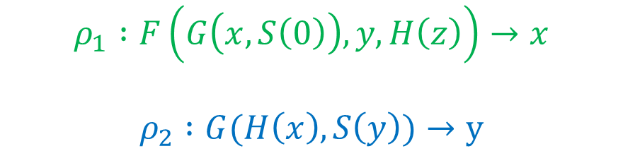
Overlap and critical pairs
$$ρ_{1} :F\left(G\left(x,S\left(0\right)\right),y,H\left(z\right)\right)→x$$
$$ρ_{2} :G(H\left(x\right),S\left(y\right))→y$$
Notes:
Overlapping existing with these rules

Slide 19
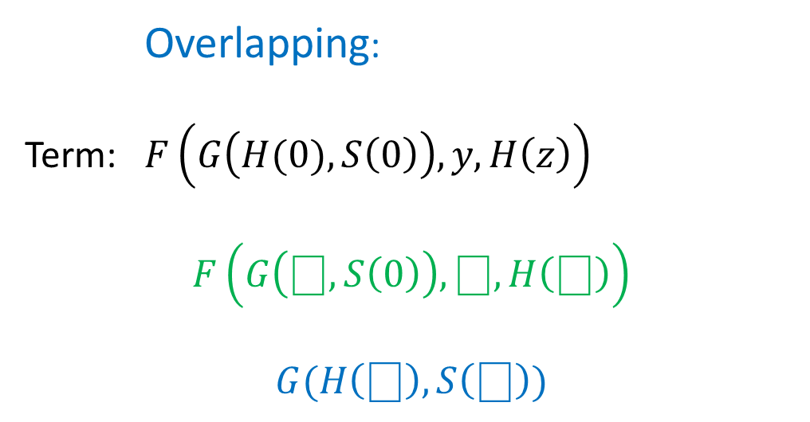
Overlap and critical pairs
Overlapping:
Term: $F\left(G\left(H(0),S\left(0\right)\right),y,H\left(z\right)\right)$
$$F\left(G\left(⎕,S\left(0\right)\right),⎕,H\left(⎕\right)\right)$$
$$G(H\left(⎕\right),S\left(⎕\right))$$
Notes:
Term initial -> can apply rules on same terms

Slide 20

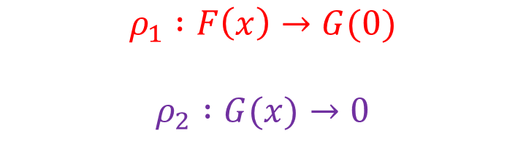




Overlap and critical pairs
Overlapping
$$F(G\left(0\right))$$
$$ρ_{1} :F\left(x\right)→G(0)$$
$$ρ_{2} :G(x)→0$$
$$ρ_{1}$$
$$ρ_{2}$$
$$G(0)$$
$$F(0)$$
$<G(x),F(x)>$ is called critical pair
Notes:
Critical pair: x et le terme F(G(x)) avec substitution p2
Divergent + non-confluent

Slide 21
Critical Pair Lemma
A terminating rewriting system is confluent
if and only if
all critical pairs are convergent
Notes:
Bleu = condition

Slide 22


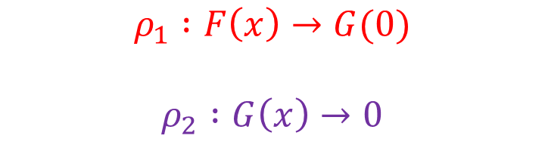








Critical Pair Lemma
$$F(G\left(0\right))$$
$$ρ_{1}$$
$$ρ_{2}$$
$$ρ_{1} :F\left(x\right)→G(0)$$
$$ρ_{2} :G\left(x\right)→0$$
$$G(0)$$
$$F(0)$$
$$ρ_{1}$$
$$ρ_{2}$$
$$G(0)$$
$$ρ_{2}$$
Convergence
$$0$$
Notes:
Algorithm pour verifier la confluence d’un TRS
Compute all canonical form of each term and verify s(t1) = s(t2)

Slide 23
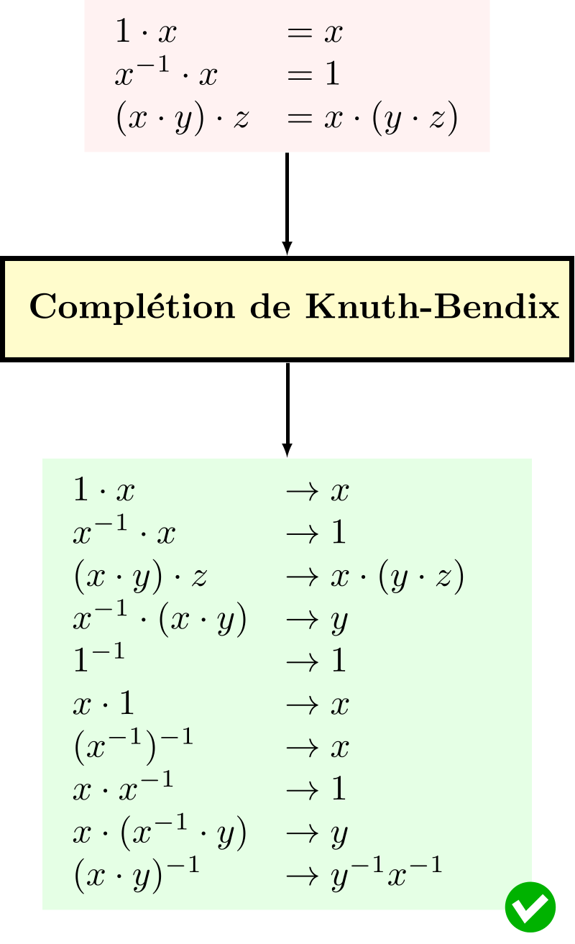
Knuth-Bendix completion
Input:
A set of equation
A reduction ordering <
Non-confluent
Notes:
Create a system confluent and terminating
Ordre de reduction < (each term is rewrote “simpler”)
Spécification des groups multiplicatifs

Slide 24
Knuth-Bendix completion
Output:
Terminate successfully
Loop indefinitely
Fail
Terminating and confluent rewrite system
Non-terminating rewrite system
Rule which cannot be ordered
(i.e. commutative operator)
Notes:
Create a system confluent and terminating
Ordre de reduction < (each term is rewrote “simpler”)
Spécification des groups multiplicatifs

Slide 25




Knuth-Bendix completion
Basic rules:
Orienting
Adding
Simplifying
Deleting
Transform $s=t$ to $s→t$
Add $s=t$ in the set of equation
Simplify $s=t$ in $s′=t′$
Delete trivial rules $s=s$
Notes:
Simplifying -> use of critical pairs and orientation

Slide 26
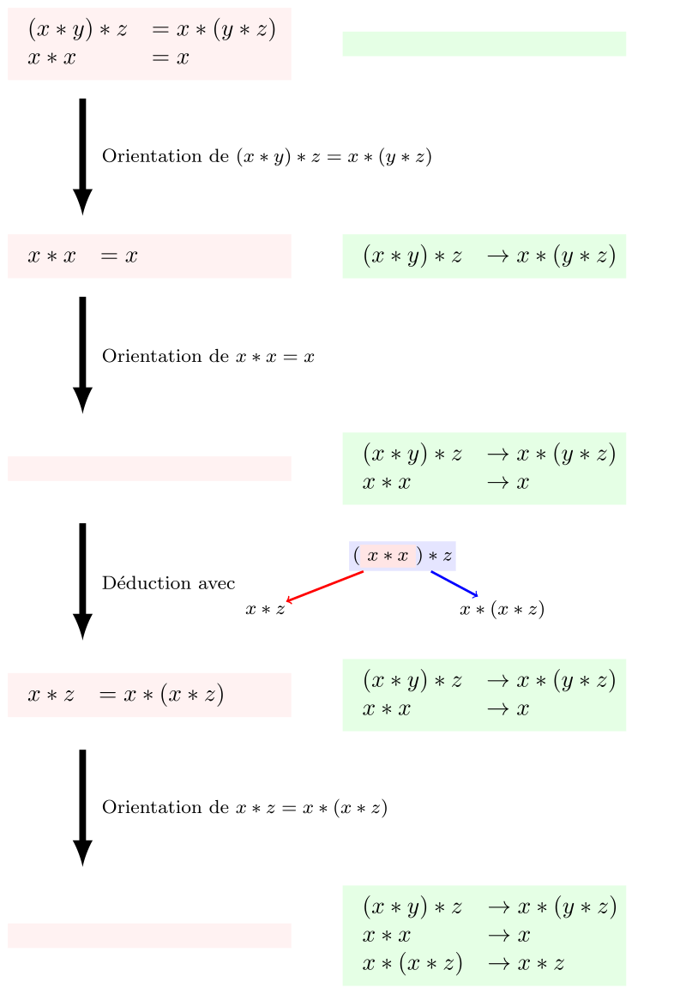

Knuth-Bendix completion
Adding
Add $s=t$ in the set of equation
New rule added
No convergent
Notes:
Simplifying -> use of critical pairs and orientation
Overlapping and divergence (impossible to converge)

Slide 27
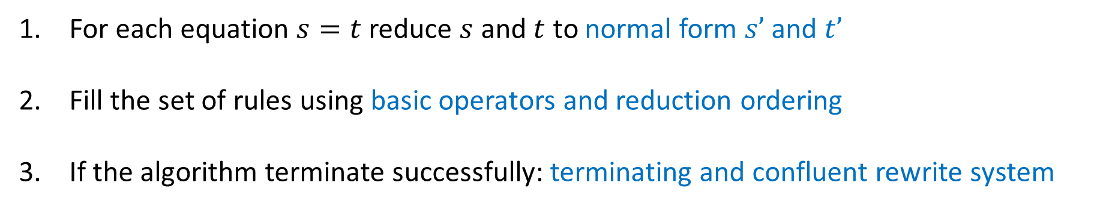
Knuth-Bendix completion
Completion process:
For each equation $s=t$reduce $s$ and $t$ to normal form $s’$and $t’$
Fill the set of rules using basic operators and reduction ordering
If the algorithm terminate successfully: terminating and confluent rewrite system
Notes:
Set of equation -> TRS

Slide 28
Knuth-Bendix completion
Completion for axioms of groups:
Notes:
Set of equation -> TRS

Slide 29


Educational tools
CSI
KBCV
Termination
Confluence
Completion

Slide 30
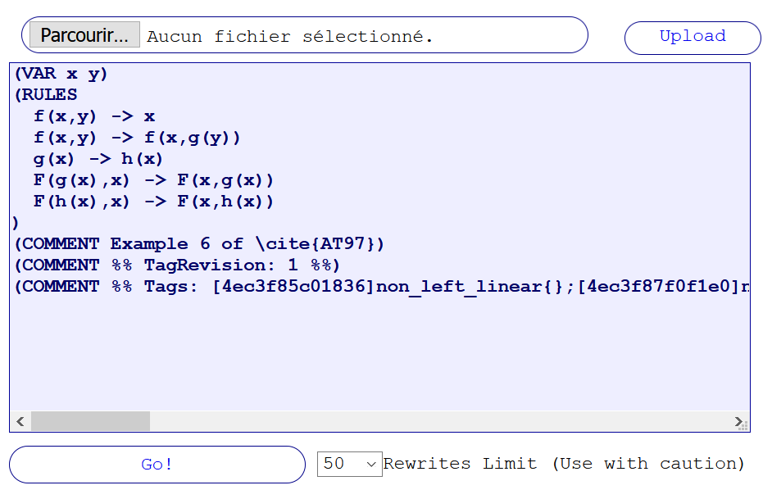
TRS tool

Slide 31
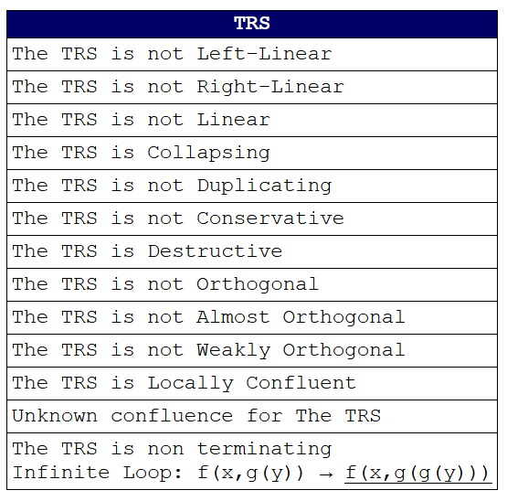
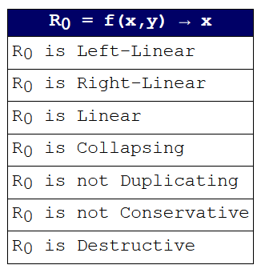
TRS tool

Slide 32
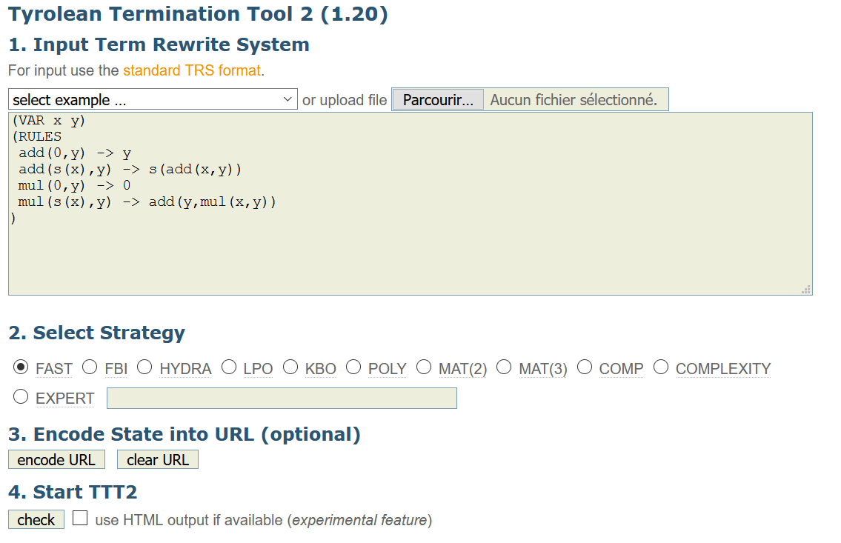
TTT2
Notes:
Output yes or no + trace of the proof

Slide 33
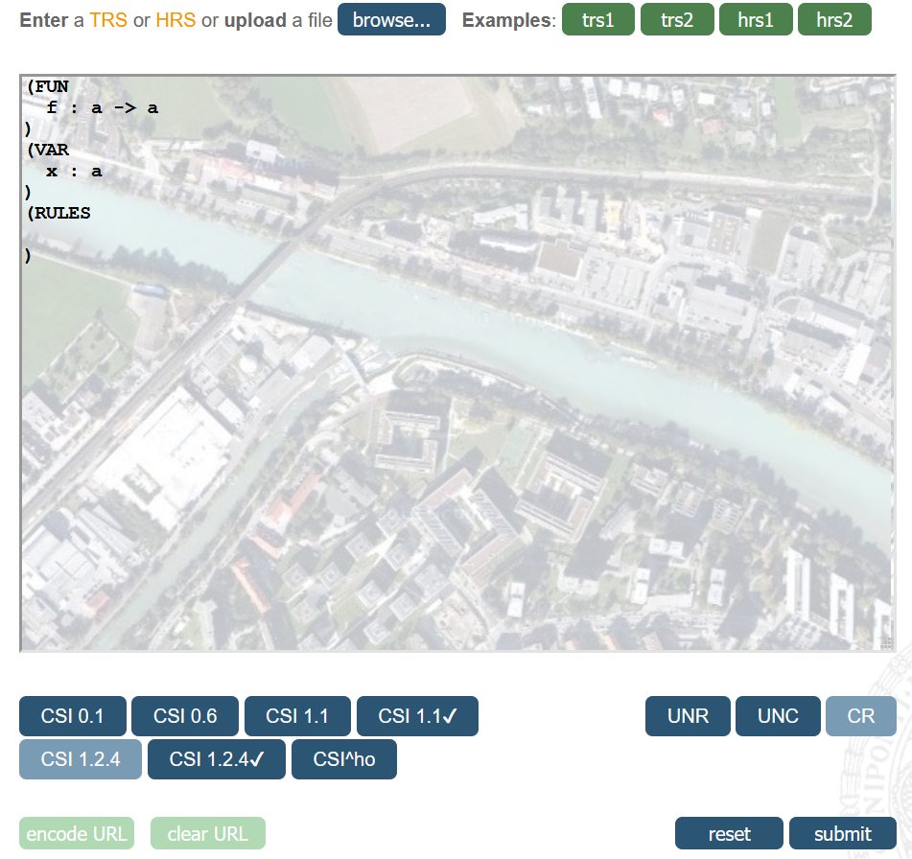
CSI
Notes:
Langage hrs

Slide 34
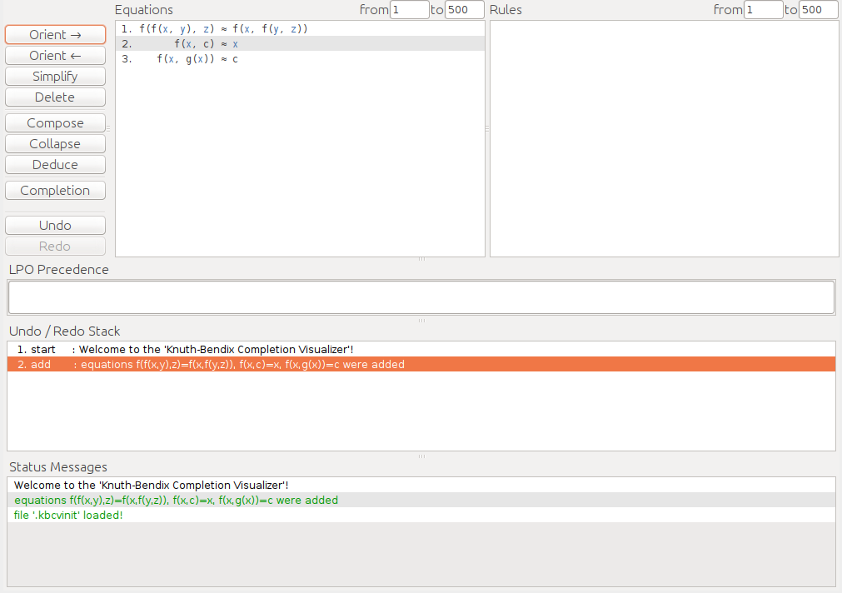
KBCV
Notes:
Kbcv (Knuth-Bendix Completion Vizualizer)

Slide 35


Performance tools
Termination
Confluence
Completion
Proof verification
MU-TERM
ACP
CoLoR
NaTT
Saigawa
Notes:
But: terminations contest, completion contest
Mu-term used by mtt, web interface

Slide 36


Hybrid tools

Slide 37


CiME
Rewriting toolkit
Proof engine
Proof certification
Notes:
Rewriting toolkit: créer et traiter des TRS
Proof : effectuer des preuves (termination, confluence,…)
Certification: get the proof in a standard file -> coq pour la preuve

Slide 38
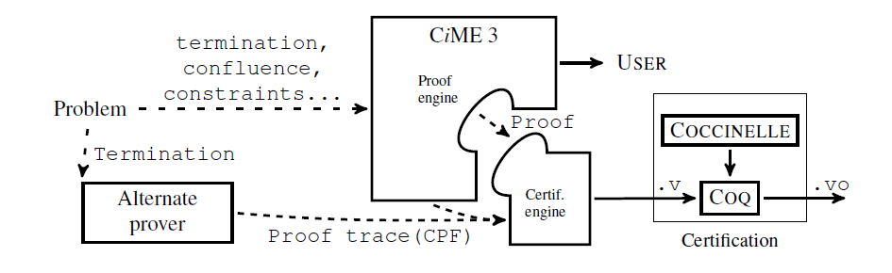
CiME
Notes:
Use cime or alternate prover
Get the trace of the proof
Put in coq/coccinelle for output in standard file

Slide 39
CiME
Examples of declarations
let X = variables “x,y”;
let F = signature “plus : binary; 0:constant; S:unary;”;
let T = algebra F;
let t1 = term T “S(0)”;
let R = trs T “plus(0,x) -> x; plus(S x, y) -> S(plus(x,y));”;
let c = order_constraints T “0 < S(0) /\ S(plus(x,y)) < plus(S(x),y)”;
Notes:
Order constraints : order operators

Slide 40
CiME
Definition of signatures
CiME> let F_peano = signature “
0 : constant; s : unary; +,* : infix binary;
";
F_peano : signature = signature "* : 2; s : 1; + : 2; 0 : 0"
CiME>let X = variables "x,y,z";
X : variable_set = variables "z,x,y"

Slide 41
CiME
Definition of algebra and terms
CiME> let A_peano = algebra F_peano ;
A_peano : F_peano algebra = algebra F_peano
CiME> let t = term A_peano "s(s(s(0)))*(s(0)+s(s(0)))";
t : F_peano term = s(s(s(0))) *(s(0)+s(s(0)))

Slide 42
CiME
Term rewriting system
CiME> let R_peano = trs A_peano “
x+0 -> x;
x+s(y) -> s(x+y);
x*0 -> 0;
x*s(y) -> (x*y)+x;
";
R_peano : F_peano trs = trs A_peano “
x+0 -> x;
x+s(y) -> s(x+y);
x *0 -> 0;
x *s(y) -> (x *y)+x "
CiME> termination R_peano;
CiME> coq_certify_proof R_peano;
CiME> convergence R_peano ;
…
Notes:
Convergence -> termination + confluence

Slide 43



Maude
Simplicity
Expressiveness
Performance
Notes:
Simplicity: based on rewrite system, simple syntax as funblock (modules)
Expressiveness: formalisms, other languages, and other logics can be naturally expressed.
Maude should be viewed as a high-performance metalanguage, through which many different domain-specific languages can be developed
Tools!!!
Performance: concrete implementations should yield system performance competive with other efficient programming languages

Slide 44
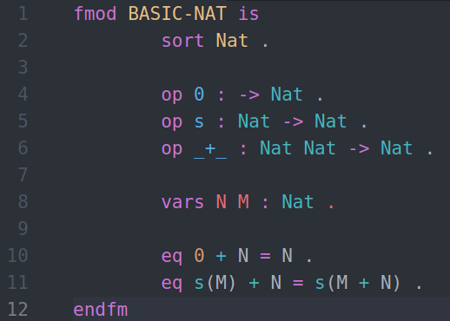
Maude
Notes:
Functional module:
- sort: type declared
- op: name , domain , co-domain (surcharge possible)
- vars: variable declaration
- eq: unconditionnal equation (conditionnal with ceq)

Slide 45
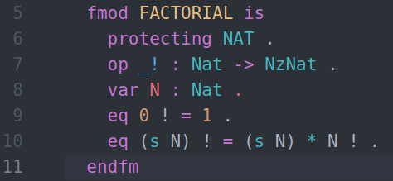
Maude
> load factorial.maude
> red 100 ! .
Reduce in FACTORIAL : 100 ! .
rewrites: 201 in 0ms cpu (0ms real) (~ rewrites/second)
result NzNAT: 93326215443944152681699238856266700490715968264381621468592963895217599993229915608941463976156518286253697920827223758251185210916864000000000000000000000000

Slide 46
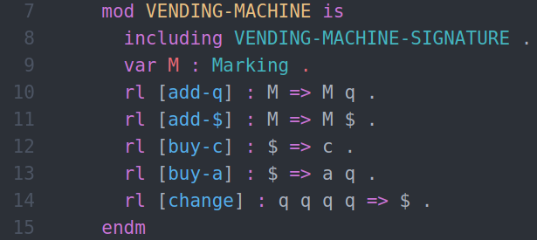
Maude
Notes:
System module:
- including -> functional module (use as a signature)
- variable
- unconditional rules (conditional with crl)

Slide 47
Maude
Inductive Theorem Prover (ITP)
Sufficient Completeness Checker (SCC)
Church-Rosser Checker (CRC)
Coherence Checker (ChC)
Maude Termination Tool (MTT)
Maude Formal Environment (MFE)
Notes:
ITP : Inductive theorem proving
SCC : Completeness of rewrite system
CRC : confluence (equational)
ChC : confluence (rewrite spec)
MTT : termination
PB: modules écrit indep, problèmes de version, compatibilite, peu maintenu

Slide 48

Tools overview
 | Maude | CiME
Extensibility
Still active
I/O files
Syntax
Documentation
Notes:
Extensible : use for other applications
- Maude: meta-languege for dsl
- CiME : yes by the use of xml-based file but not created for this purpose
Still Active: last release
- Maude 3.1 (October 2020); MFE (last release in 2016)
- CiME3 (2010) , CoLoR (2018)
I/O files: récupérer sortie et erreurs
- Maude : output formatting
- CiME : stadard input output (xml, .v, coq files)
Syntax
- Quite simple

Slide 49



I/O in Maude
Standard input/output
File handling
Sockets
Notes:
Standard input/output/error (erew)
File handling (read/write mode)
Socket handling

Slide 50
I/O in Maude
Notes:
Rules:
add-q : insérer 0.25 $
add-$ : insérer 1$
buy-c : 1$ => 1 cake
buy-a : 1$ => 1 apple + 0.25$
change : 4*0.25$ => 1$

Slide 51
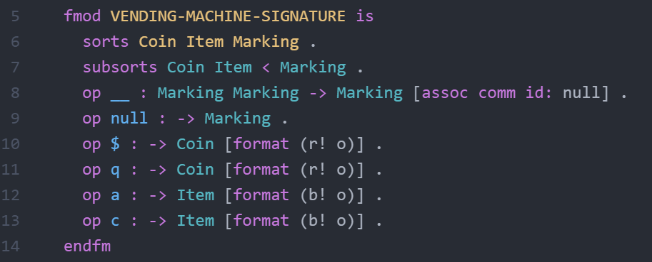
I/O in Maude
Notes:
Acheter des objets dans un distributeur automatique
Signature des actions de la vending machine (1$, 0.25$, apple, cake)
Coin item subsort of marking

Slide 52
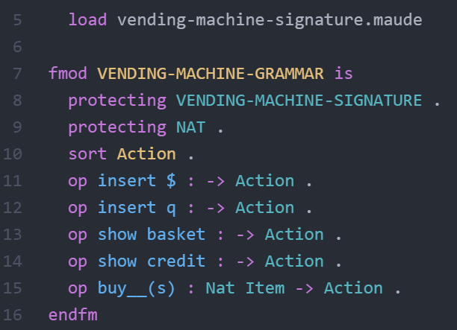
I/O in Maude
Notes:
language for interacting with the vending machine
Extending signature

Slide 53
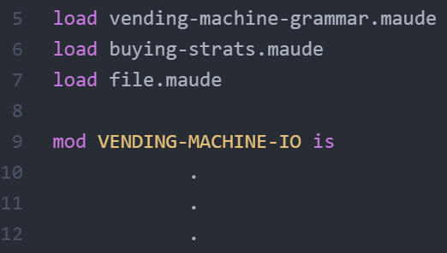
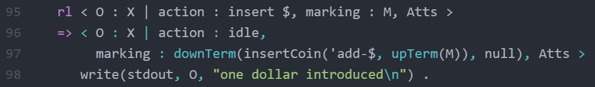
I/O in Maude
Notes:
Rule : affiche « one dollar introduced » quand insertCoin appelé
OO programming, conf <obj : class, attributs>
Vm : const vending machine
File: read, write, …
Idle : const action waited from input

Slide 54
I/O in Maude
Enter in external environment
Maude> erew vending machine .
erewrite in VENDING-MACHINE-IO : vending machine .
> insert $
one dollar introduced
> buy 1 a(s)
1 apples bought
Input
Output
Parse input?
Notes:
Erew pour entrer dans l’env ext
Get correct input? <=> parse input?

Slide 55



META-LEVEL module
Parse input
Execute
Print
Notes:
Native in Maude
Parse input, execter avec rules given, print (colors, standard error,…)

Slide 56
META-LEVEL module
META-LEVEL
META-TERM
META-MODULE
META-STRATEGY
META-VIEW
Notes:
Meta-term: Sort and Kind (getName, getType)
Meta-strategy: strategy, order, …
Meta-module (import meta-term): get member of the module (rules, eq, op,…)
Meta-view : structure de donnée view

Slide 57
META-LEVEL operations
metaParse()
upModule()/downModule()
Reduce in META-LEVEL
Parse a metarepresentation
Move through metarepresentations
Use operation of the META-LEVEL module
Notes:
metaParse:
Up: get metarepresentation / down: get canonical form (terms, op, eq, ax…)

Slide 58
Metalanguage
Funblocks
init area(disk(r))
case area(disk($d)) => mul(pi,square($d))
Maude
sorts Const Var Func State Rule Term Expr .
Notes:
Syntaxe + sorts incomplets

Slide 59
Metalanguage
case f($x) => a
Bubble
Token
‘case ‘f ‘( ‘$ ‘x ‘) ‘=> ‘a
Tokens are represented by quoted identifiers (QID)

Slide 60
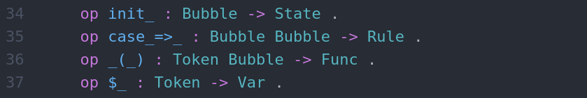
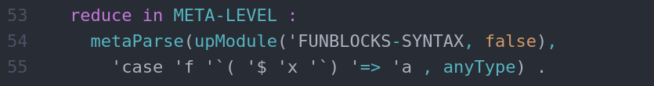
Metalanguage
> result: {‘case_=>_[bubble[…]],bubble[‘a.Qid]],’Rule}
Notes:
Parsing grossier: pas de typage dans les bubbles

Slide 61
MINI-MAUDE
mini-maude
syntaxe
mini-maude
(semantic)
mini-maude
metainterpreter
File
MetaInterpreter
Notes:
File: get input/output, read/write..
MetaInterpreter: operation of interpreter

Slide 62
MINI-MAUDE
Maude> erew minimaude .
erewrite in MINI-MAUDE-META-INTERPRETER : minimaude .
MiniMaude Execution Environment
minimaude> fmod NAT3 is
> sort Nat3 .
> op s_ : Nat3 -> Nat3 .
> op 0 : -> Nat3 .
> eq s s s 0 = 0 .
> endfm
Module loaded successfully
minimaude> reduce s s s s 0 .
result Nat3: s 0

Slide 63

System diagram
Maude environment
FILE + META-LEVEL + MFE
$$↔$$
Read file + parse + verify
Funblocks
code
input
output
Output in shell or IDE

Slide 64
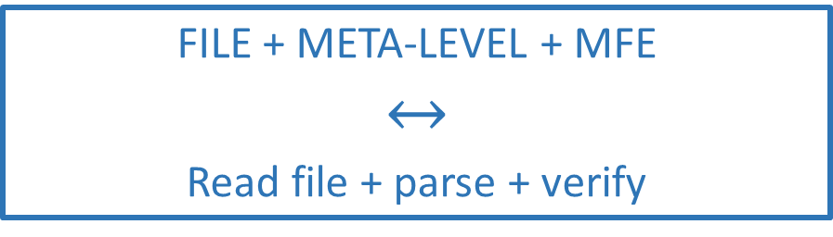
FILE + META-LEVEL + MFE
$$↔$$
Read file + parse + verify
Verify syntax and semantic of the input
Start checker environment in a shell
Get commands and verify properties
input
Read FunBlocks file
output

Slide 65

Verify syntax and semantic of the input
Start checker environment in a shell
Get commands and verify properties
input
Read FunBlocks file
output
FunBlocks file
Read file
FILE
openFile()
getLine()
…
Input
Output

Slide 66

Verify syntax and semantic of the input
Start checker environment in a shell
Get commands and verify properties
input
Read FunBlocks file
output
Read file
META-LEVEL
Module inserted
metaParse()
upModule()
…
Input
load funblocks-syntax.maude
load funblocks-semantic.maude
Output

Slide 67
Verify syntax and semantic of the input
Start checker environment in a shell
Get commands and verify properties
input
Read FunBlocks file
output
Module inserted
META-INTERPRETER
Wait for input
createInterpreter()
insertModule()
…
Input
Output

Slide 68
Verify syntax and semantic of the input
Start checker environment in a shell
Get commands and verify properties
input
Read FunBlocks file
output
MFE
(Maude Formal Environment)
Get command
Print in shell
termination()
confluence()
…
Input
Output

Slide 69
FunBlocks checker system
funblocks-syntax
funblocks
(semantic)
funblocks-metainterpreter
Notes:
File: get input/output, read/write..
MetaInterpreter: operation of interpreter

Slide 70
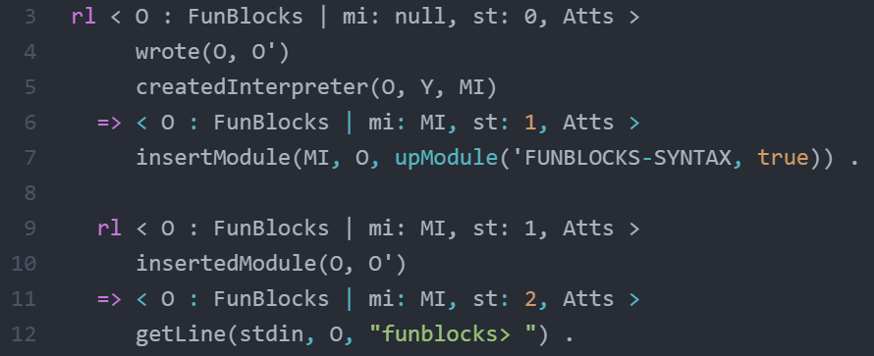
funblocks-metainterpreter

Slide 71
funblocks-metainterpreter

Slide 72
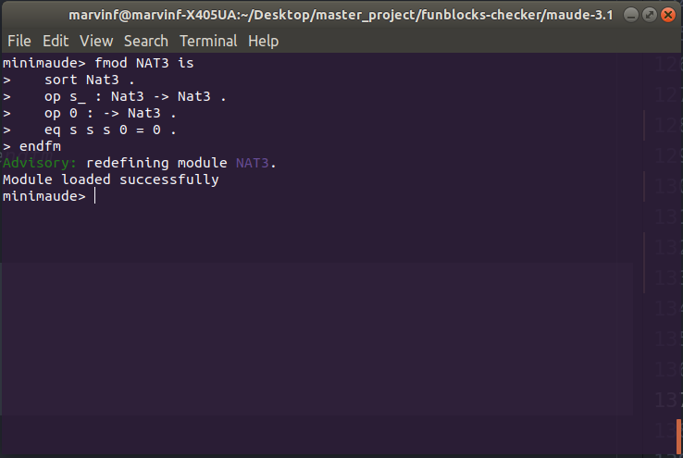
Mini-Maude: insert module

Slide 73
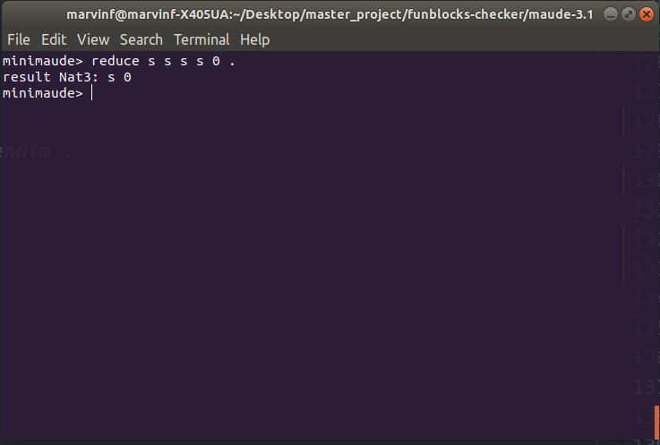
Mini-Maude: use « reduce » command

Slide 74

Mini-Maude: wrong command

Slide 75

Mini-Maude: quit environment

Slide 76
Funblocks checker
FunBlocks code
Module inserted
FUN-TO-MAUDE
Input
load funblocks-syntax.maude
load funblocks-semantic.maude
Output

Slide 77


Funblocks checker
FUN-TO-MAUDE
Input
Output

Slide 78

What’s next ?
Typing ?
Type checking
Notes:
Type checking var / const, arity of functions, …

Slide 79
FunBlocks checker system
User input
User input
User output
fun-to-maude
funblocks-metainterpreter
MFE
funblocks-syntax
funblocks
(semantic)
funrules

Slide 80

FUNBLOCK-SYNTAX
Notes:
Term = right term, left term
Token ~ Const

Slide 81
FUNBLOCKS
‘case ‘$ ‘x ‘=> ‘id ‘( ‘a ‘)
funblocks
(semantic)
‘var ‘‘$'x ‘: ‘Untyped ‘. ‘\n
‘op 'id ‘: ‘Untyped ‘-> ‘Untyped ‘. ‘\n
‘op 'a ‘: ‘-> ‘Untyped ‘. ‘\n
‘rl ‘$'x ‘=> ‘’id ’( ‘‘a ‘) ‘. ‘\n
Notes:
‘ en plus : postprocessing (Python) aka formatter ?

Slide 82
FUNBLOCKS
‘case ‘compose ‘( ‘f ‘, ‘g ‘, ‘$ ‘x ‘) ‘=> ‘f ‘( ‘g ‘( ‘$ ‘x ‘) ‘)
funblocks
(semantic)
noParse()
Notes:
Nested func, constante, n-ary …

Slide 83

FUN-TO-MAUDE
init dist(a,d)
case $ x => id(a)
fun-to-maude
funblocks-syntax
funblocks
(semantic)
Notes:
Space after $ => pré formattage ?

Slide 84

FUNRULES
Notes:
Module funtype ou les types sont définis
Définir les sorts au moment du parsing dans le module

Slide 85
Pre-processing (script)
case id($x) => $x
case id($ x) => $ x
Notes:
Space after $ => pré formattage ?

Slide 86
Post-processing (script)
case id($’x) => $’x
case id($x) => $x
op a : -> Nat
op a : -> Nat
op a : -> Nat
Notes:
Space after $ => pré formattage ?

Slide 87

FUN-TO-MAUDE
file_process
(script)
init dist(a,d)
case $x => id(a)
fun-to-maude
funblocks-syntax
funblocks
(semantic)
Notes:
Space after $ => pré formattage ?

Slide 88
FunBlocks checker system
User input
User input
User output
fun-to-maude
funblocks-metainterpreter
MFE
funblocks-syntax
funblocks
(semantic)
funrules

Slide 89
Static Typing
type List $T :: empty | cons $T (List $T)
rule ajoute $T :: $T -> List $T => List $T
case ajoute($x, cons($y, $tail)) => cons($y, $tail)
{ ajoute:
[ TypeVarRef { range: [Object], label: 'T' },
TypeDeclRef { range: [Object], name: 'List', arguments: [Array] },
TypeDeclRef { range: [Object], name: 'List', arguments: [Array] } ] }

Slide 90
Static Typing
case ajoute($x, cons($y, $tail)) => cons($y, $tail)
{ ajoute: [ TypeVarRef { range: null, label: 'T0' }, <2 empty items> ] }

Slide 91

Notes:
TRIV est une theory
List = container

Slide 92

FUNRULES
If cons()is defined:

Slide 93

FUNRULES
If cons()is undefined:

Slide 94
Execution
Funrules
create
File_process.py
fun-to-maude
File_process.py
pre()
init_module()
post()
funblocks-syntax
funblocks

Slide 95
Maude tools
Inductive Theorem Prover (ITP)
Sufficient Completeness Checker (SCC)
Church-Rosser Checker (CRC)
Coherence Checker (ChC)
Maude Termination Tool (MTT)
Maude Formal Environment (MFE)
Notes:
ITP : Inductive theorem proving
SCC : Completeness of rewrite system
CRC : confluence (equational)
ChC : confluence (rewrite spec)
MTT : termination
PB: modules écrit indep, problèmes de version, compatibilite, peu maintenu

Slide 96
Maude Formal Environment
Maude 3.1 (last version)
Maude++ 2.7
Inductive Theorem Prover (ITP)
Church-Rosser Checker (CRC)
Coherence Checker (ChC)
Sufficient Completeness Checker (SCC)
Maude Termination Tool (MTT)
AProVE
Notes:
ITP : Inductive theorem proving
SCC : Completeness of rewrite system
CRC : confluence (equational)
ChC : confluence (rewrite spec)
MTT : termination
PB: modules écrit indep, problèmes de version, compatibilite, peu maintenu

Slide 97

Maude Formal Environment
MFE
(ct <module name> .)
(ccr <module name> .)
Full Maude module
(equational specification)
output
Works only with equational specifications

Slide 98


Church-Rosser Checker

Slide 99


Church-Rosser Checker

Slide 100
Church-Rosser Checker

Slide 101


Termination tool

Slide 102
Equation vs rules (in Maude)
Equations
Rules
Represent theory
Terminating and confluent
Represent states changes
No constraints on termination and confluence
Reductions using rewrite logic

Slide 103
Parsing in Maude
reduce
red 1 + (1 + 1) .
rewrite
rew [6] $ $ q q .

Slide 104



Precedence and gathering

Slide 105
Precedence and gathering
prec
Indication of « priority » using a natural number
gather
E : precedence value ≤ precedence value of the operator
e : precedence value < precedence value of the operator
& : any precedence value

Slide 106

Precedence and gathering

Slide 107
Default precedence values
prec
0 for the constants (zero)
0 for mixfix operator which not begin nor end with _ ( (_))
41 for mixfix operator which begin or and with _ ( to_:_ )
-> 15 for unary operator ( not_ )
41 : for mixfix operator which begin and end with _ ( _+_)

Slide 108
Default gathering values
gather
& for default prefix operators
& for operator which not begin nor end with _ ( (_))
E for adjacent _ or _ at the edges ( _?_:_ is (E & E))
Special cases of binary operators which start and end with _ and have precedence value > 0 :
(e E) if it has the assoc attribute
If not, we have to look at the subsorts relationship…

Slide 109

Default gathering values
If we have Int < IntList
(e E)
(E e)

Slide 110
System diagram
Maude environment
MFE (verification tool)
Funblocks
code
input
Maude file
output
Swift AST
Output in shell

Slide 111
Pipeline
FunBlocks file
Maude file
Maude Checker tool (MFE)
Feedback
Input
User input

Slide 112

Pipeline
FunBlocks file
Maude file
Input
AST (Swift)
rule add :: Nat -> Nat => Nat
case add($x, zero) => $x
op add : Nat Nat -> Nat .
eq add($x, zero) = $x .

Slide 113
Pipeline
Maude file
Maude Checker tool (MFE)
MFE
Maude environment
op add : Nat Nat -> Nat .
eq add($x, zero) = $x .
command
> feedback

Slide 114
« TODO » list
Tranform FunBlocks file into Maude file
Integrate Maude file in the MFE
Get the user input
Make the verifications

Slide 115
References
Didier Buchs, modelisation verification course material, 2018
Dimitri Racordon, Emmanouela Stachtiri, Damien Morard, Didier Buchs, Functional Block Programming and Debugging, 2020
Nachum Dershowitz, Jean-Pierre Jouannaud, Rewrite Systems, 1990
Nachum Dershowitz, Computing with Rewrite Systems, 1985
Terese, Term Rewriting Systems, 2003
Thomas Sternagel and Harald Zankl, KBCV-Knuth-Bendix Completion Visualizer, 2012
Thomas Artsa, Jürgen Giesl, Termination of term rewriting using dependency pairs, 2000

Slide 116
References
Jürgen Giesl, René Thiemann, Peter Schneider-Kamp, Stephan Falke, Automated Termination Proofs with AProVE, 2004
D. Kapur, P. Narendran, Path ordering for proving termination of term rewriting systems, 1985
Jeremy Dick, John Kalmus and Ursula Martin, Automating the Knuth Bendix ordering, 1990
E. Contejean, P. Courtieu, J. Forest, O. Pons, X. Urbain, Automated Certified Proofs with CiME3, 2011
F. Chalub, C. Braga, Maude MSOS Tool, 2005
S. Winkler, A. Middeldorp, Tools in Term Rewriting for Education, 2020
A. Salvador, L. Salvador, Term Rewriting Systems .Net Framework, 2013

Slide 117
References (links)
Database of Rewriting Systems
http://rewriting.loria.fr/systems.html
http://www.jaist.ac.jp/~hirokawa/tool/
Knuth-Bendix Completion Visualizer
http://cl-informatik.uibk.ac.at/software/kbcv/
Knuth-Bendix Completion subject-based thesis
https://homepage.divms.uiowa.edu/~astump/papers/thesis-wehrman.pdf

Slide 118
References (links)
Prolog implementation of the Knuth-Bendix completion procedure
https://www.metalevel.at/trs/
Maude tools
http://maude.lcc.uma.es/CRChC/
http://www.lcc.uma.es/%7Eduran/MTT/
http://maude.sip.ucm.es/debugging/
Wikipedia
https://fr.wikipedia.org/wiki/Compl%C3%A9tion_de_Knuth-Bendix
https://fr.wikipedia.org/wiki/Paire_critique

Slide 119
References (links)
TRS tool:
http://tfmserver.dsic.upv.es:8080/Home.html

Slide 120
Make FunBlocks alive
Marvin FOURASTIE
Master project

