Slide 1

Artificial Intelligence and Machine Learning
Gradient Descent Methods

Slide 2
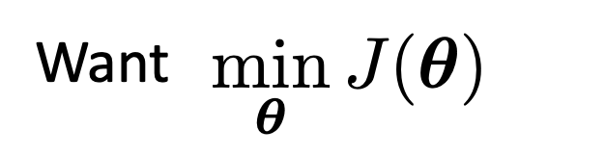
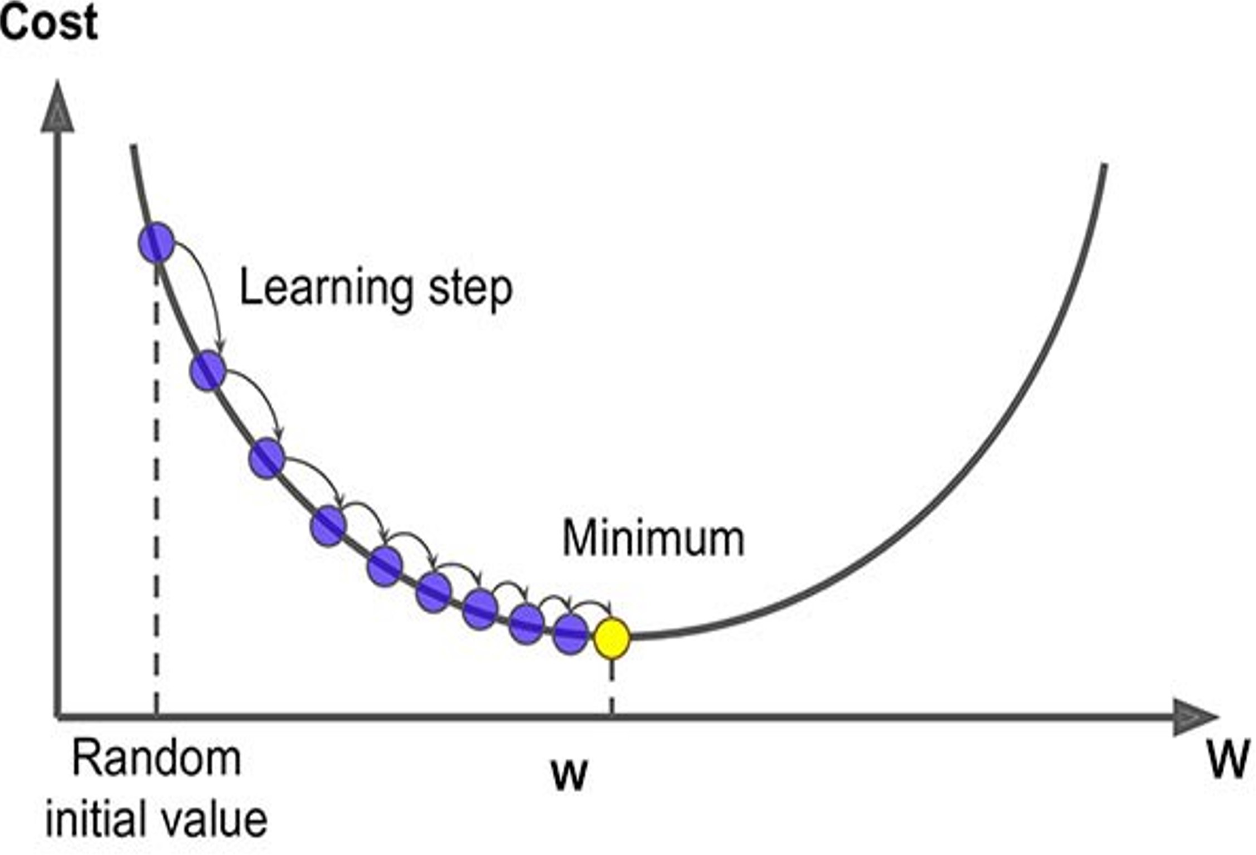
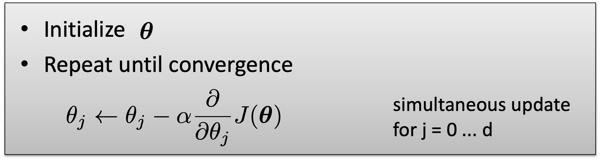
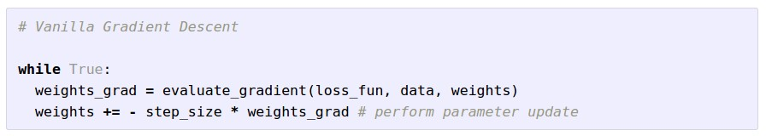
Gradient Descent
Learning rate
Notes:
\mathbf{w}^{k+1} = \mathbf{w}^{k}- \eta\nabla_{\mathbf{w}}J(\mathbf{w}^k)

Slide 3
Direction of maximum increase and decrease for a function
Gradient direction is the direction of maximum increase for a function
Negative gradient is the direction of maximum decrease for a function
Notes:
Show example

Slide 4
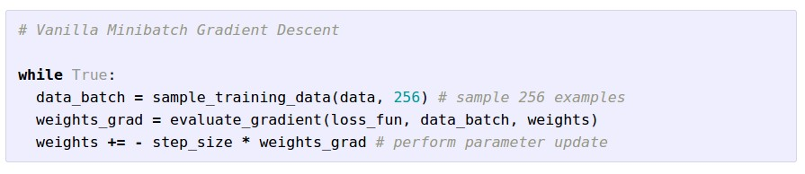
Mini-batch (Stochastic) Gradient Descent
only use a small portion of the training set to compute the gradient.
Common mini-batch sizes are 32/64/128 examples
e.g. Krizhevsky ILSVRC ConvNet used 256 examples

Slide 5
Mini-batch Gradient Descent
only use a small portion of the training set to compute the gradient.
we will look at more fancy update formulas
(momentum, Adagrad, RMSProp, Adam, …)
Common mini-batch sizes are 32/64/128 examples
e.g. Krizhevsky ILSVRC ConvNet used 256 examples

Slide 6
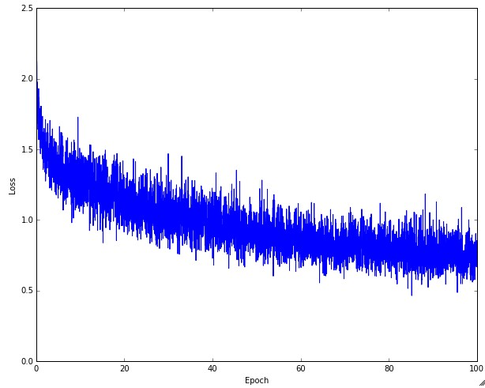
Example of optimization progress while training a neural network.
(Loss over mini-batches goes down over time.)

Slide 7
Stochastic Gradient
W_2
noisy gradient from minibatch
W_1
original W
Slide based on CS294-129 by John Canny

Slide 8
Stochastic Gradient Descent
W_2
True gradients in blue minibatch gradients in red
W_1
original W
Gradients are noisy but still make good progress on average
Slide based on CS294-129 by John Canny

Slide 9
You might be wondering…
W_2
Standard gradient
Can we compute this?
W_1
Slide based on CS294-129 by John Canny

Slide 10
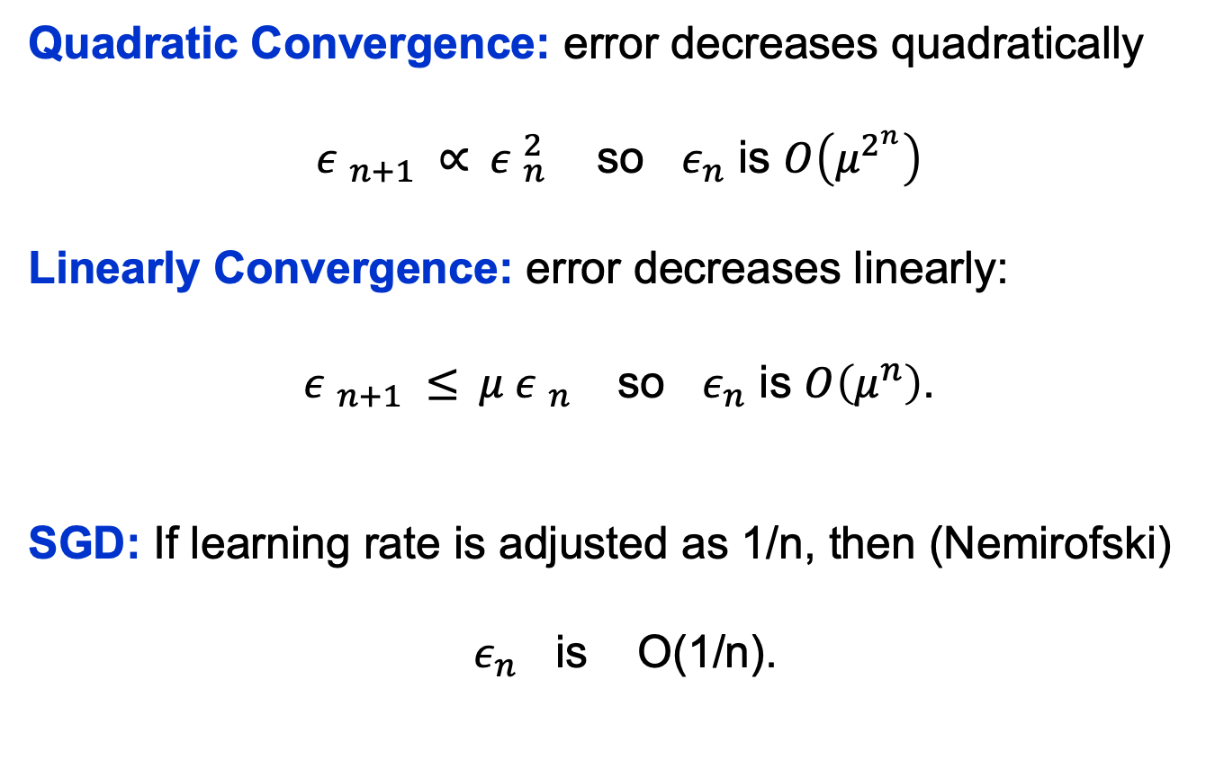
Convergence Behavior
Slide based on CS294-129 by John Canny

Slide 11
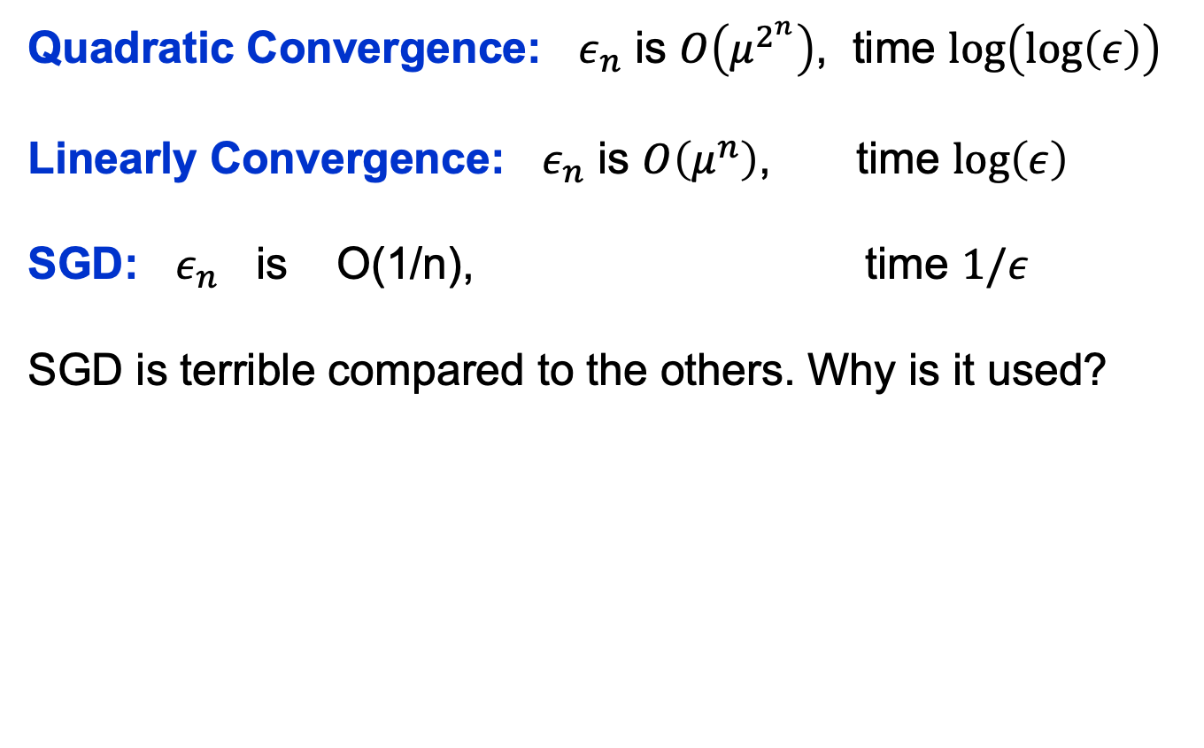
Convergence Comparison
Slide based on CS294-129 by John Canny

Slide 12
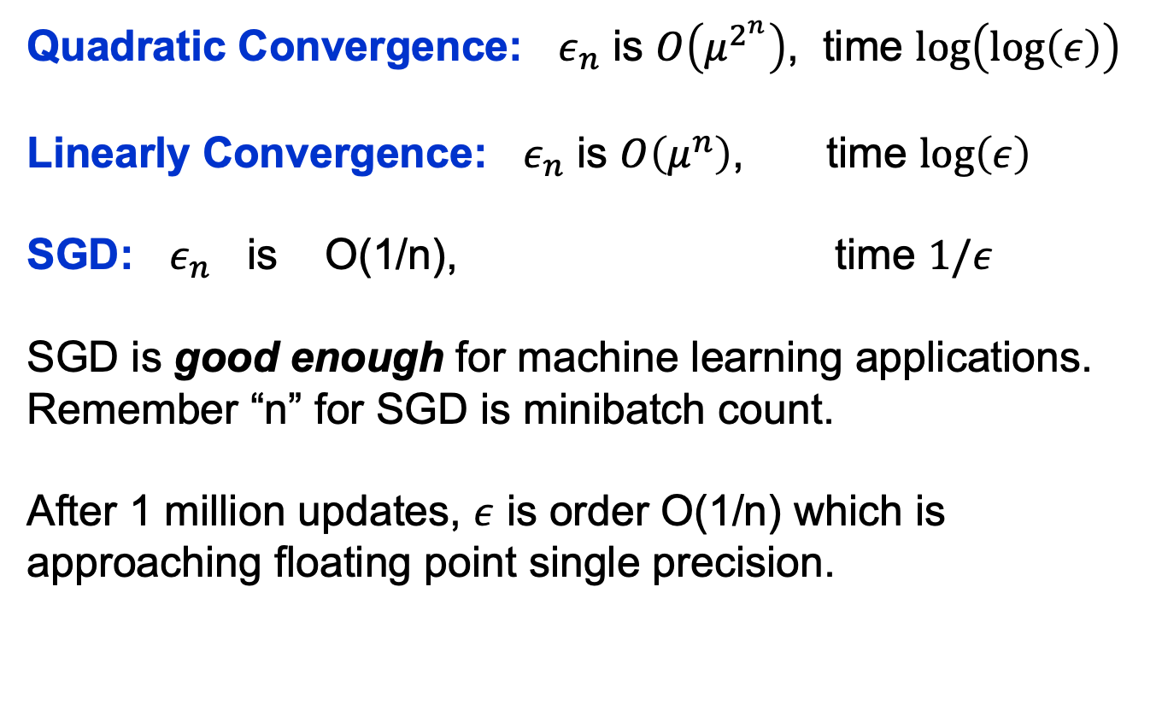
Convergence Comparison
Slide based on CS294-129 by John Canny

Slide 13


Momentum update
- Physical interpretation as ball rolling down the loss function + friction (mu coefficient).
- mu = usually ~0.5, 0.9, or 0.99 (Sometimes annealed over time, e.g. from 0.5 -> 0.99)

Slide 14
Momentum update
Allows a velocity to “build up” along shallow directions
Velocity becomes damped in steep direction due to quickly changing sign

Slide 15
SGD
vs
Momentum
notice momentum
overshooting the target, but overall getting to the minimum much faster than vanilla SGD.

Slide 16

AdaGrad update
[Duchi et al., 2011]
Added element-wise scaling of the gradient based on the historical sum of squares in each dimension

Slide 17
AdaGrad update
Q2: What happens to the step size over long time?

Slide 18
AdaGrad update
Q2: What happens to the step size over long time?

Slide 19

RMSProp update
[Tieleman and Hinton, 2012]

Slide 20
adagrad
rmsprop

Slide 21
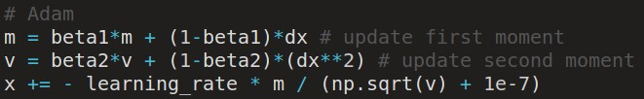
Adam update
[Kingma and Ba, 2014]
(incomplete, but close)

Slide 22
Adam update
[Kingma and Ba, 2014]
(incomplete, but close)
momentum
RMSProp-like
Looks a bit like RMSProp with momentum

Slide 23
Adam update
[Kingma and Ba, 2014]
(incomplete, but close)
momentum
RMSProp-like
Looks a bit like RMSProp with momentum

Slide 24
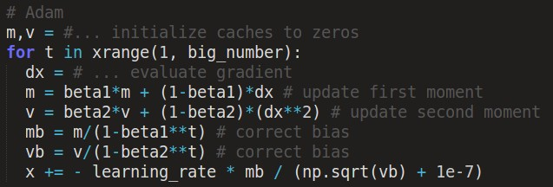
Adam update
[Kingma and Ba, 2014]
momentum
bias correction
(only relevant in first few iterations when t is small)
RMSProp-like
The bias correction compensates for the fact that m,v are initialized at zero and need some time to “warm up”.

Slide 25
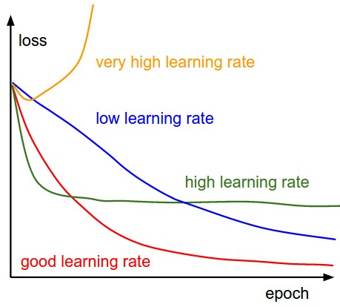


SGD, SGD+Momentum, Adagrad, RMSProp, Adam all have learning rate as a hyperparameter.
=> Learning rate decay over time!
step decay:
e.g. decay learning rate by half every few epochs.
exponential decay:
1/t decay:

Slide 26
Summary
Simple Gradient Methods like SGD can make adequate progress to an optimum when used on minibatches of data.
Momentum: is another method to produce better effective gradients.
ADAGRAD, RMSprop scale the gradient.
ADAM scales and applies momentum.

Slide 27
The effects of different update formulas
(image credits to Alec Radford)

Slide 28
Questions?

