Slide 1
Update config with more resources

Slide 2

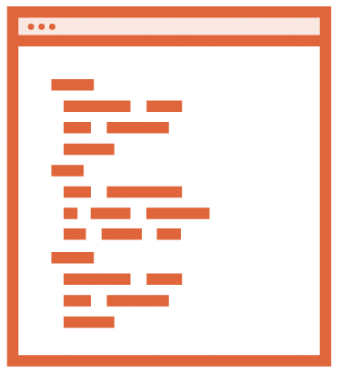


Automating Infrastructure Deployment
Provisioning resources
Planning Updates
Using Source Control
Reusing templates

Slide 3
Terraform State
Terraform must store state about your managed infrastructure and configuration.
This state is used by Terraform to map real world resources to your configuration, keep track of metadata, and to improve performance for large infrastructures

Slide 4

Terraform State
JSON format (Do not touch!)
Resources mappings and metadata Locking
Location
Local
Remote: AWS, Azure, NFS, Terraform Cloud
Workspaces

Slide 5



{
"version": 4,
"terraform_version": "0.12.5",
"serial": 30,
"lineage": "",
"outputs": {},
"resources": []
}
State file

Slide 6
Terraform Plan
The terraform plan command is used to create an execution plan. Terraform performs a refresh, unless explicitly disabled, and then determines what actions are necessary to achieve the desired state specified in the configuration files.

Slide 7

Terraform Planning
Inspect state
Dependency graph
Additions, updates, and deletions
Parallel execution
Save the plan

Slide 8
Scenario Part1
Launch the instances in customized VPC(previous one is launched the default one)

Slide 9
Adding a VPC
resource "aws_vpc" "vpc" {}
resource "aws_internet_gateway" "igw" {}
resource "aws_subnet" "subnet1" {}
resource "aws_route_table" "rtb" {}
resource "aws_route_table_association" "rta-subnet1" {}

Slide 10
Scenario Part2
Launch the instances in multiple available zones to increase availability of the service
Launch load balancer to balance the load between the instances with public dns name

Slide 11

Summary
Terraform updates and state file
Data sources
Load balancer and security

