Slide 1
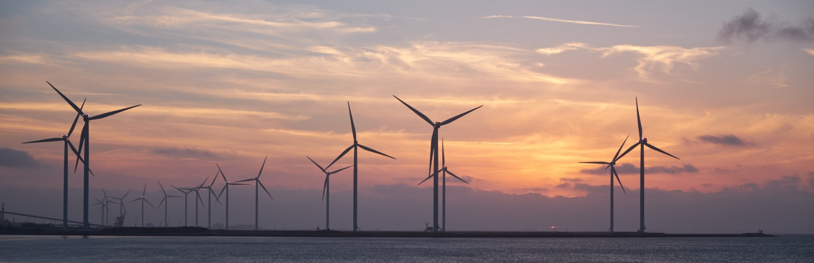
The cable routing of Wind farm

Slide 2
Problem Description
Obj: min total cost
s.t.: a connected graph
Q: a Minimum Spanning Tree (MST) ?
A: Yes, if no edge flow bound constraint (SUPER cable) No, otherwise.
substation
turbine
UNIFORM : each turbine generates the same amount
GENERAL : each turbine generates different amount

Slide 3
MODEL 1 The simplest one
UNIFORM Cable (only 1 type, SAME unit-length cost & capacity)

Slide 4
Problem Definition
Objective function:
Minimize the total installation cost
Assumptions:
There is just one substation
The locations (i.e., coordinates) of turbines are known
Each cable has the same unit-length cost and capacity (flow upper bound)
The connections between each two nodes are available (complete graph)
The flow leaving a turbine must be supported by a single cable ➔ 1 outgoing arc
The flow on each connection cannot exceed the capacity of the installed cable

Slide 5
The Settings
Sets
Node i : the turbines and substation (only 1)
Edge : possible cable between nodes i and j
Variables
Flow between turbine i and j :
Distance between turbine i and j :
Whether an arc is built with a cable or not:
if arc (i, j) is constructed, then ; otherwise,
Parameters
Unit-length cost and capacity of cable: and
The net supply of each node i : (UNIFORM or GENERAL)

Slide 6
IP Model for Model 1
Objective function:
(Investment cost)
subject to
(Flow balance)
(Capacity limitation)
(Connecting limitation)

Slide 7
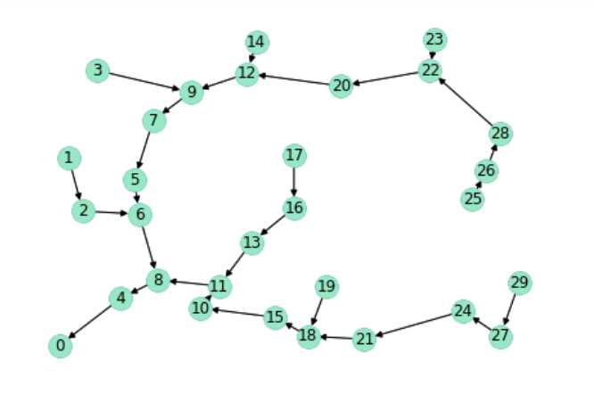
Graph of an Optimal Solution for SUPER Cable
Cost c | Capacity u
8 | ∞
UNIFORM Turbine
GENERAL Turbine
MST !!

Slide 8
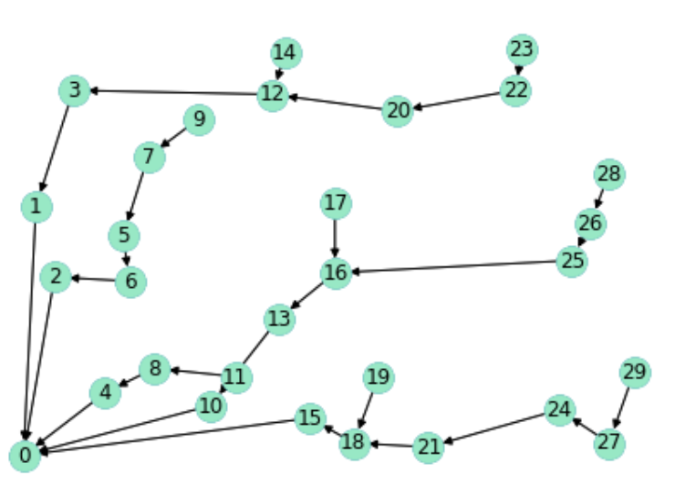
Graph of an Optimal Solution for UNIFORM Turbines
Cost c | Capacity u
8 | 7
UNIFORM Turbine

Slide 9
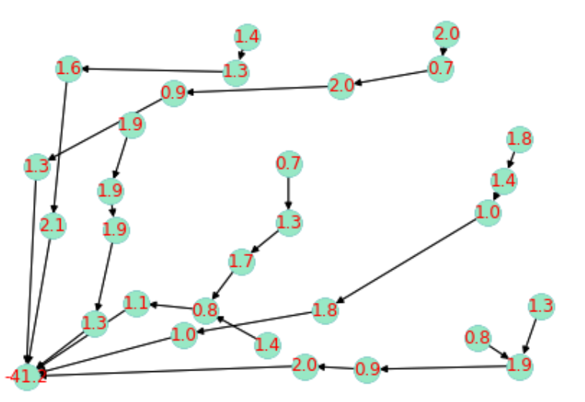
Graph of an Optimal Solution for GENERAL Turbines
Cost c | Capacity u
8 | 7
General Turbine

Slide 10
MODEL 2 a more extended MODLE 1
GENERAL Cable
multi-type, each type with different unit-length cost & flow bounds

Slide 11
Problem Definition
Objective function:
Minimize the total installation cost
Assumptions:
There is just one substation
The locations (coordinates) of turbines are known
Different cable types have different unit-length costs and flow bounds
The connections between each two nodes are available (complete graph)
The flow leaving a turbine must be supported by a single cable ➔ 1 outgoing arc
The flow on each connection must be within the flow bounds (lower and upper) of the installed cable type

Slide 12
The Settings
Sets
Node i : the turbines and substation (only 1)
Edge : possible cable between nodes i and j
Cable type t : type of a cable
Variables
Flow between turbine i and j in a cable of type t :
Distance between turbine i and j :
Whether an arc is built with a cable of type t or not:
if arc (i, j) is constructed, then ; otherwise,
Parameters
Unit-length cost and flow bounds for a cable of type t : and .
The net supply of each node i : (UNIFORM or GENERAL)

Slide 13
The Model
Objective function:
(Investment cost)
subject to
(Flow balance)
(Capacity limitation)
(Connecting limitation)

Slide 14
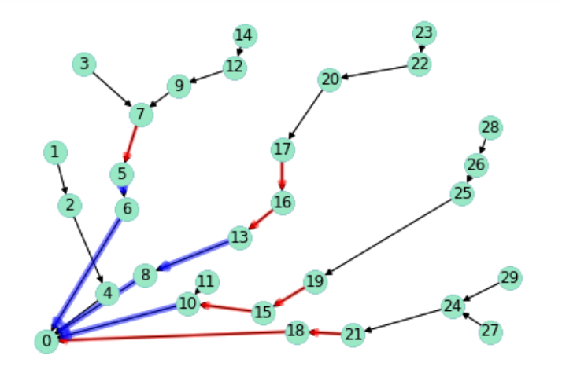
Graph of an Optimal Solution for UNIFORM Turbines
 | Cost c | Lower Bound l | Upper Bound u
Cable type 1 | 4 | 0 | 3
Cable type 2 | 6 | 4 | 5
Cable type 3 | 8 | 6 | 7
UNIFORM Turbine
Optimal solution = 320
Running time = 25(s)

Slide 15
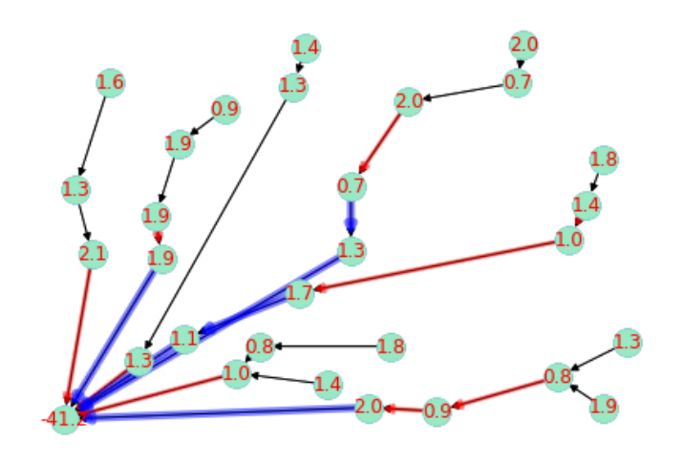
Graph of an Optimal Solution for GENERAL Turbines
 | Cost c | Lower Bound l | Upper Bound u
Cable type 1 | 4 | 0 | 3
Cable type 2 | 6 | 4 | 5
Cable type 3 | 8 | 6 | 7
Optimal solution = 435
Running time = 6835(s)
GENERAL Turbine

Slide 16
MODEL 3 a more extended MODLE 2
More REALISTIC constraints:
No cable crossing, No obstacle crossing

Slide 17
Problem Definition
Objective function:
Minimize investment cost and loss cost
Assumptions:
There is just one substation
The locations of turbines are fixed
The turbines have the same generation
Different cables have different costs and capacities
The capacities of cables are measured by the number of turbines
The connections between each two nodes are available (complete graph)
The flow leaving a turbine must be supported by a single cable
The flow on each connection cannot exceed the capacity of the installed cable
The cable crossing should be avoided
The obstacle will be put into consideration

Slide 18
The Settings
Sets
Node i : the turbines and substation (only 1)
Edge : possible cable between nodes i and j
Subcable type : original cables divided into subtype cables depends
on the supporting flow
Cross set : contain edge(i, j) and edge(h, k) are intersect
Parameters
The fixed investment cost, loss cost and capacity of subcable per unit
distance : , and
The net supply of each node i :

Slide 19
The Settings
Variables
Flow between turbine i and j in a subcable of type :
Distance between turbine i and j :
Whether an arc is built with a subcable of type or not:
if arc (i, j) is constructed, then ; otherwise,
Whether an arc is built with any cable or not:
if arc (i, j) is constructed, then ; otherwise,
Other adjustment
Add dummy nodes and edges to express the positions of obstacles, and then add again, so that we can bypass the obstacle
Divide a cable type into many subcables because of the loss costs are different from the number of turbines supported

Slide 20
The Model
Objective function:
(Investment and loss cost)
subject to
(Flow balance)
(Capacity limitation)
(Connecting limitation)

Slide 21
The Model
subject to
(relation between x and y)
(Avoid cross case)

Slide 22
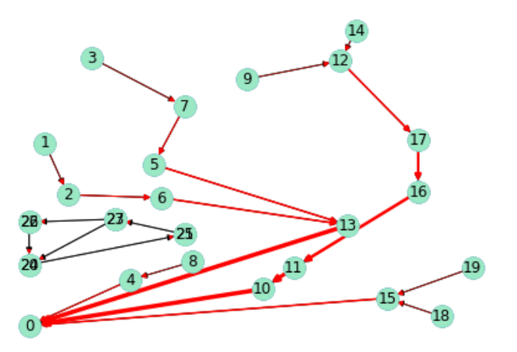
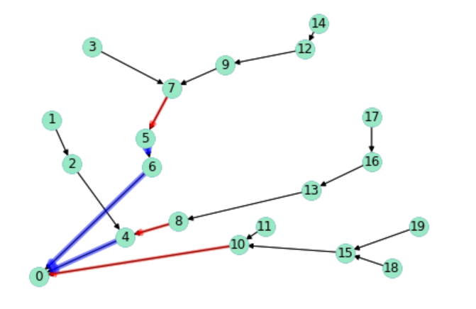
The graph of optimal solution(node=20)
Cable type | Capacity Bound (l, u) | Loss Cost loss | Investment Cost c | Total Cost loss+c
Cable 0 | (0,0) | 0 | 0 | 0
Cable 1 | (0,1) | 1 | 4 | 5
 | (1,2) | 2 | 4 | 6
 | (2,3) | 3 | 4 | 7
Cable 2 | (3,4) | 4 | 6 | 10
 | (4,5) | 5 | 6 | 11
Cable 3 | (5,6) | 6 | 8 | 14
 | (6,7) | 7 | 8 | 15
The thicker line, the more capacity cable used
UNIFORM Turbine
obstacle
Optimal solution = 359
Running time = 5(s)
Running time = 2(s)

Slide 23
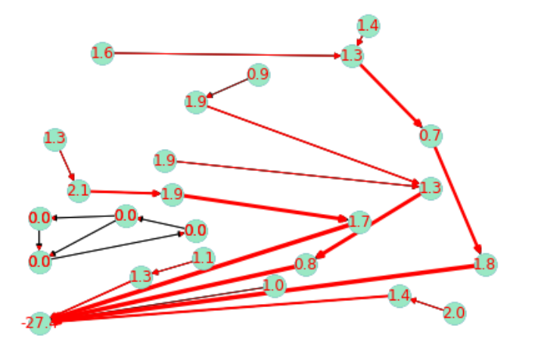
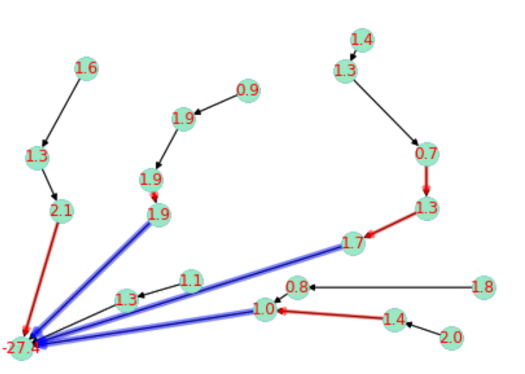
The graph of optimal solution(node=20)
Cable type | Capacity Bound (l, u) | Loss Cost loss | Investment Cost c | Total Cost loss+c
Cable 0 | (0,0) | 0 | 0 | 0
Cable 1 | (0,1) | 1 | 4 | 5
 | (1,2) | 2 | 4 | 6
 | (2,3) | 3 | 4 | 7
Cable 2 | (3,4) | 4 | 6 | 10
 | (4,5) | 5 | 6 | 11
Cable 3 | (5,6) | 6 | 8 | 14
 | (6,7) | 7 | 8 | 15
The thicker line, the more capacity cable used
GENERAL Turbine
obstacle
Optimal solution = 574
Running time = 440(s)
Running time = 25(s)

Slide 24
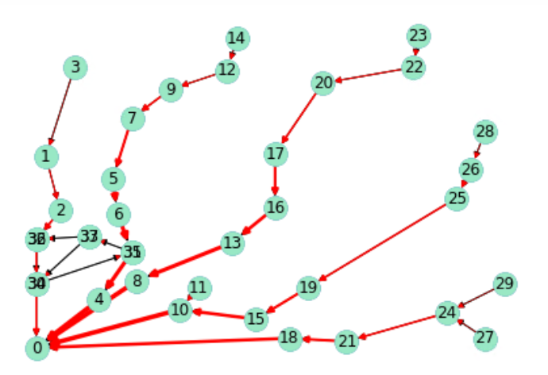
The graph of optimal solution(node=30)
Cable type | Capacity Bound (l, u) | Loss Cost loss | Investment Cost c | Total Cost loss+c
Cable 0 | (0,0) | 0 | 0 | 0
Cable 1 | (0,1) | 1 | 4 | 5
 | (1,2) | 2 | 4 | 6
 | (2,3) | 3 | 4 | 7
Cable 2 | (3,4) | 4 | 6 | 10
 | (4,5) | 5 | 6 | 11
Cable 3 | (5,6) | 6 | 8 | 14
 | (6,7) | 7 | 8 | 15
The thicker line, the more capacity cable used
UNIFORM Turbine
obstacle
Optimal solution = 549
Running time = 29(s)

Slide 25
The graph of optimal solution(node=30)
Cable type | Capacity Bound (l, u) | Loss Cost loss | Investment Cost c | Total Cost loss+c
Cable 0 | (0,0) | 0 | 0 | 0
Cable 1 | (0,1) | 1 | 4 | 5
 | (1,2) | 2 | 4 | 6
 | (2,3) | 3 | 4 | 7
Cable 2 | (3,4) | 4 | 6 | 10
 | (4,5) | 5 | 6 | 11
Cable 3 | (5,6) | 6 | 8 | 14
 | (6,7) | 7 | 8 | 15
The thicker line, the more capacity cable used
UNIFORM Turbine
obstacle
still running, running time = 168342(s), gap = 0.99%

Slide 26
Running Time(s)
Model 2 | Node 20 | Node 30
(1,1) | 2 | 25
(0.7,2.2) | 25 | 6835
Model 3 | Node 20 | Node 30
(1,1) | 5 | 29
(0.7,2.2) | 440 | More

Slide 27
Computer Specification
CPU | Intel(R) Core(TM) i9-9900K
OS | windows10
RAM | 32GB
Python | 3.7.4
Gurobi | 9.0.0

