Slide 1












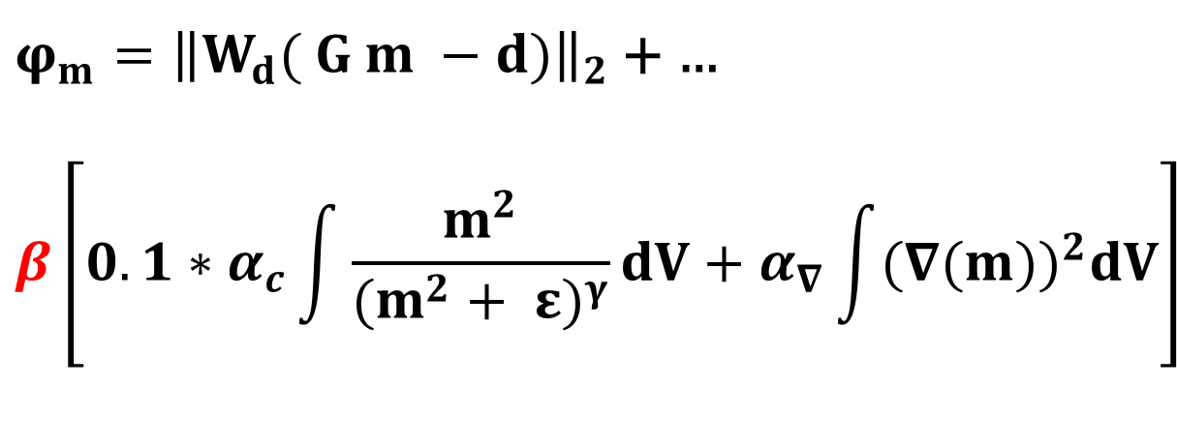





Radar Imaging
Reference: Holliger, K. Musil, M. 2001. Ray-based amplitude tomography for crosshole georadar data. Journal of Applied Geophysics 47: 285-298
Objective function:
Various trade-off parameters…
$$β={10}^{0}$$
$φ_{m}={\left\|W_{d}( G m −d)\right\|}_{2}$ + …
$$β\left[{0.1∗α}_{c}\int{\frac{m^{2}}{{(m^{2}+ ε)}^{γ}}dV+α_{∇}\int{{(∇(m))}^{2}dV}}\right]$$
$$β=0$$
$$β={10}^{1}$$
$$β={10}^{2}$$
$$β={10}^{3}$$
$$β={10}^{4}$$
where $W_{d}=\left[\begin{matrix}(\frac{1}{r_{1}} & ⋯ & 0 \\ ⋮ & ⋱ & ⋮ \\ 0 & ⋯ & \frac{1}{r_{n}}\end{matrix}\right]$
Models
$$Observed data$$
$Predicted$ data
$φ_{m}={\left\|W_{d}( G m −d)\right\|}_{2}$ +
$${10}^{2}\left[α_{c}\int{\frac{m^{2}}{{(m^{2}+ ε)}^{γ}}dV+α_{∇}\int{{(∇(m))}^{2}dV}}\right]$$
Various $α_{c}/α_{∇}$ ratios
$$α_{c}=0$$
$$α_{c}=0.2$$
$$α_{c}=0.4$$
$$α_{c}=0.6$$
$$α_{c}=0.8$$
$$α_{c}=1.0$$

