Slide 1
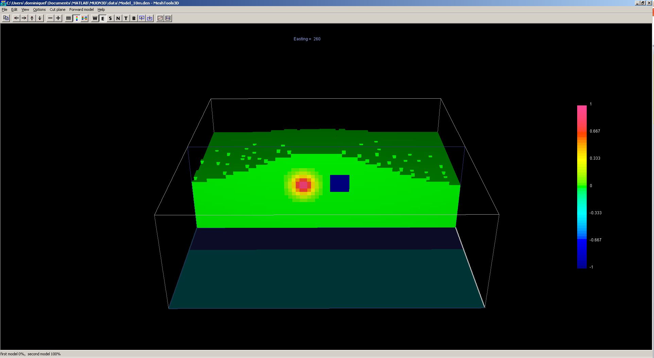
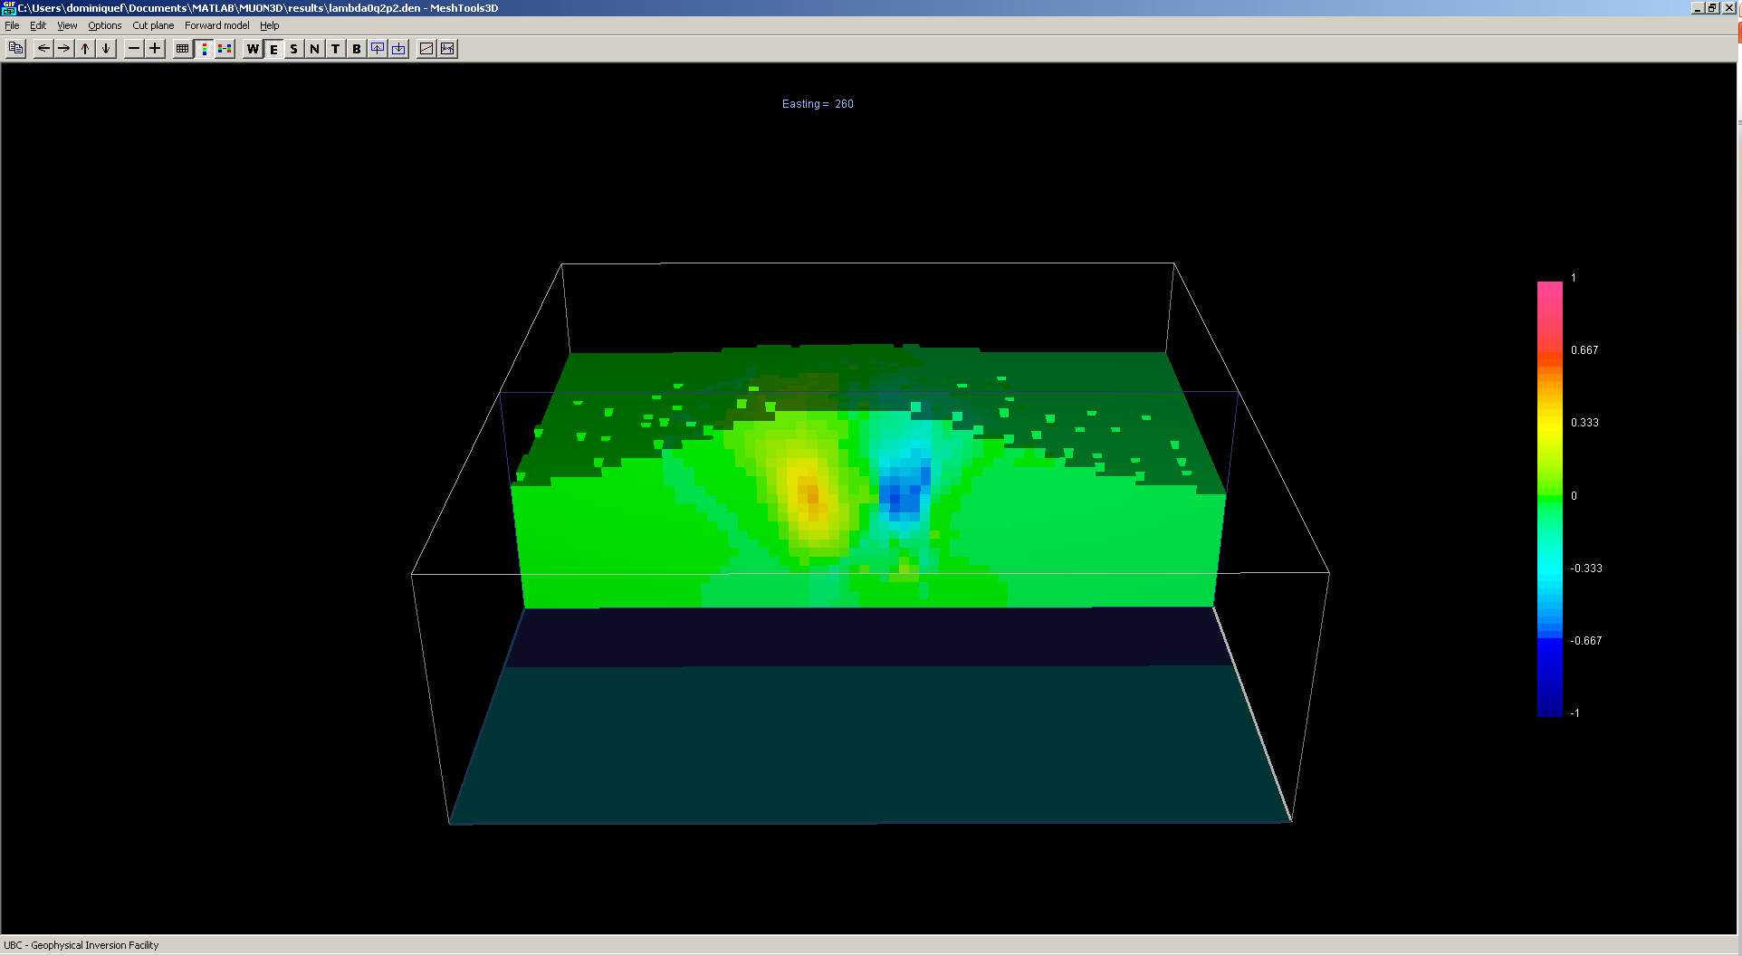
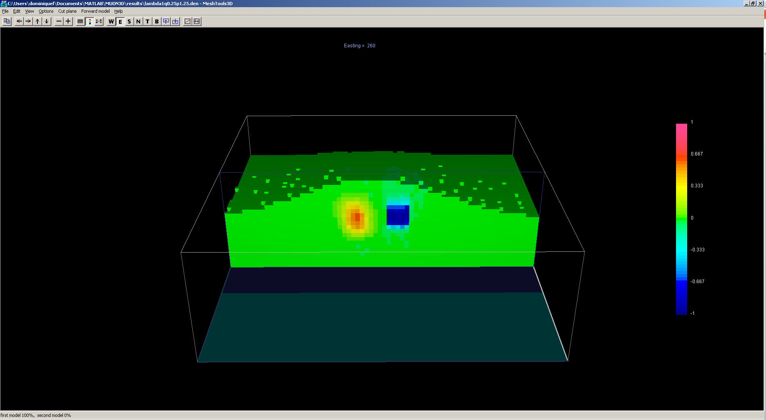
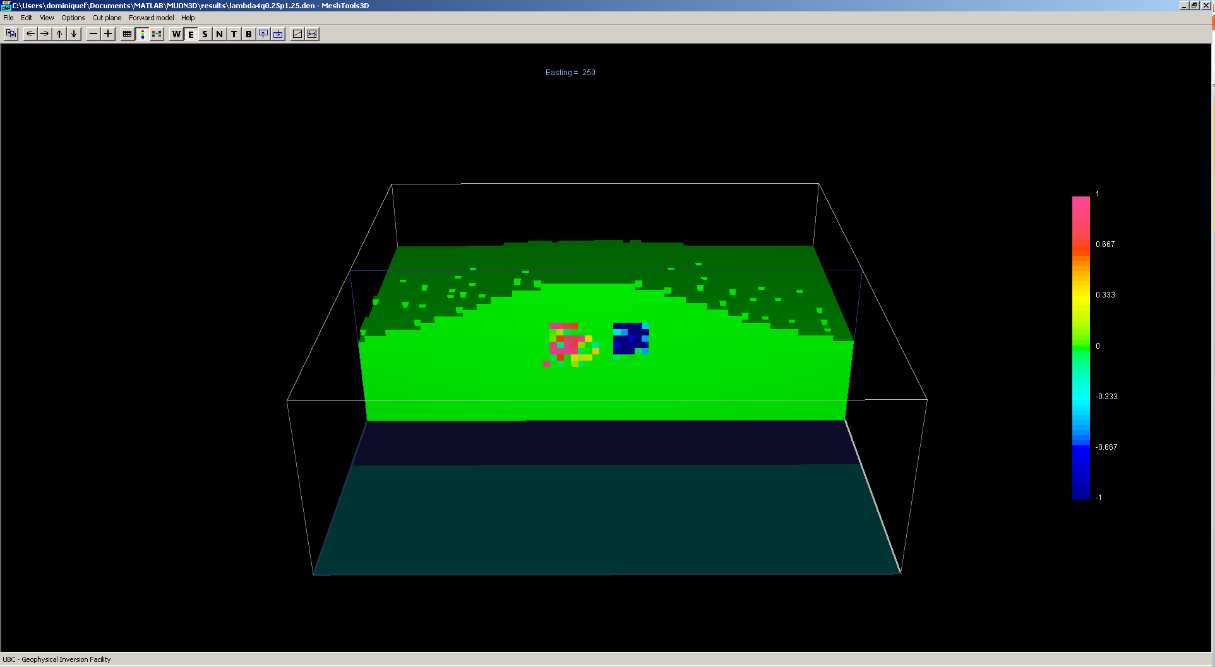
True model: 10 x 10 x 10m cells
1M cells
2880 data
Lambda:0.0, lq: 2.0, lp: 2.0
Lambda:1.0, lq: 0.25, lp: 1.25
Lambda:4.0, lq: 0.25, lp: 1.25

