Slide 1
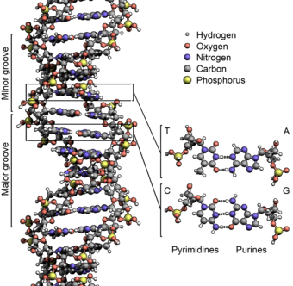

Slide 2
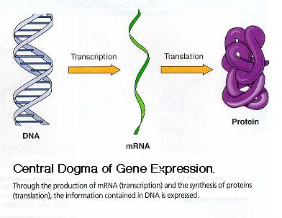

Slide 3
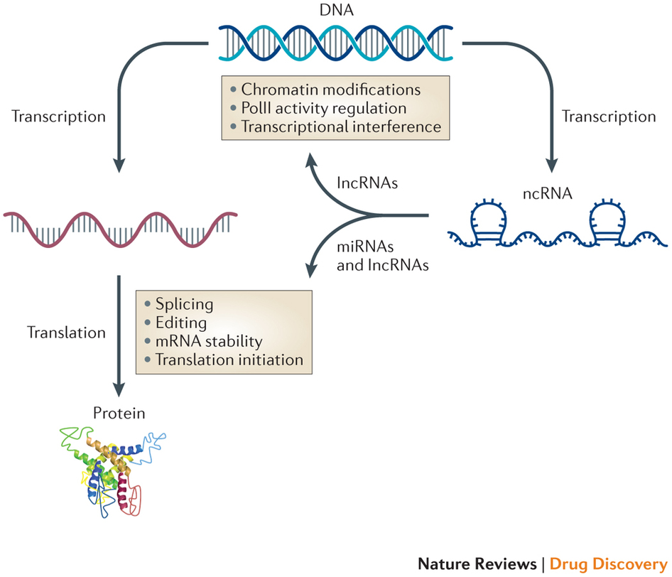

Slide 4
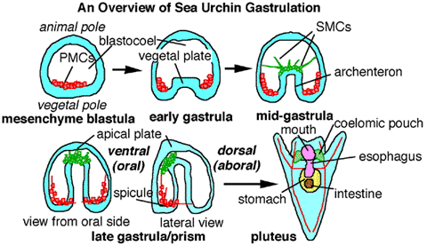

Slide 5
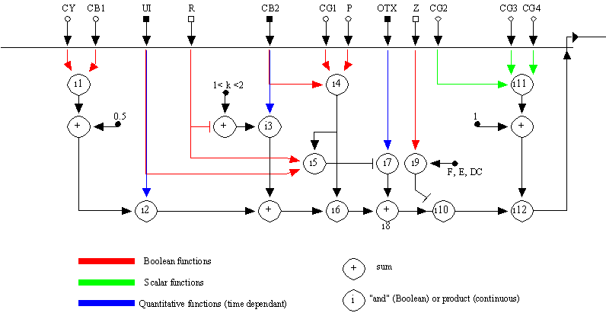

Slide 6
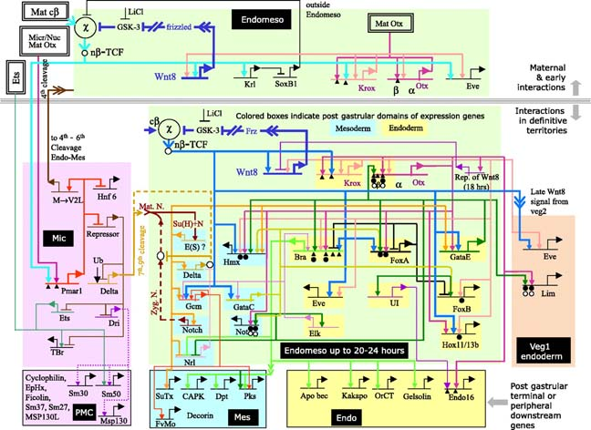

Slide 7
Biological networks
Some links specified by regions of DNA
Protein interactions, RNA/RNA, RNA/DNA, RNA/Protein, cell signalling
Exhibit modular structure
  Components
  Scalability

Slide 8
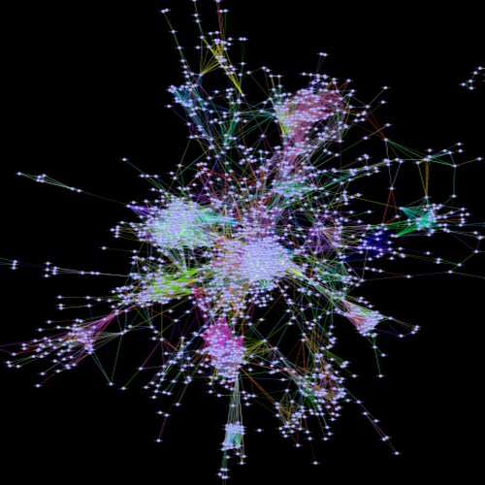
Modularity
System built of components

Slide 9
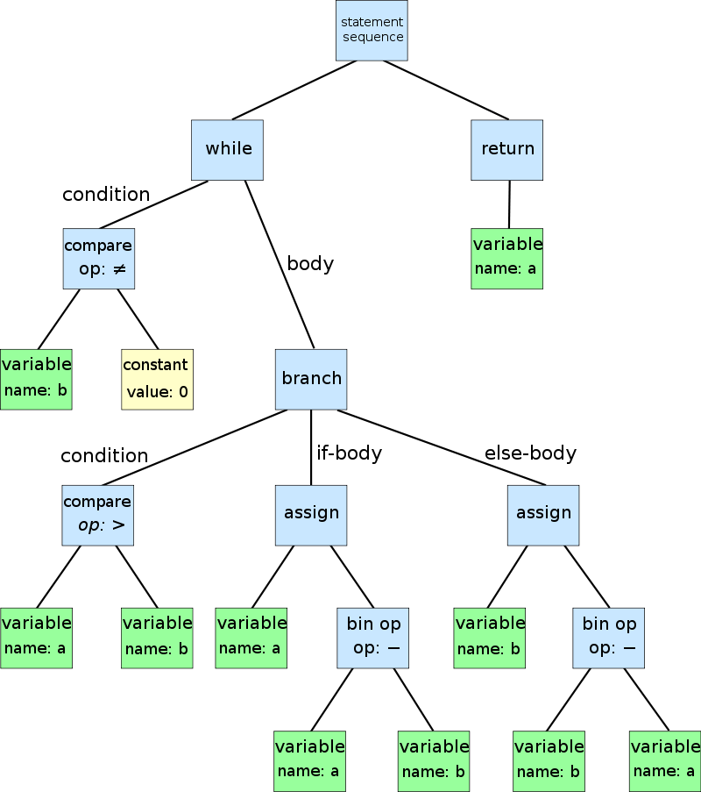
Program as tree

Slide 10
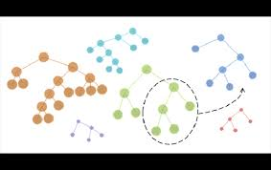

Slide 11
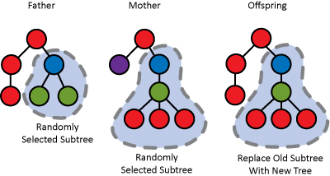

Slide 13
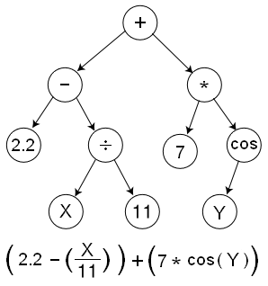

Slide 14
meetup.com/biocoders
@resurgo
peter@fourpartswater.com
@biocoders_uk
TensorFlow + 3D genome hackathon

Slide 15
Complexity and networks
Small simple networks can lead to complex structure/function = phenotype
Network links swapped changes higher level behaviour
Preferential swapping within modules allows scaling → more complex life

Slide 16
Genetic Programming
One type of genetic algorithm
  Populations of solutions
  Evolve by natural selection inspired processes
  Selection, mutation, recombination
Represent solutions to problems as computational trees
Human competitive for small systems
  Breaks patents

Slide 17
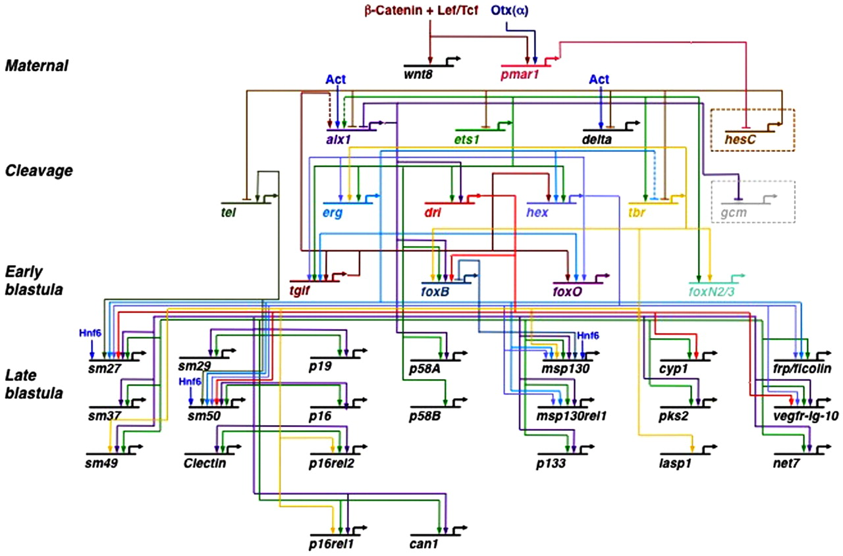

Slide 18
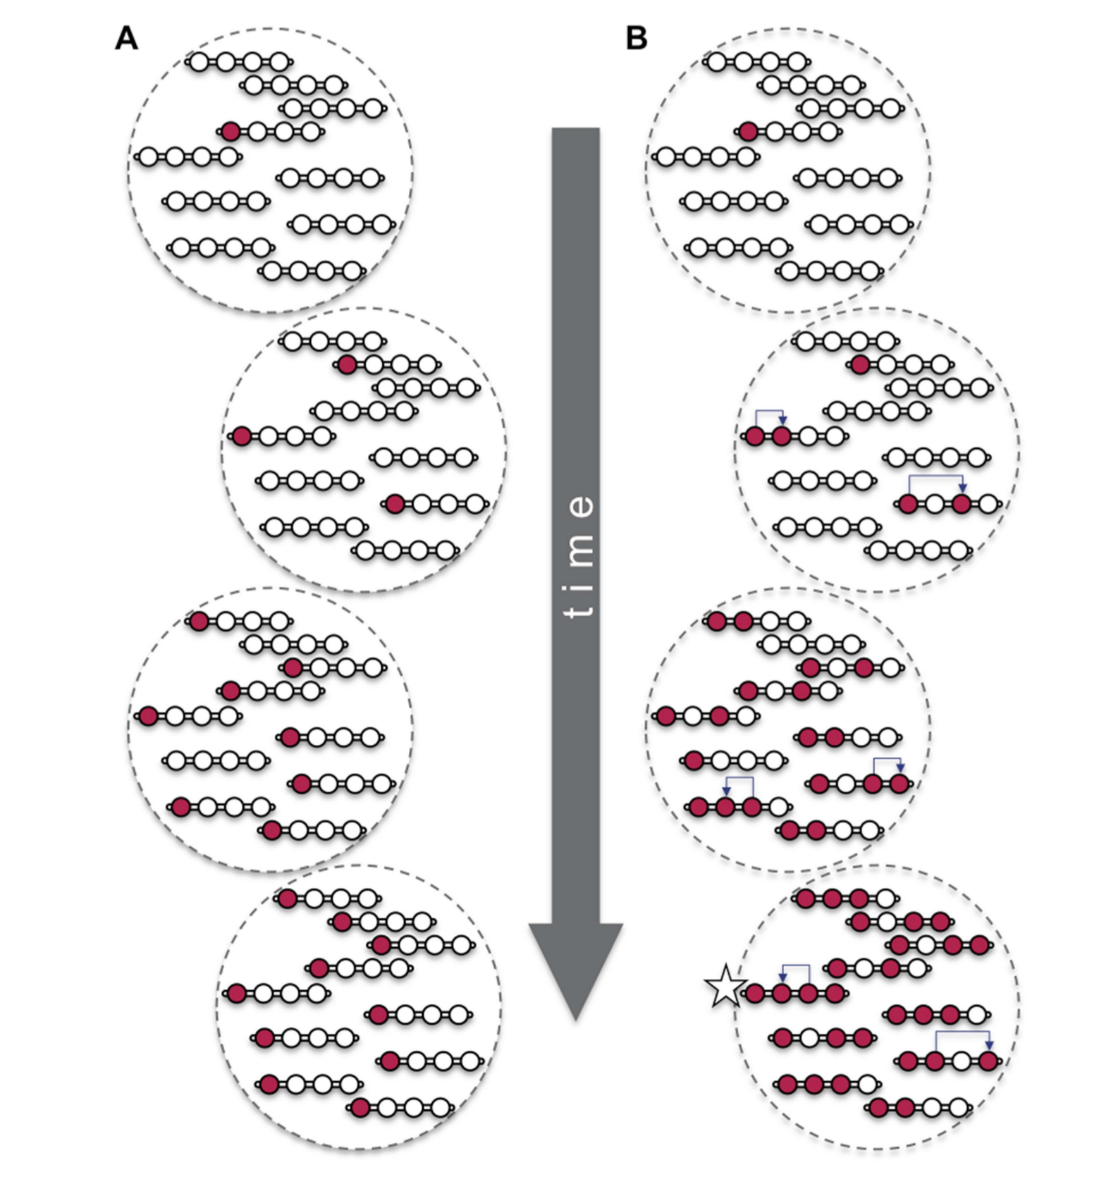

Slide 19
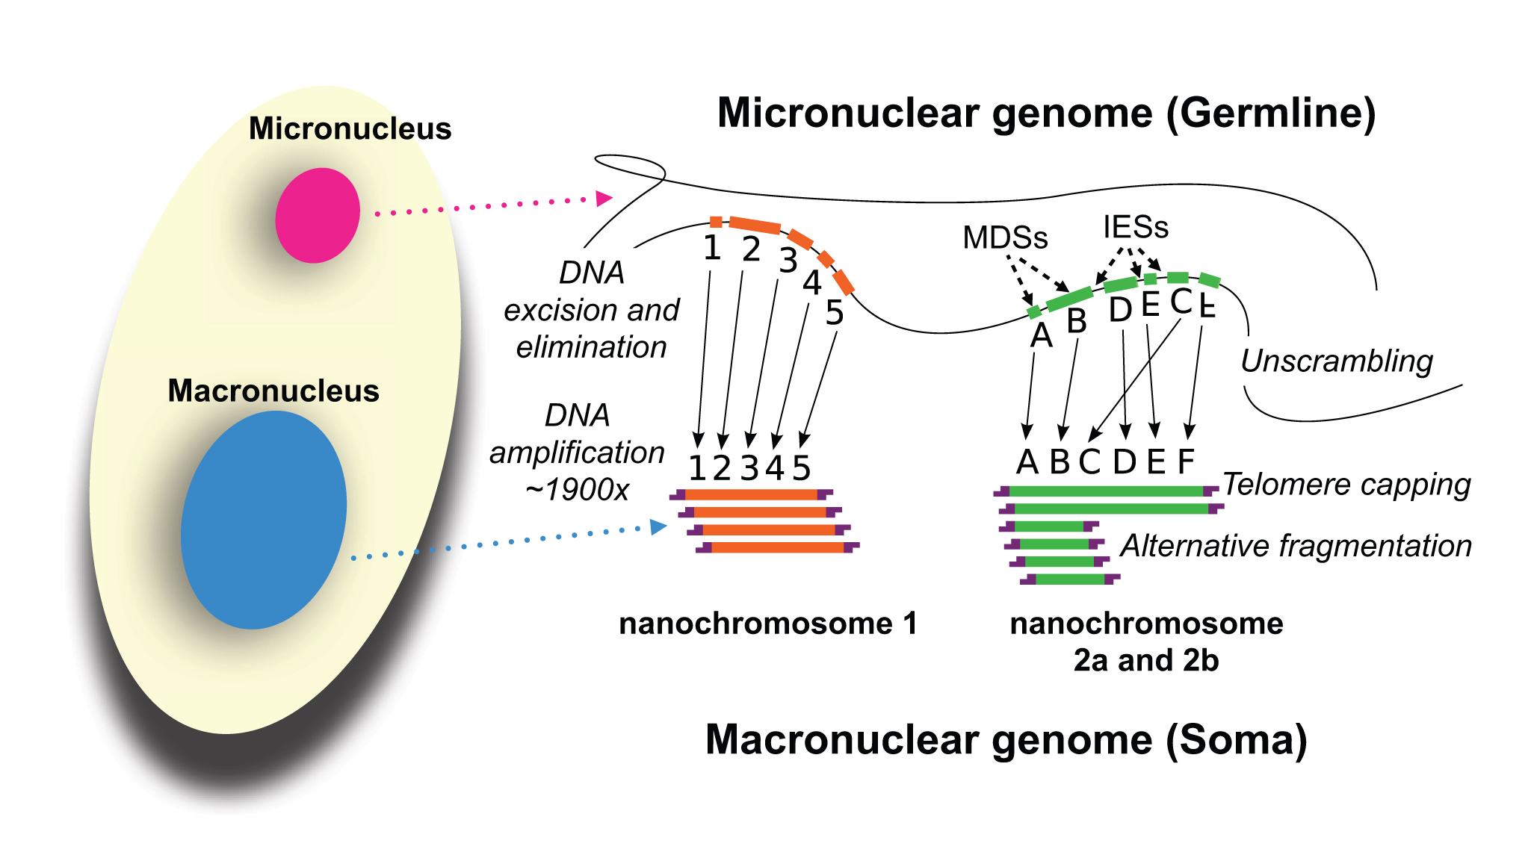

Slide 20
Scalability
GP not very scalable
Specialisation in subtrees broken by swapping
Network evolution
  Network connectivity determines behaviour
Modular evolvability
How might the genome do this?

Slide 23
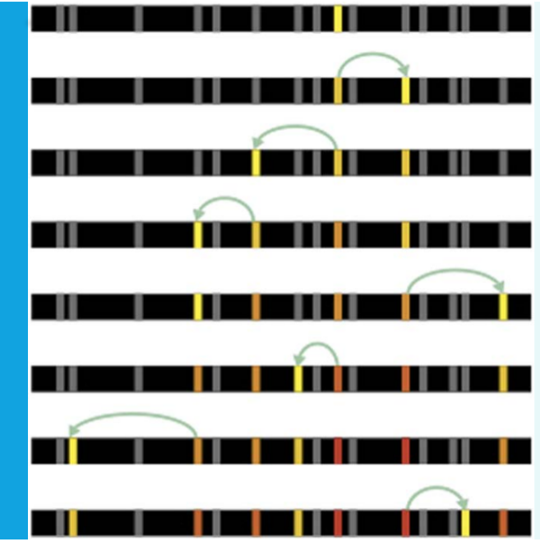

Slide 24
Gene conversion and repeats
Majority of genome repetitive sequence
Provides template for exchange of DNA – network connections
Maintained by short term selection on new links – hitchhiking homology
Repetitive landscape conserved and evolves
Links selected for increase linkage
  Not the case if no selection

