Slide 1
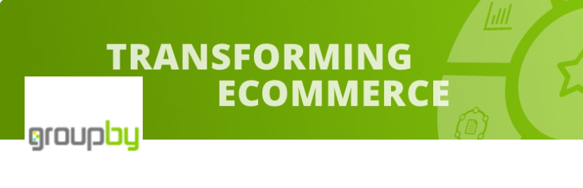
GroupBy Project Presentation
Janice Tjeng, Paulo Kuong
Notes:
Introduce groupby: e-commerce startup based in Canada that aims to create highly converting and relevant site experience to maximize revenue through online shopping in e-comm channels. For this project, we are going to focus on implementing the conversion and personalization aspects.

Slide 2
Agenda
Problem
Demo
Data
Solution
Results
Analysis
Conclusions & Future work

Slide 3
Problem
Online shopping
Customer journey
Session-level
Personalization
Recommend items based on customer journey
“A lot of times, people don’t know what they want until you show it to them” (Steve Jobs)¹
Conversion
Predict purchase based on session-level
Nudge models and automated inventory²
Increase revenue, decrease churn¹
Polachowska, K (2019). Is it Worth It? ROI of Recommender Systems. AI Zone. Link.
Roychowdry et al. (2021). Online Purchasing-behavior Analysis using Machine Learning. ARXIV. Link.
Notes:
Animation
Maximize engagement using online shopping behavior data
2 levels of data customer journey and session-level data to predict purchase and recommend items
Result: Amazon reported increase in revenue by 35%
(1 min)

Slide 4
Demo
Click to show interactive demo
Notes:
Demo should be half

Slide 5
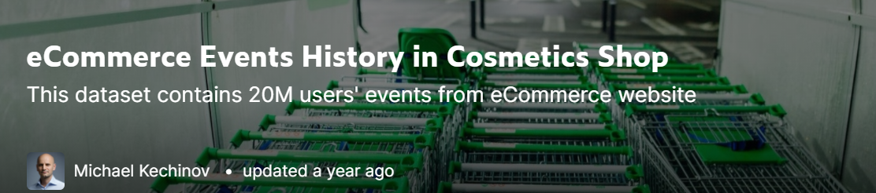
Data
2 data sets
Public Kaggle data³
Internal GroupBy data
Columns | Description
User ID | Permanent user identifier
Session ID | Temporary session identifier
Product ID | Product identifier
Product Category | Collection of product
Event Type | Search, view, add to cart, remove from cart, purchase
Product Price | Price of product
3. Kechinov, M (2020). eCommerce Events History in Cosmetics Shop. Kaggle. Link.
Notes:
For comparison and benchmarking
Items in each dataset

Slide 6
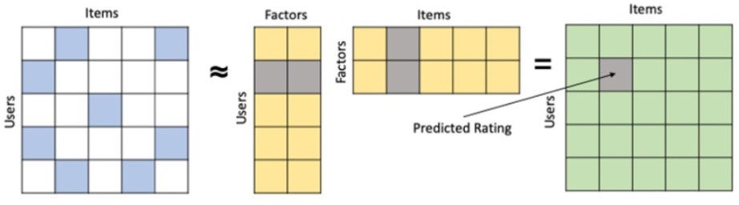
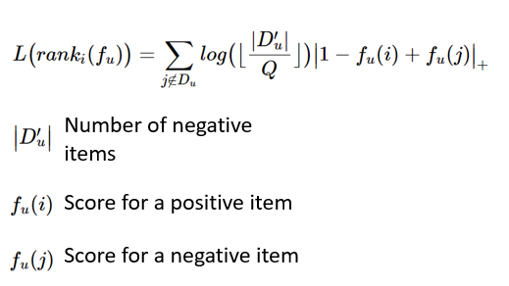
Technique - Personalization
User-Item Collaborative Filtering Matrix Factorization
Ranking loss function optimize for purchase (binary 0: not purchase or 1: purchase)
Figure 1: Matrix Factorization⁴
Figure 2: Weighted Average Rank Pairwise (WARP) Loss⁵
4. Lundquist, E. (2020). Factorization Machines for Item Recommendation with Implicit Feedback Data. Towards Data Science. Link.
5. Weston et al. (2011). Scaling up to large vocabulary image annotation. IJCAI. Link
Notes:
Score a user has rated for an item is a binary 0 or 1
Ranking loss function: Score for an item, sort and rank by descending order
Number of factors is tuned later on

Slide 7
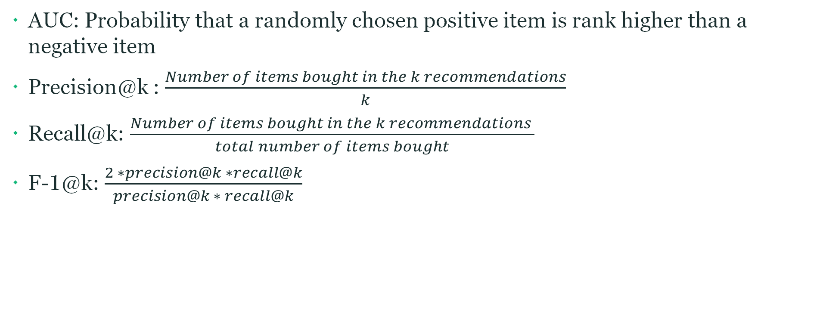
Offline Metrics - Personalization
AUC: Probability that a randomly chosen positive item is rank higher than a negative item
Precision@k : $\frac{Number of items bought in the k recommendations}{k}$
Recall@k: $\frac{Number of items bought in the k recommendations }{total number of items bought}$
F-1@k: $\frac{2 ∗precision@k ∗recall@k}{precision@k ∗ recall@k}$
Notes:
Just mention
Fraction of items bought out of the k recommended items
Number of items bought in the k recommendations/total number of items bought

Slide 8

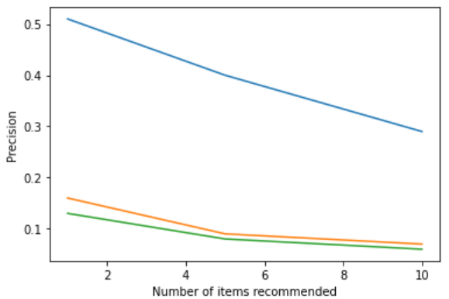
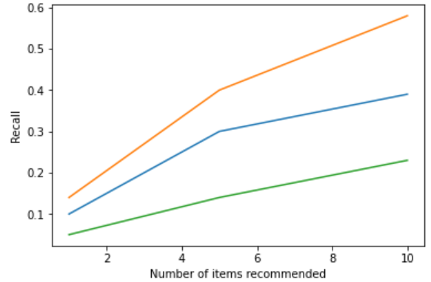
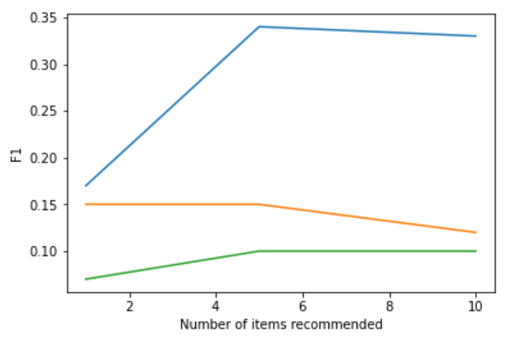
Results - Personalization

Slide 9
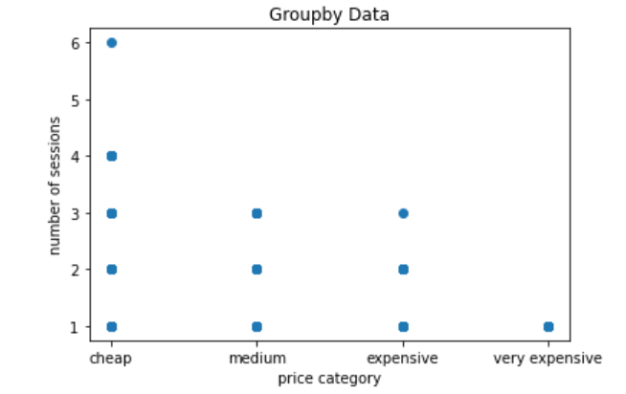
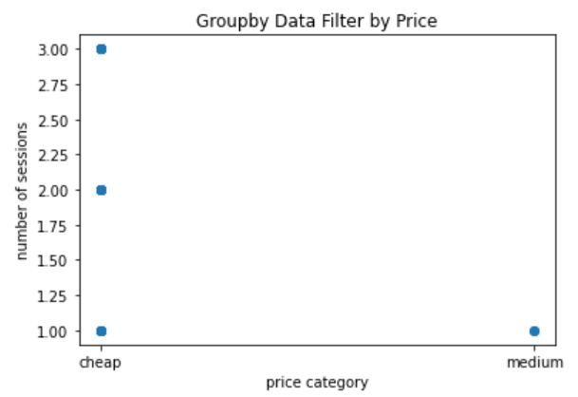
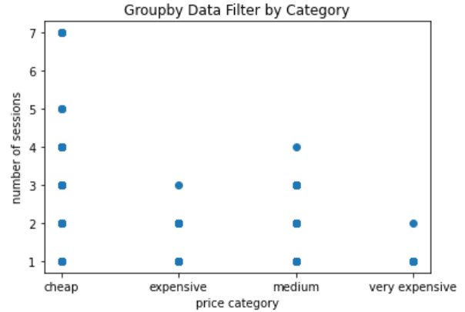
Analysis – Personalization: GroupBy Data
AUC: 0.89
P@5: 0.4
R@5: 0.3
17408 products
AUC: 0.98
P@5: 0.56
R@5: 0.43
AUC: 0.69
P@5: 0.01
R@5: 0.05
17480 products
2649 products
Similar findings as the Kaggle dataset:
The more expensive an item is, the lesser the number of sessions required for purchase
Focusing on a specific product category results in the best model performance
However, using the whole data set for GroupBy improves model performance compared to the Kaggle dataset.
Notes:
Transition to conversion: now we looked at customer level data where sessions are aggregated based on customer login, we are going to look at session level data where a new ID is assigned if the user does not log in, for predicting conversion
Cheap below $24, medium between 24 & 48, expensive between 48 and 94, very expensive, greater than 94
This might be due to the number of sessions to purchase. In the groupby dataset, there are fewer sessions (1 day of data) and less overlap between number of sessions to purchase across products of different prices. While on the Kaggle dataset, there are more sessions and items (5 months of data) and more overlap, which makes it harder for a user to purchase an item that is recommended.
Important to include brand as a feature

Slide 10
Conclusions & Future Work
Optimize for user-item scores using number of views, sessions to purchase, number of clicks per session
Hybrid model with user and item features to overcome cold-start problem
Additional data sources such as holidays, events, to indicate user’s preference
Online evaluation methods

Slide 11
Thank You!

