Slide 1
Sliding Mode Control of Nonlinear Systems
Austin Smith and Rhet Hailey
Feedback Control of Dynamic Systems
Final Project
May 4, 2023

Slide 2


Problem Statement
Classical control techniques, such as PID, perform best when system is LTI
Nonlinear systems can be linearized to implement classical control approaches, but models are not valid for controlling outside of the region
How can we control systems outside the
linearized region?
$$θ$$
$$θ$$

Slide 3
Outline
Problem Statement
Background
System 1: Inverted Pendulum
Model Derivation
SMC and Classical Control Comparison
Raw Measurements and State Estimation Comparison
System 2: Cart and Pendulum
Model Derivation
SMC and Classical Control Comparison
Raw Measurements and State Estimation Comparison
Conclusions
Future Work

Slide 4
Sliding Mode Control Overview

Slide 5
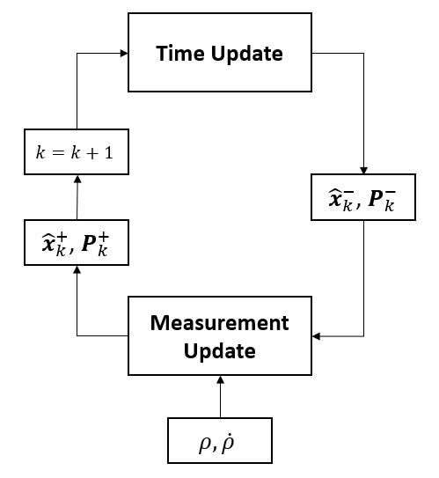
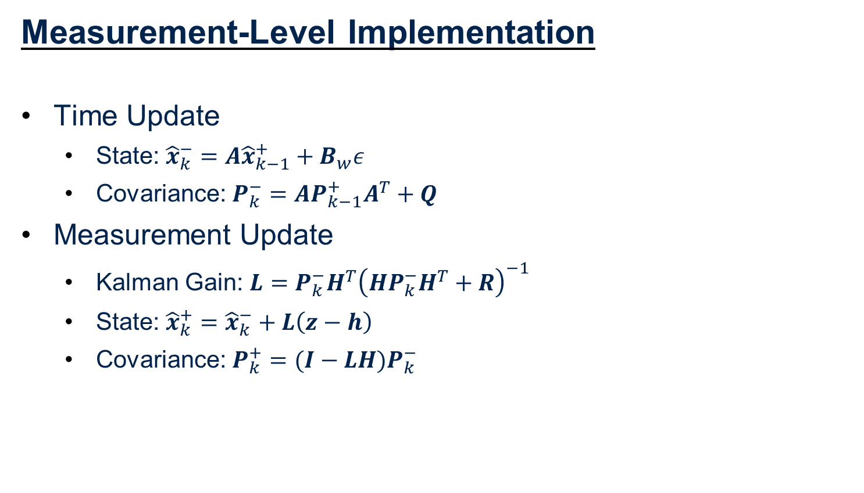
Full-State Extended Kalman Filter (EKF)
Measurement-Level Implementation
Time Update
State: ${\hat{x}}_{k}^{−}=A{\hat{x}}_{k−1}^{+}+B_{w}ε$
Covariance: $P_{k}^{−}=AP_{k−1}^{+}A^{T}+Q$
Measurement Update
Kalman Gain: $L=P_{k}^{−}H^{T}{\left(HP_{k}^{−}H^{T}+R\right)}^{−1}$
State: ${\hat{x}}_{k}^{+}={\hat{x}}_{k}^{−}+L\left(z−h\right)$
Covariance: $P_{k}^{+}=(I−LH)P_{k}^{−}$

Slide 6
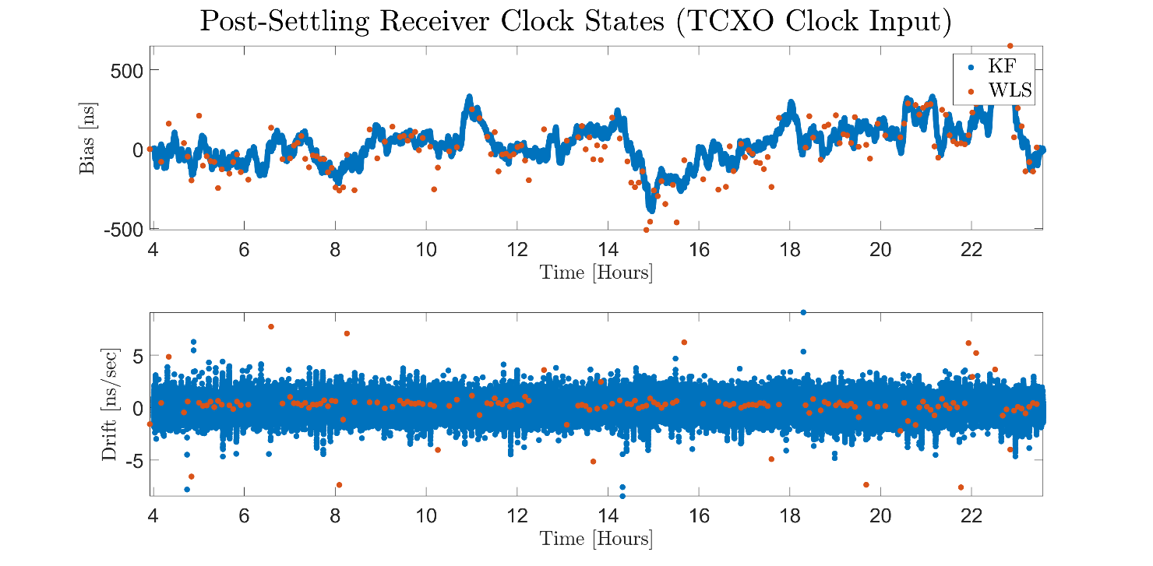
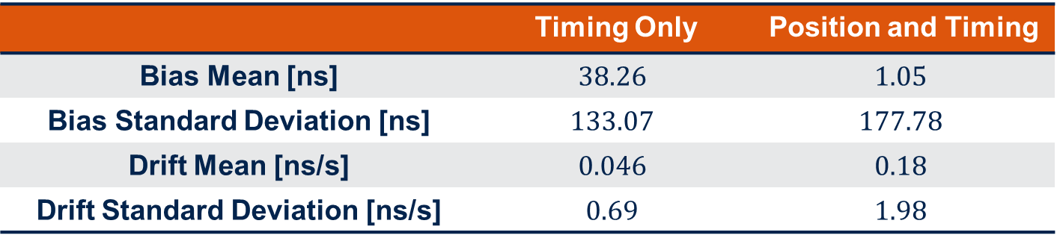
Estimation Configuration 1 Results
 | Timing Only | Position and Timing
Bias Mean [ns] | $$38.26$$ | $$1.05$$
Bias Standard Deviation [ns] | $$133.07$$ | $$177.78$$
Drift Mean [ns/s] | $$0.046$$ | $$0.18$$
Drift Standard Deviation [ns/s] | $$0.69$$ | $$1.98$$

Slide 7
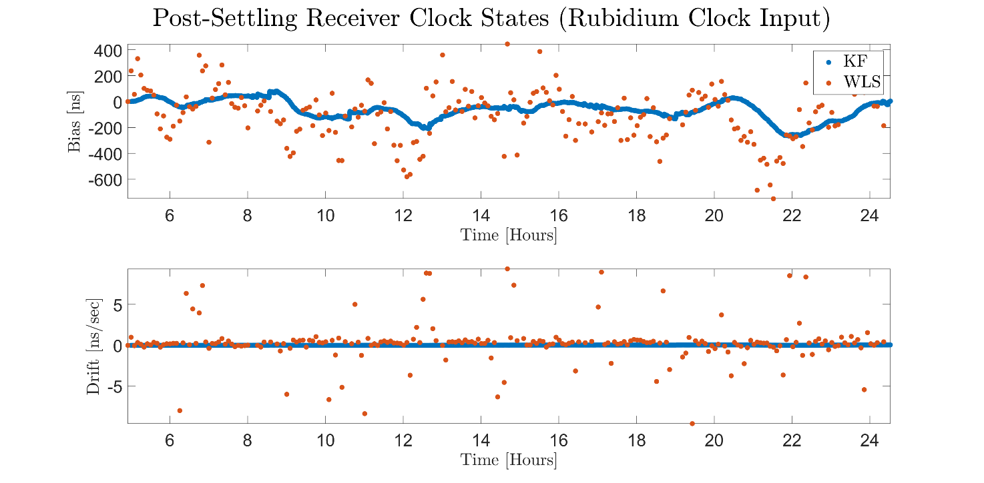
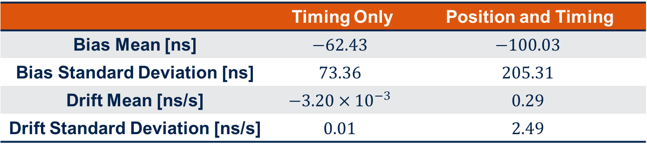
Estimation Configuration 2 Results
 | Timing Only | Position and Timing
Bias Mean [ns] | $$−62.43$$ | $$−100.03$$
Bias Standard Deviation [ns] | $$73.36$$ | $$205.31$$
Drift Mean [ns/s] | $$−3.20×{10}^{−3}$$ | $$0.29$$
Drift Standard Deviation [ns/s] | $$0.01$$ | $$2.49$$

Slide 8

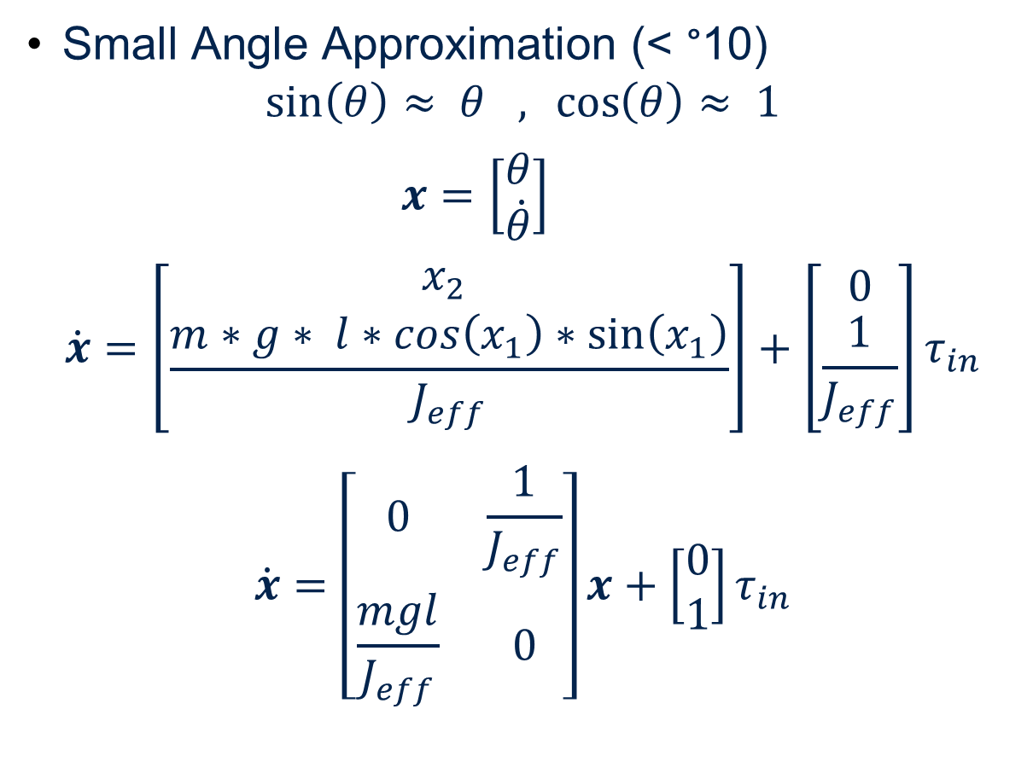

Inverted Pendulum – EOM
Small Angle Approximation (< °10) $\sin\left(θ\right)≈ θ , \cos\left(θ\right)≈ 1$
$x=\left[\begin{matrix}θ \\ \dot{θ}\end{matrix}\right]$
$$\dot{x}=\left[\begin{matrix}x_{2} \\ \frac{m∗g∗ l∗cos\left(x_{1}\right)∗\sin\left(x_{1}\right)}{J_{eff}}\end{matrix}\right]+\left[\begin{matrix}0 \\ \frac{1}{J_{eff}}\end{matrix}\right]τ_{in}$$
$$\dot{x}=\left[\begin{matrix}0 & \frac{1}{J_{eff}} \\ \frac{mgl}{J_{eff}} & 0\end{matrix}\right]x+\left[\begin{matrix}0 \\ 1\end{matrix}\right]τ_{in}$$
m
$$θ$$
l
y
$$τ$$
x

Slide 9

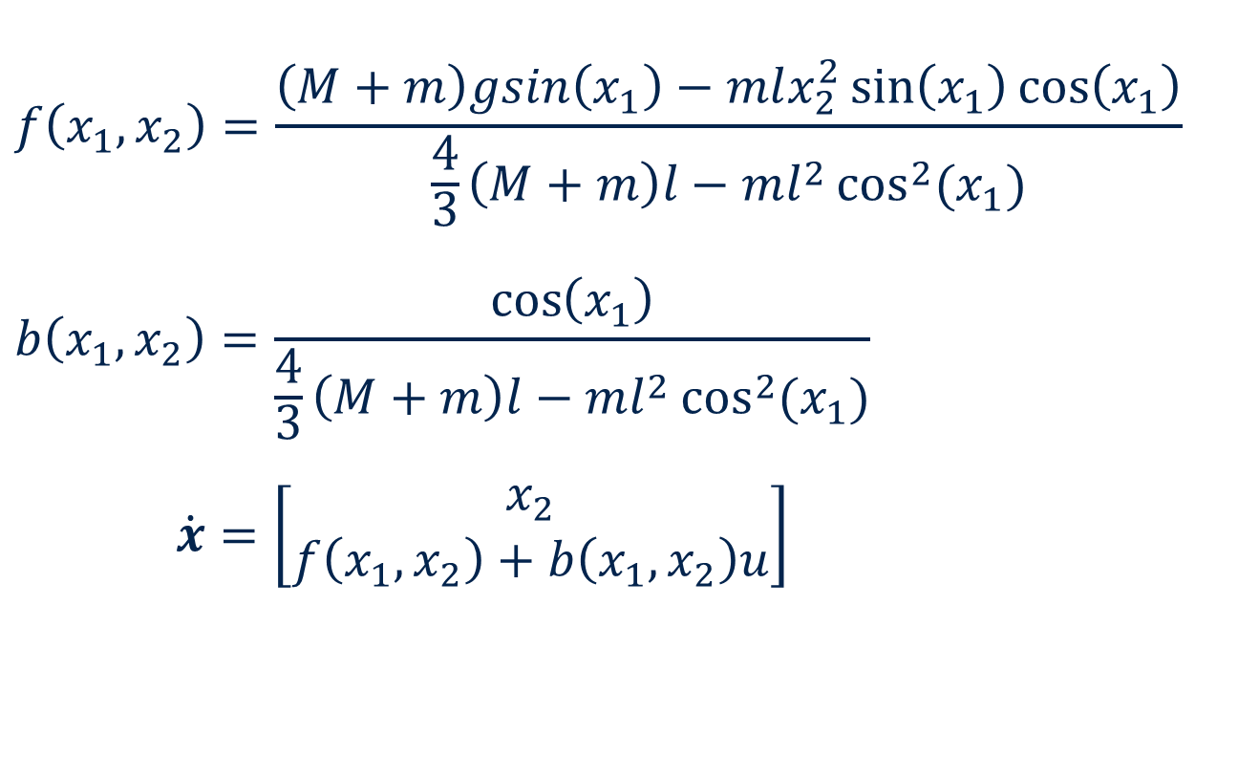

Cart and Pendulum – EOM
$$f\left(x_{1},x_{2}\right)=\frac{\left(M+m\right)gsin\left(x_{1}\right)−mlx_{2}^{2}\sin\left(x_{1}\right)\cos\left(x_{1}\right)}{\frac{4}{3}\left(M+m\right)l−ml^{2}\cos^{2}{(x_{1})}} \\ b\left(x_{1},x_{2}\right)=\frac{\cos\left(x_{1}\right)}{\frac{4}{3}\left(M+m\right)l−ml^{2}\cos^{2}{(x_{1})}}$$
$\dot{x}=\left[\begin{matrix}x_{2} \\ f\left(x_{1},x_{2}\right)+b\left(x_{1},x_{2}\right)u\end{matrix}\right]$
m
$$θ$$
y
l
x
M
$$F$$

Slide 10
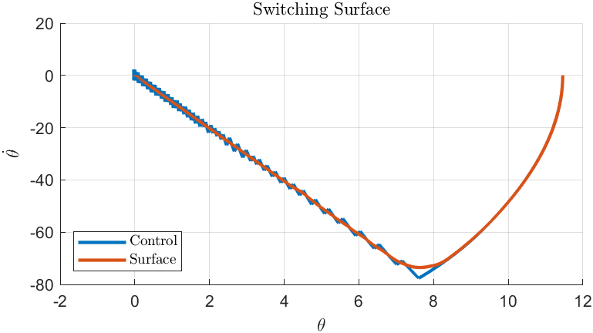
Cart and Pendulum

Slide 11
Conclusions
Conclusions
In both experiments, Iridium STL demonstrated the capability to provide nanosecond-level timing accuracy
Knowledge of receiver position significantly improves the accuracy and stability of the estimation solution
The on-board TCXO is suitable for maintaining precise timing with the STL signal, but highly-stable oscillators, such as rubidium, further improve performance
Future Work
Implement calibration methods to reduce mean error in the time interval study
Test indoor receiver timing solutions

Slide 12
References
O’Connor, A.C., Gallaher, M.P., Clark-Sutton, K., Lapidus, D., Oliver, Z.T., Scott, T.J., Wood, D.W., Gonzalez, M.A., Brown, E.G., and Fletcher, J. 2019, June. Economic Benefits of the Global Positioning System (GPS). RTI Report Number 0215471. Sponsored by the National Institute of Standards and Technology. Research Triangle Park, NC: RTI International
Fisher, K. A. (2005). The Navigation Potential of Signals of Opportunity-based Time Difference of Arrival Measurements. Ph. D. Dissertation, Air Force Institute of Technology.
Morales, J. J., Khalife, J., Abdallah, A. A., Ardito, C. T., and Kassas, Z. M. (2018). Inertial Navigation System Aiding with Orbcomm LEO Satellite Doppler Measurements. In 31st International Technical Meeting of The Satellite Division of the Institute of Navigation (ION GNSS+ 2018), pages 2718–2725, Miami, Florida.
Hayek, S., Saroufim, J., Neinavaie, M., Kozhaya, S., and Kassas, Z. M. (2023). Assessment of Differential Doppler Navigation with Starlink LEO Satellite Signals of Opportunity. In 2023 International Technical Meeting of The Institute of Navigation, pages 1021–1031, Long Beach, California.
Khalife, J. J. and Kassas, Z. M. (2019). Receiver Design for Doppler Positioning with Leo Satellites. In ICASSP 2019 - 2019 IEEE International Conference on Acoustics, Speech and Signal Processing (ICASSP), pages 5506–5510, Brighton, United Kingdom. IEEE.
Benzerrouk, H., Nguyen, Q., Xiaoxing, F., Amrhar, A., Nebylov, A. V., and Landry, R. (2019). Alternative PNT based on Iridium Next LEO Satellites Doppler/INS Integrated Navigation System. In 2019 26th Saint Petersburg International Conference on Integrated Navigation Systems (ICINS), pages 1–10, Saint Petersburg, Russia. IEEE.
Tan, Z., Qin, H., Cong, L., and Zhao, C. (2019). Positioning Using IRIDIUM Satellite Signals of Opportunity in Weak Signal Environment. Electronics, 9(1):37.
Kassas, M., Morales, J. J., and Khalife, J. J. (2019). New-Age Satellite-Based Navigation STAN: Simultaneous Tracking and Navigation with LEO Satellite Signals. Inside GNSS, 4600.
Mortlock, T. R. and Kassas, Z. M. (2020). Performance Analysis of Simultaneous Tracking and Navigation with LEO Satellites. In 33rd International Technical Meeting of the Satellite Division of The Institute of Navigation (ION GNSS+ 2020), pages 2416–2429.
Zhao, C., Qin, H., Wu, N., and Wang, D. (2023). Analysis of Baseline Impact on Differential Doppler Positioning and Performance Improvement Method for LEO Opportunistic Navigation. IEEE Transactions on Instrumentation and Measurement, 72:1–10.

Slide 13
Questions?
Thank you!

