Slide 1
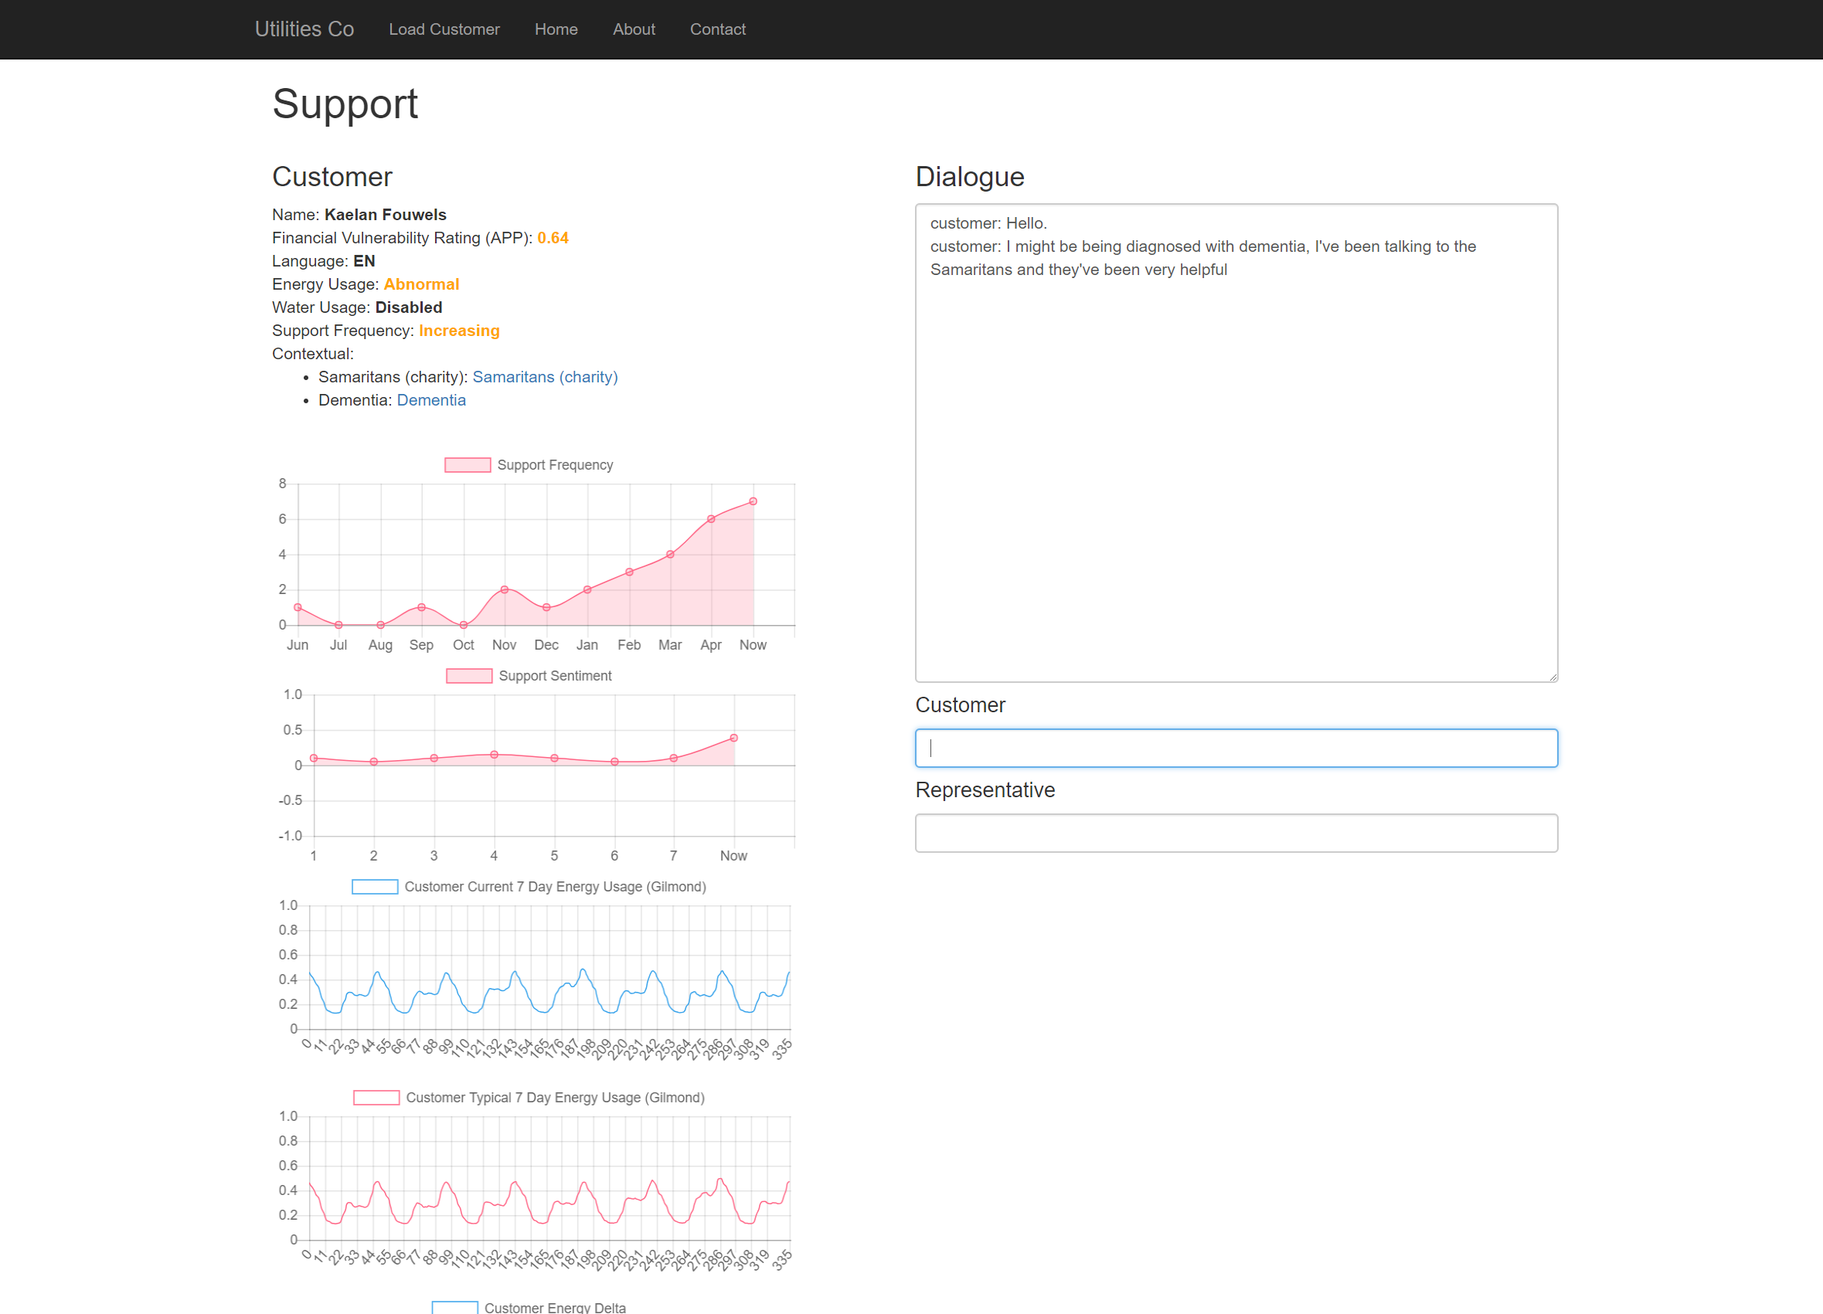

Slide 2
Use machine learning to aid in the early detection of vulnerability traits, through it’s application to a customers historical utility usage data and support interactions.

Slide 3
How?
Analyse customers historical information and energy usage for changes and anomalies.
Build up a profile of a user based on support interactions and trends in their utility usage.
Highlight potential indicators, and provide contextual information to aid in proactive response and continued support of the customer.

Slide 4
Sample Application
Sentiment trends across support interactions
Frequency trends of support requests
Energy usage trends – Smart meter integration (Via Gilmond API)
Financial Vulnerability – Open banking team’s API
Machine Learning Key Text Entity Extraction

Slide 5
Sample Demonstration

Slide 6
What can we do
Better leverage a customers historical utility usage information to detect changes in behaviour that indicate vulnerability.
Generate applications to allow “smart” meter usage data be used to it’s full potential.
Aid in proactive customer support through integrating machine learning and textual analysis on existing data alongside a human support agent.

