Slide 1
Disease Detection Using Ensemble Learning , Transfer Learning and Explainable AI Techniques
Improving Accuracy & Trust in AI-Driven Medical Diagnosis
Fouzia Zilani
2012176111

Slide 2
Introduction
What is Disease Detection using AI?
AI models help doctors in predicting diseases based on patient data.
Helps in early diagnosis, reducing human errors, and improving treatment planning.
Challenges in Current AI-based Disease Detection
Lack of interpretability (black-box AI models are not trusted by doctors).
Data imbalance (rare diseases have less data, leading to biased predictions).
Solution
Hybrid method: Combining Transfer Learning + Ensemble Learning.
Explainability: Using SHAP & LIME to make AI decisions transparent.
Key Outcome: Higher accuracy, generalizable, and reliable AI predictions.

Slide 3
What I Did
Collected multiple healthcare datasets (Heart, Diabetes, Parkinson’s, Kidney, Breast Cancer).
Reviewed research papers and thesis work related to:
  Machine Learning (SVM, Decision Trees, Random Forest)
  Deep Learning (ANN, CNN)
  Transfer Learning & Explainability (SHAP, LIME)
Analyzed gaps in current approaches.
Datasets:
UCI Heart Disease Dataset
Diabetes Dataset
Parkinson’s Dataset
Kidney Dataset
Breast Cancer Dataset

Slide 4
Why I Did It
Current AI models are often black boxes, doctors can’t trust what they don’t understand.
Many models fail to generalize due to imbalanced data or overfitting.
It requires a model that combines accuracy, transparency, and reliability.
Requirement Specification
Datasets: UCI Heart, Diabetes, Parkinson’s, Kidney, Breast Cancer.
Tools: Python, Scikit-learn, PyTorch/TensorFlow, SHAP, LIME.
Models required:
  Pre-trained Tabular models (TabNet, SAINT)
  Ensemble models (XGBoost, LightGBM, Random Forest)

Slide 5
Methodologies :
1.Input: Patient symptoms (Example: fever, sugar, cough, etc.).
2.Filling missing value in datasets and normalizing the values.
3.Splitting datasets into training and testing data.
4.Extracting features from symptoms using transfer learning from pretrained model (Example: TabNet, SAINT).
5.Predicting final disease using Ensemble learning(XGBoost, LightGBM, and Random Forest).
6.Explainability Using SHAP & LIME.

Slide 6
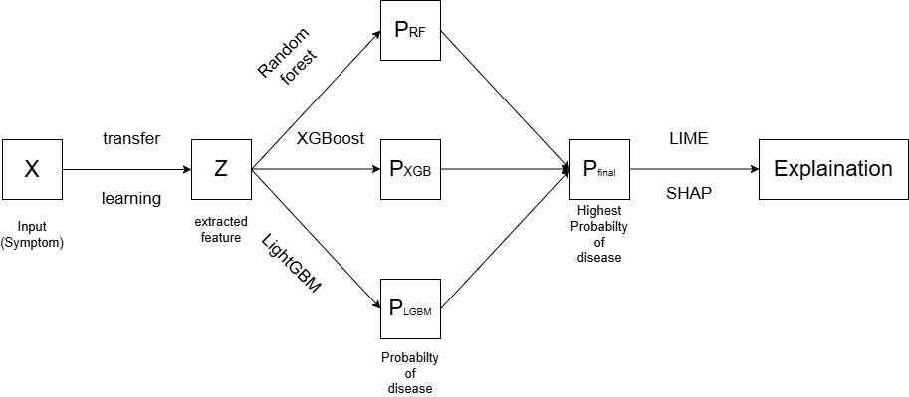
Program Flow:

Slide 7
Outcomes
Improved Accuracy:
  5-10% improvement compared to traditional ML.
Better Generalization:
  Works well across multiple disease datasets.
Transparent Predictions:
  Doctors can understand model output using SHAP/LIME.
Timeline:
Task | Timeframe
Data Collection | Week 1–2
Literature Review | Week 2–3
Model Development | Week 4–6
Integration + Testing | Week 7–8
Evaluation & Explainability | Week 9
Final Report & Presentation | Week 10

Slide 8
Conclusion
Developed a hybrid AI system for disease detection using Transfer + Ensemble Learning.
Introduced explainability to build trust with medical professionals.
Achieved higher accuracy and reliable predictions across various datasets.

Slide 9
Thank You

