Slide 1
Disease Prediction Using Ensemble Learning and
XAI: A Comparative Study on Heart, Diabetes,
Kidney, Parkinson’s and Breast Cancer Datasets
Fouzia Zilani
Student ID: 2012176111
Session: 2019-20
Course: CSE4202
University of Rajshahi

Slide 2
Introduction
Early disease diagnosis saves lives and reduces healthcare costs.
Traditional diagnostic systems are time-consuming, error-prone, and inconsistent.
ML can detect hidden patterns in medical data.
The current study introduces an ensemble-based predictive framework supported by Explainable Artificial Intelligence (XAI) for five major diseases:
Heart Disease
Diabetes
Chronic Kidney Disease (CKD)
Parkinson’s Disease
Breast Cancer
The goal is to design a transparent, generalizable, and accurate diagnostic system.
2 of 18

Slide 3
Problem We Solved
Challenges in prior research:
Models lacked consistency across datasets.
Class imbalance reduced performance on disease-positive cases.
Doctors could not interpret model’s decision.
Our Solution:
Used SMOTETomek to balance data and remove noise.
Built Ensemble Model (Soft Voting) combining Random Forest, XGBoost, LightGBM, CatBoost, SVM, and LR.
Integrated SHAP and LIME to explain predictions.
Result: A robust and interpretable framework that performs well for five major diseases.
3 of 18

Slide 4
Research Objectives
Develop independent predictive models for five diseases.
Apply advanced data preprocessing:
Missing value handling
Feature scaling
Encoding categorical features
Data balancing (SMOTETomek)
Train and optimize base classifiers:
Random Forest, XGBoost, LightGBM, CatBoost, SVM, and Logistic Regression.
Construct an Ensemble Soft Voting Classifier for improved robustness.
Evaluate models using Accuracy, Precision, Recall, F1-Score.
Apply SHAP and LIME for explainability of model predictions.
4 of 18

Slide 5
Workflow of the Proposed System
Dataset Collection
Data Cleaning & Preprocessing
SMOTETomek Balancing
Feature Scaling
Train Base Models
Ensemble Voting
Model Evaluation
XAI (SHAP & LIME) Interpretation
Model Evaluation & Deployment
↓
↓
↓
↓
↓
↓
↓
↓
5 of 18

Slide 6
Datasets Used
All datasets were obtained from UCI Machine Learning Repository:
Disease | Samples | Features | Type
Heart | 303 | 13 | Numeric + Categorical
Diabetes (PIMA) | 768 | 8 | Numeric
CKD | 400 | 24 | Mixed
Parkinson’s | 197 | 23 | Numeric
Breast Cancer | 569 | 30 | Numeric
6 of 18

Slide 7
Data Preprocessing
Steps implemented for all datasets:
Missing Data Handling:
  Mean/median imputation for missing lab values (e.g., hemoglobin, albumin).
Encoding:
  Label or One-Hot Encoding for categorical variables.
Outlier Treatment:
  Threshold-based filtering to handle extreme medical readings.
Feature Scaling:
  StandardScaler applied to normalize feature ranges.
Train-Test Split:
  Stratified 80:20 split to maintain class balance.
7 of 18

Slide 8
Handling Class Imbalance – SMOTETomek
Medical datasets often have fewer disease-positive cases than healthy ones.
Used SMOTETomek, a hybrid method that:
SMOTE: Creates synthetic minority samples.
Tomek Links: Removes borderline and noisy samples.
Advantages:
Prevents bias toward the majority class.
Increases sensitivity (recall) for disease-positive samples.
Produces cleaner decision boundaries for classifiers.
8 of 18

Slide 9
Pipeline for SMOTETomek-based class balancing:
Imbalanced Training Dataset
Analyze Class Distribution
SMOTE Oversampling Generate Synthetic Samples for Minority Class
Tomek Links Detection Identify Overlapping & Borderline Noise
Remove Tomek Links Clean Ambiguous Boundary Samples
Balanced & Cleaner Dataset
Used for Model Training Only
9 of 18

Slide 10
Base Machine Learning Models
Six base classifiers were trained per disease dataset:
Logistic Regression
Random Forest
Support Vector Machine (SVM)
XGBoost
LightGBM
CatBoost
Each model tuned using grid search for optimal parameters.
CatBoost performed best with categorical data; XGBoost excelled in tabular numeric datasets.
Base models’ performance guided ensemble weighting.
10 of 18

Slide 11
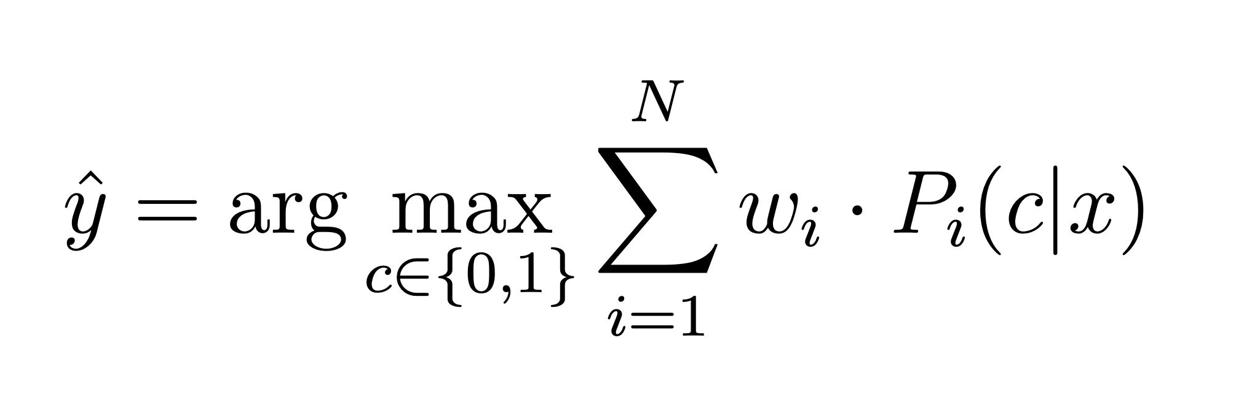
Ensemble Learning Approach
Soft Voting Ensemble was implemented to integrate predictions from multiple models.
Formula:
Where wi = weight of classifier i, Pi(c∣x) = predicted probability.
Combines strengths of individual models → improved generalization.
Reduces overfitting and variance.
Achieves stable predictions across all five diseases.
11 of 18

Slide 12
Model Evaluation Metrics
To ensure clinically meaningful evaluation:
Accuracy: Overall correctness.
Precision: Reliability of positive predictions.
Recall (Sensitivity): Ability to detect true disease cases.
F1-Score: Balance between Precision & Recall.
Confusion Matrix: Shows TP, FP, FN, TN — crucial in clinical evaluation.
In healthcare, False Negatives (FN) are more critical than False Positives.
12 of 18

Slide 13
Explainable Artificial Intelligence (XAI)
To interpret model predictions, two XAI tools were used:
SHAP (SHapley Additive exPlanations):
  Based on cooperative game theory.
  Quantifies contribution of each feature to the prediction.
  Provides both global and local interpretability.
LIME (Local Interpretable Model-Agnostic Explanations):
  Locally approximates the model around a specific prediction.
  Helps explain why an individual patient was classified as diseased or healthy.
Improves model transparency and clinician trust.
13 of 18

Slide 14
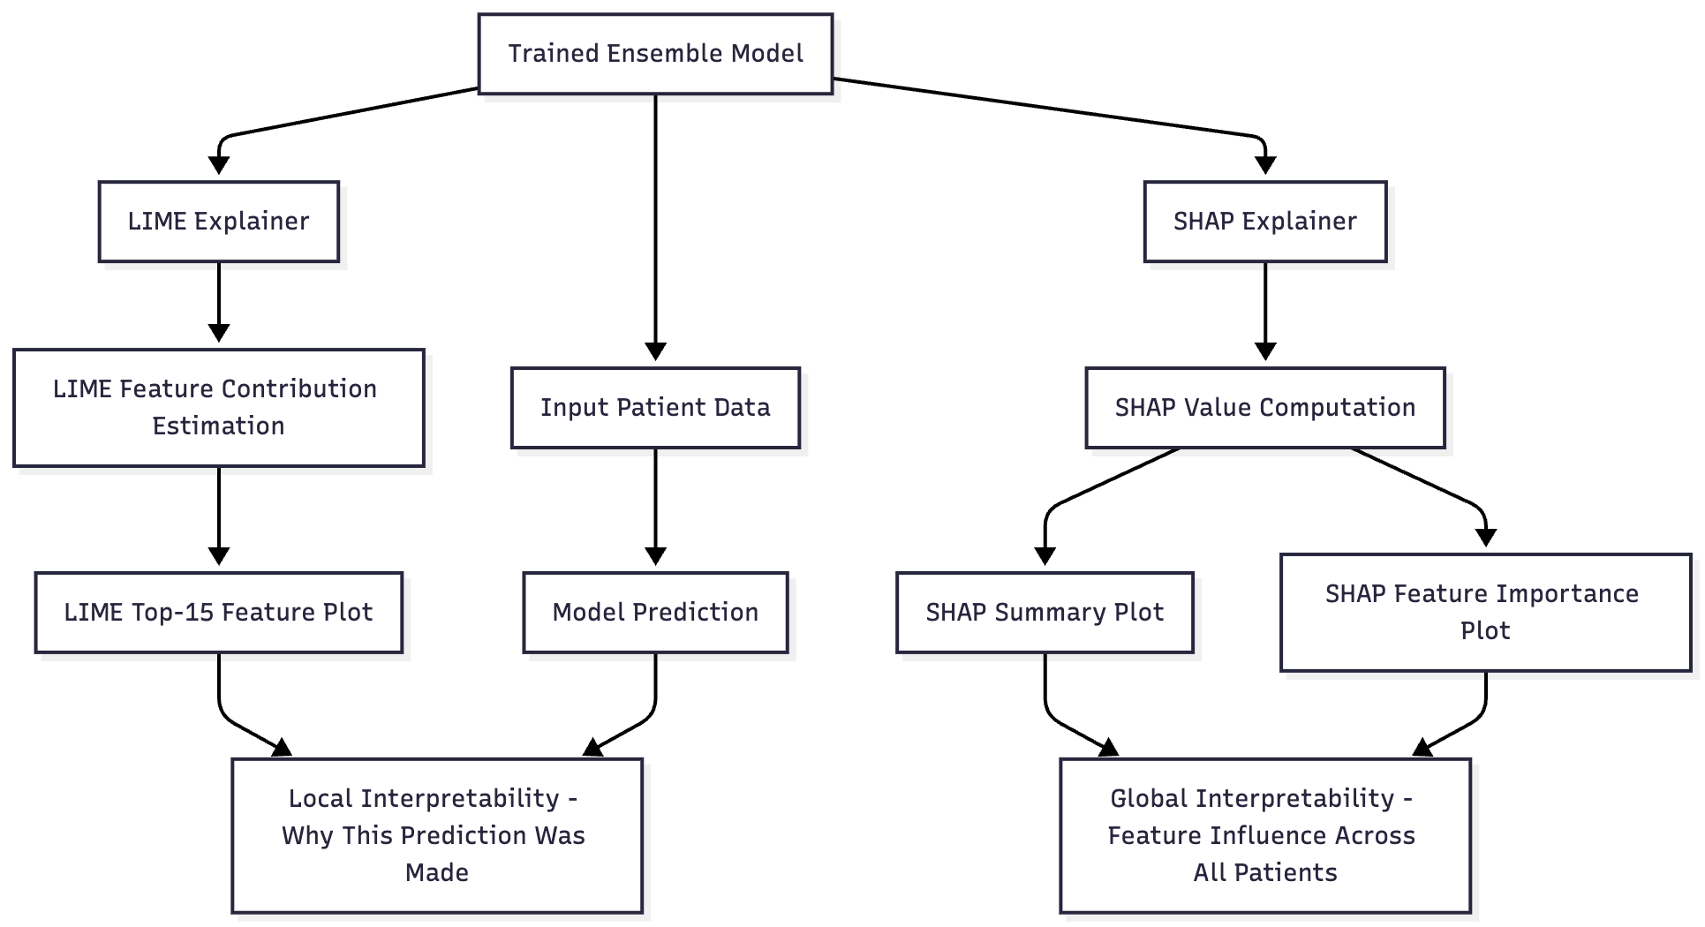
SHAP and LIME based Explainability Framework for Disease Diagnosis
14 of 18

Slide 15
Performance Results – Accuracy
Ensemble models outperform single classifiers.
CKD and Breast Cancer show near-perfect accuracy due to distinct biomarkers.
Heart and Diabetes models improved significantly with SMOTETomek balancing.
Disease | Accuracy (%)
Heart Disease | 85.2
Diabetes | 81.2
CKD | 98.8
Parkinson’s | 92.3
Breast Cancer | 98.2
15 of 18

Slide 16
Comparative Discussion
Ensemble models demonstrated higher accuracy and stability.
SHAP and LIME improved model transparency and clinical trust.
Class balancing techniques enhanced model sensitivity.
Results validate that Explainable Ensemble Learning is effective for medical prediction tasks.
Framework can be extended to multi-modal or multi-disease prediction systems.
16 of 18

Slide 17
Conclusion & Future Work
Conclusion:
Developed ensemble-based, explainable AI models for five diseases.
Achieved high accuracy and interpretability.
XAI ensures transparency in AI-assisted diagnosis.
Future Work:
Integrate genetic, imaging, and clinical data for multi-modal prediction.
Develop real-time hospital deployment system.
Explore deep ensemble and federated learning for privacy-preserving diagnostics.
17 of 18

Slide 18
Thank You

