Slide 1

Predictive Modeling of Medical Costs for Health Insurance Planning.
DONE BY : FOUZIA KOUSER

Slide 2
OBJECTIVE OF PROJECT:
This analysis aims to predict medical costs billed by heath insurance based on individual characteristics and lifestyle factors , which includes:
Developing machine learning models to accurately predict individual medical costs billed by health insurance.
Ensuring that the developed models achieve high levels of accuracy and performance in predicting medical costs.
Improve healthcare planning and resource allocation by providing reliable predictions for insurance companies and individuals.

Slide 3
SUMMARY OF DATA:
The dataset consists of personal attributes such as age, sex, BMI, number of dependents, smoking status, and residential region, along with the target variable, medical charges.
The dataset contains both continuous and categorical data. It includes around 6 independent variables and approximately 1338 data points.
This dataset is crucial for understanding factors influencing medical expenses and assisting insurance companies in setting premiums effectively.

Slide 4
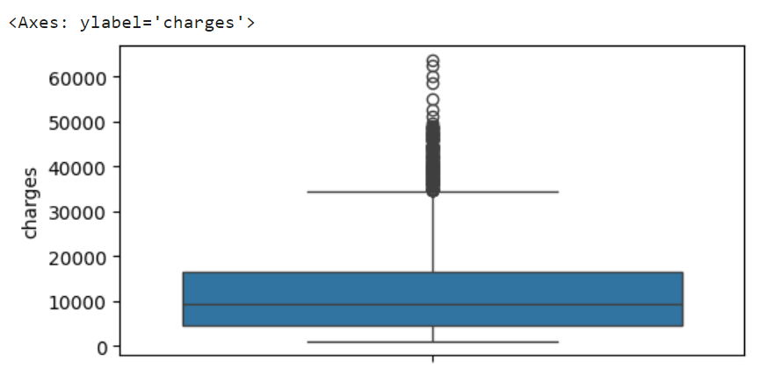
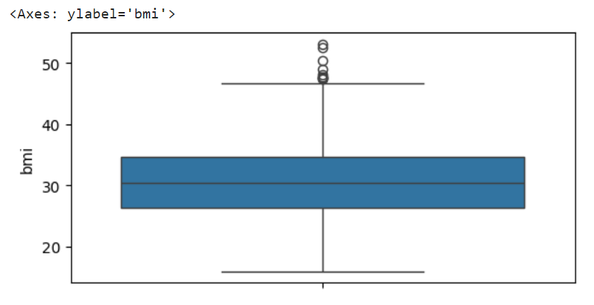
DATA PREPROCESSING:
HANDLING OUTLIERS:
Outliers were identified in the 'charges' and 'bmi' variables using the Interquartile Range (IQR) method and were winsorized to the upper bound.
Before Handling Outliers:

Slide 5
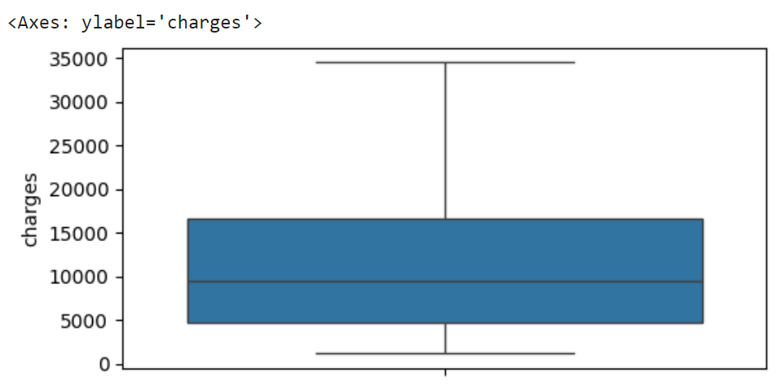
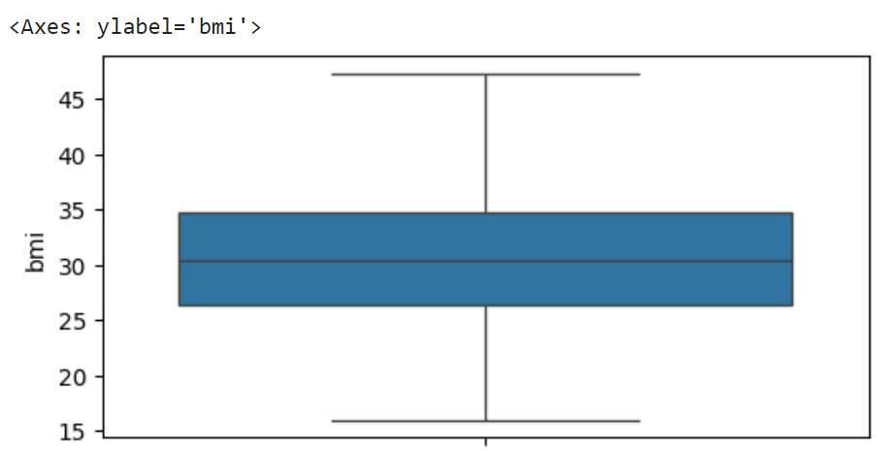
After Handling Outliers:

Slide 6
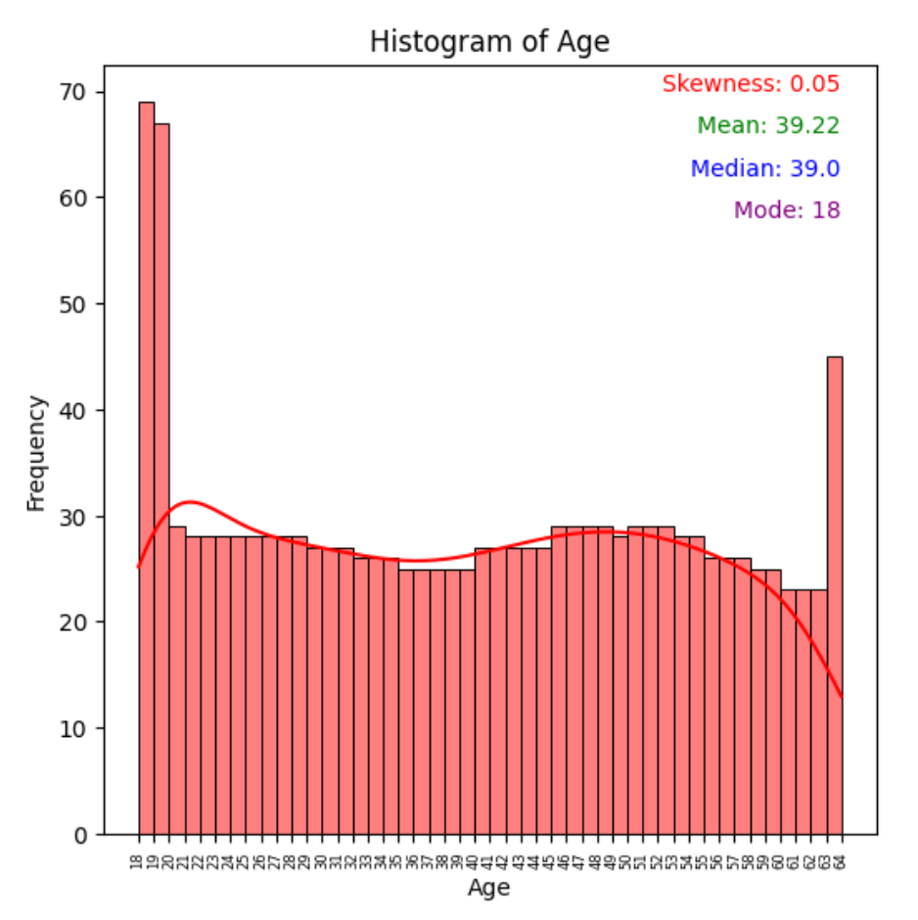
Analysis on Age:
The age distribution exhibits a slight positive skewness (0.05) indicating a slight tendency towards higher ages.
The mean age of 39.22 suggests that, on average, individuals in the dataset tend to be slightly older.
The mode at 18 and median at 39 suggest a predominantly younger
population with central
tendency.

Slide 7
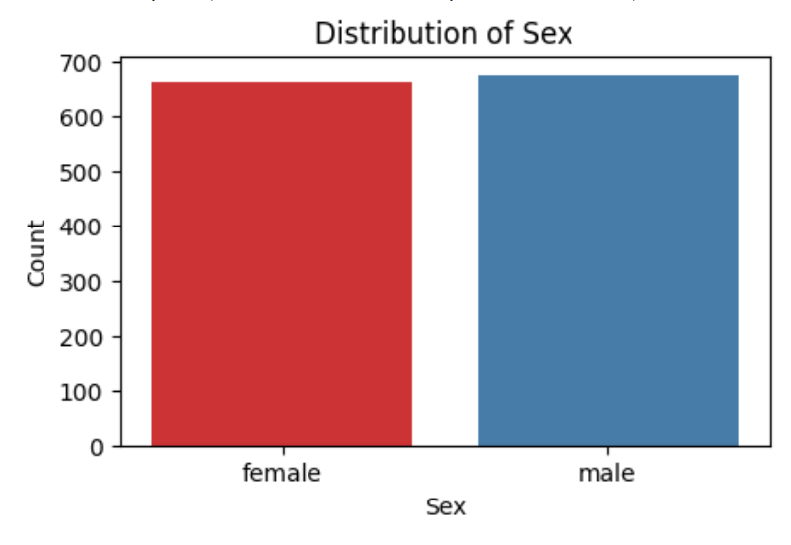
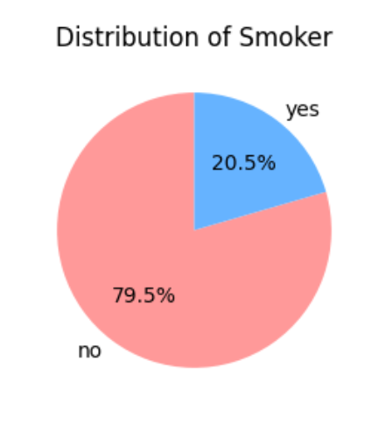
Analysis on Sex: Analysis onSmoking Status:
Analysis onSmoking Status:
The dataset contains slightly more males(675) than females (662), indicating a relatively balanced distribution of sex.
The dataset comprises 23.7% smokers and 76.3% non-smokers, indicating a larger proportion of non-smokers.

Slide 8
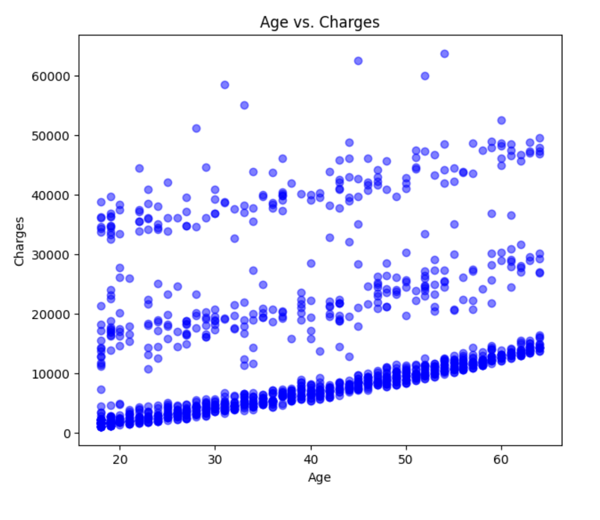
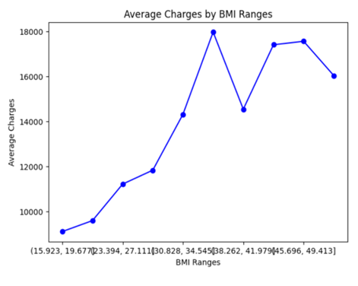
Exploring Relationships: Age and Charges, BMI and Charges
As individuals age or have higher BMI values, their medical charges tend to increase, indicating potential age and BMI-related factors influencing health care costs.

Slide 9
Developing Machine Learning Models:
In this phase, we apply various regression algorithms to the preprocessed dataset to predict
medical costs billed by health insurance. Key steps in the ML analysis include:
1.Data Preprocessing:
Handling Missing Values:
There were no missing values in the dataset, so no imputation or deletion was
required.
Handling Categorical Variables:
Categorical variables such as 'sex', 'smoker', and 'region' were one-hot encoded to
convert them into numerical format suitable for model training.
Handling Numerical Variables:
Numerical variables such as 'age', 'bmi', and 'children' were standardized using the
StandardScaler to ensure they have a mean of 0 and a standard deviation of 1.

Slide 10
2.Model Selection:
Choose appropriate regression algorithms based on the nature of the problem, dataset characteristics, and business requirements. Common models include Linear Regression, Random Forest Regression, Support Vector Regression, and others.
3.Model Training and Evaluation :
In the "Model Training and Evaluation" phase, we trained various regression models including K-Nearest Neighbors (KNN), Linear Regression, Support Vector Regression (SVR), Decision Tree Regression, Random Forest Regression.
Hyperparameters were fine-tuned using cross-validation techniques to optimize model performance. Evaluation metrics such as Mean Absolute Error were employed to assess each model's predictive accuracy.

Slide 11
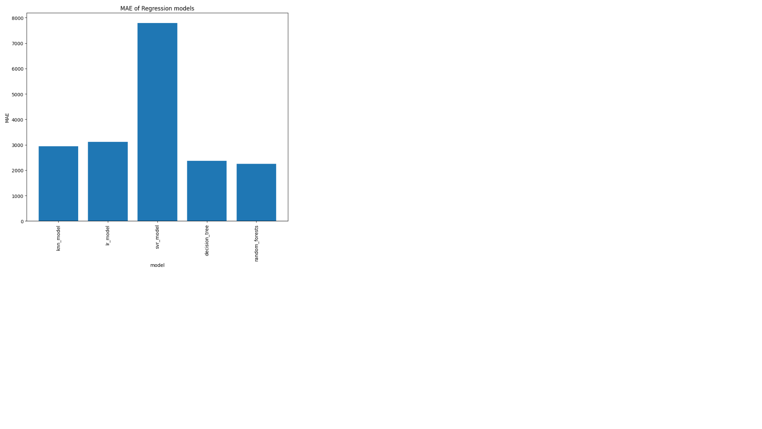
Observations:
The Random Forest algorithm emerged as the top-performing model, achieving a Mean Absolute Error (MAE) of approximately $2779.80.
Our findings demonstrate the effectiveness of Random Forest in accurately predicting medical costs based on individual features such as age, sex, BMI, number of children, smoking status, and region.
The low MAE suggests that, on average, the predictions made by the Random Forest model are close to the actual medical costs, indicating its potential utility in healthcare cost prediction tasks.

Slide 12
4.Saving the Trained Model:
Utilize joblib's dump function to save the trained machine learning model.
2.Save the model with an appropriate filename, such as "medical_cost_prediction_model.pkl".
Ensure that both the model and the preprocessing scaler are included for seamless real-time prediction.
5.Real-Time Prediction:
The predicted medical cost for the given input features is approximately $4992.16.
This prediction is generated using the trained machine learning model and the provided input data.
The model is ready to provide real-time predictions for medical costs based on varying input parameters.

Slide 13
Conclusions:
Through extensive exploratory data analysis (EDA), we gained valuable insights into the factors influencing medical costs, such as age, BMI, smoking status, and region.
Various machine learning models were trained and evaluated for predicting medical costs, including K-Nearest Neighbors, Linear Regression, Support Vector Regression, Decision Tree Regression, and Random Forest Regression.
Based on mean absolute error (MAE) values, Random Forest Regression demonstrated the best performance, closely followed by Decision Tree Regression, indicating their effectiveness in accurately predicting medical costs.
Real-time prediction was implemented, that instantly predicts medical expenses using user-input data. This allows for quick estimation of costs without delay.

Slide 14

THANK YOU

