Slide 1

Knowledge Graph-based Retrieval-Augmented Generation System for Domain Specific Information Extraction with Glossary-Aided Responses
K. N. N. C. De Silva, D. S. K. Jayawickrama, W. G. K. M. Weerasingha, D. L. C. P. Liyanage
Department of Information and Communication Technology, Faculty of Technology, University of Sri Jayewardenepura
Presenting Author : K. N. N. C. De Silva

Slide 2
Introduction and Background
Long-standing organisations such as regulatory agencies, healthcare institutions, and legal bodies rely on large collection of historical and operational documents.
These documents encode institutional knowledge accumulated over years in the form of policies, protocols, and regulations.
Accessing critical information from these archives typically relies on manual search, keywords matching, or expert knowledge.
Traditional document retrieval system struggle to:
Understand domain specific terminology
Provide context-aware answers
Support natural language querying

Slide 3
Introduction and Background (Cont.)
Proposed Framework : Intelligent, reliable, and explainable system that enables users to query structured, domain-specific documents using natural language while preserving institutional knowledge.
To support accurate, context-aware question answering, semantic interpretation of domain terminology must be integrated into retrieval and generation workflows.
Graph-RAG Model
Domain-Specific Glossary
Web-based Portal
AI-Powered Query System

Slide 4
Research Problem
Practical challenges in Institutional Knowledge Retrieval
Critical organisational knowledge is embedded in long, domain-specific documents. (e.g., regulations, clinical protocols, legal records)
Documents contains:
Ambiguous terminology
Abbreviations
Evolving definitions
Limitations in Existing Traditional Document Search and Standard RAG systems
Retrieve large but semantically misaligned contexts.
Fail to disambiguate specialised terms
Produced irrelevant or unfaithful answers, or avoid answering altogether.
Core Research Problem:
How can Knowledge Graph-based Retrieval Augmented Generation (KG-RAG) system accurately interpret domain-specific terminology and deliver reliable, context-aware answers from institutional documents?

Slide 5
Literature Review
Literature Studies - Existing RAGs
RAG models: reduces hallucinations through retrieval grounding [10].
KG-RAG systems (GraphRAG, AutoRAG, AutoKG) enhances structured reasoning and graph-based retrieval [11], [15], [16].
Hybrid vector-graph approaches: improve recall and multi-hop reasoning [7], [9].
Identified Gap
Existing approaches assume general-purpose terminology and, lack dynamic mechanism to resolve domain-specific vocabulary ambiguity in institutional documents.
Our Contribution
Introduces a user-maintained glossary with fuzzy semantic alignment integrated into the KG-RAG pipeline to enable terminology-aware retrieval and generation.

Slide 6
Objectives and Outcomes
Main Objective
Build a knowledge Graph-based Retrieval-Augmented Generation (RAG) system with an externally managed domain-specific glossary to enhance organisations’ ability to manage, retrieve and utilise historical documents.
Support effective decision-making by delivering accurate and contextually relevant information based on institutional records and domain knowledge
Outcomes
Knowledge Graph-based RAG for context retrieval
LLMs integration for context-aware responses
Domain-specific glossary
Web-based document management portal

Slide 7
Methodology
1
Data Collection and Preprocessing
Document management
Text Extraction
Knowledge Graph Creation
Knowledge Graph Construction
Automation
Query Filtering and Sanitization
Query sanitization
Block unsafe, out-of-domain queries
2
3
Graph-based Context Retrieval
Context retrieval by graph traversal
Integration to LLM with Glossary
LLM Integration
Glossary Integration
Answer Generation and Delivery
Answer Generation Using LLM
Frontend Delivery
4
5
6

Slide 8
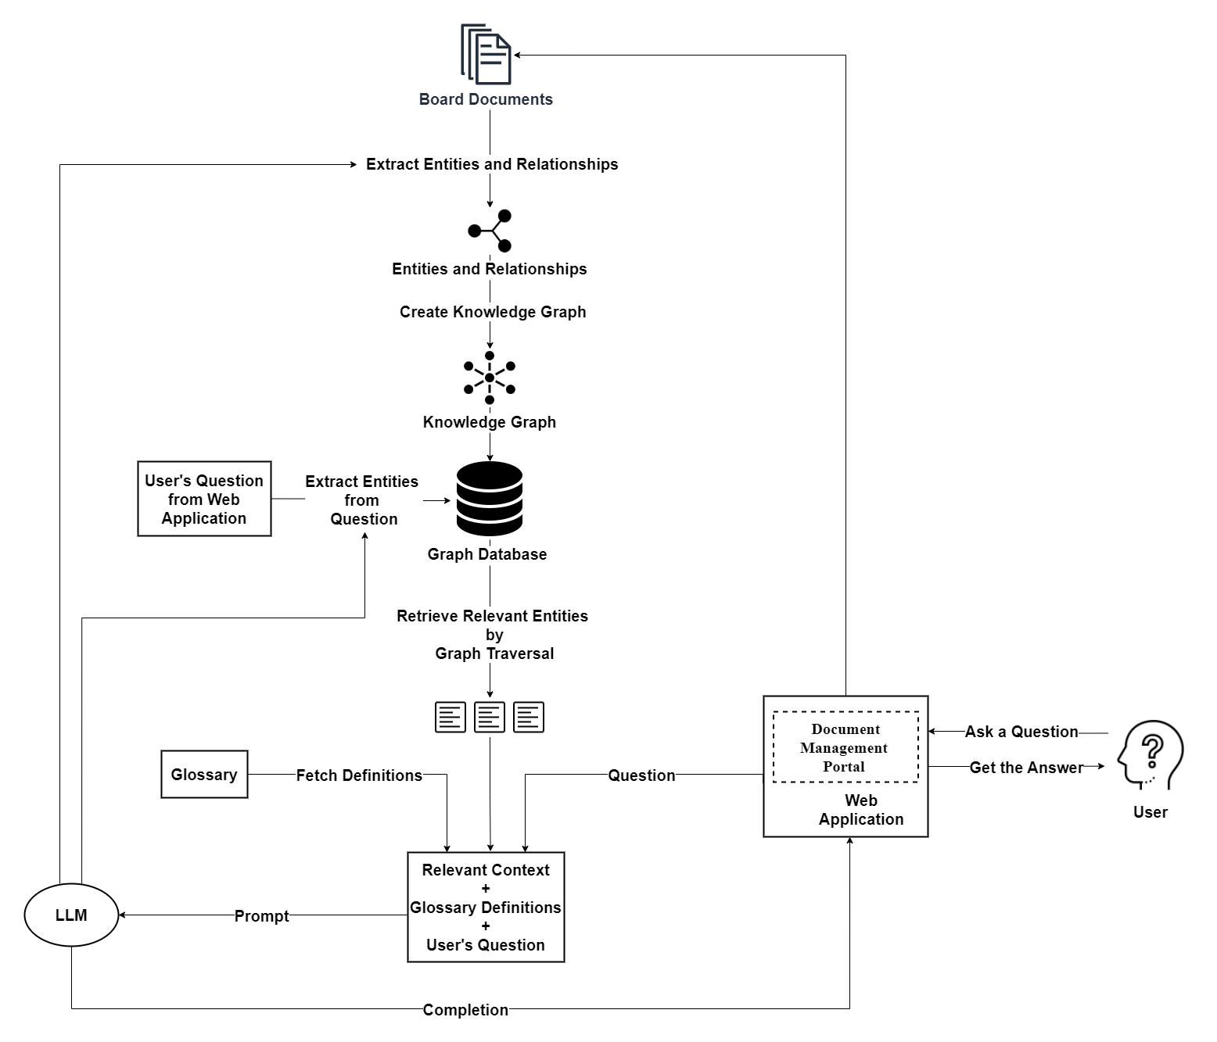
Proposed System Design

Slide 9
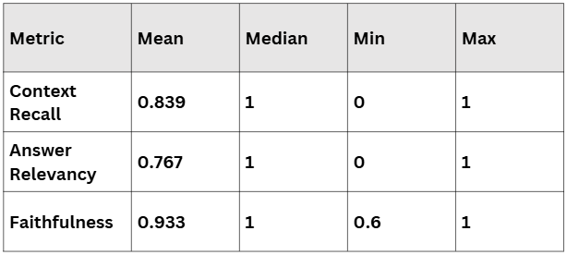
Result and Evaluation
To access the effectiveness of the proposed system, we conducted a comprehensive evaluation under two hypothesis,
H1 - Retrieval and Generation Evaluation
H2 - Glossary Integration Impact Evaluation
H1 - Retrieval and Generation Evaluation
Retrieval
Mean Recall: The system retrieves 84% (0.84) of relevant knowledge graph triples.
Consistent performance: The median recall is 1.000 in at least half of the cases, with all relevant triples retrieved.
Generation
Mean answer relevancy: 0.767 (over 76% relevant responses)
Mean answer faithfulness: 0.933 (most answers factually correct)

Slide 10
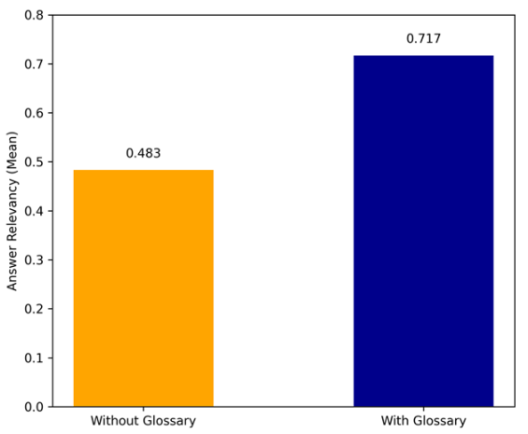
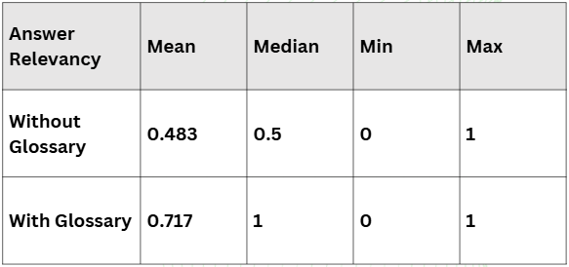
H2 - Glossary Integration Impact Evaluation
Glossary Boosts Relevancy
Without glossary: mean answer relevancy: 0.483
With glossary: mean answer relevancy = 0.717 (48% increase)
Improved Understanding
Median relevancy jumps to 1.0 with glossary - over half of glossary-based queries are relevant
Fewer Fallback Responses
Glossary integration reduced “I don’t understand” answers, improving contextual grounding

Slide 11
Challenges
Data Availability & Domain Constraints
Lack of publicly available industry-specific institutional dataset.
Regulatory/organizational documents are often confidential.
Used Public NIH Clinical Trial Protocol (clinicaltrial.gov) as a proxy dataset.
Complex Document Structures
Long, multi-section PDF documents.
Scanned PDFs requires OCR.
Tables with multi-rows/merged cells
Scalability Considerations
Maintain glossary consistency across documents.
Managing growing knowledge graph.
Entity & Relationship Extraction Complexity
Time-consuming LLM-based triple extraction

Slide 12
Future Works
Extend evaluation to multiple domains and heterogeneous datasets
Improve triple extraction efficiency and reduce processing time
Explore fine-tuned/domain specific LLMs
Investigate automated glossary enrichment
Validate long-term scalability in large institutional settings.

Slide 13
Conclusion
Project Achievements
Successfully developed a knowledge Graph-based RAG system for domain-specific information extraction from unstructured documents.
Combined graph-based context retrieval, glossary-aided interpretation, and LLM-based response generation in functional, web-based platform.
Key Evaluation Outcomes
Context Recall: 0.839 - High retrieval accuracy
Faithfulness: 0.933 - Response grounded in facts
Answer Relevancy (with glossary): improved by 48%
Architecture proved scalable and deployment-ready

Slide 14
References
[1] Lewis, P. et al. (2020) ‘Retrieval-Augmented Generation for Knowledge-Intensive NLP Tasks’, in Advances in Neural Information Processing Systems. Curran Associates, Inc., pp. 9459–9474.
[2] Yadav and W. Andreopoulos, “Domain-Specific Graph RAG Pipelines: Optimized Approaches for Building Efficient Personal Knowledge Repositories,” in 2025 IEEE 11th International Conference on Big Data Computing Service and Machine Learning Applications (BigDataService), 2025, doi: 10.1109/BIGDATASERVICE65758.2025.00036.
[3] Akkiraju, R. et al. (2024) ‘FACTS About Building Retrieval Augmented Generation-based Chatbots’. arXiv.
[4] V. Kamra, L. Gupta, D. Arora, and A. K. Yadav, “Enhancing Document Retrieval Using AI and Graph-Based RAG Techniques,” in 2024 5th International Conference on Communication, Computing Industry 6.0 (C2I6), 2024. doi: 10.1109/C2I663243.2024.10895931.
[5] Y. Dong, J. Chen, S. Wang, Z. Zhang, H. Zheng, and C. Wang, “Advanced RAG Models with Graph Structures: Optimizing Complex Knowledge Reasoning and Text Generation,” in 2024 5th International Symposium on Computer Engineering and Intelligent Communications (ISCEIC), 2024, pp. 626–629. doi: 10.1109/IS-CEIC63613.2024.10810209.
[6] D. Inani, J. Tang, and R. Kuo, “Smart University Assistant: Leveraging Graph Databases and Vector Embeddings for Efficient Information Retrieval,” in 2025 Intermountain Engineering, Technology and Computing (IETC), 2025, doi: 10.1109/IETC64455.2025.11039481.
[7] Edwards, C. (2024) Hybrid Context Retrieval Augmented Generation Pipeline: LLMAugmented Knowledge Graphs and Vector Database for Accreditation Reporting Assistance.
[8] Sarmah, B. et al. (2024) ‘HybridRAG: Integrating Knowledge Graphs and Vector Retrieval Augmented Generation for Efficient Information Extraction’. arXiv. Available at: https://doi.org/10.48550/arXiv.2408.04948.
[9] Omrani, P. et al. (2024) ‘Hybrid Retrieval-Augmented Generation Approach for LLMs Query Response Enhancement’, in 2024 10th International Conference on Web Research (ICWR). 2024 10th International Conference on Web Research (ICWR), pp. 22–26. Available at: https://doi.org/10.1109/ICWR61162.2024.10533345.
[10] S. AboulEla, P. Zabihitari, N. Ibrahim, M. Afshar, and R. Kashef, “Exploring RAG Solutions to Reduce Hallucinations in LLMs,” in 2025 IEEE International Systems Conference (SysCon), 2025, doi: 10.1109/SYSCON64521.2025.11014810.

Slide 15
[11] M. R. Rani, B. K. Mishra, D. Thakker, and M. N. Khan, “To Enhance Graph-Based Retrieval-Augmented Generation (RAG) with Robust Retrieval Techniques,” 2024. doi: 979-8-3315-0869-2/24/$31.00.
[12] S. Knollmeyer, M. U. Akmal, L. Koval, S. Asif, S. G. Mathias, and D. Großmann, “Document Knowledge Graph to Enhance Question Answering with Retrieval Augmented Generation,” in 2024 IEEE 29th International Conference on Emerging Technologies and Factory Automation (ETFA), 2024, doi: 10.1109/ETFA61755.2024.10711054.
[13] Y. Suresh, T. M. Hayath, and S. S. Begum, “Best Practices for Constructing Knowledge Graphs in Retrieval-Augmented Generation (RAG) Systems,” in 2025 2nd International Conference on New Frontiers in Communication, Automation, Management and Security (ICCAMS), 2025, doi: 10.1109/ICCAMS65118.2025.11234485.
[14] SFang, J., Meng, Z. and Macdonald, C. (2024) ‘TRACE the Evidence: Constructing Knowledge-Grounded Reasoning Chains for Retrieval-Augmented Generation’. arXiv. Available at: https://doi.org/10.48550/arXiv.2406.11460.
[15] Yu, S., He, T. and Glass, J. (2021) ‘AutoKG: Constructing Virtual Knowledge Graphs from Unstructured Documents for Question Answering’. arXiv.
[16] Kim, D. et al. (2024) ‘AutoRAG: Automated Framework for optimization of Retrieval Augmented Generation Pipeline’. arXiv.
[17] ‘Li, Z. et al. (2024) ‘Retrieval Augmented Generation or Long-Context LLMs? A Comprehensive Study and Hybrid Approach’, in F. Dernoncourt, D. Preot¸iuc-Pietro, and A. Shimorina (eds) Proceedings of the 2024 Conference on Empirical Methods in Natural Language Processing: Industry Track. EMNLP 2024, Miami, Florida, US: Association for Computational Linguistics, pp. 881–893. Available at: https://doi.org/10.18653/v1/2024.emnlp-industry.66.
[18] Wang, X. et al. (2024) ‘Searching for Best Practices in Retrieval Augmented Generation’, in Y. Al-Onaizan, M. Bansal, and Y.-N. Chen (eds) Proceedings of the 2024 Conference on Empirical Methods in Natural Language Processing. EMNLP 2024, Miami, Florida, USA: Association for Computational Linguistics, pp. 17716–17736. Available at: https://doi.org/10.18653/v1/2024.emnlp-main.981.
[19] Y. Luo, W. Xu, C. Zeng, Q. Fu, and Z. Xiang, “Application and evaluation of RAG technology in civil aviation policy question answering,” in 2024 2nd International Conference on Computer Network Technology and Electronic and Information Engineering (CNTEIE), 2024, doi: 10.1109/CNTEIE66268.2024.00032.
[20] B. Xu, R. J. Tong, Y. Li, P. Chen, H. Li, J. Liang, X. Fan, and J. Tong, “An Architectural Framework for Educational Knowledge Graphs (IEEEP2807.6): Ontology Design, LLM Integration, and Adaptive Learning Applications,” in 2025 IEEE Conf. on Artificial Intelligence (CAI), 2025, doi: 10.1109/CAI64502.2025.00249.

Slide 16
Thank you for your
time & support!
Q&A

