Slide 1

Humor Detection in one liners
Submitted By:
Dilpreet Singh Chawla - 171
Amit Kumar - 165
Yash Chandra Verma - 196
Aditya - 160
Devesh Kaushik - 170
Submitted To:
Dr. Tirthankar Dasgupta

Slide 2
Introduction
Humor is one of the most interesting and puzzling aspects of human behavior. Despite the attention it has received in fields such as philosophy, linguistics, and psychology, there have been only few attempts to create computational models for humor recognition or generation. We utilize the state-of-the-art in deep learning to show that we can learn by example what constitutes humor in the context of one-liner text. This is an interesting NLP problem in that we must learn higher order structures that constitute humor.

Slide 3
Project Motivation
Humor is an essential element in personal communication. While it is merely considered a way to induce amusement, humor also has a positive effect on the mental state of those using it and has the ability to improve their activity. Therefore computational humor deserves particular attention, as it has the potential of changing computers into a creative and motivational tool for human activity.

Slide 4
Dataset Used
We chose to restrict our investigation to the type of humor found in one-liners. The humorous data set consists of one-liners collected from the Web using an automatic bootstrapping process. The non-humorous data is selected such that it is structurally and stylistically similar to the one-liners.
Link: Short-Text-Corpus-For-Humor-Detection
Description:
Type | No. of sentences | Class
Humorous one-liners | 5251 | Positive
English Proverbs | 1019 | Negative
Wikipedia sentences | 5251 | Negative
Reuters Headlines | 5243 | Negative

Slide 5
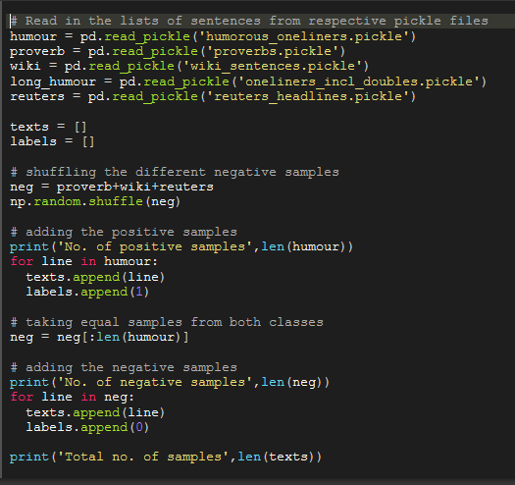
Steps in training the model
Loading the dataset
Read the pickle files of data
Splitting into positive and negative samples

Slide 6
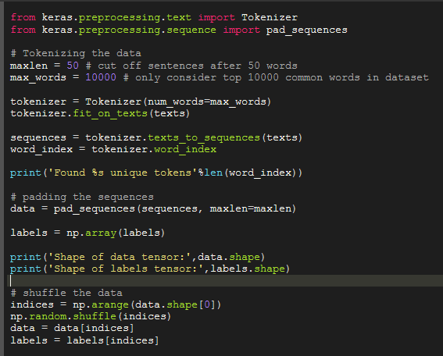
2. Preprocessing the data
Tokenizing into words
Building sequences
Pad sequences

Slide 7
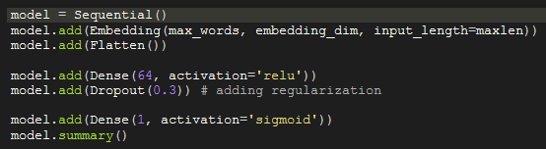
3. Building DNN Models and Results Achieved
Simple feed-forward network with dense layers on top of embedding layer
Using GloVe word embeddings
Training loss: 0.1027 Training accuracy: 0.9660 Training f-measure: 0.9646
Validation loss: 0.2236 Validation accuracy: 0.9210 Validation f-measure: 0.9231
Training embedding layer
Training loss: 0.0467 Training accuracy: 0.9854 Training f-measure: 0.9848
Validation loss: 0.1251 Validation accuracy: 0.9543 Validation f-measure: 0.9558

Slide 8
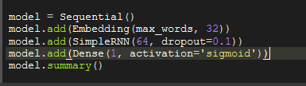
2. Using Simple RNN layer on top of embedding layer
Training loss: 0.0813 Training accuracy: 0.9686 Training f-measure: 0.9660
Validation loss: 0.1532 Validation accuracy: 0.9420 Validation f-measure: 0.9413

Slide 9
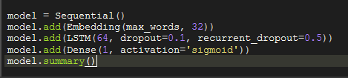
3. Using LSTM layer on top of the embedding layer
Training loss: 0.1119 Training accuracy: 0.9587 Training f-measure: 0.9573
Validation loss: 0.1373 Validation accuracy: 0.9496 Validation f-measure: 0.9514

Slide 10
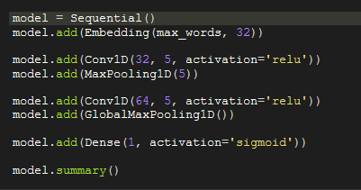
4. Using two Conv1D layers on top of the Embedding layer
Training loss: 0.0895 Training accuracy: 0.9674 Training f-measure: 0.9655
Validation loss: 0.1376 Validation accuracy: 0.9458 Validation f-measure: 0.9469

Slide 11
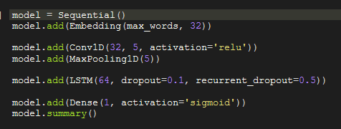
5. Using LSTM layer on top of Conv1D layer
Training loss: 0.1069 Training accuracy: 0.9617 Training f-measure: 0.9603
Validation loss: 0.1525 Validation accuracy: 0.9401 Validation f-measure: 0.9434

Slide 12
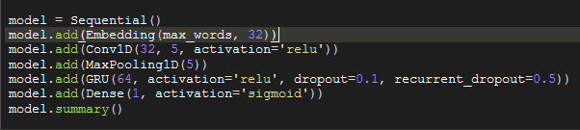
6. Using GRU layer on top of Conv1D layer
Training loss: 0.1120 Training accuracy: 0.9599 Training f-measure: 0.9586
Validation loss: 0.1449 Validation accuracy: 0.9448 Validation f-measure: 0.9462

Slide 13
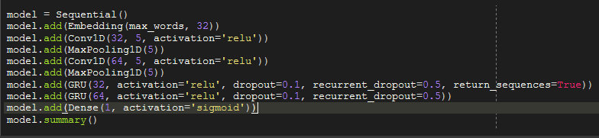
7. Using two GRU layers on top of two Conv1D layers
Training loss: 0.0876 Training accuracy: 0.9693 Training f-measure: 0.9687
Validation loss: 0.1460 Validation accuracy: 0.9448 Validation f-measure: 0.9472

Slide 14
4. Training the models
Optimizer: RMSprop (learning rate: 0.0001)
Loss: Binary Cross Entropy
Epochs: 20
Batch size: 32
Validation split: 0.1

Slide 15
Ranking the models
Rank | Name | Validation Accuracy | Validation f-measure
1 | Dense layer | 0.9543 | 0.9558
2 | LSTM layer | 0.9496 | 0.9514
3 | 2 Conv1D layers | 0.9458 | 0.9469
4 | 2 GRU on 2 Conv1D layers | 0.9448 | 0.9472
5 | GRU on Conv1D layers | 0.9448 | 0.9462
6 | Simple RNN | 0.9420 | 0.9413
7 | LSTM on Conv1D | 0.9401 | 0.9434
Note: We used Embedding layer trained on our dataset

Slide 16
Conclusion and Future Scope of Working
Given the importance of humor in our everyday life, and the increasing importance of computers in our work and entertainment, we believe that studies related to computational humor will become increasingly important.
In future we will try to improve the accuracy of model using Google’s Bidirectional Encoder Representations from Transformer (BERT) and ELMo pre-trained word embeddings.

Slide 17
References
[1] Rada Mihalcea and Carlo Strapparava, Making Computers Laugh: Investigations in Automatic Humor Recognition, in Proceedings of the Joint Conference on Human Language Technology / Empirical Methods in Natural Language Processing (HLT/EMNLP), Vancouver, October, 2005.
[2] Oliveira and Rodrigo, “Humor Detection in Yelp reviews”, at Stanford University.

