Slide 1
Book Store Presentation
Fowsia Bilkeer
22APREnable1

Slide 2
Introduction
The purpose of this presentation is to show how we were able create a complete application which would be functional and used all the modules that were taught over the last two months.
Agile & Project Management
Databases/Cloud fundamentals
Java SE/EE
Front-end development
Automated testing

Slide 3
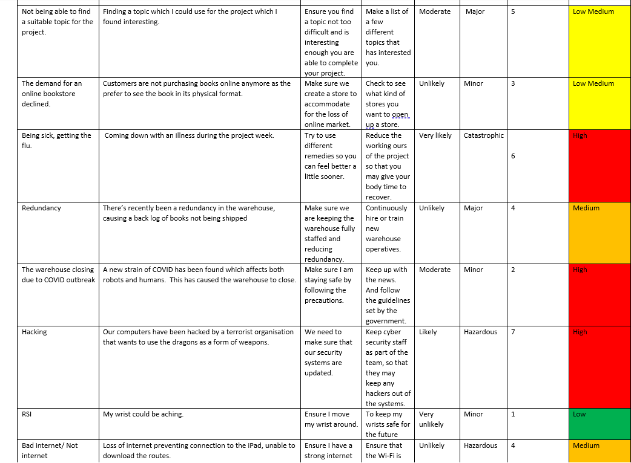
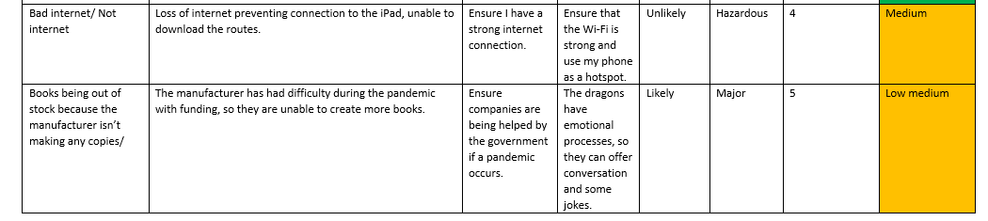
RISK

Slide 4
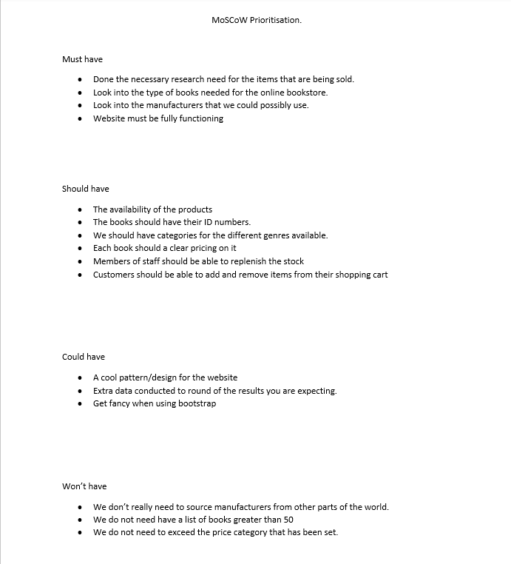
MoSCoW

Slide 5
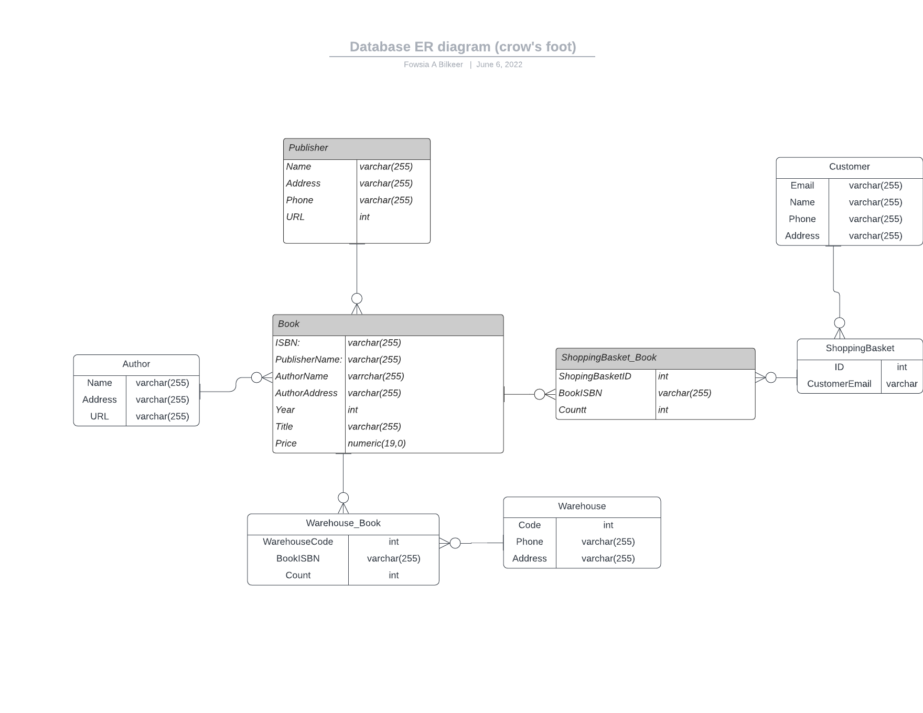
ERD

Slide 6
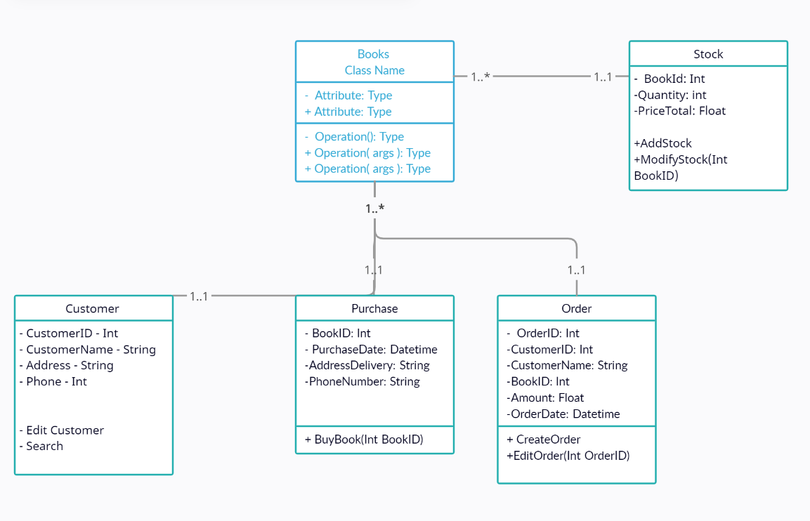
UML Class
Notes:
As you can see if the first UML diagram I didn’t include

Slide 7
Sprints
https://fowsia-bilkeer.atlassian.net/jira/software/projects/SOF/boards/4/backlog

Slide 8
Tasks
https://fowsia-bilkeer.atlassian.net/jira/software/projects/SOF/boards/4/backlog

Slide 9
User Stories
https://fowsia-bilkeer.atlassian.net/jira/software/projects/SOF/boards/4/backlog

Slide 10
GitHub
Creating multiple feature branches which we had to push our working codes to. And finally pushing that to the dev branch and then to the main branch.

Slide 11
Test Coverage
The aim of the functional application was to aim for at least 80% coverage.

Slide 12
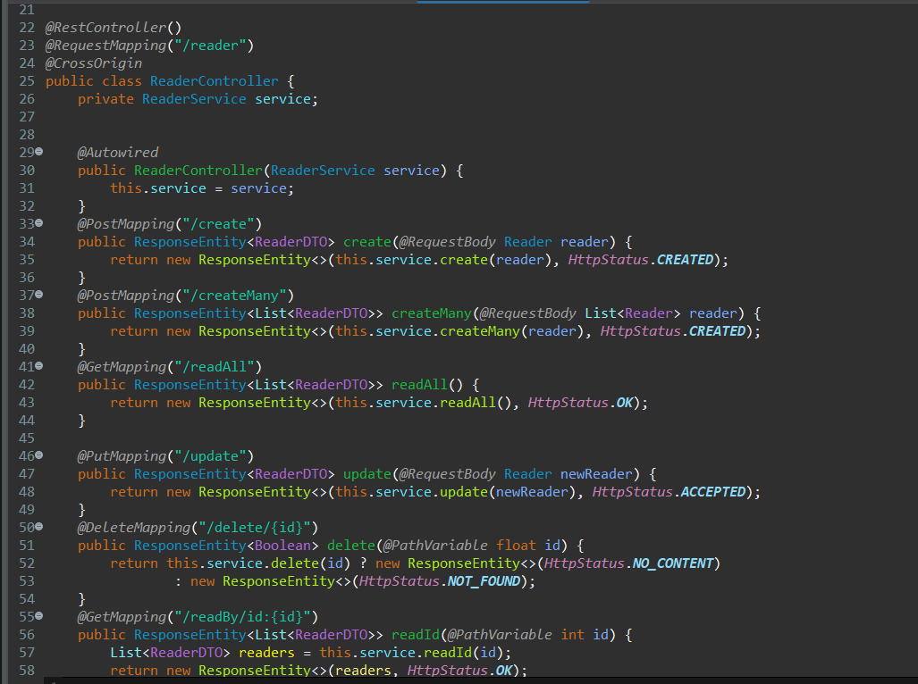
CRUD
Create
Read
Update
Delete

