Slide 1
Digital Portfolio
STUDENT NAME : A. FOWZIYA
REGISTER NO : 24132271802522011
NMID : 032E5128F988F8D85CD4C3A9F50A630
DEPARTMENT : BSC-COMPUTER SCIENCE
COLLEGE : GOVERNMENT ARTS AND SCIENCE COLLEGE , GINGEE

Slide 2
PROJECT TITLE
“Interactive Quiz Web Application with Animations”

Slide 3
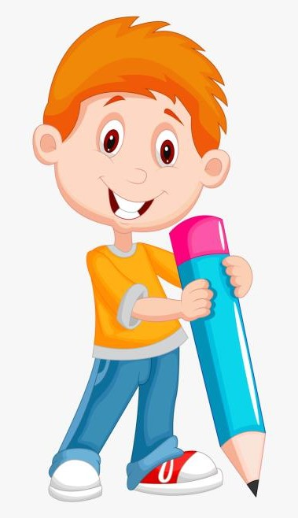

AGENDA
Problem Statement
Project Overview
End Users
Tools and Technologies
Portfolio design and Layout
Features and Functionality
Results and Screenshots
Conclusion
Github Link
3/21/2024 Annual Review

Slide 4

PROBLEM STATEMENT
People often want a fun ad interactive way to test their knowledge .
Traditional quizzes are boring and static.
Need a simple we-based quiz with animations, feedback and multiple categories.

Slide 5


PROJECT OVERVIEW
Built a Quiz Web App using HTML, CSS, and JavaScript.
Includes 10 questions:
5 General Knowledge
5 Programming
Features popup celebration, confetti shower, and red flash animation for wrong answers.
Designed to be engaging and user-friendly.

Slide 6

WHO ARE THE END USERS?
Students preparing for exams.
Beginners learning programming.
Anyone who wants to test general knowledge & coding basics in a fun way.

Slide 7

TOOLS AND TECHNIQUES
HTML → Page structure.
CSS → Styling, animations, responsive design.
JavaScript → Quiz logic, score tracking, confetti effects.
GitHub Pages → Hosting the quiz online.

Slide 8
POTFOLIO DESIGN AND LAYOUT
Clean card-based quiz box.
Two sections: General Knowledge & Programming Quiz
Colorful animations → popup + confetti + red flash.
Mobile-friendly layout.
8

Slide 9
FEATURES AND FUNCTIONALITY
✅ Multi-category quiz (GK & Programming).
✅ Interactive feedback (Correct → popup, Wrong → flash).
✅ Confetti shower celebration 🎉.
✅ Smooth animations (fade, bounce, shake).
✅ “Next Question” button with automatic flow.
✅ Final score display.

Slide 10
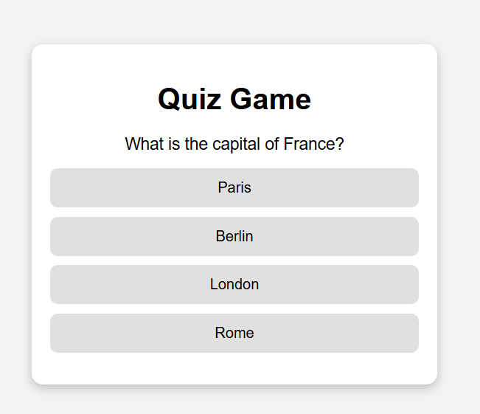

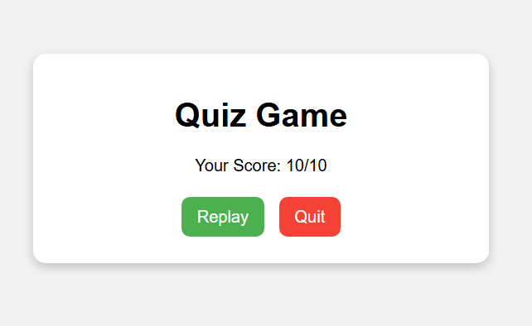
RESULTS AND SCREENSHOTS
Start screen → Title: General Knowledge Quiz
Correct Answer → Popup with confetti
Wrong Answer → Quiz box flashes red
Final screen → Quiz Completed! message
3/21/2024 Annual Review
10

Slide 11
CONCLUSION
Built an interactive quiz game with fun animations.
Helps users learn in an engaging way.
Can be expanded with:
More categories
Timer & leaderboard
Online multiplayer mode
11

