Slide 1


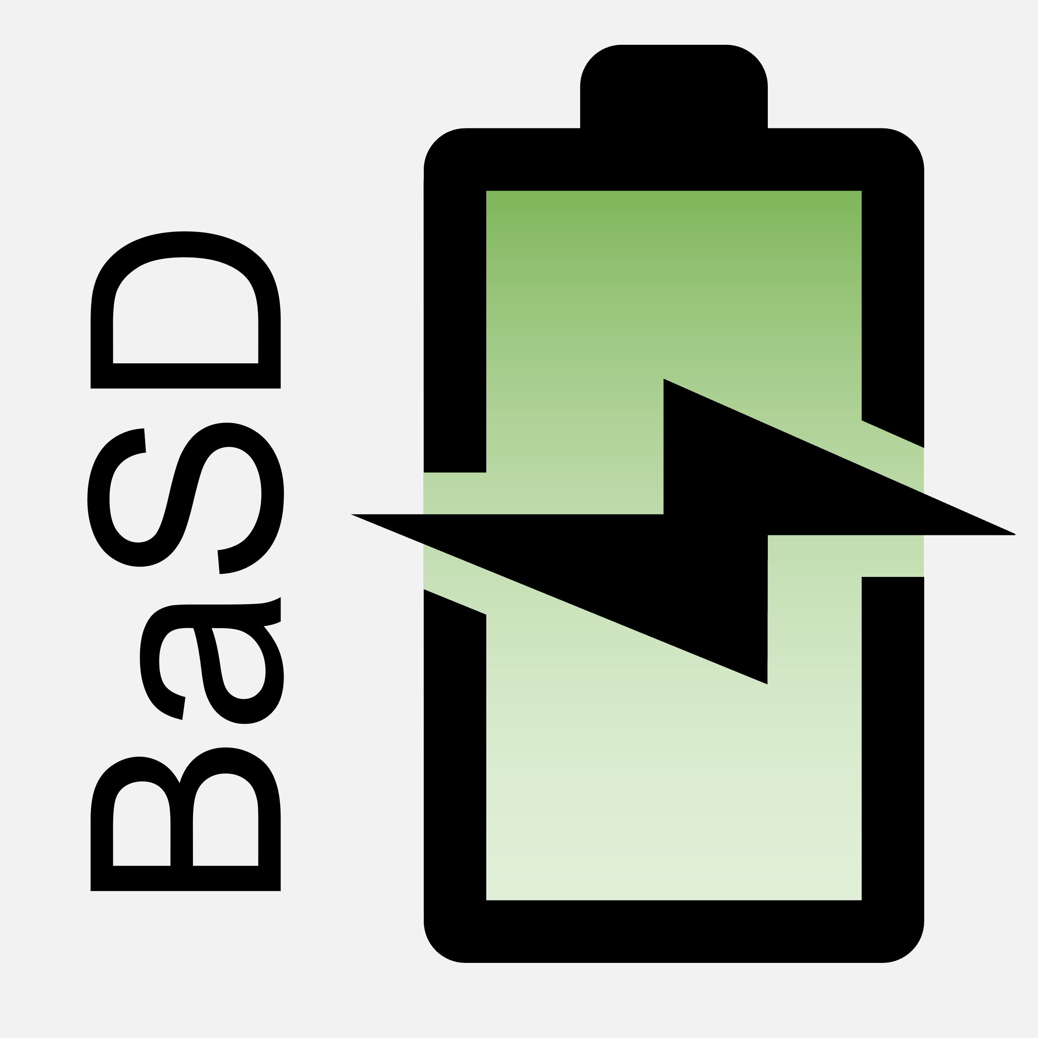

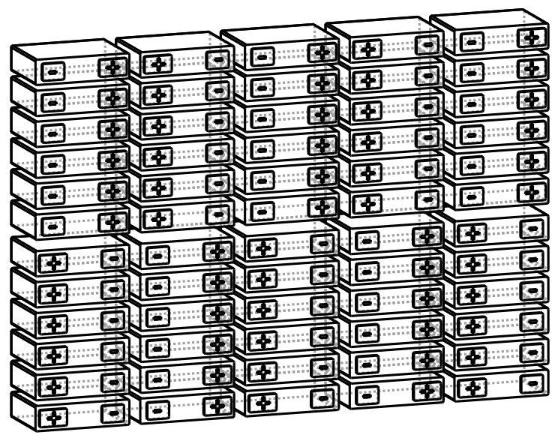
Generated Battery System Configuration and Layout
Cell Database
Requirements

