Slide 1
16
16+32
16
16
1
3
Convolution 3x3
Convolution 1x1
Dropout 0.1
16
Max Pooling 2x2
Skip connection
Dropout 0.2
Up Sampling 2x2
Block copied
Dropout 0.3
32
32
32+64
32
64
64
64+128
64
128
128
128+256
128
256
256
Notes:
By @avsthiago

Slide 2



Init conv
3,128,128
64,128,128
down 1
up5
down 2
up4
64,64,64
64,128,128
128,32,32
down 3
up3
64,64,64
256,16,16
up2
128,32,32
down 4
512,8,8
down 5
up1
256,16,16
hidden
up0
1024,4,4
512,8,8
3,128,128
1024,1,1
1024,4,4
Init conv
64,128,128
time 3
256,1,1
ctx4
128,1,1
ctx5
64,1,1
ctx 1
1024,1,1
ctx3
256,1,1
time 4
128,1,1
time 5
64,1,1
time 1
1024,1,1
time 2
512,1,1
ctx2
512,1,1
time

Slide 3
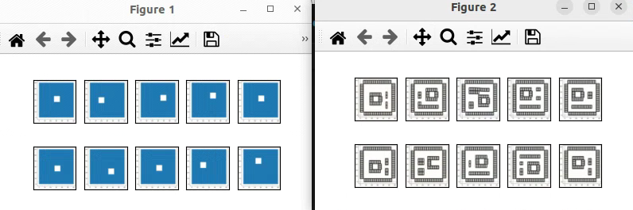
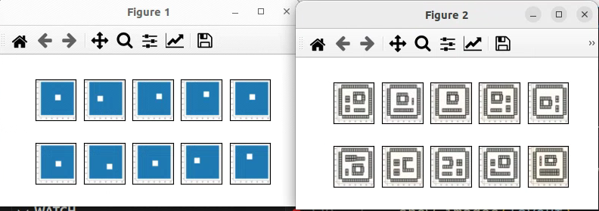

Slide 4
