Slide 1
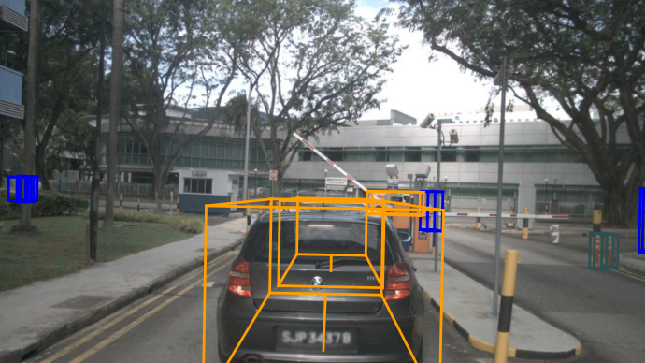
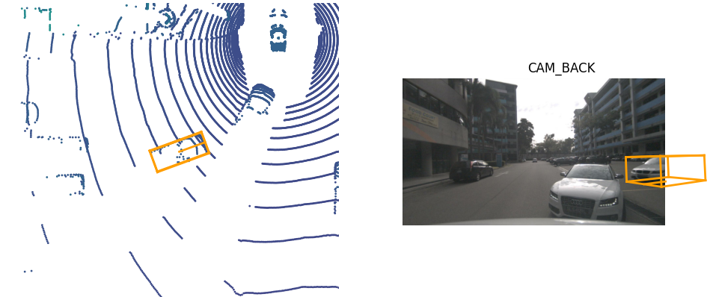
*代表一对多
场景:一个场景包含了20s的数据，标注频率为2帧/s
场景名:'scene-0001' 场景标识符:'73030fb67d3cxx' 样本数量:40 第一帧样本:'e93e98b63d3b’ 最后一帧样本:'40e413c92218425‘
实例：在多帧内连续存在的标注对象
标注数量 第一帧标注标志 最后一帧标注标志
所有标注在前视摄像头投影
*
样本:定义了一个场景中的一帧样本
时间戳:1531883530449377 标志: 上一个样本的标志: 下一个样本的标志: 样本数据： 前置摄像头: 左前摄像头 右边前摄像头 左后涉摄像头 右后摄像头 后置摄像头: 顶补激光雷达: 样本标注
样本标注
样本标志: 对象标志: 属性标志: 尺寸： 平移: 旋转:
*
单个标注在后视摄像头和激光上的投影
*
自车位姿
时间戳 旋转 位移
样本数据:单个传感器数据
标志: 时间戳 文件名:_CAM_FRONT__1534.jpg 传感器标定参数标志:
传感器标定
标志: 旋转 位移

Slide 2
Detr配置文件
BaseDetector
SingleStageDetector
Backbone
Neck
Bbox_head
Train_cfg
Test_cfg
Pretrained
Init_cfg
DETR

Slide 3
算法介绍流程
Detr
Detr3d
PointPillar（voxelization)
Futr3d

Slide 4
LIDARInstance3DBoxes
Bev: 31x5 Bottom center: 31x3 Bottom_height: 31 Top_height: 31 Volume: 31 Yaw:31

Slide 5
MMDetection3d config文件
Model
Backbone
Neck
Head
Dataset
Data
Train_pipeline
Test_pipeline
Schedule
Learning_rate
decay

Slide 6
Mmdetectoin3d tools/train.py
Read_Config()
Import plugin
build_model()
Detr3d.py
build_dataset()
nuscenes_dataset.py
Train_model()

Slide 7
Voxelization

Slide 8
VFE
Linear
Norm
Relu
Max

Slide 9
Mmdetectoin3d 数据集配置
Dataset.py
Data
数据集主体配置
关联数据集对象nuscenes_dataset.py
关联数据集文件
Train.pkl
设置分类类型等
train_pipeline
训练时的预处理流程
test_pipeline
测试时的预处理流程
eval_pipeline

Slide 10
Testing Process
6x1x900x10
Detr3dHead transformer
pts_bbox_head()
imgs
extract_img_feat()
Img_feats
all_cls_scores
6x3x928x1600
6x256x232x400
6x512x116x200
6x1024x58x100
6x2048x29x50
all_bbox_preds
6x1x900x10
Img_metas
外参

Slide 11
Training Process
31
gt_labels_3d
N_imgs:6
C:3
H
nb_dec, bs, num_query, cls_out_channels
6x1x900x10
Detr3dHead transformer
pts_bbox_head()
imgs
extract_img_feat()
Img_feats
all_cls_scores
loss_cls
6x256x232x400
6x512x116x200
6x1024x58x100
6x2048x29x50
N_imgsxCx928x1600
Single_loss()
all_bbox_preds
Multi_apply for 6 decoder layers
Img_metas
loss_box
nb_dec, bs, num_query, 9
cx, cy, w, l, cz, h, theta, vx, vy
6x1x900x10
外参
gt_bboxes_3d
LiDARInstance3DBoxes
Bev 31x5
Bottom_center:31x3

Slide 12
PointPillar配置文件
Base3DDetector
MVXTwoStageDetector
pts_voxel_layer
pts_voxel_encoder
pts_middle_encoder
pts_fusion_layer
img_backbone
pts_backbone
img_neck
pts_neck
pts_bbox_head
img_roi_head
img_rpn_head
train_cfg
test_cfg
pretrained
init_cfg
MVXTwoStageDetector
Pointpillar(MVXFasterRCNN)

Slide 13
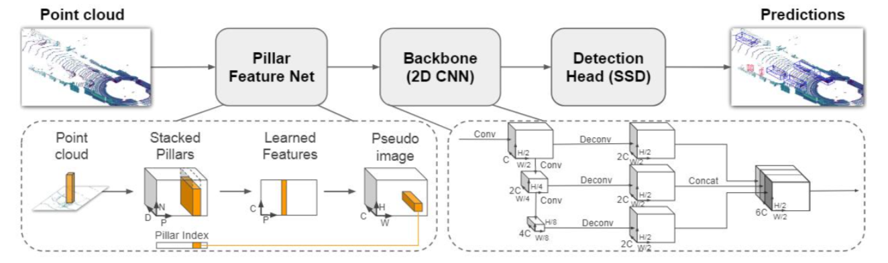
PointPillar 代码流程流程
点云特征提取extract_pts_feat
N:Batch_size, NumP:点数量
检测头Anchor3Dhead
points
extract_pts_feat()
pts_bbox_head()
Nxn_ptsx4
n_pts ex. 363827
点云x,y,z,intensity
Nx80x200x200
Nx80x100x100
Nx80x50x50
Nx72x200x200
Nx72x100x100
Nx72x50x50
Nx16x200x200
Nx16x100x100
Nx16x50x50
多尺度锚框
体素化
体素编码器VFE
中间编码器PointPillarsScatter
主干网络SECOND
颈部网络FPN
voxelize()
pts_voxel_encoder()
pts_middle_encoder()
pts_backbone()
pts_neck()
n_voxelx64x4
n_voxel:60348batch内所有体素一起，有coordinate变量分割
60349x64
通过全连接和norm层，提取特征
Nx64x400x400
组织成BCHW形式，便于后续CNN应用
Nx64x200x200
Nx128x100x100
Nx256x50x50
Nx256x200x200
Nx256x100x100
Nx256x50x50

Slide 14
Futr3d 激光部分代码流程
检测头Futr3Dhead
points
extract_pts_feat()
pts_bbox_head()
Nxn_ptsx4
n_pts ex. 363827
点云x,y,z,intensity
体素化
体素编码器
中间编码器
主干网络SECOND
颈部网络FPN
voxelize()
pts_voxel_encoder()
pts_middle_encoder()
pts_backbone()
pts_neck()
n_voxelx64x4
n_voxel:60348batch内所有体素一起，有coordinate变量分割
60349x64
Nx64x400x400
Nx64x200x200
Nx128x100x100
Nx256x50x50
Nx256x200x200
Nx256x100x100
Nx256x50x50

Slide 15
Detr3d配置文件
Base3DDetector
MVXTwoStageDetector
pts_voxel_layer
pts_voxel_encoder
pts_middle_encoder
pts_fusion_layer
img_backbone
pts_backbone
img_neck
pts_neck
pts_bbox_head
img_roi_head
img_rpn_head
train_cfg
test_cfg
pretrained
init_cfg
Detr3d(MVXTwoStageDetector)

Slide 16
Detr 代码流程流程
B:Batch_size
C:通道数
H: 图片高度
W:图片宽度
ResNet
Conv2d
检测头DetrHead
imgs
extract_img_feat()
input_proj
pts_bbox_head()
(B, C,H,W)
2x3x800x1091
2x2048x25x35
2x256x25x35
分类结果
[nb_dec, bs, num_query, cls_out_channels]
[6,2,100,81]
回归结果
[nb_dec, bs, num_query,4]
[6,2,100,4
最后一维数据含义是
cx, cy, w, h
nb_dec: transformer解码层数
num_query: query数量
cls_out_channels:分类数量,detr有81类
img_metas

Slide 17
Detr3d 代码流程流程
B:Batch_size
N_img:图片数量
C:通道数
H: 图片高度
W:图片宽度
ResNet
FPN
检测头Detr3Dhead
imgs
extract_img_feat()
img_neck()
pts_bbox_head()
(B,N,C,H,W)
1x6x3x928x1600
Nx256x232x400
Nx512x116x200
Nx1024x58x100
Nx2048x29x50
BxNx256x116x200
BxNx256x58x100
BxNx256x29x50
BxNx256x15x25
分类结果
[nb_dec, bs, num_query, cls_out_channels]
回归结果
[nb_dec, bs, num_query,9]
最后一维数据含义是
cx, cy, w, l, cz, h, theta, vx, vy
nb_dec: transformer解码层数
num_query: query数量
cls_out_channels:分类数量
img_metas

Slide 18
Detr3DHead
AnchorFreeHead
DetrHead
Detr3DHead

Slide 19
Detr3Head分析
Detr3D
Detr3DHead
Detr3DTransformer
Detr3DTransformerDecoder
DetrTransformerDecoderLayer
MultiheadAttention
Detr3DCrossAtten

Slide 20
Detr3DTransformer机制
Detr3DCrossAtten
Reference_point
(900,3)
V
K
Q
Embedding
query
(900,256)
query_pos
(900,256)
Img feature
Query_embeded
(900,256)
MultiheadAttention

Slide 21
Detr3DHead
[[1,6,256,116,200],
[1,6,256,58,100],
[1,6,256,29,50],
[1,6,256,15,25]]
[900,512]
mlvl_feats
query_embeds
transformer
outputs_classes
outputs_coords
Self Attention

Slide 22
Detr3DTransformer
[[1,6,256,116,200],
[1,6,256,58,100],
[1,6,256,29,50],
[1,6,256,15,25]]
[900,512]
mlvl_feats
query_embeds
transformer
outputs_classes
outputs_coords
Self Attention

Slide 23
Feature sampling
query_embed
[900,1,512]
query
query_pos
[900,1,256]
[900,1,256]
[[6,256,116,200],
[6,256,58,100],
[6,256,29,50],
[6,256,15,25]]
FC
Extrinsic parameters
[1,900,3]
Reference point
features
feature_sampling()
Reference_points_3d
Sampled_feats
[1,900,3]
[1,256,900,6,1,4]

Slide 24
Detr3DTransformerDecoder
Add & Norm
FFN
Add & Norm
Detr3DCrossAtten
V
K
Q
[1,256,900,6,1,4]
Add & Norm
feature_sampling
MultiheadAttention
V
K
Q
features
[900,1,256]
[900,1,256]
[[6,256,116,200],
[6,256,58,100],
[6,256,29,50],
[6,256,15,25]]
query
query_pos
Reference_points
Object query

Slide 25
Deformable detr build
Build Model
build_backbone
build_deforamble_transformer
Backbone(ResNet50)
PositionEmbeddingSine
transformer
Backbone+PE
DeformableDETR

Slide 26
nn.Module
ModulatedDeformConv2d
ModulatedDeformConv2dPack

Slide 27
Multi Scale Deformable Attention in Encoder
参数 | 含义 | 取值
N | Batch num | 2
Len_q | Query长度 | 100
Len_in | Value长度 | 1360
n_heads | 头数 | 8
n_levels | 特征层数 | 4
n_points | 参考点数 | 4
d_model | 特征通道数 | 256
Features
Position Embed
(2,1360,256)
Query
(2,1360,256)
Value
(2,1360,256)
(bz,token_num,256)
(bz,token_num,256)
(bz,token_num,256)
Sampling_offset
(2,1360,256)
Attention_weights
(2,1360,128)
Value
(2,1360,8,32)
Features size
(bz,token_n_heads, dim)
reference_points
(2,1360,4,2)
Sampling_offset
(2,1360,8,4,4,2)
Attention_weights
(2,1360,8,4,4)
Features
[(2,256,32,32),
(2,256,16,16),
(2,256,8,8),
(2,256,4,4)]
(2,1360,n_heads,n_levels,n_points,2
Attention_weights
(16,1,1360,16)
Sampling_location
(2,1360,8,4,4,2)
N*n_heads,1,1360,n_levels*n_points
(2,1360,n_heads,n_levels,n_points,2
Sampled_value
(16,32,1360,16)
MSDeform Attn
(2, 1360,256)

Slide 28
Futr3Head分析
Futr3DHead
Futr3DTransformer
Futr3DTransformerDecoder
DetrTransformerDecoderLayer
MultiheadAttention
FUTR3DAttention

Slide 29
多进程训练
torchrun --nproc_per_node=2 main.py启动多进程
dist.init_process_group
进程初始化
dist.init_process_group
进程初始化
torch.cuda.set_device(rank)
设置跑在哪个显卡上
torch.cuda.set_device(rank)
设置跑在哪个显卡上
复制模型到GPU上
复制模型到GPU上
DistributedSampler进行数据分配
DistributedSampler进行数据分配
前向传播、反向传播、梯度汇总、参数更行
前向传播、反向传播、梯度汇总、参数更行
dist. destroy_process_group
dist. destroy_process_group

Slide 30
Futr3D激光 配置文件
Base3DDetector
MVXTwoStageDetector
pts_voxel_layer
pts_voxel_encoder:HardSimpleVFE
pts_middle_encoder:SparseEncoder
pts_fusion_layer
img_backbone
pts_backbone:SECOND
img_neck
pts_neck:FPN
pts_bbox_head:FUTR3DHead
img_roi_head
img_rpn_head
train_cfg
test_cfg
pretrained
init_cfg
FUTR3D

Slide 31
Futr3D激光视觉配置文件
Base3DDetector
MVXTwoStageDetector
pts_voxel_layer
pts_voxel_encoder:HardSimpleVFE
pts_middle_encoder:SparseEncoder
pts_fusion_layer
img_backbone:ResNet
pts_backbone:SECOND
img_neck:FPN
pts_neck:FPN
pts_bbox_head:FUTR3DHead
img_roi_head
img_rpn_head
train_cfg
test_cfg
pretrained
init_cfg
FUTR3D

Slide 32
Futr3D Attention
Reference points
(1,900,3)
Query
(1,900,256)
mlvl_pts_feats
pts_feat_flatten
(1,43054,256)
mlvl_img_feats
pts_weight
Img_weight
mlvl_pts_feats
[(1,256,180,180),
(1,256,90,90),
(1,256,45,45),
(1,256,23,23)]
mlvl_img_feats
[(1,6,256,116,200),
(1,6,256,58,100),
(1,6,256,29,50),
(1,6,256,15,25)]

Slide 33
Futr3D Attention
pts_feat_flatten
mlvl_img_feats
Multi-Head Self-Attention
Reference points
(1,900,3)
Query
(900,256)

Slide 34
Futr3DTransformerDecoder

