Slide 1
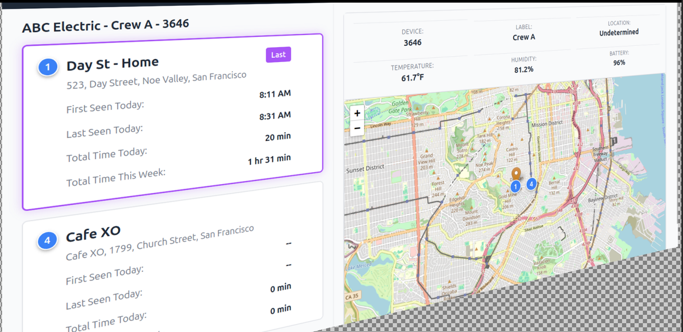
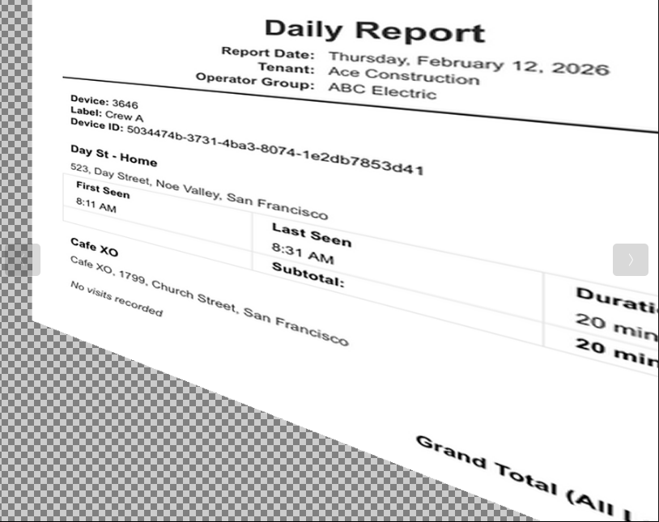
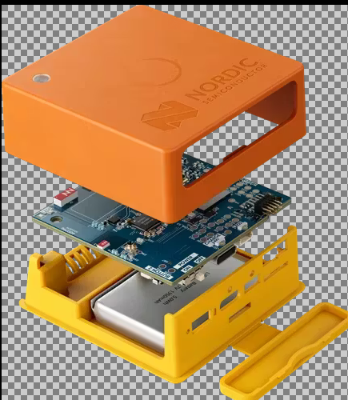

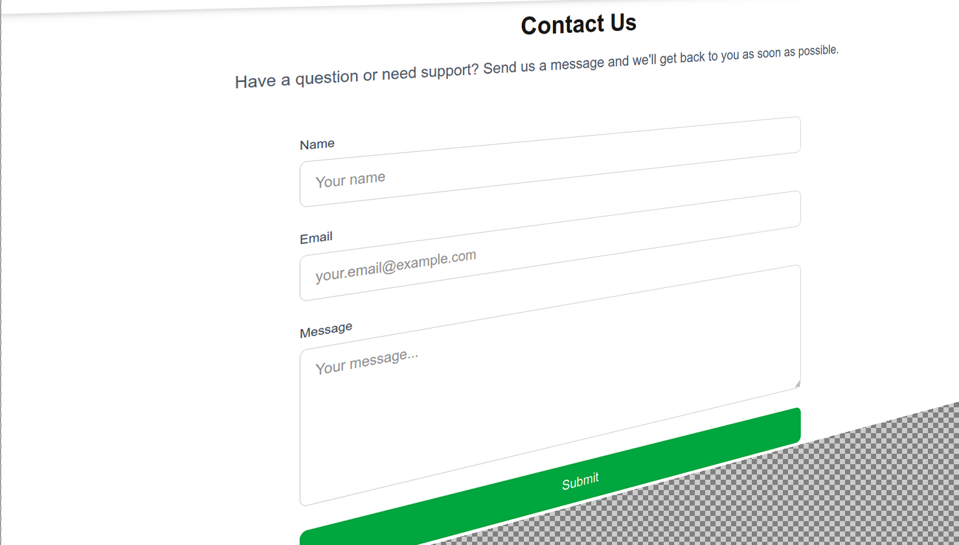
Tracking Features
Track devices at locations in real time
Assign devices to crews and print daily reports
Tracking device is a Nordic Semiconductor Thingy-91X
Starting at $20 USD a month per device (includes device, sim usage and tracking)
Contact us now to order

