Slide 1
Efficient file sharing between host and unikernel
DIPLOMA THESIS
Fotis Xenakis
Supervisor: Nectarios Koziris
30/10/2020

Slide 2
Cloud computing & virtualization
In the beginning there was the cloud:
Utility computing
Everything as a Service
Large scale
Relying on virtualization:
Elasticity for the provider
Isolation for the user
Notes:
From operational perspective?
We want to run applications. Fast, cheap and easy.
With many, shared machines, we can.
But how to share them fairly, securely and efficiently (performance + security + efficiency)?
Virtualization to split them into smaller ones, one machine each.

Slide 3
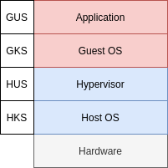
Operating systems
General-purpose guest OS:
Imposes isolation
In practice:
Only runs a single application
Could be more efficient. Bloat!
Notes:
Due to scale: small costs in isolation -> large in total

Slide 4
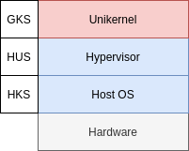
Unikernels
“OS” + application:
Library OS
Single address space
Thus:
Efficiency (size, memory, time)
Performance(?)
OSv: Linux compatibility, many features, many(!) file systems
Notes:
Unikernels:
Library OS: only what’s necessary
Single address space: embrace the reality, we are in this together
OSv:
FOSS unikernel
Linux ABI compatibility
Lots of functionality: virtual memory, VFS, mature implementations
Has a file system and >1 in fact!

Slide 5
File systems & virtualization
Traditionally:
Guest: disk (block device)
Host: file (opaque)
Indirection
Access to the host fs:
High level
Easier for the guest
Access from the host too
Notes:
The guest disk is simple an opaque file on the host, pretending to be a block device.
Traditional require exclusivity

Slide 6
Virtio-fs
Until now:
NFS, SMB, VirtFS...
Network
virtio-fs:
Virtualization-native
virtio, FUSE
virtiofsd
Notes:
virtio-fs:
Lightweight (guest requirements)
Takes advantage of host-guest colocation
virtiofsd:
vhost-user
Modularity, can be swapped

Slide 7
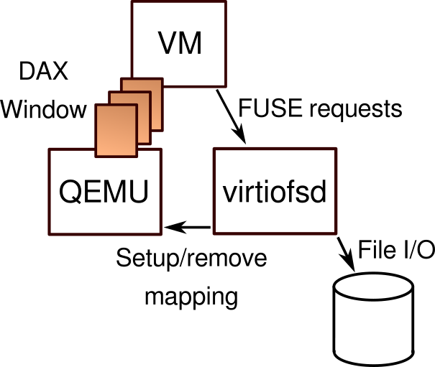
Virtio-fs DAX window
Shared guest⇔host memory:
mmap()
No VMEXIT
Better performance
Notes:
Workflow:
Guest requests mapping
virtiofsd checks and orders QEMU to mmap
Guest direct access to files

Slide 8
Thesis goals
Technical:
virtio-fs DAX window in OSv
Read-only
Boot from virtio-fs
...or not:
Contribution to FOSS project
Practical work ⇒ practical value
Notes:
Technical:
Practical value for virtio-fs in OSv
Hence need performance (DAX)
And applicability (boot)

Slide 9
Virtio-fs in OSv
Pre-existing, elementary implementation
Driver:
Low-level PCI device handling
Agnostic to FUSE
File system:
High-level fs operations
Knows FUSE
Notes:
TODO: Is the driver / fs split unnecessary here?

Slide 10
DAX window in OSv
Driver:
PCI
File system:
map alignment
FUSE_SETUPMAPPING
FUSE_REMOVEMAPPING
Notes:
PCI:
BAR: device memory, MMIO
FS:
map alignment due to mmap() on the host
Mappings overlap
FUSE_REMOVEMAPPING normally unnecessary

Slide 11
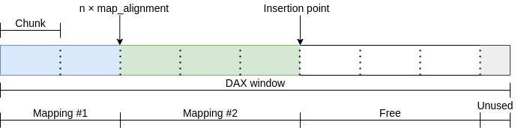
DAX window manager
Problem:
Multiple mappings
Solution:
Chunks
Stack (LIFO)
Notes:
Chunks:
2 MiB
Always whole
No prefetching > 1 chunk

Slide 12
Boot from virtio-fs
Initially:
Boot fs: always ramfs
Root fs: dynamically rofs ⇒ ZFS ⇒ ramfs
Eventually:
Optional kernel command line option
Root fs: rofs, ZFS, virtio-fs, ramfs
Backwards compatible
Changes to kernel and tools
Notes:
Boot fs is part of the image -> always ramfs (like in Linux)
Ultimately easy thanks to VFS + done in the past -> simple extension

Slide 13
Evaluation
Various scenarios:
Microbenchmark
Startup time
Real-world application
Notes:
Microbenchmark:
Simple operations, local to a part only
Built to measure performance
Startup time:
Very important in unikernels, big advantage vs gp OS
Application:
Complex, indicates overall system view

Slide 14
Microbenchmark
Flexible I/O tester (fio)
1 file / multiple files
Total size 1 GiB
Serial / random reading
Throughput
Comparison:
Host (baseline)
Linux: virtio-fs, virtio-fs-DAX
OSv: virtio-fs, virtio-fs-DAX, ZFS, rofs, ramfs, NFS

Slide 15
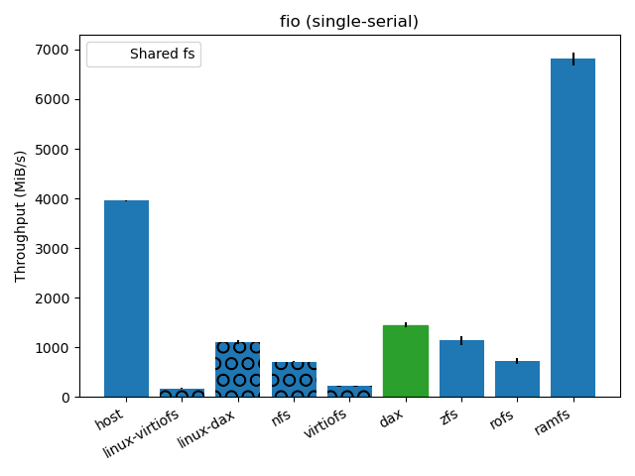
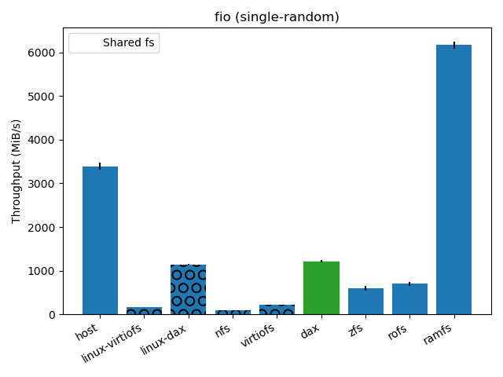
Microbenchmark results (single file)
Notes:
Remarks:
Shared marked with circles, virtio-fs-DAX-OSv in green
Best of shared
Better than traditional local on OSv

Slide 16
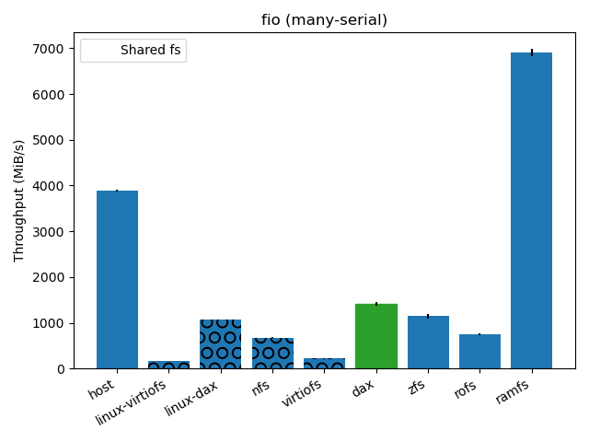

Microbenchmark results (multiple files)
Notes:
Similar to single file

Slide 17
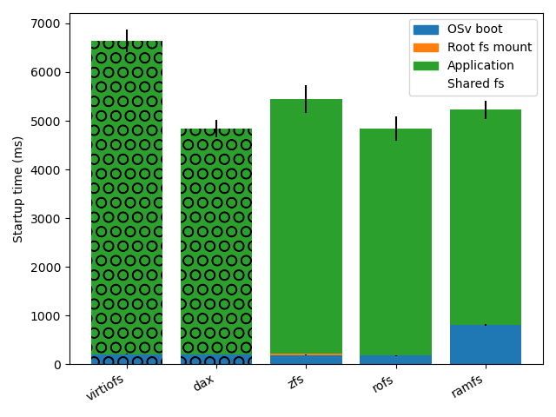
Startup time
Simple web (spring) application
OSv boot
Root fs mount
Application initialization
Comparison:
OSv: virtio-fs, virtio-fs-DAX,
ZFS, rofs, ramfs
Notes:
Stateless web app: typical unikernel application
Best together with rofs
OPT: ramfs boot time anomaly: large ELF, slow uncompression and loading

Slide 18
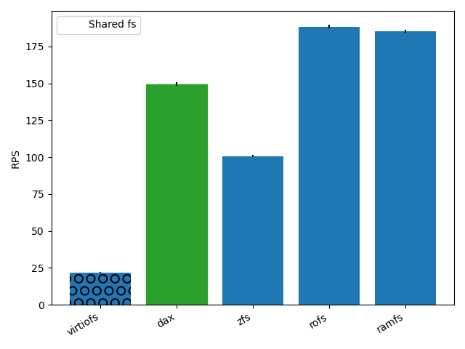
Application benchmark
Nginx static web server:
Many files ~MiB
Vegeta HTTP load client
Requests / second
Comparison:
OSv: virtio-fs, virtio-fs-DAX,
ZFS, rofs, ramfs
Notes:
Again stateless web app: typical unikernel application
HTTP load client
Application for benchmarking web servers, performs many requests
Runs on the host
Second best performance (-20%), after rofs
Can be further investigated through profiling, maybe explained by the access pattern

Slide 19
Summary
Technical conclusions:
virtio-fs in OSv useful (changes without rebuilding)
DAX window ⇒ excellent performance
Pleasant development on OSv (like application development)
Non-technical conclusions:
Open, supportive communities
Contribution

Slide 20
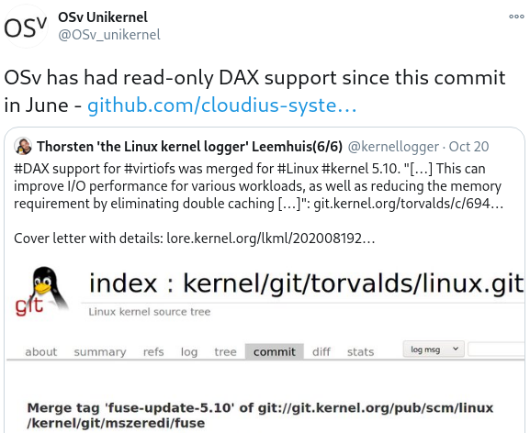
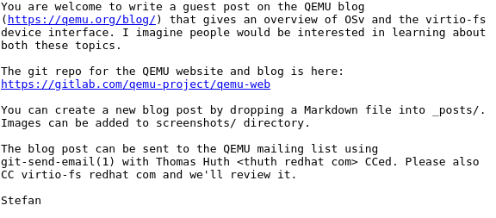
Contribution
Notes:
Left:
Official OSv twitter account, when DAX support was merged in Linux (recently, yet to be released)
Right:
Virtio-fs mailing list, invitation for guest post in QEMU blog

Slide 21
Thank you!
Questions?

