Slide 1
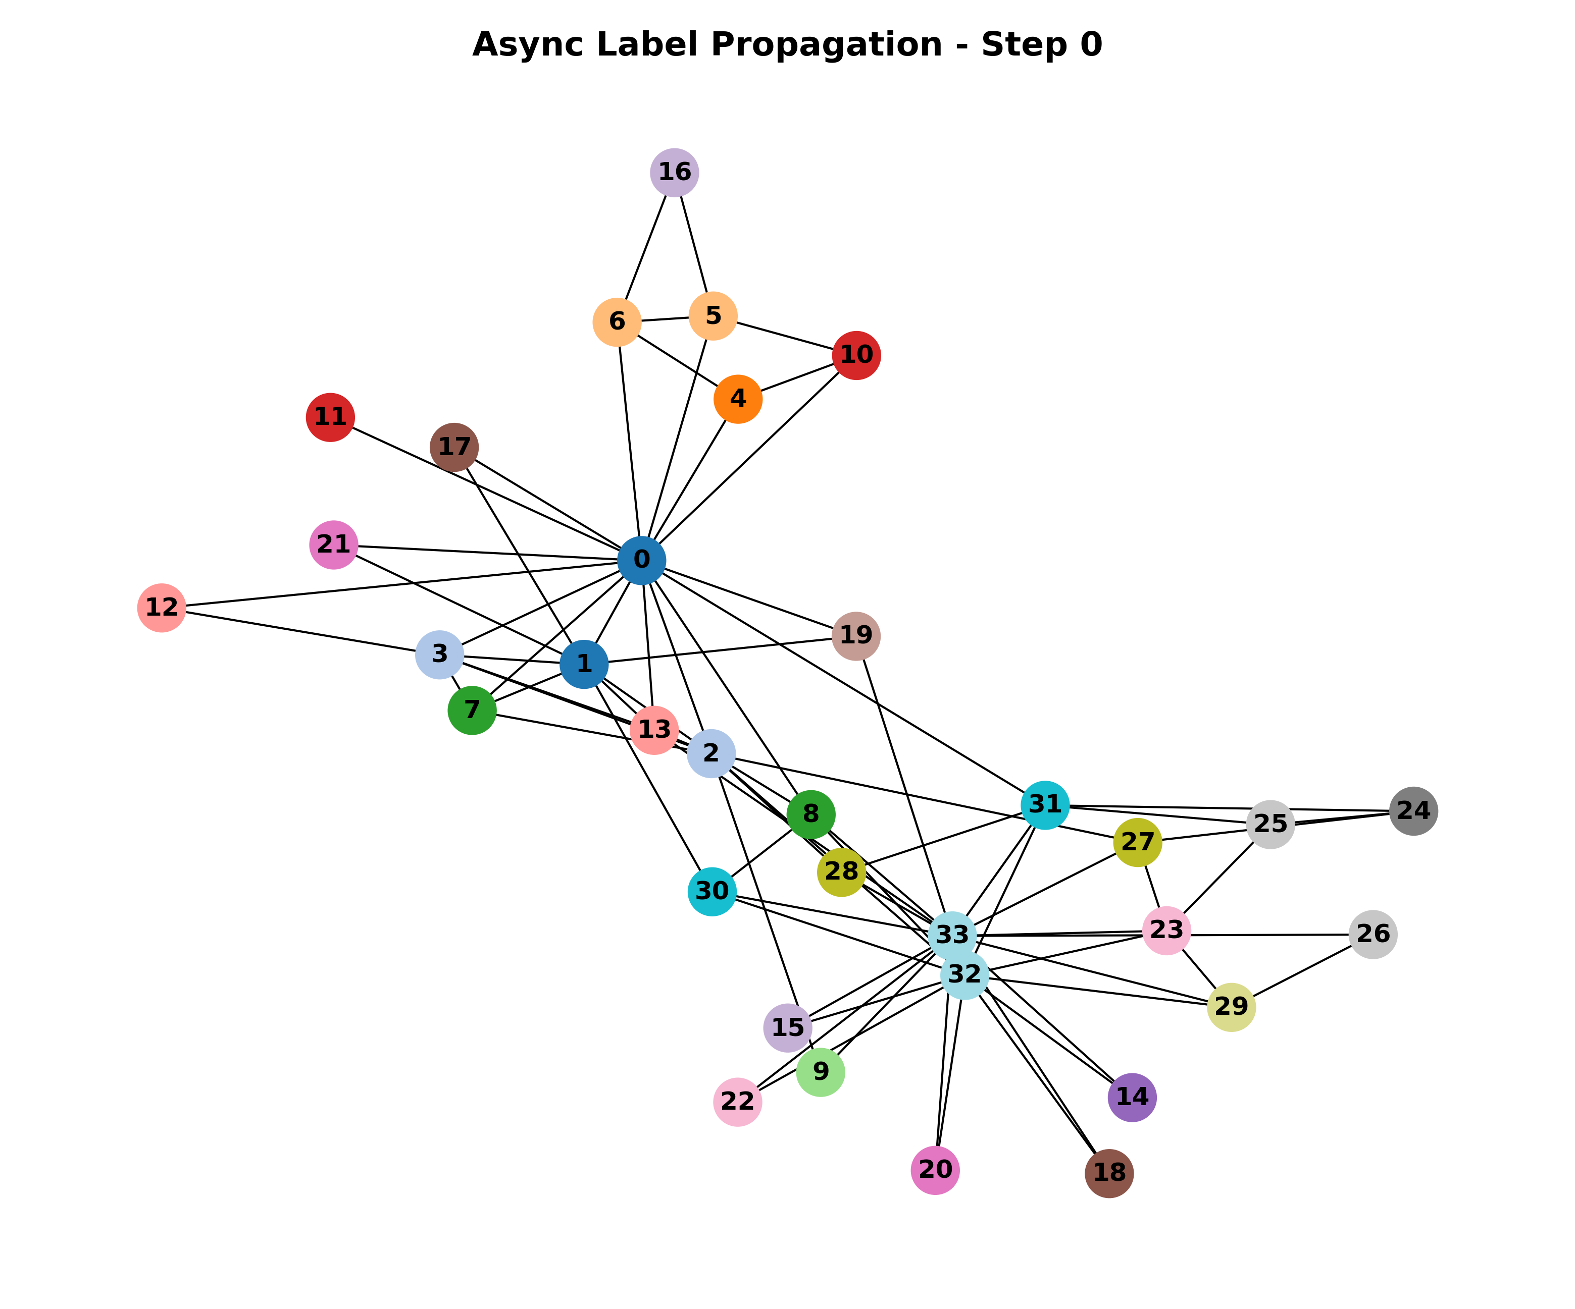
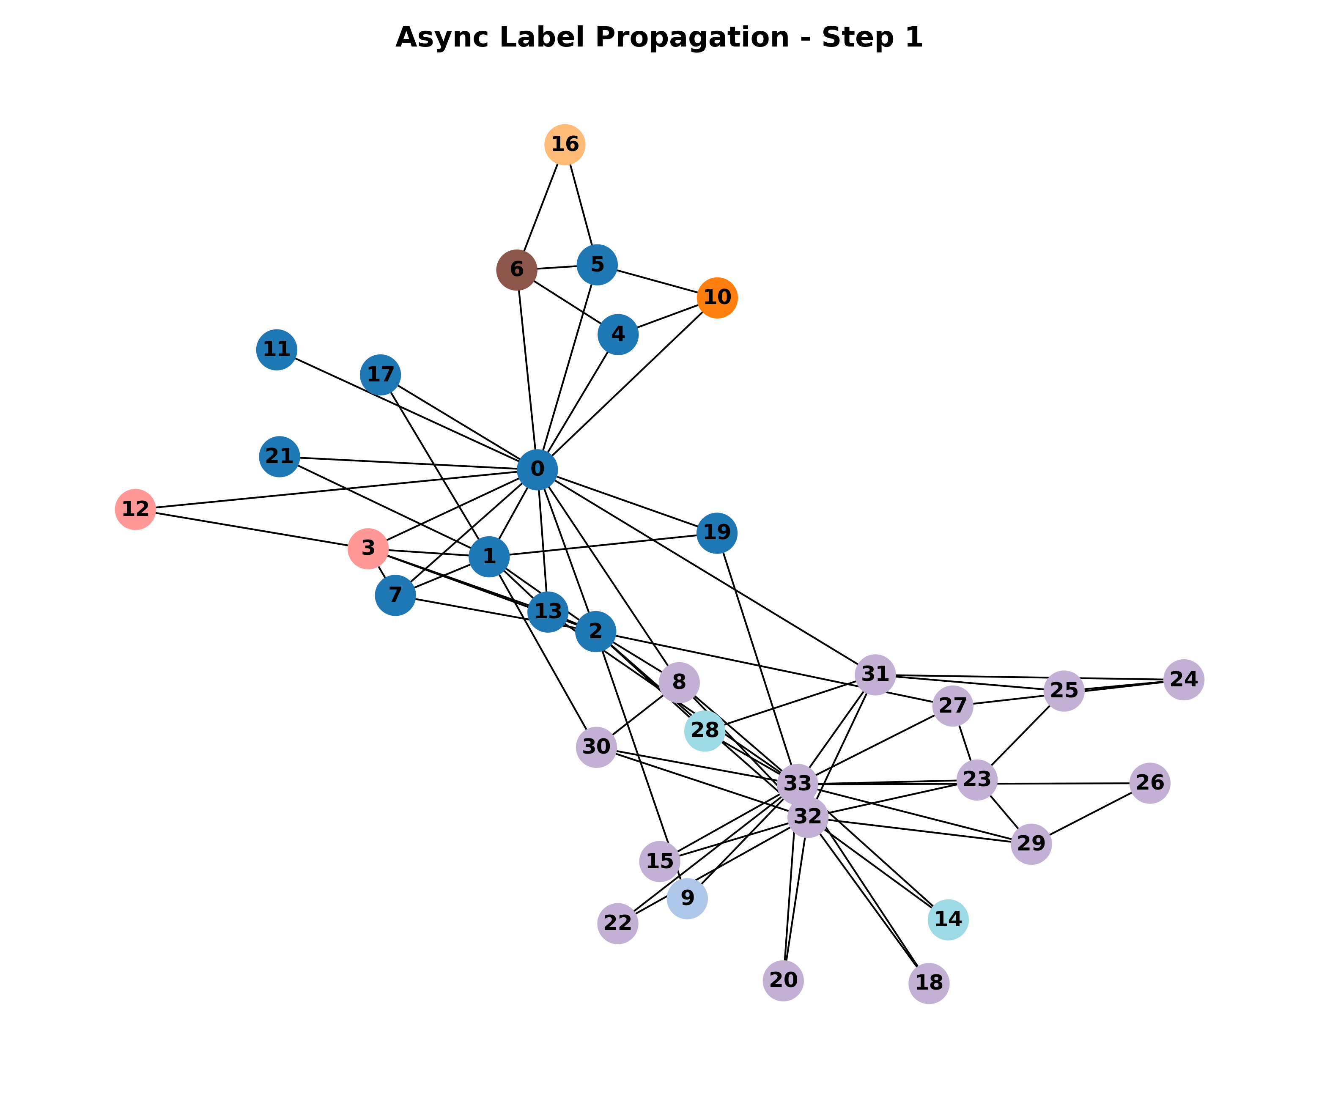
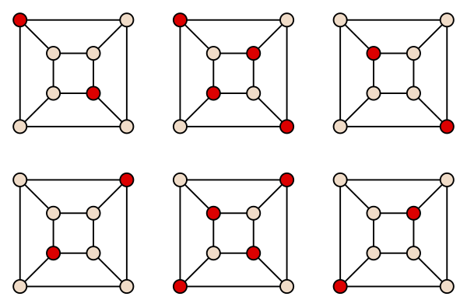
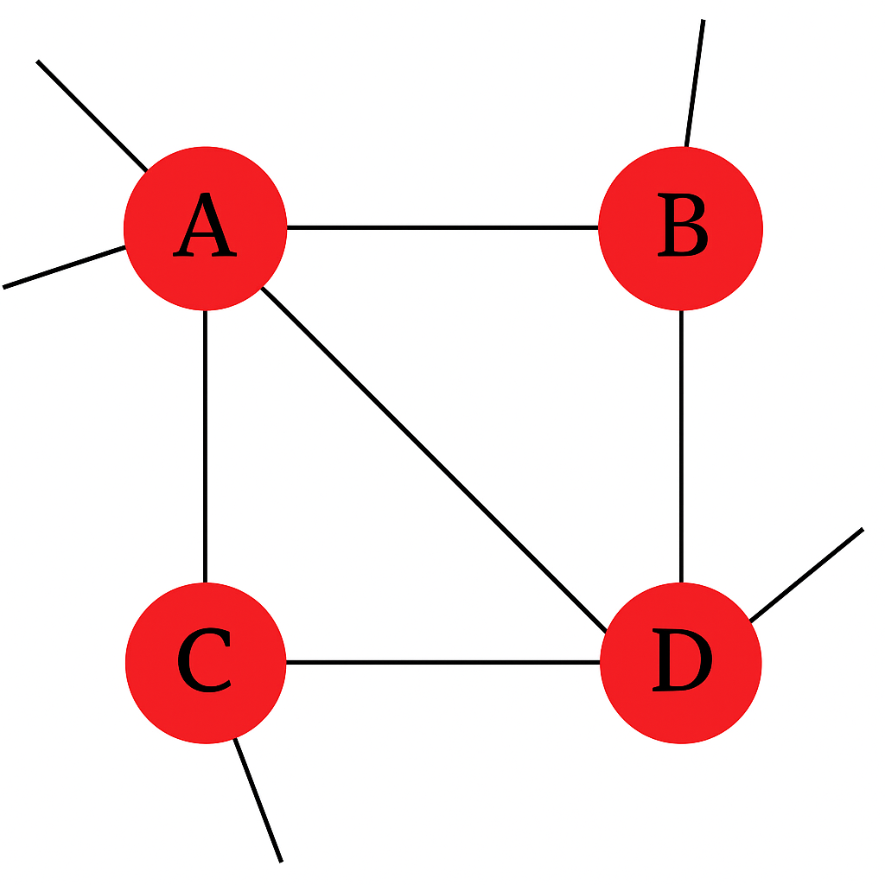
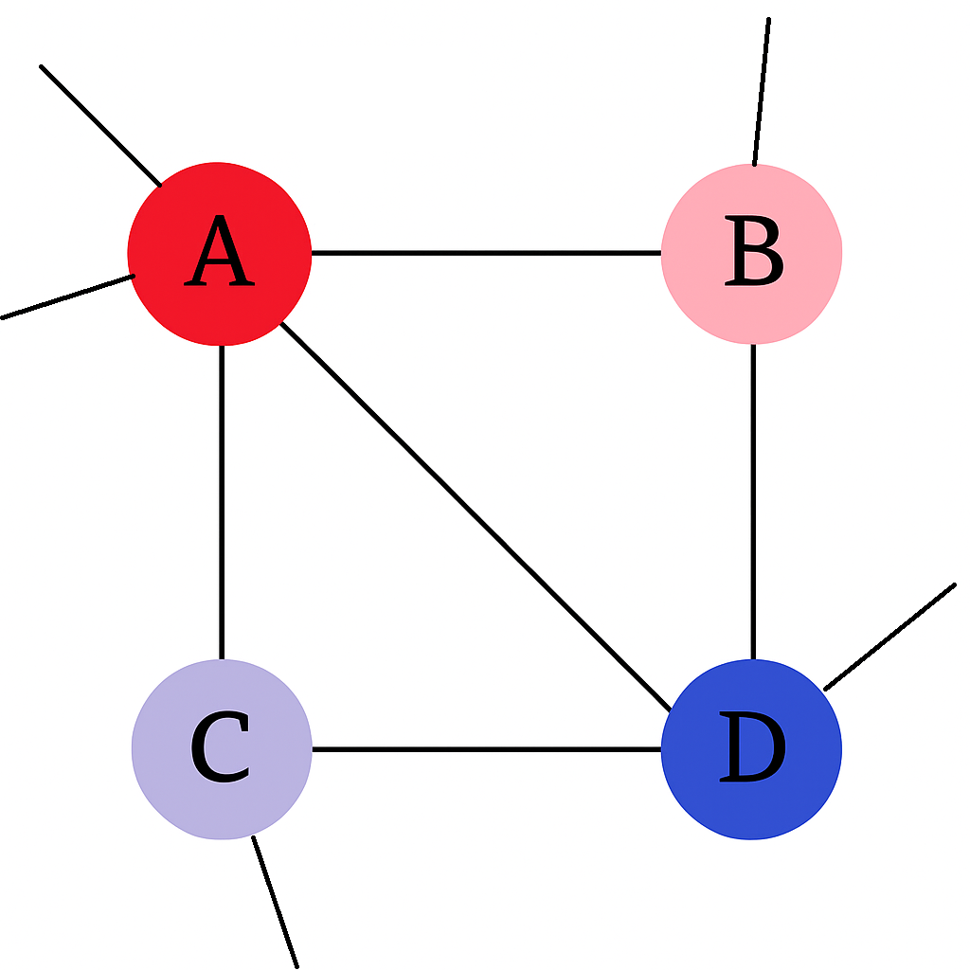

Label Propagation With Maximal Independent Set
20211277 Hojun Lee
Background : Label Propagation
Proposed Algorithm
Maximal Independent Set (MIS)
No adjacent nodes
No any additional nodes can be added
Asynchronous update
: When a node determines the next label, it is immediately applied and affects the next node update
Synchronous update
: Once all nodes decide on their next labels, the node labels are updated simultaneously.
Multiprocessing
Over-propagation problem:
propagates far beyond, and form overly large clusters.
decrease model prediction accuracy
Unstable (Results may vary widely)
https://en.wikipedia.org/wiki/Maximal_independent_set
Sync LPA with MIS Algorithm
At each round:
Each node must update at least once
MIS (Maximal Independent Set) must include nodes that haven't been updated yet in this round
When all nodes are updated, start a new round
Termination conditions:
Convergence: No actual updates occur
Max iteration: Predetermined hyperparameter limit
$$\text{Time} \text{Complexity}\text{ : }\text{O}\text{(}\text{max}\text{_}\text{iteration} × n^{3})$$
Observation
Init state
B->D->C
Idea:
we should not update a node and its any adjacent node sequentially

Slide 2
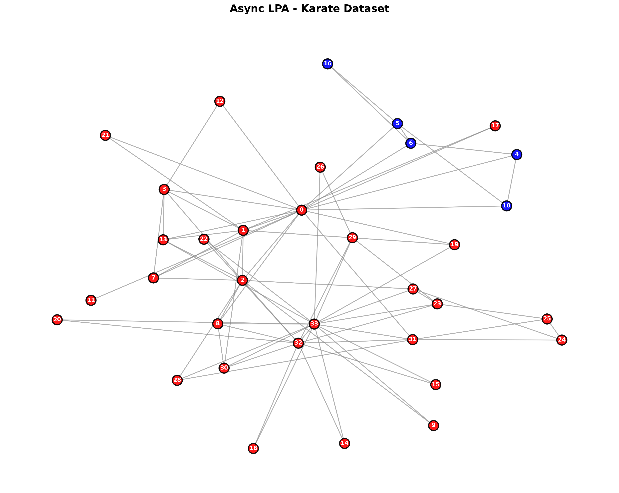
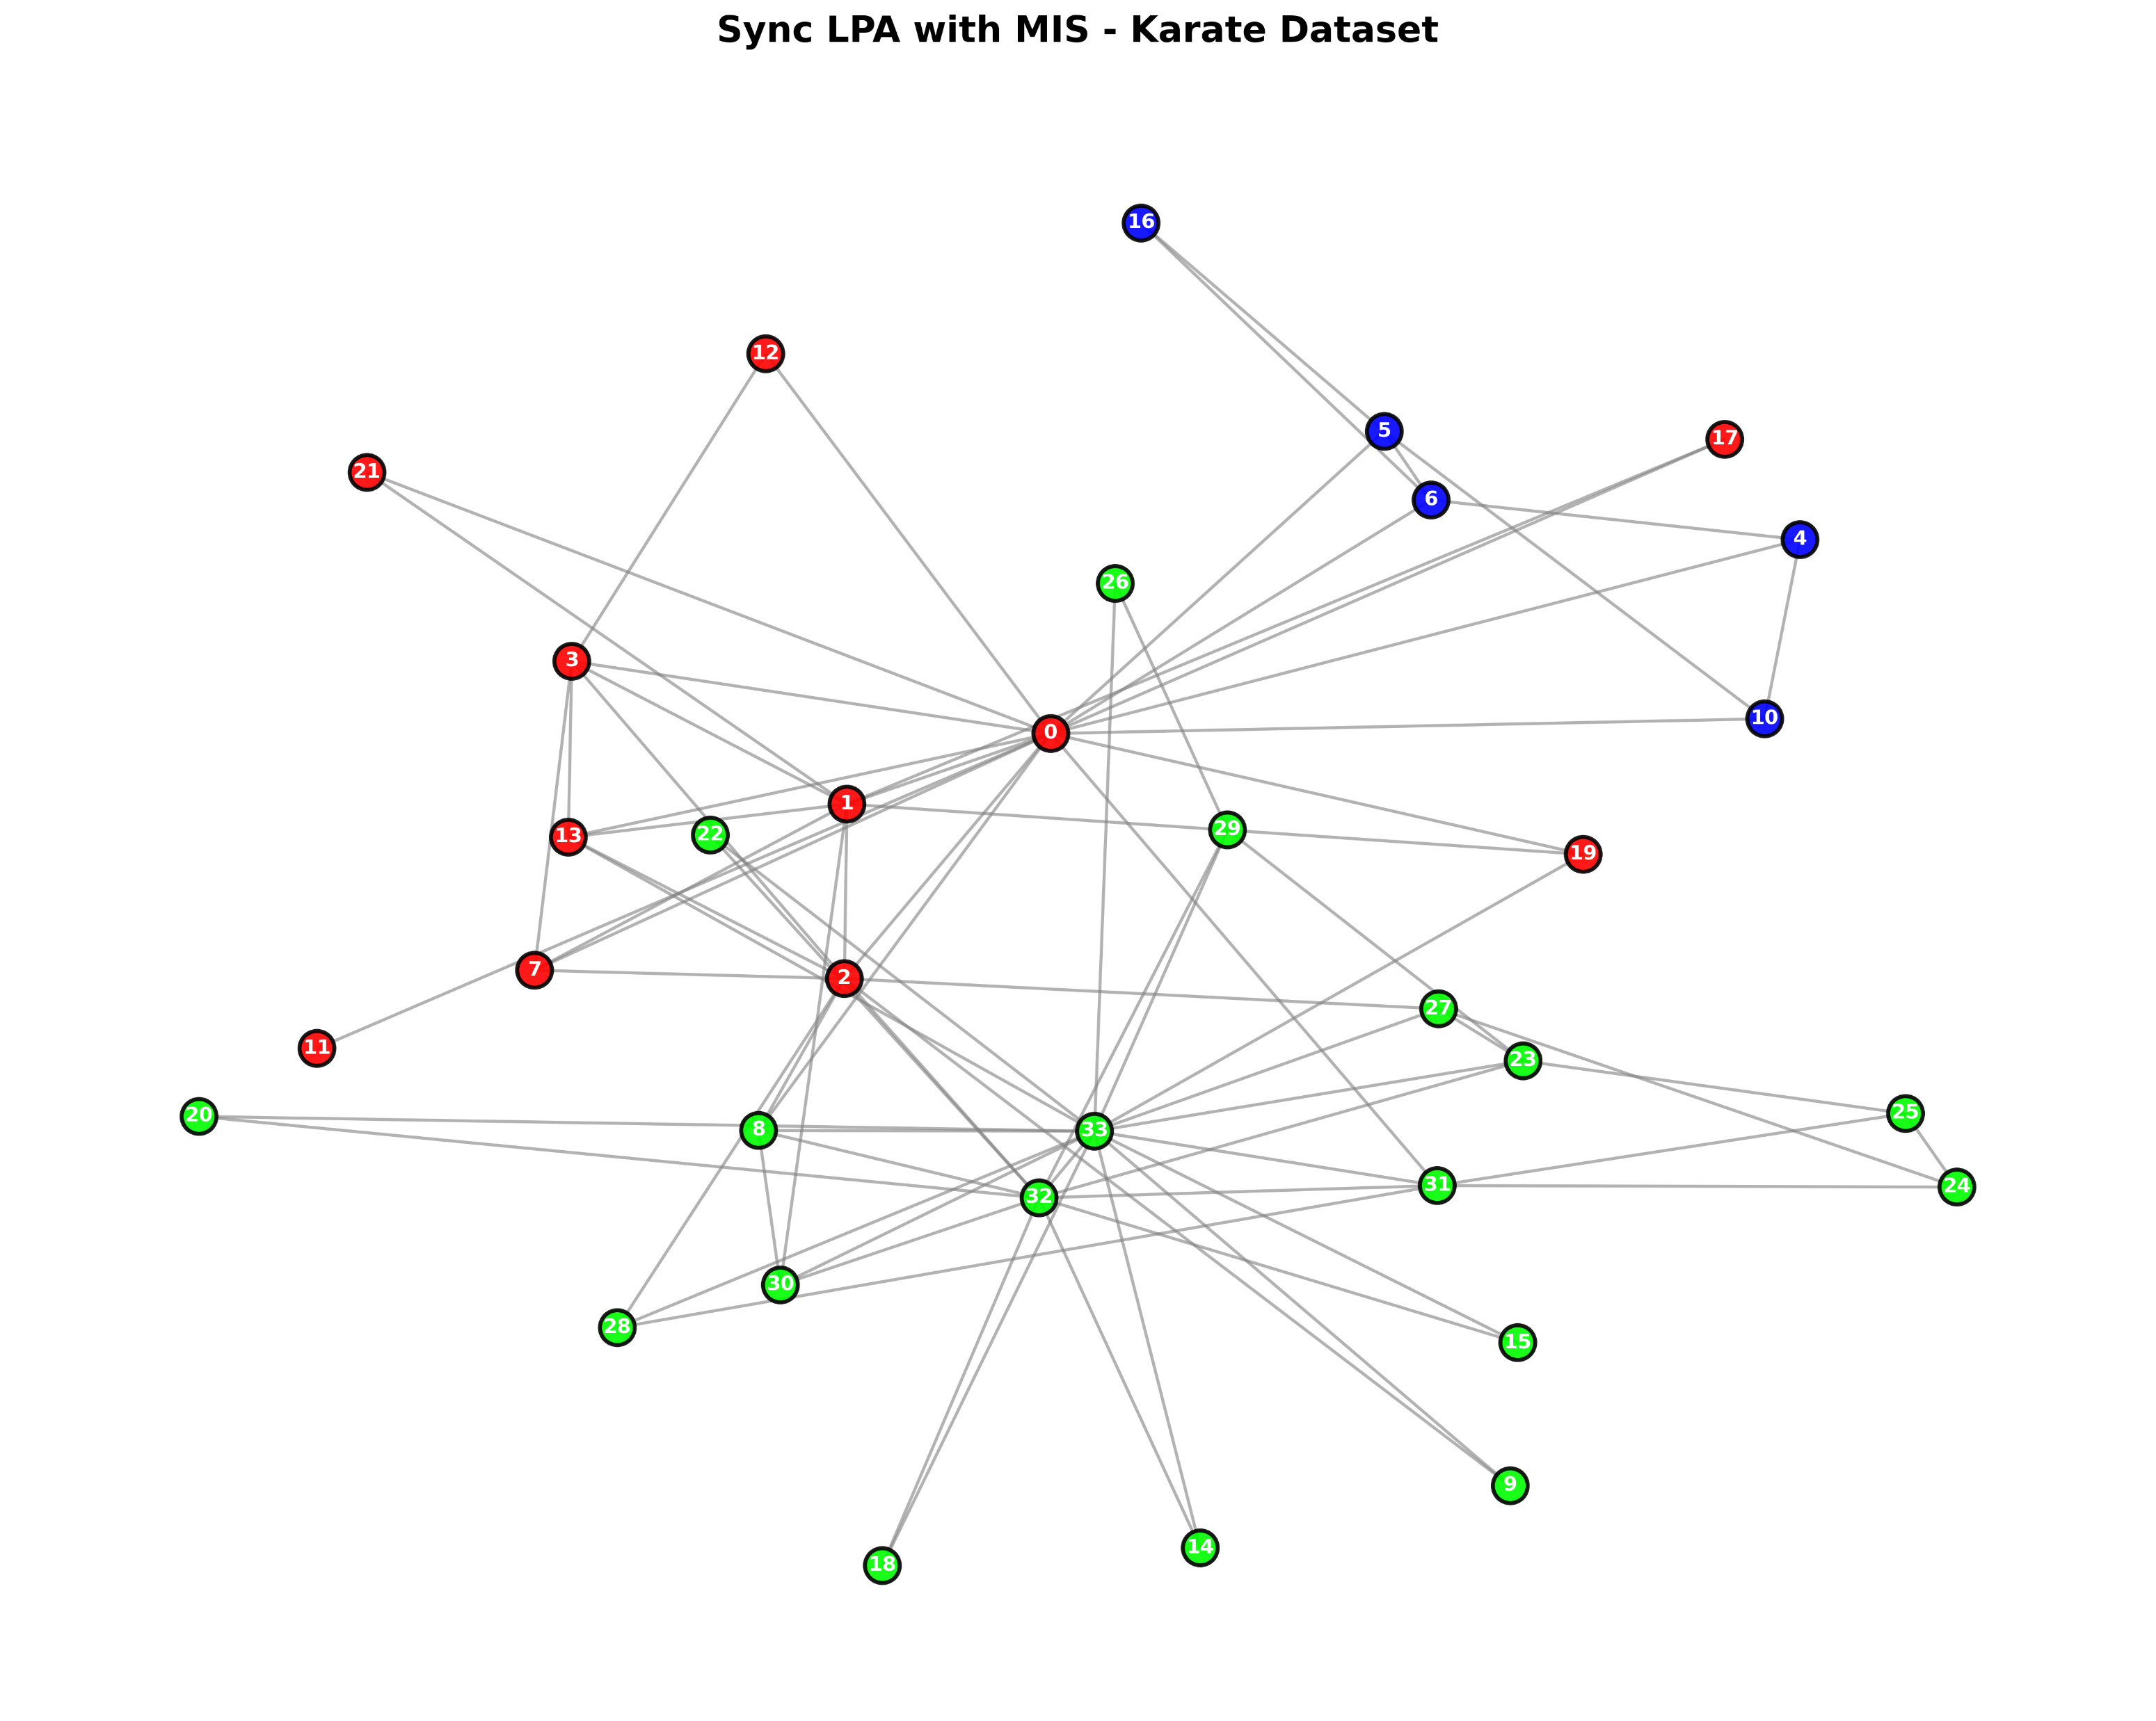
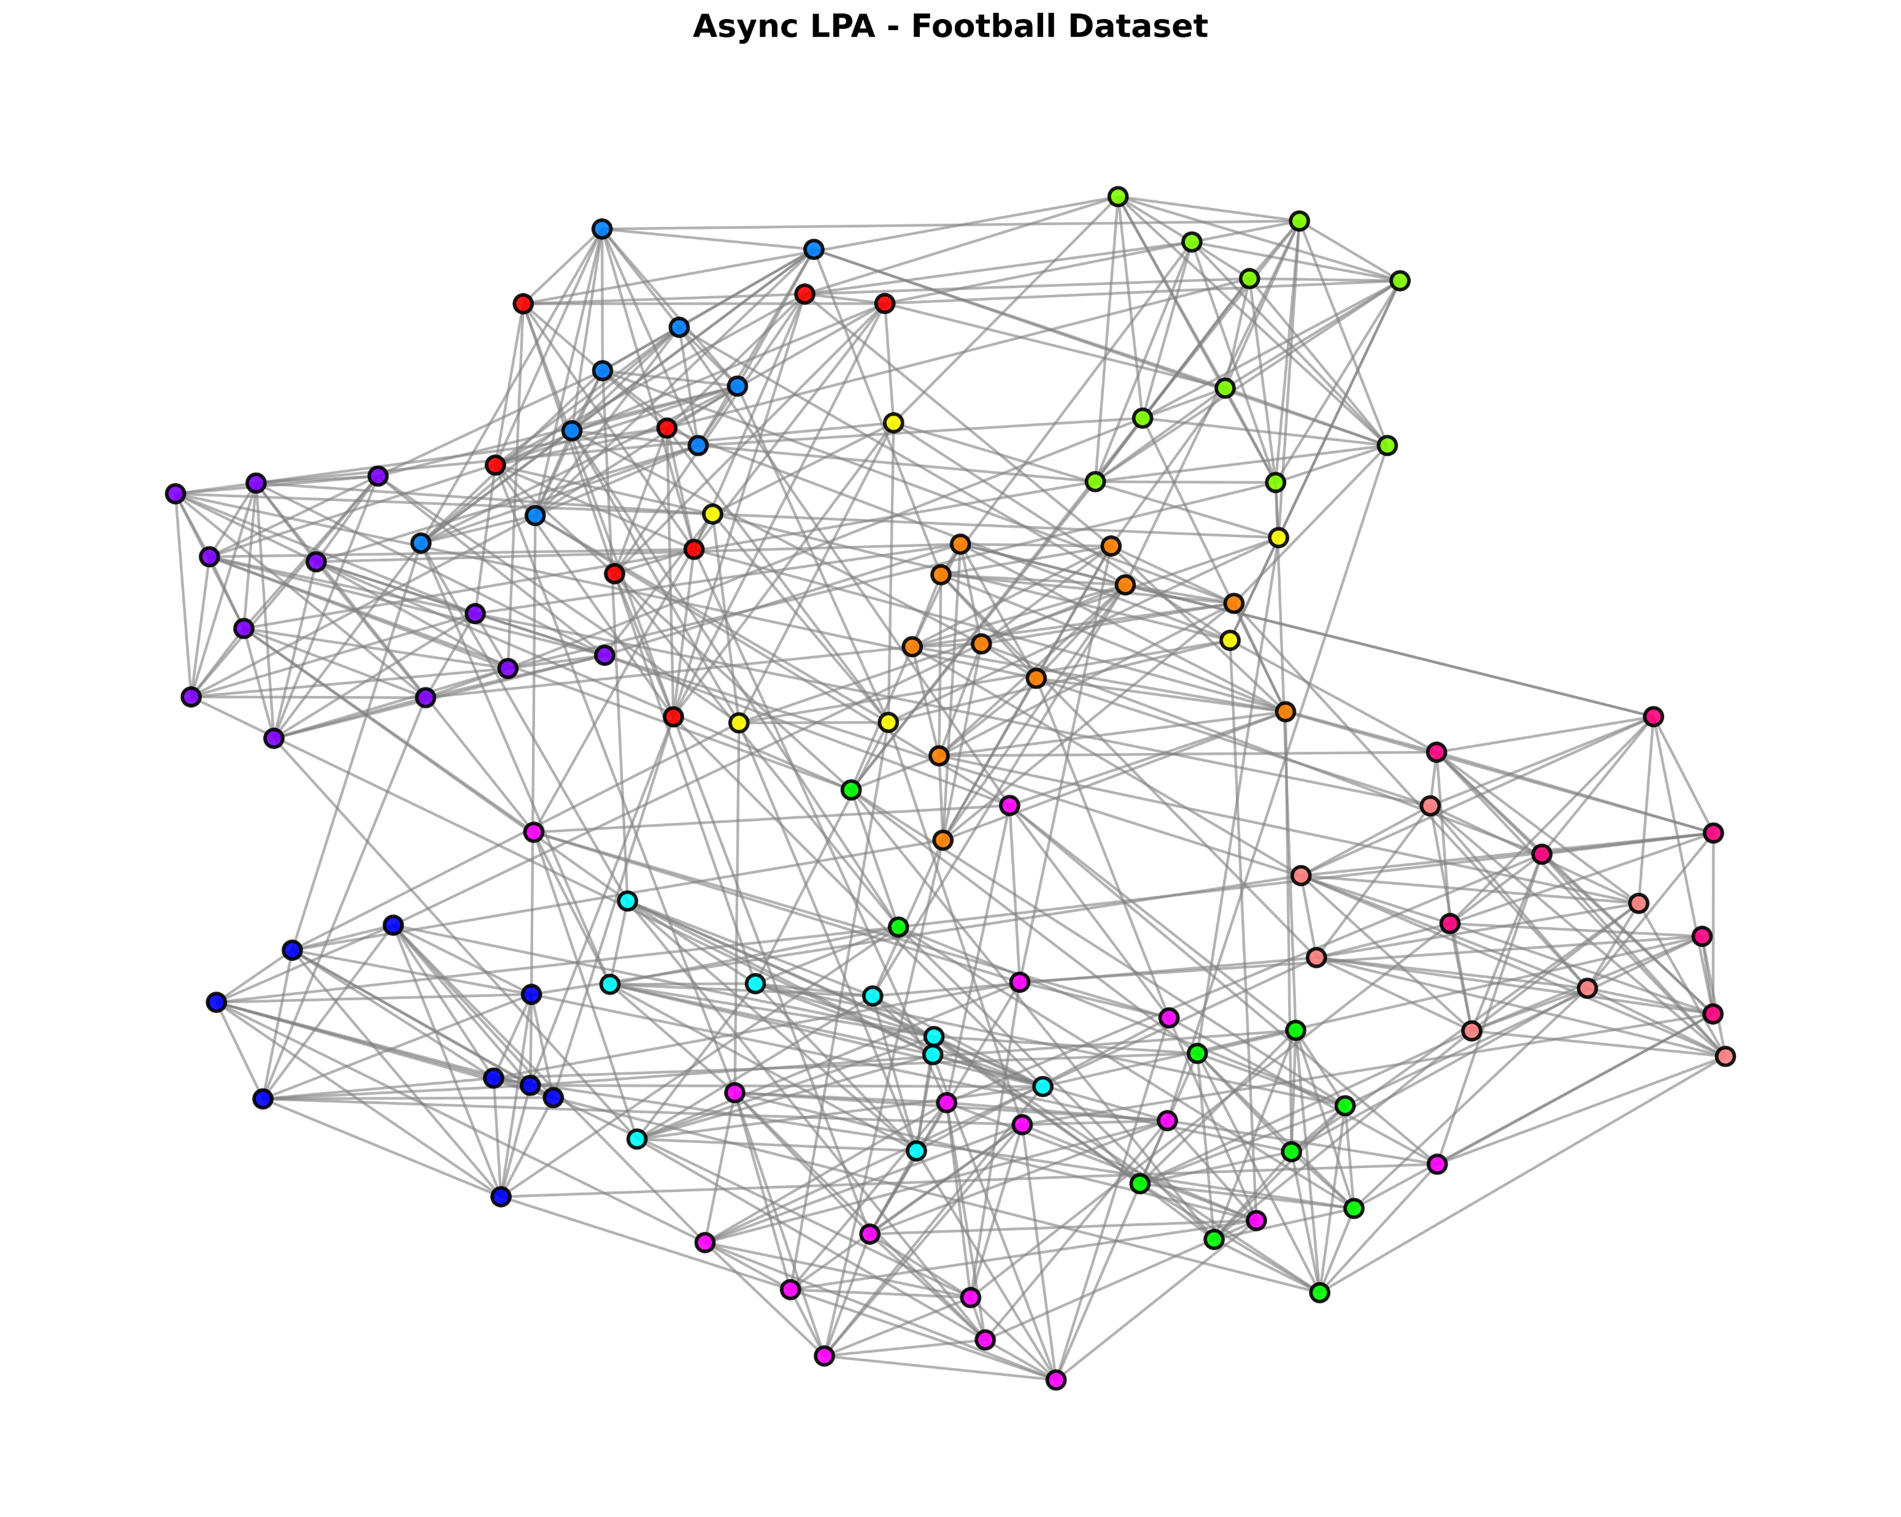
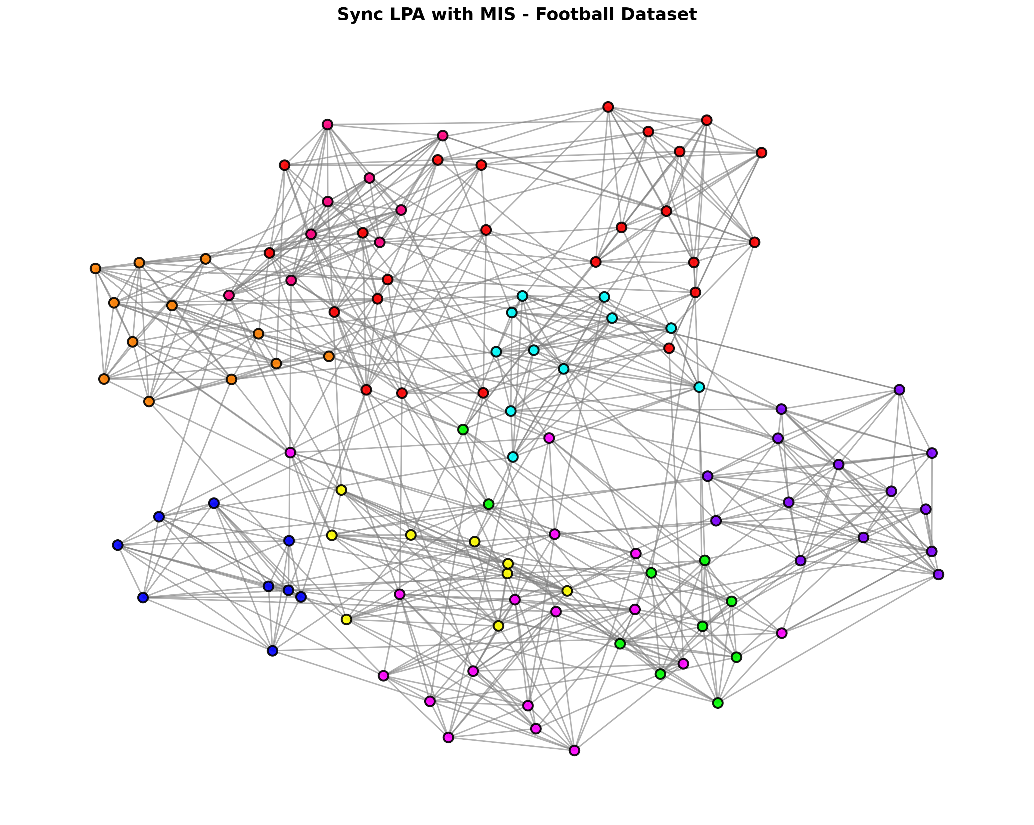
Experiment Results
Clustering Results
Benchmark dataset
Dataset | # of nodes | # of edges
Karate | 34 | 78
Dolphin | 62 | 159
Football | 115 | 613
Accuracy Comparison: NMI Values by Algorithms
Algorithm | Karate | Dolphin | Football
Async LPA | 0.6064 | 0.0250 | 0.4769
Sync LPA | 0.4854 | 0.0236 | 0.4778
Sync LPA with MIS | 0.6592 | 0.0354 | 0.4873
LPA with MIS can capture smaller cluster better
Stability Comparison: Standard Deviation
Algorithm | Karate | Dolphin | Football
Async LPA | 0.1951 | 0.0155 | 0.0272
Sync LPA | 0.2081 | 0.0111 | 0.0188
Sync LPA with MIS | 0.1253 | 0.0251 | 0.0210
Execution Time (Without Multiprocessing)
Conclusion
LPA with MIS captures smaller clusters
than traditional LPA.
- It mitigates the over-propagation problem.
This improves accuracy and stability.
Algorithm | Karate | Dolphin | Football
Async LPA | 0.46 | 7..65 | 6.95
Sync LPA | 19.54 | 33.63 | 36.24
Sync LPA with MIS | 8.78 | 47.60 | 64.74

