Slide 1
Memory Lane

Slide 2
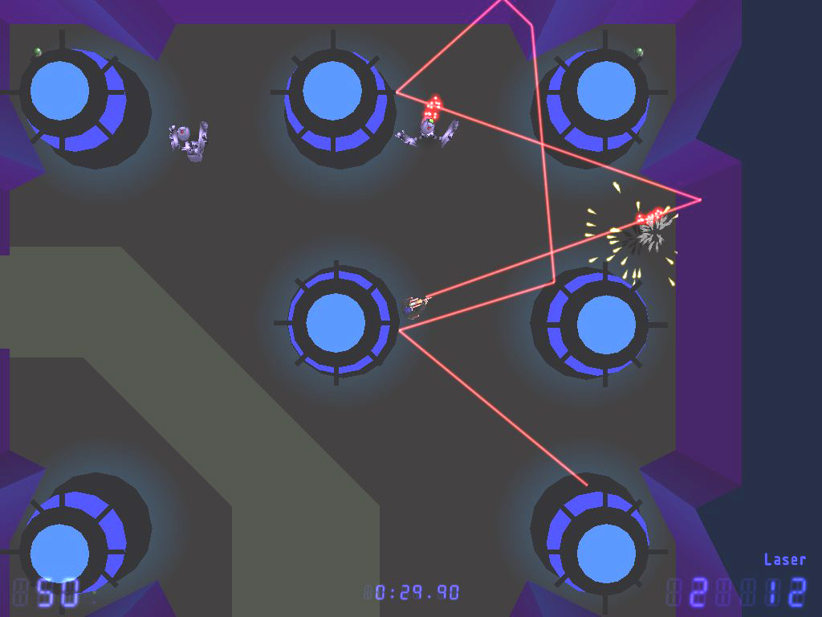
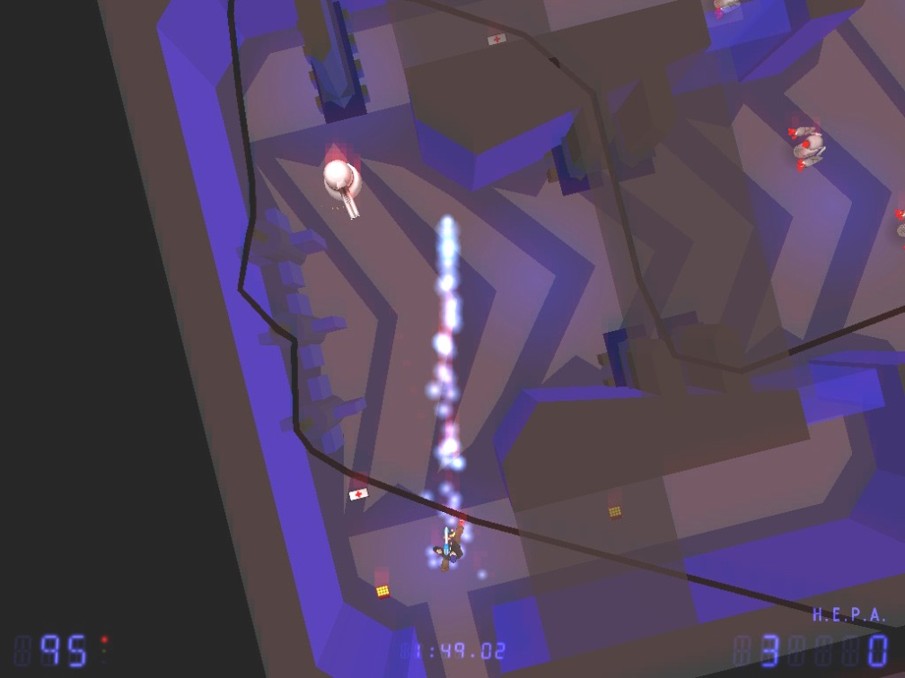
Shotgun Debugger

Slide 3
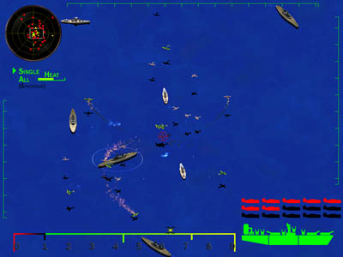
Battleship 88

Slide 4
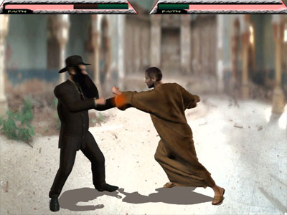
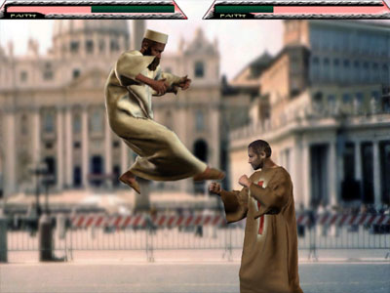
Monk Kombat 3

Slide 5
These games are all:
Fun
Immediately Fun
Instantly Recognizable
Very Polished

Slide 6
Let's Do Better

Slide 7
uh… who are you?
Andrew Fox, CIT class of 2009
Member of GCS since Freshman year
GCS Officer for the 2nd year now
(You elected me in the fall, remember?)
I’ve got a few interesting ideas.
And I’ve made a few games before.

Slide 8
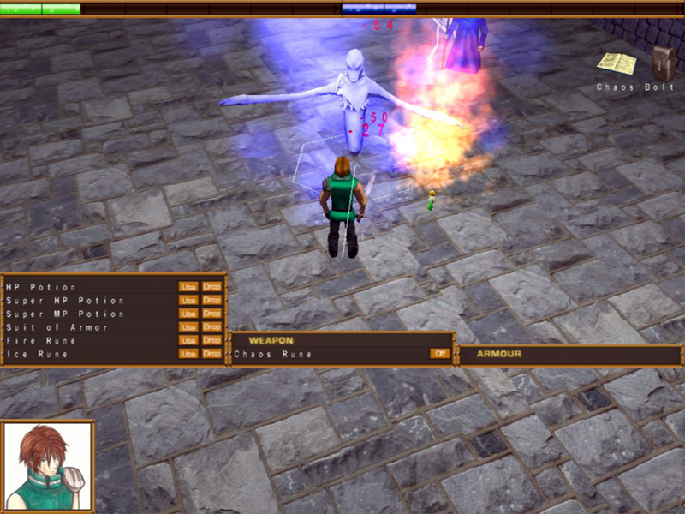
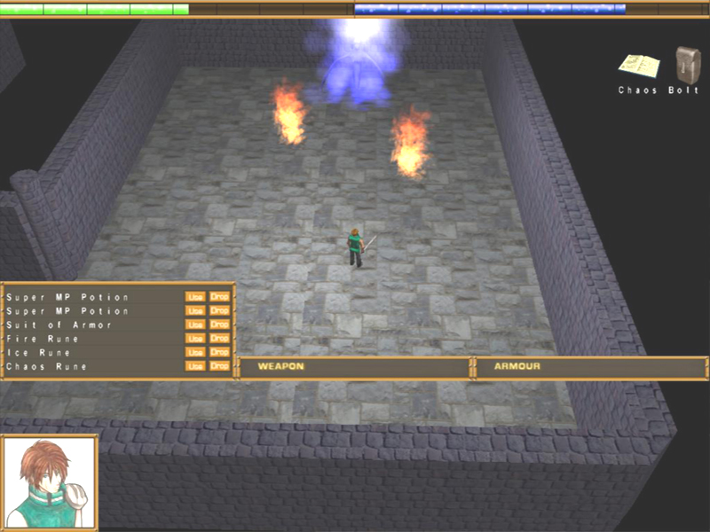
Arbarlith
Fall 2005

Slide 9
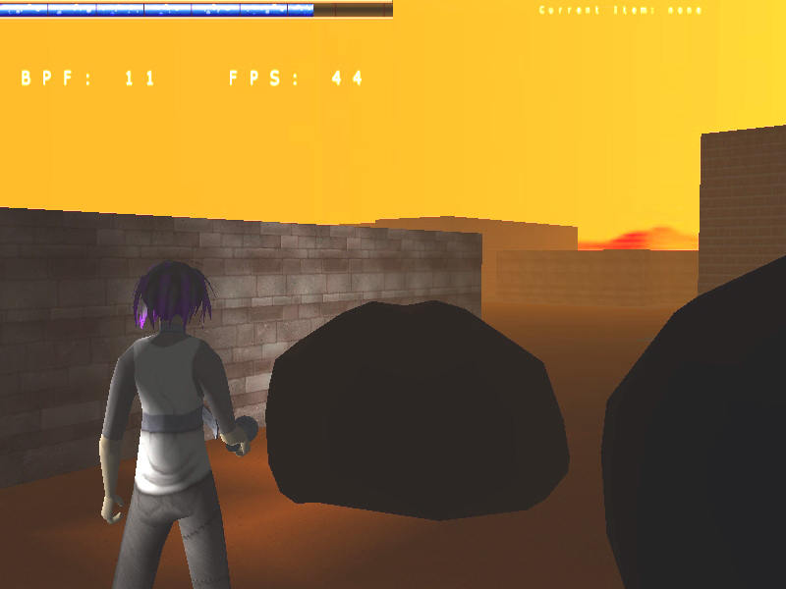
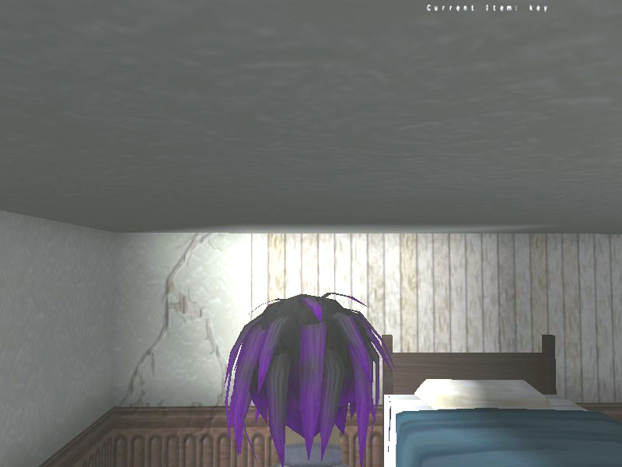
Parasomnia
Spring - Fall 2006

Slide 10
Lessons Learned
Things never go according to plan, but you still need to make a plan.
Start with a big idea, and you’ll struggle to get everything done.
Start with a small idea, and you might have time to make it better.

Slide 11
Arbarlith 2
Fast-Paced, hack’n’slash to kill some time.

Slide 12
Features
Mazes
Dungeon Crawling
Boss Battles
Power-Ups
Magical Attacks and Abilities
Sweet Graphics

Slide 13
(Hit ALT+TAB and show the demo.)

Slide 14
Who am I looking for?
Artists
Musicians
Map Designers
Play-Testers
Do you have a cool idea? I’ll listen : D
I’m looking to assemble a team of 3-5 people, do you want to be a part of it?

Slide 15
Get in touch with me!
Andrew Fox
arfox@andrew.cmu.edu

