Slide 1
FOXSI blanketing characterization, continued…
March 20, 2013

Slide 2
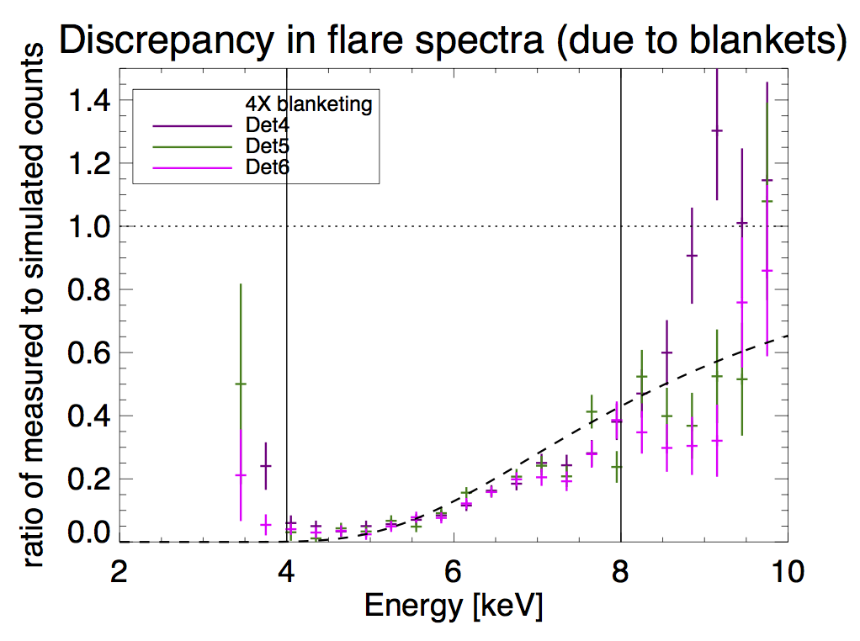
Flare spectra ratios, 3 “best” detectors
Only correction: curves are translated vertically so that min=0.
Vertical bars are fit intervals (not used here)
Dashed line is expected curve for 4x extra blanketing
Discrepancies

Slide 3
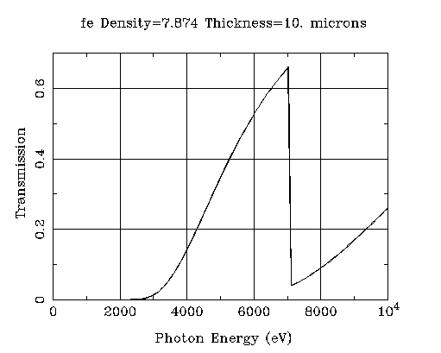
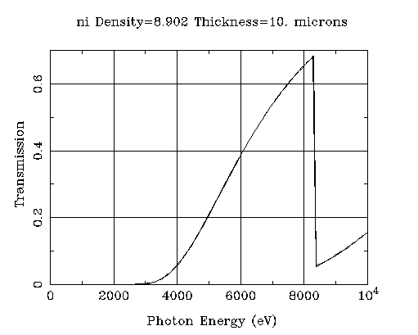
Other materials in path?
Iron edge 7.05 keV
Nickel edge 8.26 keV

Slide 4
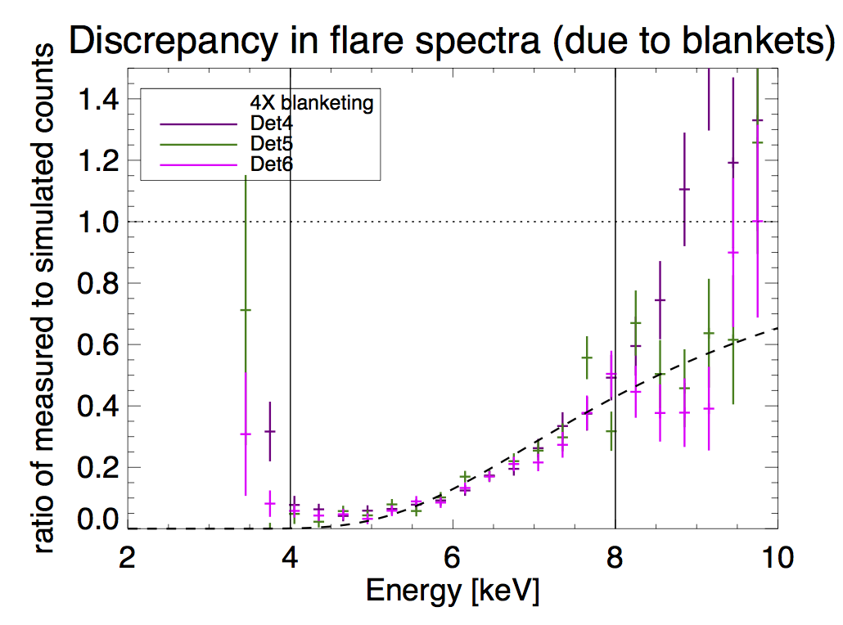
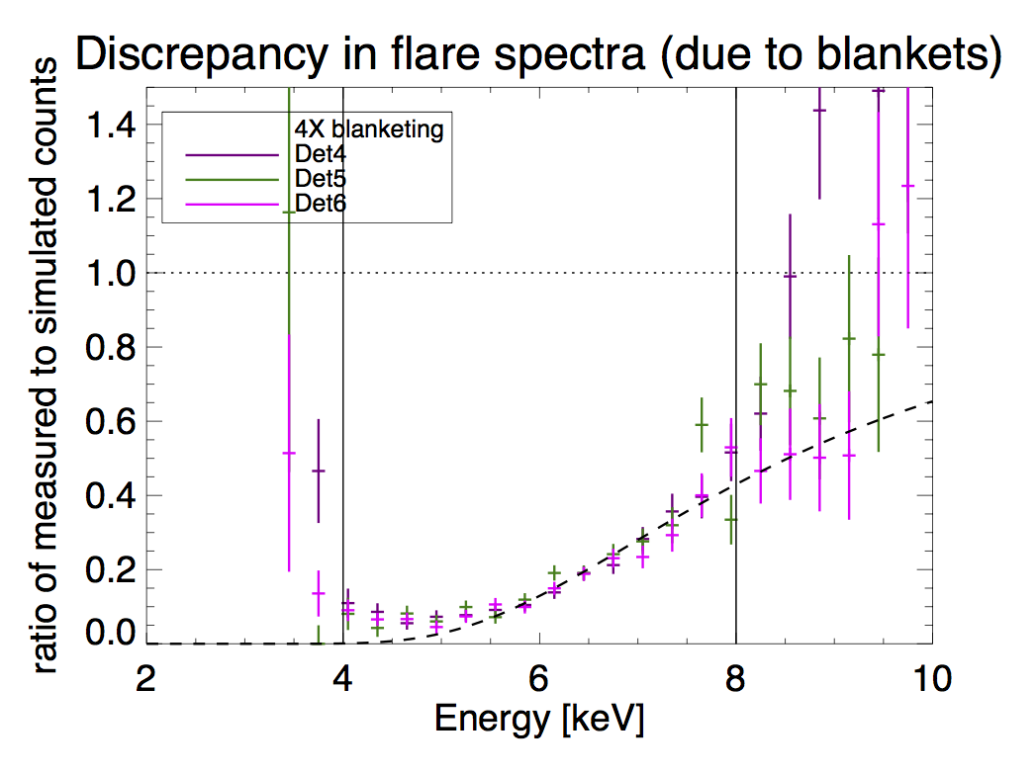
Add in some metals…
Add in 1um Fe
Add in 1um Ni

Slide 5
Conclusion:
We need to figure out what’s in our blankets!
( or other payload parts)

