Slide 1
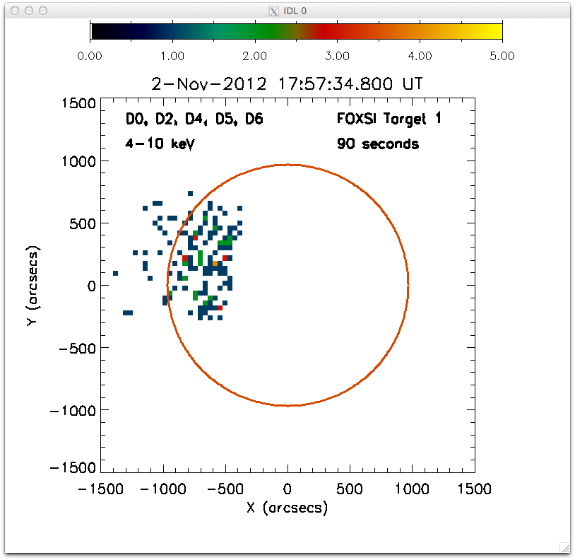
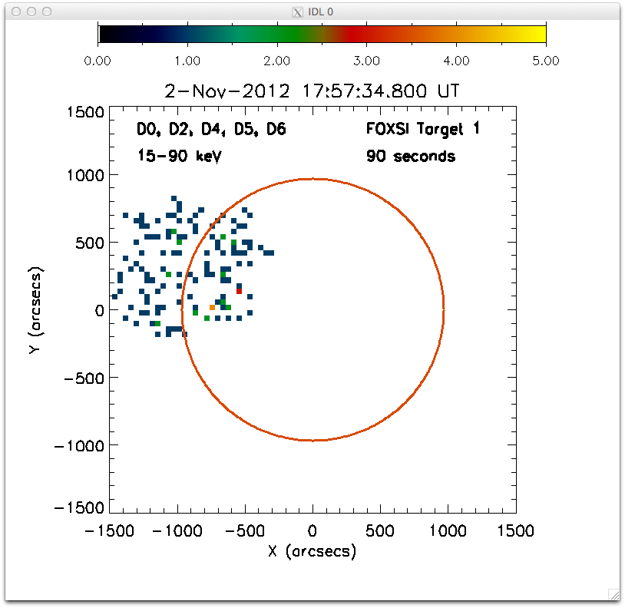
One FOXSI target (nonflaring)
Outside FOXSI’s sensitive energy range (background)
In FOXSI’s sensitive range

Slide 2
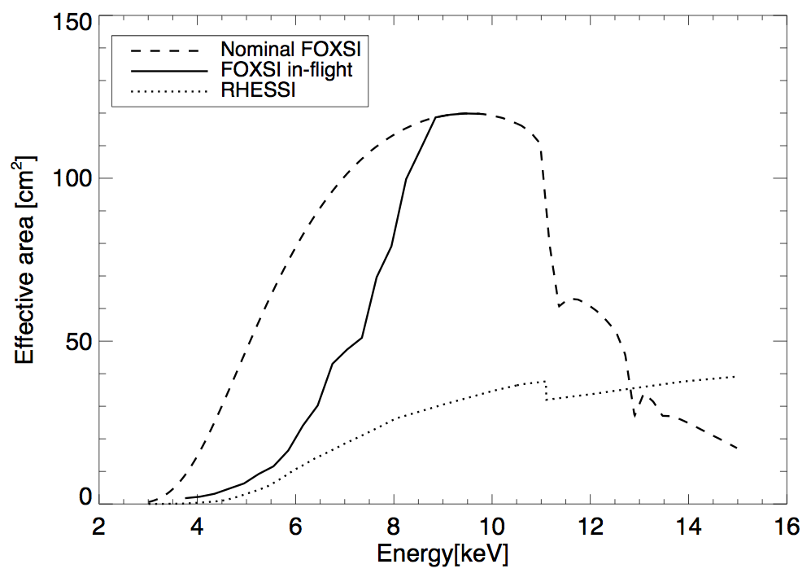
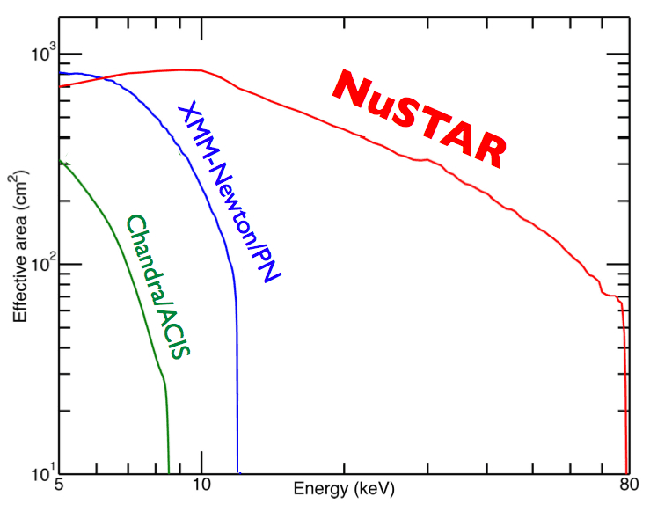
Sensitivity was reduced by blanket absorption...

Slide 3
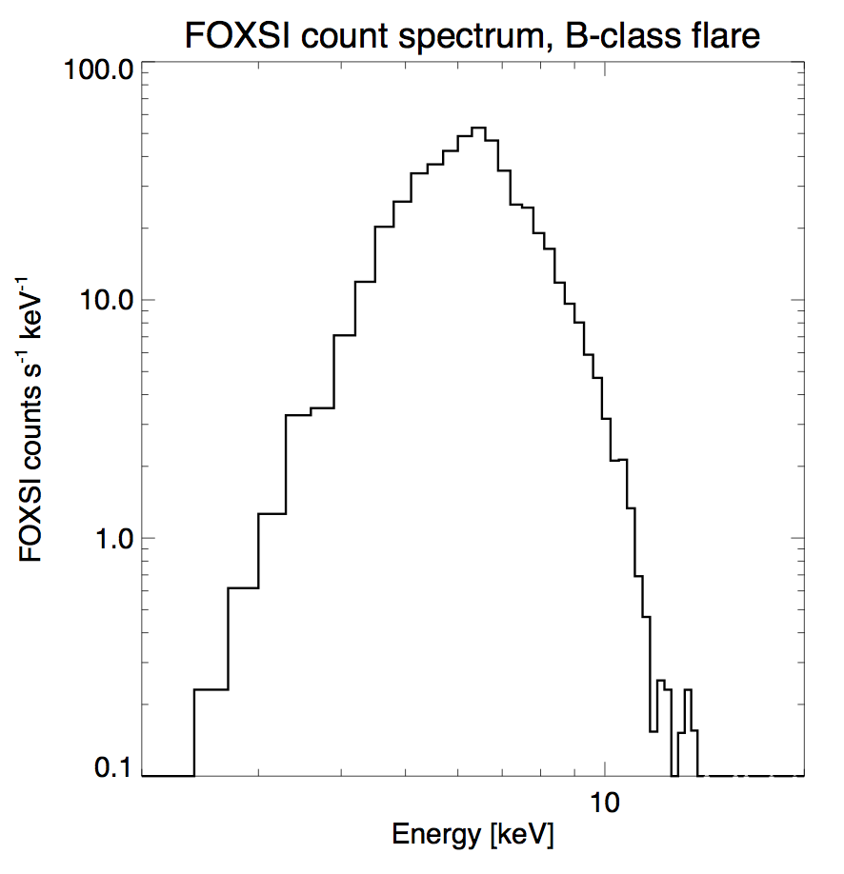
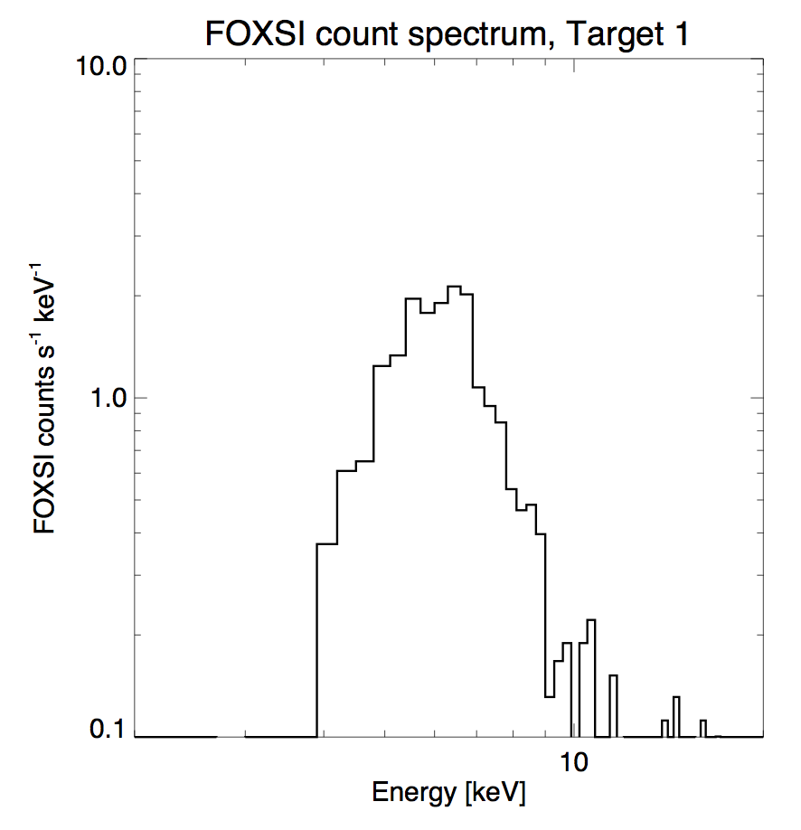
…but spectra were obtained anyway.
Flare
Nonflaring target

Slide 4
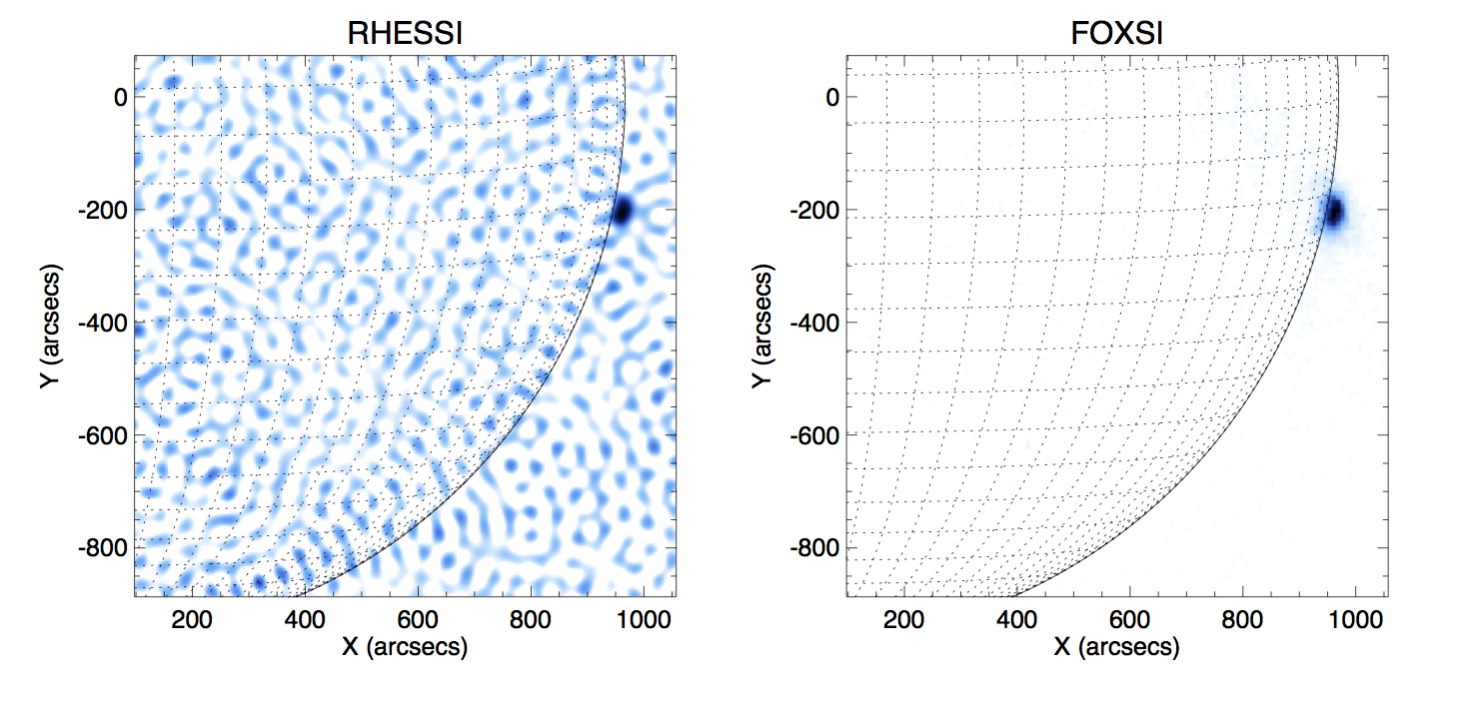
Imaging of the microflare shows the improvement over RHESSI:

