Slide 1
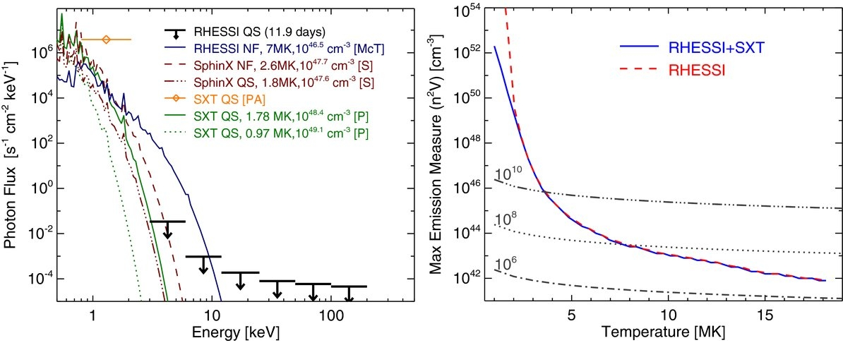
FOXSI 4-10 keV (on-disk)

