Slide 1
netcode, netfox, and net-you
An increasingly frustrating tale of “ok, but”

Slide 2
Let me confess
I have a condition, started in 2017
It’s building multiplayer games
Turns out it’s difficult
Why is it difficult?

Slide 3
Hi, my name is...
Whatever introductions and promos go here

Slide 4
wdym multiplayer?
Make sure everyone sees the same thing
  ok, just transmit the data then
  each player broadcasts their position, done
Ok, but... cheaters
  Malevolent client can just say whatever they want
  “I don’t care about cheaters!”
Ok, but... confusing netcode interactions
  two players pushing the same button – who pushed it?
  players using shared resources – who built the thing?

Slide 5
wdym multiplayer?
Server auth then
  Server owns all game state
  Players just submit their inputs
No more “who did what”
Ok, but... latency
  Data takes time to arrive from client to server
  Frowned upon in action-oriented games

Slide 6
Misconception#1
“I’ve tested locally / on LAN and it works!”
  Running on local / LAN is basically like running singleplayer
  No latency, updates arrive instantly
  If LAN is your target, great!
  Otherwise, latency will break the game
  Simulate latency when testing locally!

Slide 7
wdym multiplayer?
*interactive demo*

Slide 8
ok, then what?
Client-Side Prediction
  Clients apply their input the moment they get it
  Send input to server
Server Reconciliation
  Server applies inputs, broadcasts results
  Clients correct if they mispredicted
No* latency
No* cheating
Ok, but… how do I get it?

Slide 9
Implementing CSRP
Implement tick loop
  Update game at same rate everywhere
  Synchronize clocks ( important soon )
  Consider clock latency, jitter, drift
Track history
  Take snapshots of game state
  Take snapshots of player input
  Trim old snapshots
Synchronize history
  Clients submit their input snapshots
  Server broadcasts state snapshots
  Timestamp packets
(Re)simulate game
  Grab latest state or earliest input update
  Resimulate game from there
  Discern local prediction from server truth

Slide 10
Implementing CSRP
Ok, but… bandwidth?
  Implement delta compression
  Implement binary serialization
Ok, but… tickrates?
  Implement / enable interpolation
Ok, but… jitters?
  Implement display offset
Ok, but… visibility?
  Implement interest management
Ok, but… physics?
  Yea uh... good luck
Ok, but… game?
Ok, but… game?

Slide 11
Implementation Indecision
Ok, but… isn’t this excessive?
  I just want to make a game?
Ideal:
  Just implement game logic in some callback
  Configure what should be synchronized
  Rest is taken care of
Good news: netfox*

Slide 12
netfox
Ok, but… bandwidth?
  Does delta compression
  Does binary serialization
Ok, but… tickrates?
  Does interpolation
Ok, but… jitters?
  Can do display offset
  Can do input delay
Ok, but… visibility?
  Has interest management
Ok, but… physics?
  Can run physics in rollback
Ok, but also… time?
  NTPv4-like time sync
  Time-stretching to keep in sync
Ok, but… game?

Slide 13
Misconception#2
“Clock synchronization is easy!”
  Just have the server send timestamp on join
    Doesn’t account for latency
  Measure latency and adjust
    Clocks will drift
  Measure continuously
    Time may jump around, game may freak out
Grab a premade implementation
Or take the time when rolling your own

Slide 14
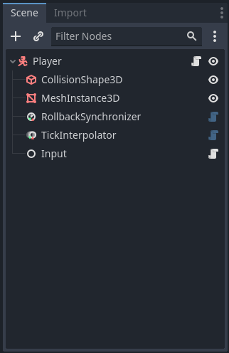
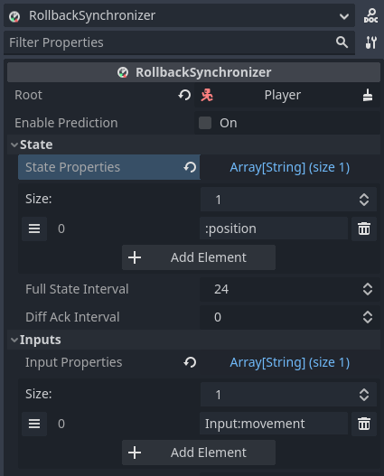
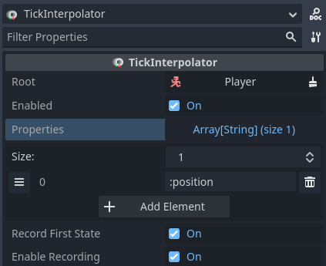
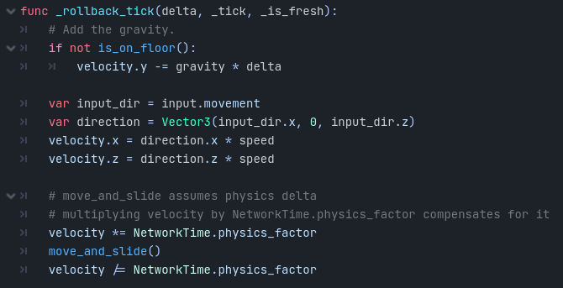
Let’s take an example

Slide 15
Ok, but… I don’t care?
“I don’t need CSRP”
“I don’t care about cheating”
“I just want to make games”
“Godot’s built-ins are fine”
Why use netfox?

Slide 16
Ok, but… I don’t care?
Fixed tickrate
Synchronized clocks
Interpolation
Schemas
Diff states

Slide 17
Let’s play
Yay, time to test with a friend!
Ok, but… how to connect?
Dedicated servers
  Costly
Player hosting
  Routers decline direct connections

Slide 18
Players as hosts
Port-forwarding
  Player manually configures router to let data through
  Routers are pleased
  Players are mildly not pleased
NAT punchthrough
  Both parties throw data at eachother
  Routers are pleased
Relays
  A middle-man forwards data
  Middle-man must be public
  Routers are pleased

Slide 19
Players as hosts
Steam
  Offers relays
  Potential lock-in
noray
  Open source
  Does NAT punchthrough
  Does relaying
  Self-hosted
  Offers free instance for testing

Slide 20
Misconception#3
“I’ve tested with another player and it’s fine!”
Works with 1 player – sanity check
  Code is not broken, logic works as expected
Works with 2 players – can be predicted by client
  Client can initiate mechanic / use system
  Server acknowledges and runs it too
Works with 3 players – is actually replicated
  Third player can witness mechanic in action
Make sure to test with 3 players!

Slide 21
Are you sold yet?
Extensive documentation
  A whole website, in fact
Multiple examples
  Includes a whole game
Built-in latency simulation
  No need to mess with tools
Auto-connect on game start
  No need to repeat the same process
Auto-tiling windows
  No need to fuss with aligning your windows
Logging utility for debug
  Enriches each message with network debug data
Performance monitors
  So you know what’s happening

Slide 22
*links and such*

Slide 23
netcode, netfox, and net-you
An increasingly frustrating tale of “ok, but”

