Slide 1
CS301 Project Report
Project Title: Sample Sort
Team members:
Aayush Kapadia (201401407)
Mit Naria (201401448)

Slide 2
Introduction
Sample sort is a parallel sorting algorithm.
Sample sort is a comparison based sorting algorithm.
Sample sort follows PSRS algorithm design strategy. [Parallel Sorting by Regular Sampling] [explained in upcoming slides.]

Slide 3
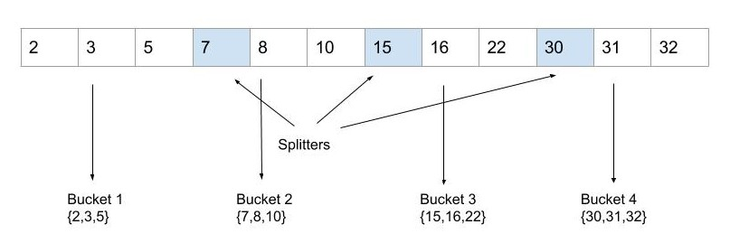
Definition of Splitters
Splitters: Splitters are the elements which divides sorted array into small blocs[chunks or buckets].
Example:
Here, a sorted array of 12 elements is splitted in 4 blocs [chunks or buckets] by 3 splitters.

Slide 4
PSRS algorithm design strategy
This algorithm design consists of 5 stages:
Local sorting
Generation of local splitters by using a sampling algorithm
Generation of global splitters
Distributing buckets to nodes
Local sorting of a bucket

Slide 5
Sample sort algorithm
Local sorting (Quicksort) .
Generation of local splitters. ( each node selects (p-1) splitters ) .
Generation of global splitters. ( root node gathers p*(p-1) splitters and sorts them using quicksort and selects (p-1) splitters from total p*(p-1) splitters. They are transmitted to each node. )
Distributing buckets to nodes. ( buckets are prepared by using new (p-1) splitters and send to respective node. Bucket[i] goes node with rank=i. After that each node merges the buckets received. )
Local sorting of a bucket (Quicksort).

Slide 6
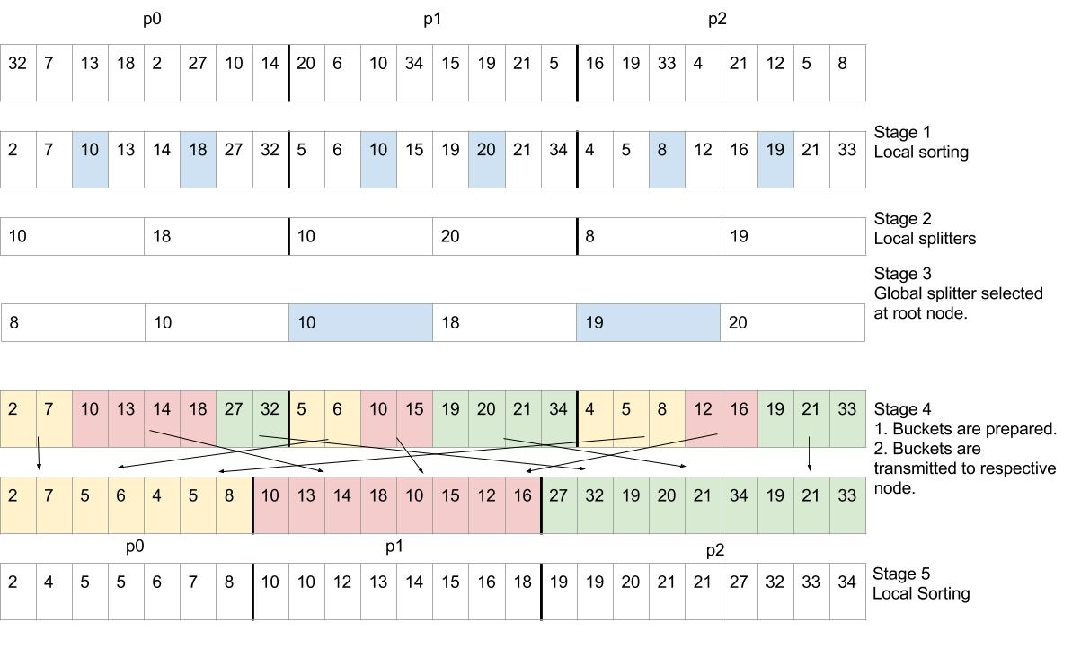
Algorithm example

Slide 7
Theoretical analysis of parallel algorithm
Note: We have assumed that communication latency is O(log(p)).
Step 1: O((n/p)*log(n/p)) [Sorting]
Step 2: O(p) [Choosing local splitters]
Step 3: O(p*log(p)) [Collecting local splitters] + O((p² * log(p) )) [Sorting local splitters] + O(p) [Choosing global splitters] + O(p*log(p)) [Distributing global splitters]
Step 4: O(n/p) [Buckets generation] + O((n/p)*log(p)) [Buckets transmission] + O((n/p)*log(p)) [Merging buckets]
Step 5: O((n/p)*log(n/p)) [Sorting]

Slide 8
Theoretical analysis of parallel algorithm
Computational complexity: O((n/p)*log(n/p)) + O((p² * log(p) )) + O((n/p)*log(p))
Since n>>p , log(n/p) ~ log(n) , Overall computational complexity:
O( ( n/p )*( log(n)+log(p) ) ) .
Communication complexity: O(p*log(p)) + O((n/p)*log(p))
Since (n/p) >> log(p) and (n/p)>>p, Overall communication complexity:
O(n/p) .
Total bound: O( ( n/p )*( log(n)+log(p) ) ) + O(n/p) .
We compare this parallel algorithm to serial randomized quicksort algorithm. [most widely used comparison based sorting algorithm] .

Slide 9
Theoretical analysis of serial algorithm and expected speedup
Total bound (serial code) = O(n*log(n))
Theoretical speedup =
O(n*log(n)) /{O( (n/p)*( log(n)+log(p) ) ) + O(n/p) } .
Expected speedup (predication based approach):
To calculate approximate speedup, we simply say that parallel algorithm actually sorts twice.[Local sorting]. Thus, on p processors, calculation is p times faster but 2 times slower. Thus, predicated speedup = p/2 . [This speedup is just based on observation.]

Slide 10
Scalability
From theoretical analysis of parallel algorithm:
k(n,p) = O(p*log(p)) + O((n/p)*log(p))
We can ignore first term in k(n,p).
Thus, k(n,p) = O((n/p)*log(p)) .
Therefore To(n,p) = O(n*log(p)) .
T(n,1) = O(n*log(n)) .
Isoefficiency function:
T(n,1) >= C * To(n,p)
n*log(n) >= C * n * log(p)
log(n) >= C * log(p)
n >= p^{C} ....equation(1)

Slide 11
Scalability
Scalability function:
Since M(n) = n , Scalability function M(f(p))/p = p^{(C-1)} .
If C=1 then system will perfectly scalable.
C = (1 - efficiency)/efficiency .
Suppose x = maximum allowed efficiency which results into perfectly scalable system.
Then C = (1-x)/x = 1 (because system is perfectly scalable.)
This only happens when x = ½.
Thus we can maintain efficiency of 1/2 and speedup of p/2 by increasing n linearly with p. (i.e. put C=1 in equation(1) thus isoefficiency function becomes n >= p ).

Slide 12
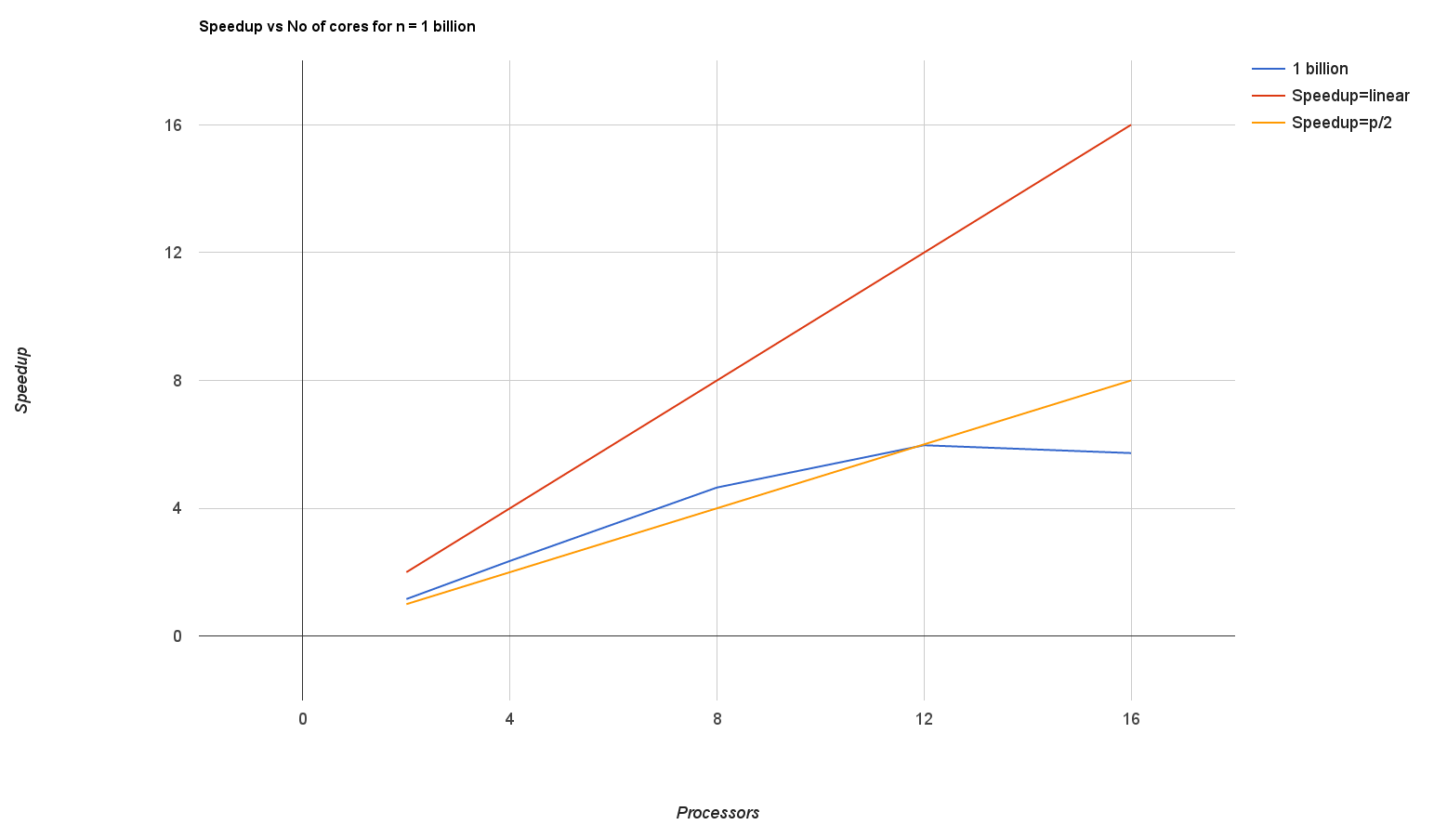
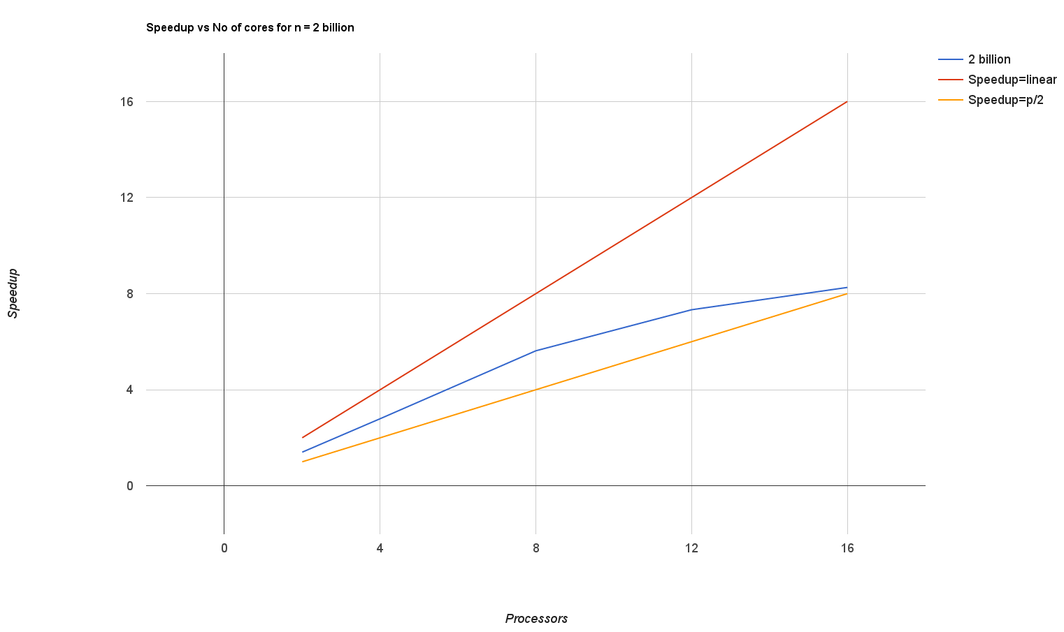
Practical analysis: Amdahl’s Law

Slide 13
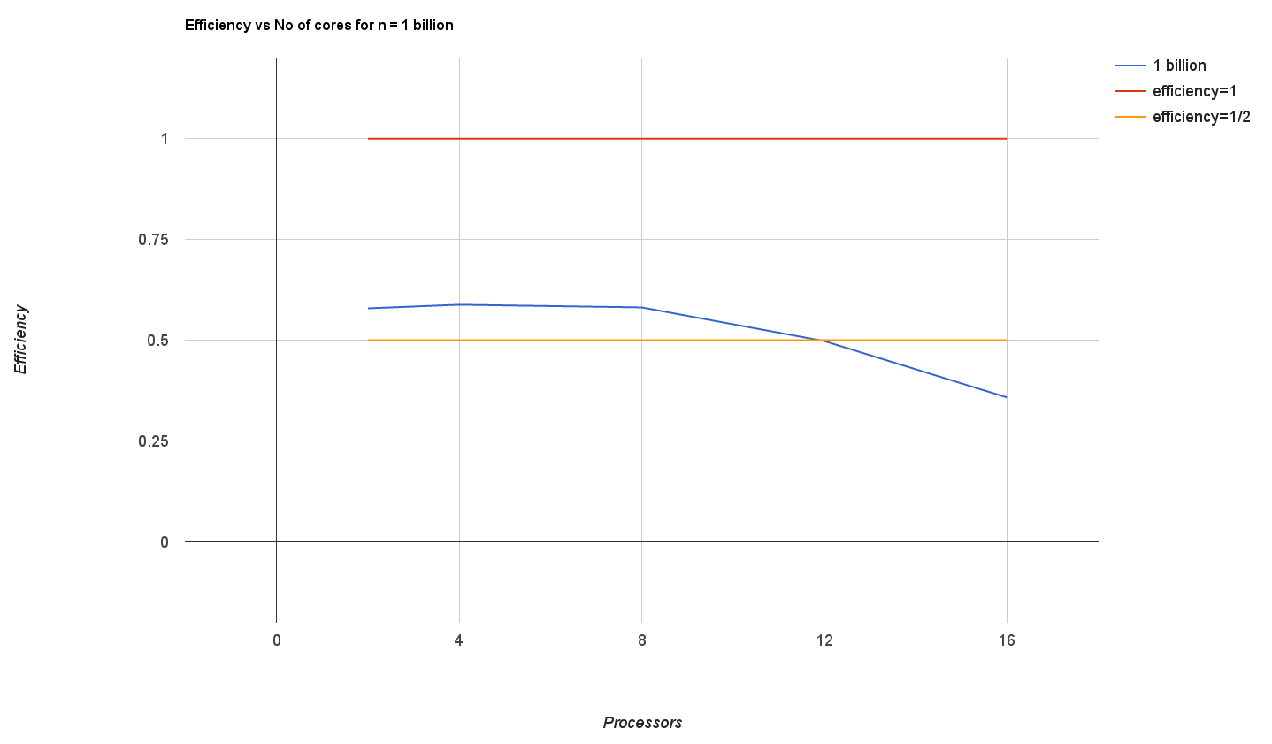
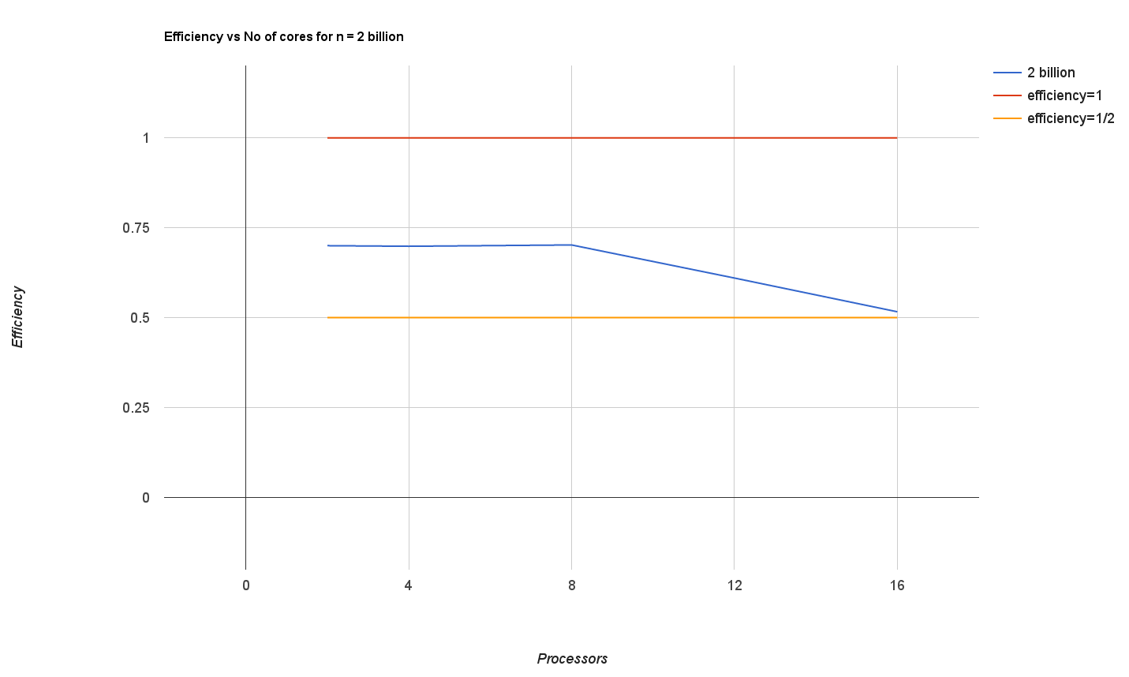
Practical analysis: Amdahl’s Law

Slide 14
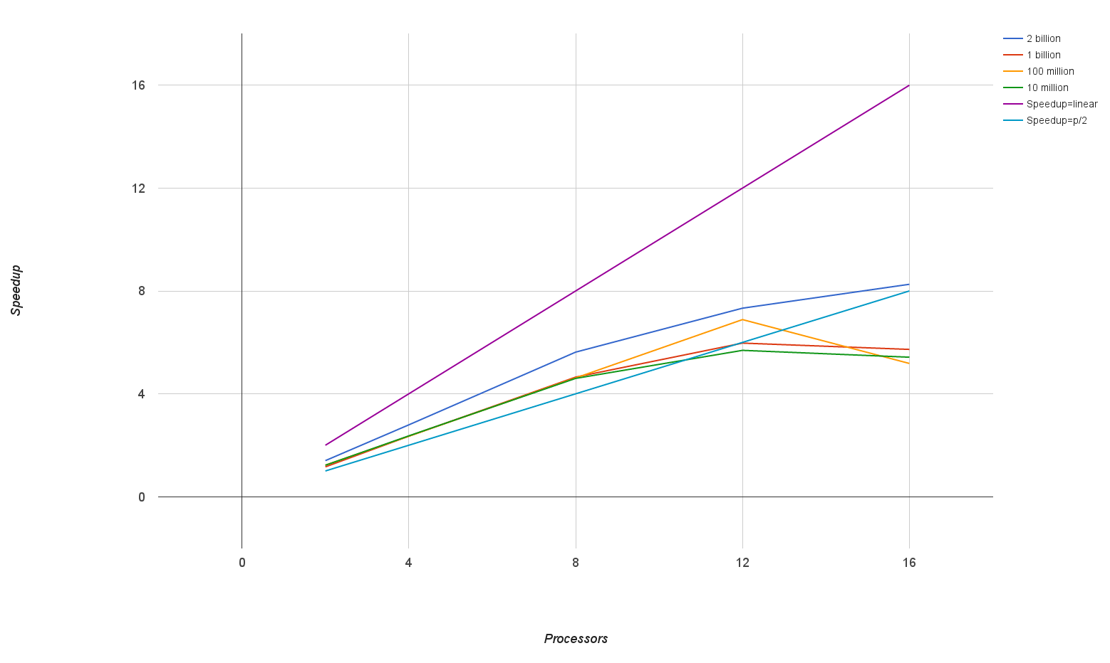
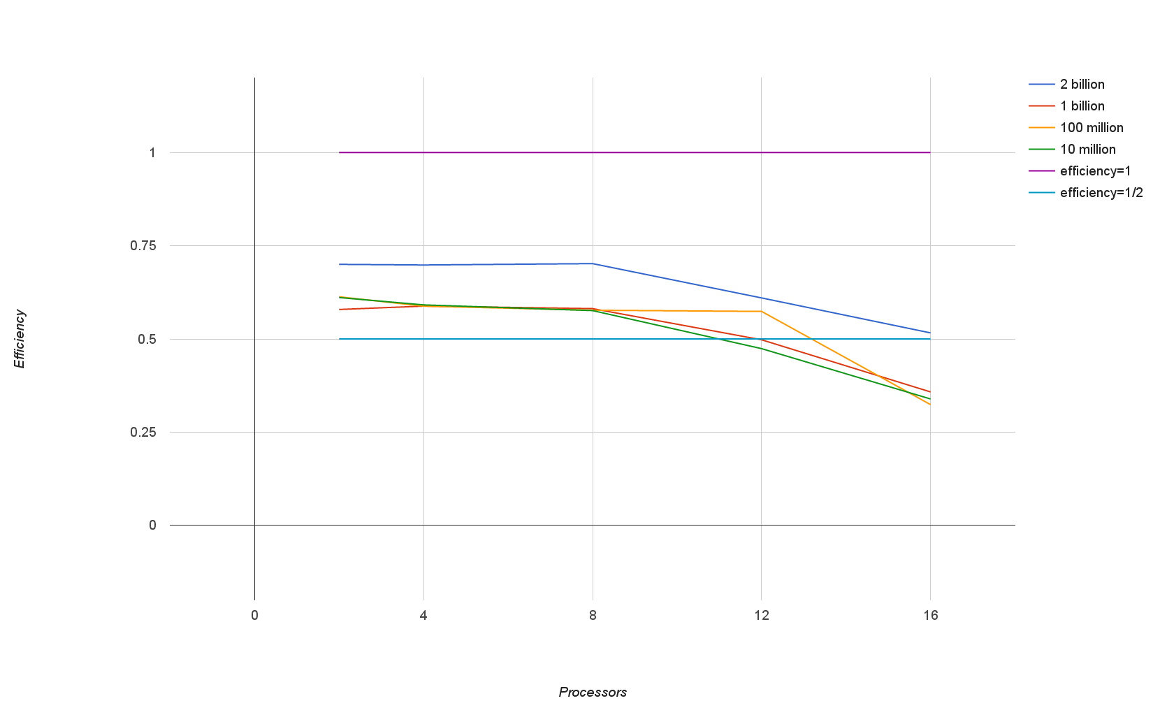
Practical analysis: Amdahl’s Effect

Slide 15
Improvements
Based on design strategy of sample sort, several new sorting algorithms have been developed. Most of them focus on 2 things:
(i) Better Sampling algorithm
(ii) Decrease communication time
  By using shared memory programming model
  By improving communication patterns

Slide 16
Optional Slides
Below slides have same graphs as shown in slide number 12,13,14. If they are not clearly visible in above slides , you can find them in upcoming slides.

