Slide 1


Hideo Kojima
Japanese Video game designer, writer, director and producer
Regraded as an auteur of video games

Slide 2




Life
Kojima developed a strong passion for action/adventure cinema and literature during his childhood and adolescence.
Later in his life he brought his affection for art into the video game industry.
He was born the youngest of three children in Setagaya, Tokyo,Japan.
Dropped out of his economics course in university to pursue a career in the video game industry.
Massively influenced by pop culture, particularly in the film industry.

Slide 3
Early Life & Family
The family watched movies every night and he “wasn’t allowed go to bed until the film had finished.”
His family was somewhat well off and had to move often for his parents’ work opportunities.
When Kojima was 13 his father passed away, which had a huge impact on him and his family, saying afterwards he had to learn to come to terms with death, a theme which later appeared in his work.
He wanted to be an artist, filmmaker or illustrator but felt discouraged by the pressure of social norms favouring a stable salaried job over creative pursuits.
Eventually, he shifted his creative focus to making films with a friend who had a 8mm camera
Before starting his career in the video game industry he attended university studying economics.

Slide 4



Work
Kojima has written, directed and produced around 16 titles spanning over 30 years.
Most of his career was spent working at Konami.
Recently however, he has taken a venture of his own and started making games under his own company, Kojima Productions.
1986:
Kojima joins the video game industry in Konami’s MSX home computer division.
1998:
Kojima’s first major success for his work on his iconic series Metal Gear Solid for the PS1 .
2019:
Kojima releases his first independent title Death Stranding under his own company.
3
2
1

Slide 5
Early work at KONAMI
Kojima's gameplay ideas were often overlooked initially, and due to his lack of familiarity with programming was repeatedly snubbed for his failures in his initial years at Konami.
After working as assistant director on “Penguin Adventure” and building some repour within the company he was asked to take over a project titled “Metal Gear”.
This was to be an action focused game however, the hardware limitations were too restrictive. Inspired by The Great Escape, Kojima altered the gameplay to focus instead, on sneaking.
Metal Gear is one of the earliest examples of the stealth action game genre, where avoiding encounters with the enemies is emphasized over direct combat.

Slide 6
90’s at KONAMI
Metal Gear 2: Solid Snake released in 1990 and further evolved Kojima’s stealth game genre. The player had more abilities, such as crouching, crawling into hiding spots and air ducts, distracting guards by knocking on surfaces, and using a radar to plan ahead. The enemies had improved AI and the game also had improved graphics and a complex storyline dealing with themes such as the nature of warfare and nuclear disarmament
In 1994, Kojima released Policenauts, a film noir-science fiction-themed adventure game set in a space colony.
During this time Kojima began to adapt certain art styles to his games which brought his concepts to life and made his work easily recognizable.

Slide 7

Kojima’s first major success
With the release of Metal Gear Solid in 1998, Kojima became an international celebrity among the video game media. Metal Gear Solid was the first in the Metal Gear series to use 3D graphics and voice acting, which gave a more cinematic experience to the game. Metal Gear Solid was highly regarded for its well-designed gameplay ,charismatic characters and engaging storyline

Slide 8
In 2001 Kojima announced a sequel, Metal Gear Solid 2: Sons Of Liberty, the game's highly detailed graphics, physics, and expanded gameplay quickly made it one of the most anticipated games at the time.
The game was highly successful and critically acclaimed at release, due to its graphics, gameplay, and storyline, which dealt with myriad philosophical themes.
While Metal Gear Solid 2 appealed to gamers with the discussion of these themes, the bewildering maze of dialogue and plot revelation in the final hours of the game was a disappointment for many gamers, who expected the Hollywood-style resolution of its forerunner.

Slide 9
After the successful of his new series Konami green lit a sequel again and Metal Gear Solid 3:Snake Eater was release in 2004 and features wilderness survival, camouflage, and James Bond styled espionage. The game was a huge critical and commercial success.
Although Kojima felt he had put the series to bed, Konami insisted he make another sequel to which he agreed and began production of Metal Gear Solid4: Guns Of The Patriots for the PS4
It was another hit, selling over five and a half million copies worldwide.
During this time Metal Gear Solid games had been releasing on Sony’s other system the PSP, and the series had gained a life of its own as a cult classic.
It seemed Kojima had had his fill of the series. However, yet again, he was approached to make another sequel in the franchise.

Slide 10
Beginning of the end at KONAMI
Kojmia really wanted to reboot the Silent Hill franchise and was even given the go ahead by Konami and he developed a demo alongside Mexican film director Guillermo del Toro.
However, he forced into making another instalment in the Metal Gear franchise and in 2013 he unveiled Metal Gear Solid 5:Phantom Pain.
The Fox Engine he developed for Silent Hills was instead used for MGS5 and although the game achieved a high level of acclaim evidence of Kojima’s resentment towards Konami can be seen in game with a half baked story and some other elements missing.

Slide 11
Independence
On December 16, 2015, Kojima announced that Kojima Productions would be re-established as an independent studio, partnered with Sony Computer Entertainment, and that his first game would be console exclusive to the PlayStation 4.At E3 2016 in Los Angeles, Kojima personally announced the game's title as Death Stranding
Death Stranding was met with mixed critical reviews, but was however very successful from a sales point of view, and Kojima has said he plans to keep releasing titles.
In 2016, Kojima launched his own YouTube channel, where he and film critic Kenji Yano discuss their favorite films and matters pertaining to Kojima's studio. Starting in 2017, Kojima became a regular contributor to Rolling Stone, often discussing recent film releases, and occasionally drawing comparisons to his own works.

Slide 12






Awards and recognition
2015 Game awards:
Best Action Game and Best/Soundtrack
2016 Game awards:
Industry Icon Award
Guinness World Records:
Most followers on Twitter/Instagram for a video game director
:IGN Top Game Creators Of all Time:
6th
19th Annual D.I.C.E Awards:
AIAS Hall of Fame Award
Game Developers Conference:
Lifetime Achievement Award

Slide 13





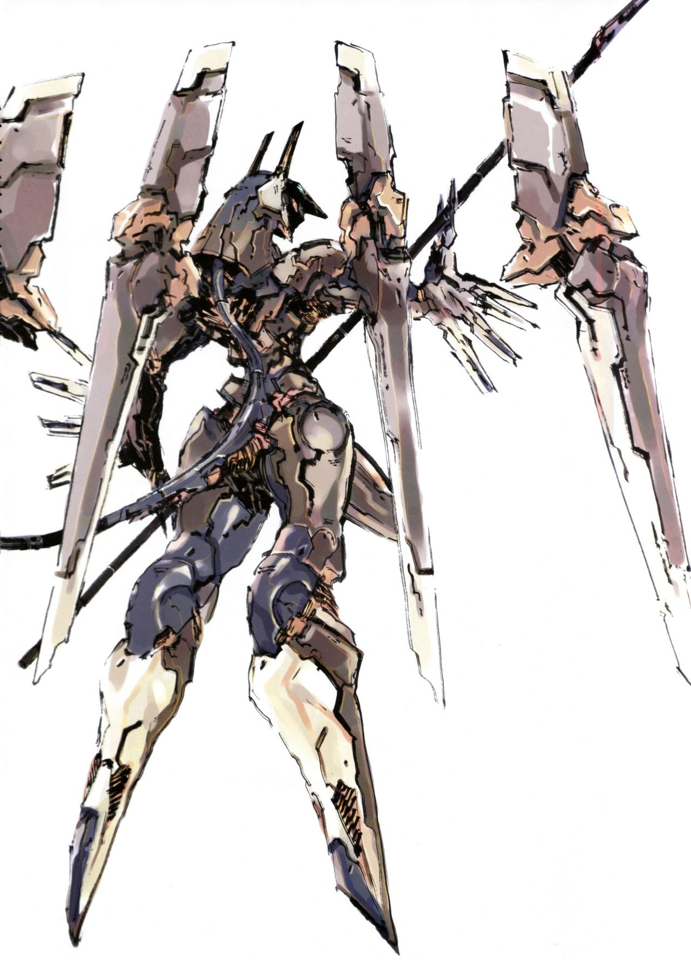

Legacy
Yoji Shinkawa: The artist credited with giving the series it’s art style
MGS 2: Considered a technical milestone
Distinct Art-Style gave his work a unique style
Kojima’s final title with Konami
Zone of the Enders: another popular franchise conceived by Kojima
Kojima’s latest endeavor
Kojima’s influence has been huge in the gaming industry by giving his games a highly stylized look and cinematic feel.

Slide 14
Bibliography
https://en.wikipedia.org/wiki/Hideo_Kojima
https://ie.ign.com/articles/2019/11/04/every-ign-hideo-kojima-review
https://www.youtube.com/watch?v=LDqvzhPOSqA
https://www.gamespot.com/articles/hideo-kojima-has-been-awarded-two-guinness-world-r/1100-6471334/
https://gamefaqs.gamespot.com/boards/691087-playstation-4/76976674

