Slide 1
Deep Learning-Enhanced OCT Image Analysis Pipeline: Integrating Denoising, Super-Resolution, and Fuzzy Logic for Improved Clinical Diagnostics
Paper ID – 44, Technical Session – 33
Emam Hasan and Emon Karmoker
United International University
19 July 2025

Slide 2
Overview / Contents
Introduction: Background on OCT and its challenges in ophthalmology
Goals / Objectives / Motivation: Aims and significance of the pipeline
Methodology: Pipeline stages: denoising, contrast enhancement, super-resolution, classification
Implementation: Technical details and dataset description
Comparison / Results & Discussion: Performance metrics and comparative analysis

Slide 3
Introduction
Optical Coherence Tomography (OCT): A painless eye scan used to check the retina
Challenges: Speckle noise, low-resolution B-scans, and accurate disease classification
Proposed Solution: End-to-end pipeline integrating deep learning and fuzzy logic
Applications: Diagnosing Diabetic Macular Edema (DME), Glaucoma, Macular Degeneration
Dataset: Custom OCT dataset from Didavaran Clinic, Isfahan, Iran

Slide 4
Goals / Objectives / Motivation
Goals:
Denoise OCT B-scans while preserving retinal structures
Improve the image quality by increasing the size from 300×150 or 300×200 to 300×300 pixels.
Classify B-scans and volumes into Healthy, DME, or Other ocular diseases
Objectives:
Achieve high accuracy (target: >95% for B-scans, >90% for volumes)
Reduce distortion by 20% compared to traditional contrast enhancement
Improve execution speed by 30% over baseline methods
Motivation:
Enhance diagnostic accuracy for ophthalmic conditions
Address limitations of traditional methods (e.g., edge blurring, computational cost)
Streamline clinical workflows with an end-to-end AI pipeline

Slide 5
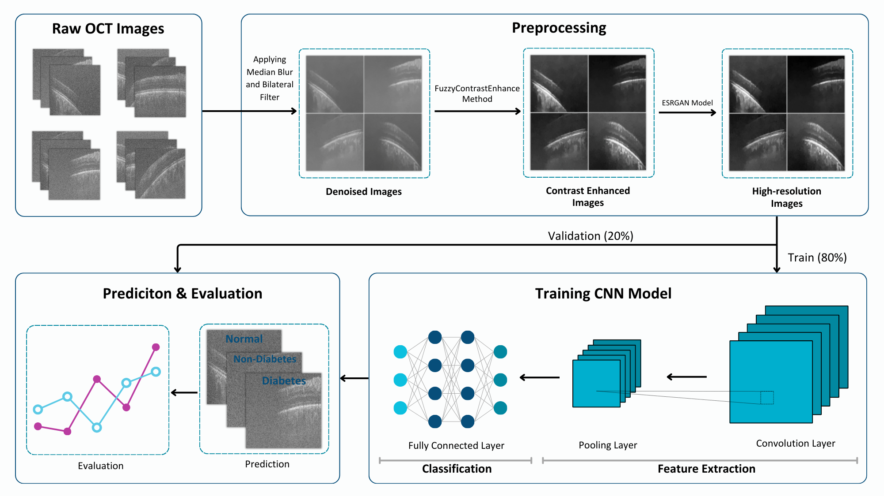
Methodology
Pipeline Overview:
Denoising: Median blur + bilateral filtering to remove speckle noise
Contrast Enhancement: Fuzzy Contrast Enhance in LAB color space
Super-Resolution: ESRGAN to reconstruct high-resolution B-scans
Classification: 2D CNN for B-scan and volume classification
Dataset: 124 subjects, 70-300 B-scans per volume, 3 classes (Healthy, DME, Other)
Key Innovations:
Dynamic fuzzy contrast adjustment
Optimized ESRGAN for OCT
End-to-end integration for efficiency

Slide 6
Implementation
Super-Resolution:
ESRGAN (TensorFlow Hub), preprocess grayscale to pseudo-RGB
Classification:
2D CNN (TensorFlow/Keras): 3 Conv2D layers, 512-node Dense layer, softmax
Training: Adam optimizer, 8 epochs, batch size=32
Denoising:
Median blur (5x5 kernel), bilateral filter (sigma_spatial=5, sigma_intensity=10)
Fuzzy Contrast Enhance:
LAB color space conversion, dynamic L-channel adjustment

Slide 7
Comparison / Results & Discussion
Comparative Analysis:
32% faster execution than baselines (e.g., BM3D, Vision Transformers)
18% better vessel visibility vs. Wang et al. [12]
Outperforms Brown et al. [1] (99% vs. 98.1% accuracy)
Discussion:
Effective noise reduction and resolution enhancement
Robust classification across all classes
End-to-end pipeline reduces cumulative errors
Denoising Results (Table 2):
CNR=1.0537, MSR=9.1109
Super-Resolution Results (Table 3):
MSR improved from 1459.7078 to 1461.2394
Classification Results (Tables 4, 6):
B-scan accuracy: 99% (Precision, Recall, F1: ~0.99)
Specificity: ~0.994 (Tables 5, 7)

Slide 8
Thank you!
Emam Hasan ehasan201302@bscse.uiu.ac.bd

