Slide 1

RideGO
Presented By:
1. Rokibul Hasan (011193040)
2. Md. Mansurul Haque (011202034)
3. Md Rajib Hossen (011191244)
4. Emam Hasan (011201302)
5. Muminul Islam (011202115)

Slide 2
Short Description
RideGO is a straightforward web
application that allows student to share
a ride from one location to another for a
reasonable fee.

Slide 3

Research Papers

Slide 4
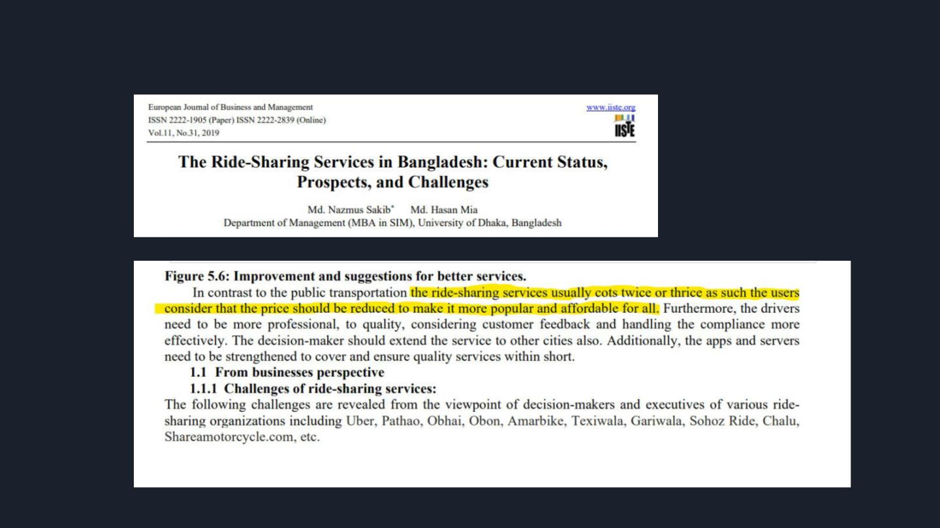
Research Paper
https://link.springer.com/article/10.1186/s12544-
021-00522-1

Slide 5
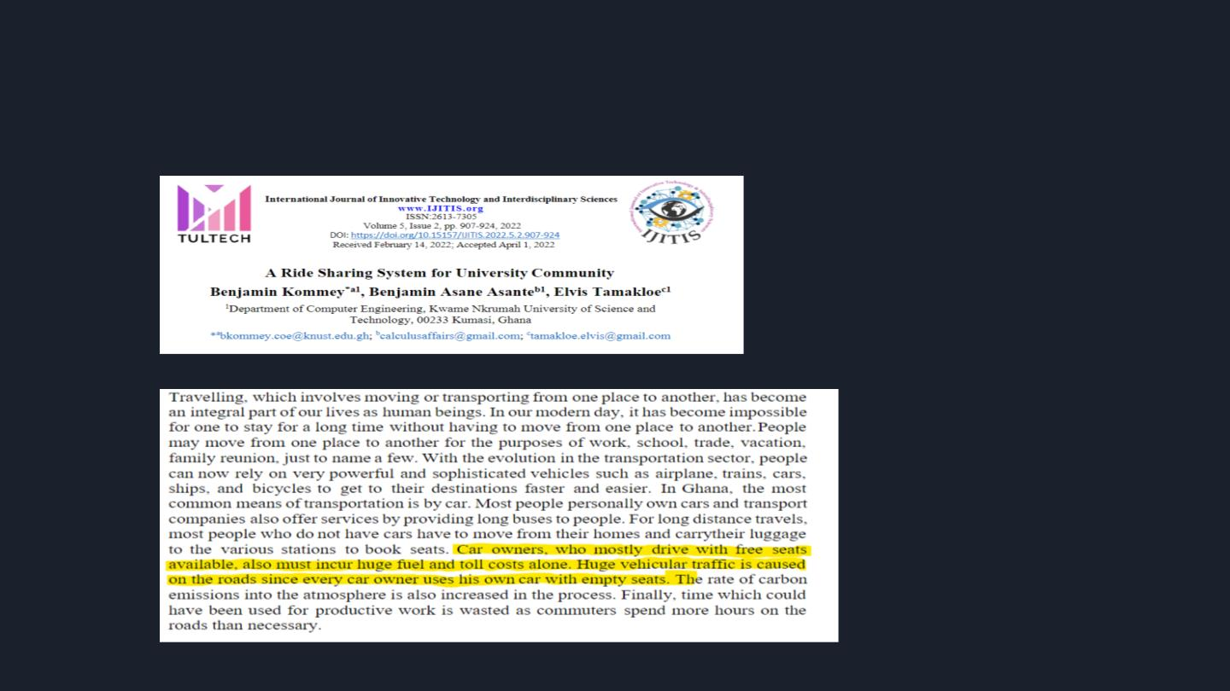
Research Paper

Slide 6
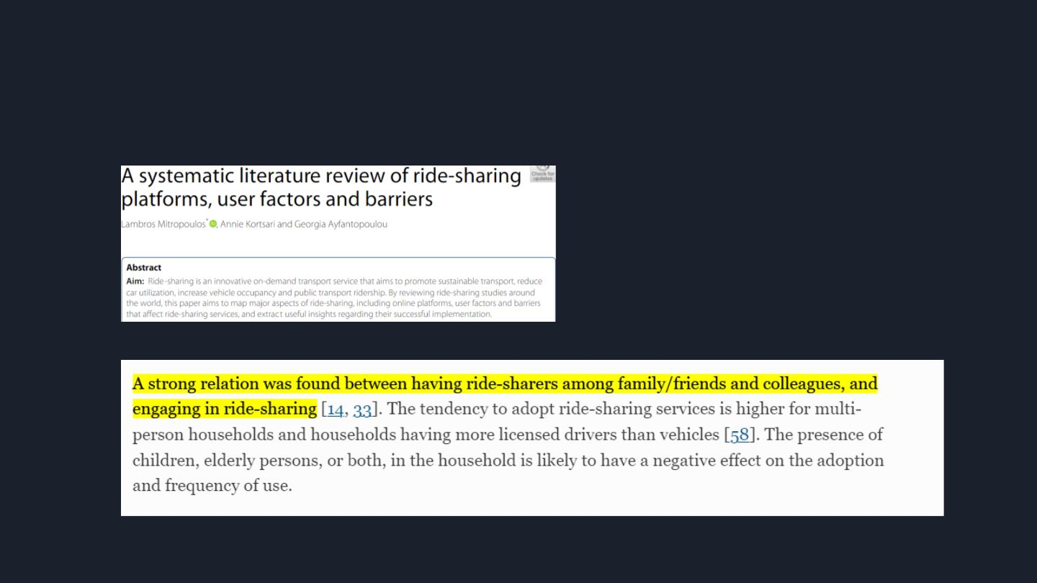
Research Paper

Slide 7

Online Articles

Slide 8
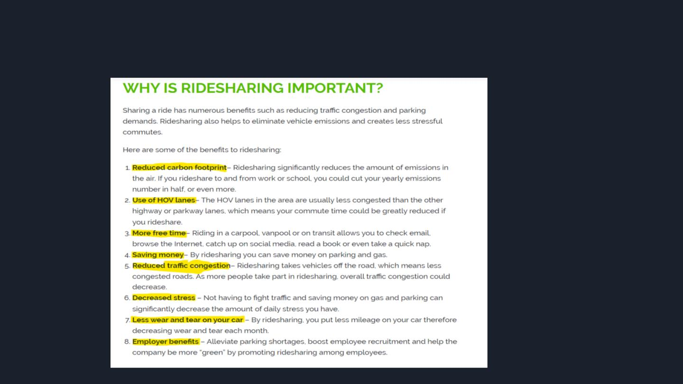
Online Article

Slide 9
Benchmark Analysis

Slide 10

Benchmark Website/ Apps

Slide 11

Comparison Chart
Friend
s
profile
view
Recommen
d
Commen Review &
Live Room Opening
Based on Fan Forum
t & Adda
Rating
Searching
Top Fan
IMDB
Yes
Yes
Yes
No
Yes
Yes
Yes
Yes
Yes
No
No
Yes
Yes
No
No
Rotten
Tomatoes
Yes
TV Time
Yes
Yes
Yes
Yes
No
No
Yes
Yes
Yes
Yes
Yes
Yes
Yes
No
Yes
Yes
Yes
Yes
No
No
Yes
Yes
Yes
No
No
No
KillerMovies
Film|Board
hojoborolo
No
No
No
Yes
Yes
Yes

Slide 12
Gap Analysis
We have read a bunch of articles related to our project . We found some
information and gaps among them.
1. There is no known platform for Student only Ride Sharing Service.
2. Some of the service are more costly.
3. There is no such type of “Live Chat” option with all user.
4. They focus on all user but we will focus only on ‘students’.

Slide 13
Gap Analysis
We have read a bunch of articles related to our project . We found some information and
gaps among them.
1. There is no known platform for Student only Ride Sharing Service.
2. Some of the service are more costly.
3. There is no such type of “Live Chat” option with all user.
4. They focus on all user but we will focus only on ‘students’.

Slide 14
Gap Analysis
We have read a bunch of articles related to our project . We found some
information and gaps among them.
1. There is no known platform for Student only Ride Sharing Service.
2. Some of the service are more costly.
3. There is no such type of “Live Chat” option with all user.
4. They focus on all user but we will focus only on ‘students’.

Slide 15
Features List
Those are –
1. Student Verification.
2. Auto Suggestion Searching.
3. Live chat support with all user.
4. Rate/Feedback.
5. Live Location Sharing
6. Pick Up Point
7. Booking Rides Ahead of Time

Slide 16
RideGO
RideGO has 2 stakeholders.
1. Rider.
2. Passenger.

Slide 17

Thank You

