Slide 1
Cinephiles
Recommend Movies Based On One’s Mood & Interest
Emam Hasan- 011201302
Mehedi Hasan Jony- 011201336
Muminul Islam-011202115
Shojib Talukder- 011201345
MD Yasir Arafat- 011183030
Ahsan Yasir- 011201

Slide 2
Project proposal
Automated movie recommendation.
Identifying moods depending on some question answer
Recommending movie based on the user’s mood
Creating fun forum by user and the admin
Commenting on specific movie
Top fan/user listing based on their comments and review
Based on the movie choice users can be friends
User can see the watch list of their friend
Live room will be open for discussing on any specific movie

Slide 3
Motivation
All movies are not suitable for all the people
Easy to choose movie
Accurately choose a movie for watching
Entertainment and making fun based on the movie selection
Open discussion on specific movie in the live room

Slide 4
Benchmark Analysis:
System | Recommend | Comment & Discussion | Review & Rating | Searching | Live Room Chat | Opening Forum | Top Fan | View Friends Profile | Add friend Based on Interest | Quizzes | Fan Club | MEME Contest
IMDB | YES | NO | YES | YES | NO | NO | NO | NO | NO | NO | NO | NO
Rotten Tomatoes | YES | NO | YES | YES | NO | NO | YES | NO | NO | NO | NO | NO
TV Time | YES | YES | YES | YES | NO | NO | YES | YES | NO | NO | NO | NO
KillerMovies | YES | NO | YES | YES | NO | NO | NO | NO | NO | NO | NO | NO
Movie forums | NO | YES | YES | YES | NO | YES | Yes | NO | NO | YES | NO | NO
Cinephiles | YES | YES | YES | YES | YES | YES | YES | YES | YES | YES | YES | YES

Slide 5
Feature List
-Recommend
-Comment & Discussion
-Review & Rating
-Searching
-Live Room Based on Fan
-Opening Forum
-Top Fan
-View Friends Profile
-Based on the movie choice users can be friends
-Quizzes
-Fan Club

Slide 6
Demo Feature
-Add Friends: Based on the movie choice users can be friends:
-Quizzes: There will be quizzes based on movies for fan club.
-Fan Club: There will be fan club based on characters, casts and directors.
Live Room Chat: Users can create live room based on characters/movies/episodes for discussion for certain period of time.
Meme Contest: Based on uploaded screenshot by admin, there will be a contest where users will make memes

Slide 7
Gap Analysis
-Meme Contest
-Add Friend Based On Interest
-Fan Club
-Live Room Chat

Slide 8
Scope:
-1000 Monthly Active Users
-100 Posts Per Day
-10-20 Discussions Per Day

Slide 9
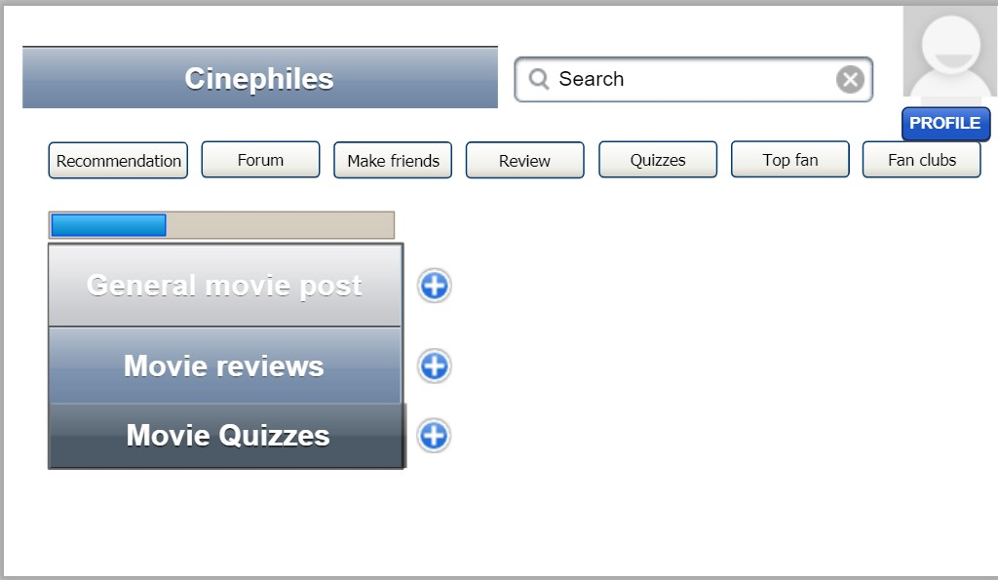
Prototype Made With Pencil Tools

Slide 10




Tools To Be Used:

