Slide 1

Inventory Management System
Presenting By :
1. Sumaiya Drong Sompa
ID: 2201081136
2. Auntora Yasmin
ID: 2201081128
3. Md. Faisal Mia
ID: 2201081149
4. Ripon Sarker
ID: 2201081138
Presented To:
Md. Wahidur Rahman

Slide 2
Contents
Introduction
Motivation
Project objectives
Amis
Methodology and Working Principles
Developed Application
Conclusions
References

Slide 3
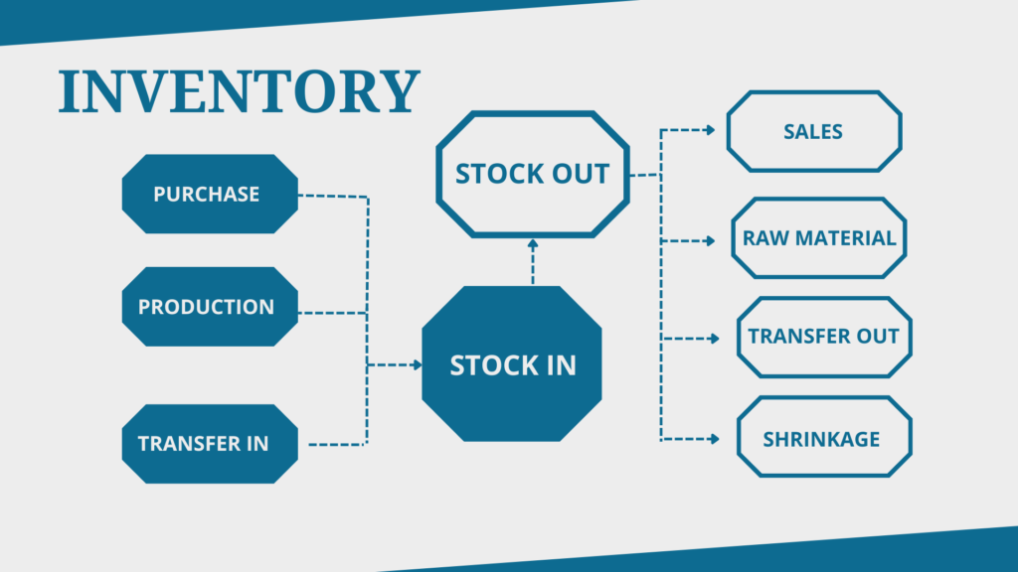
Introduction
An inventory management system is a system to manage each inventory item a business owns.
Periodic Inventory Management System
Perpetual Inventory Management System
Basic inventory management system features to look for include:
Inventory control systems
Demand Planning
Product lifecycle management
Finances

Slide 4
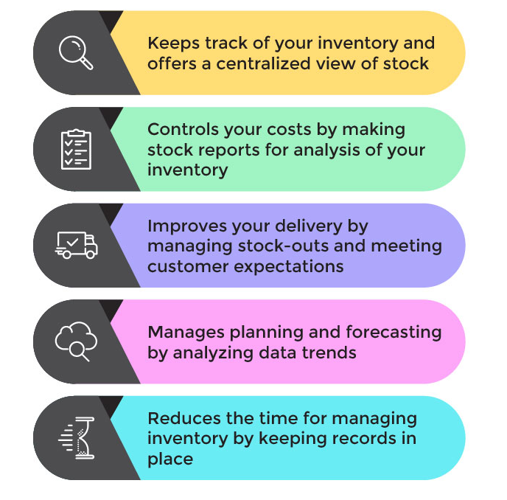
Motivation
Inventory management is a set of all those processes which you utilize to oversee and organize your goods or materials in your facility.
Transaction Motive.
Precautionary Motive.
Speculative Motive.
Benefits of inventory Management :
Tracking Inventory
Control your costs
Improve your delivery
Manage planning and forecasting
Reduce the time for managing inventory.

Slide 5
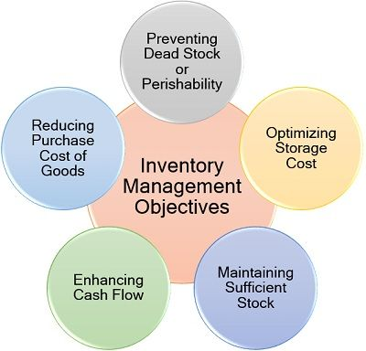
Project Objective
To facilitate furnishing of data for short and long-term planning with a controlled inventory.
To ensure the quality of goods at reasonable prices.
To maintain a systematic record of inventory.
To maintain minimum working capital as required for operational and sales activities.

Slide 6
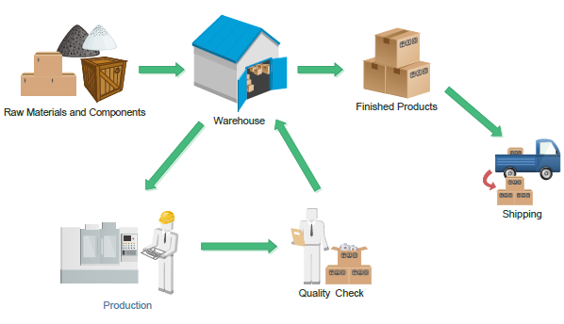
Aims
The primary objective of the inventory management system is to make sure material availability. With sufficient inventory, the production process can continue.

Slide 7
Methodology and Working Principles Contd…..
Methodology
Working Principles
Some of these management methods include just-in-time (JIT) manufacturing, materials requirement planning (MRP), economic order quantity (EOQ), and days sales of inventory (DSI).
There five key principles of inventory management:
demand forecasting,
warehouse flow,
inventory turns/stock rotation,
cycle counting and
process auditing.

Slide 8
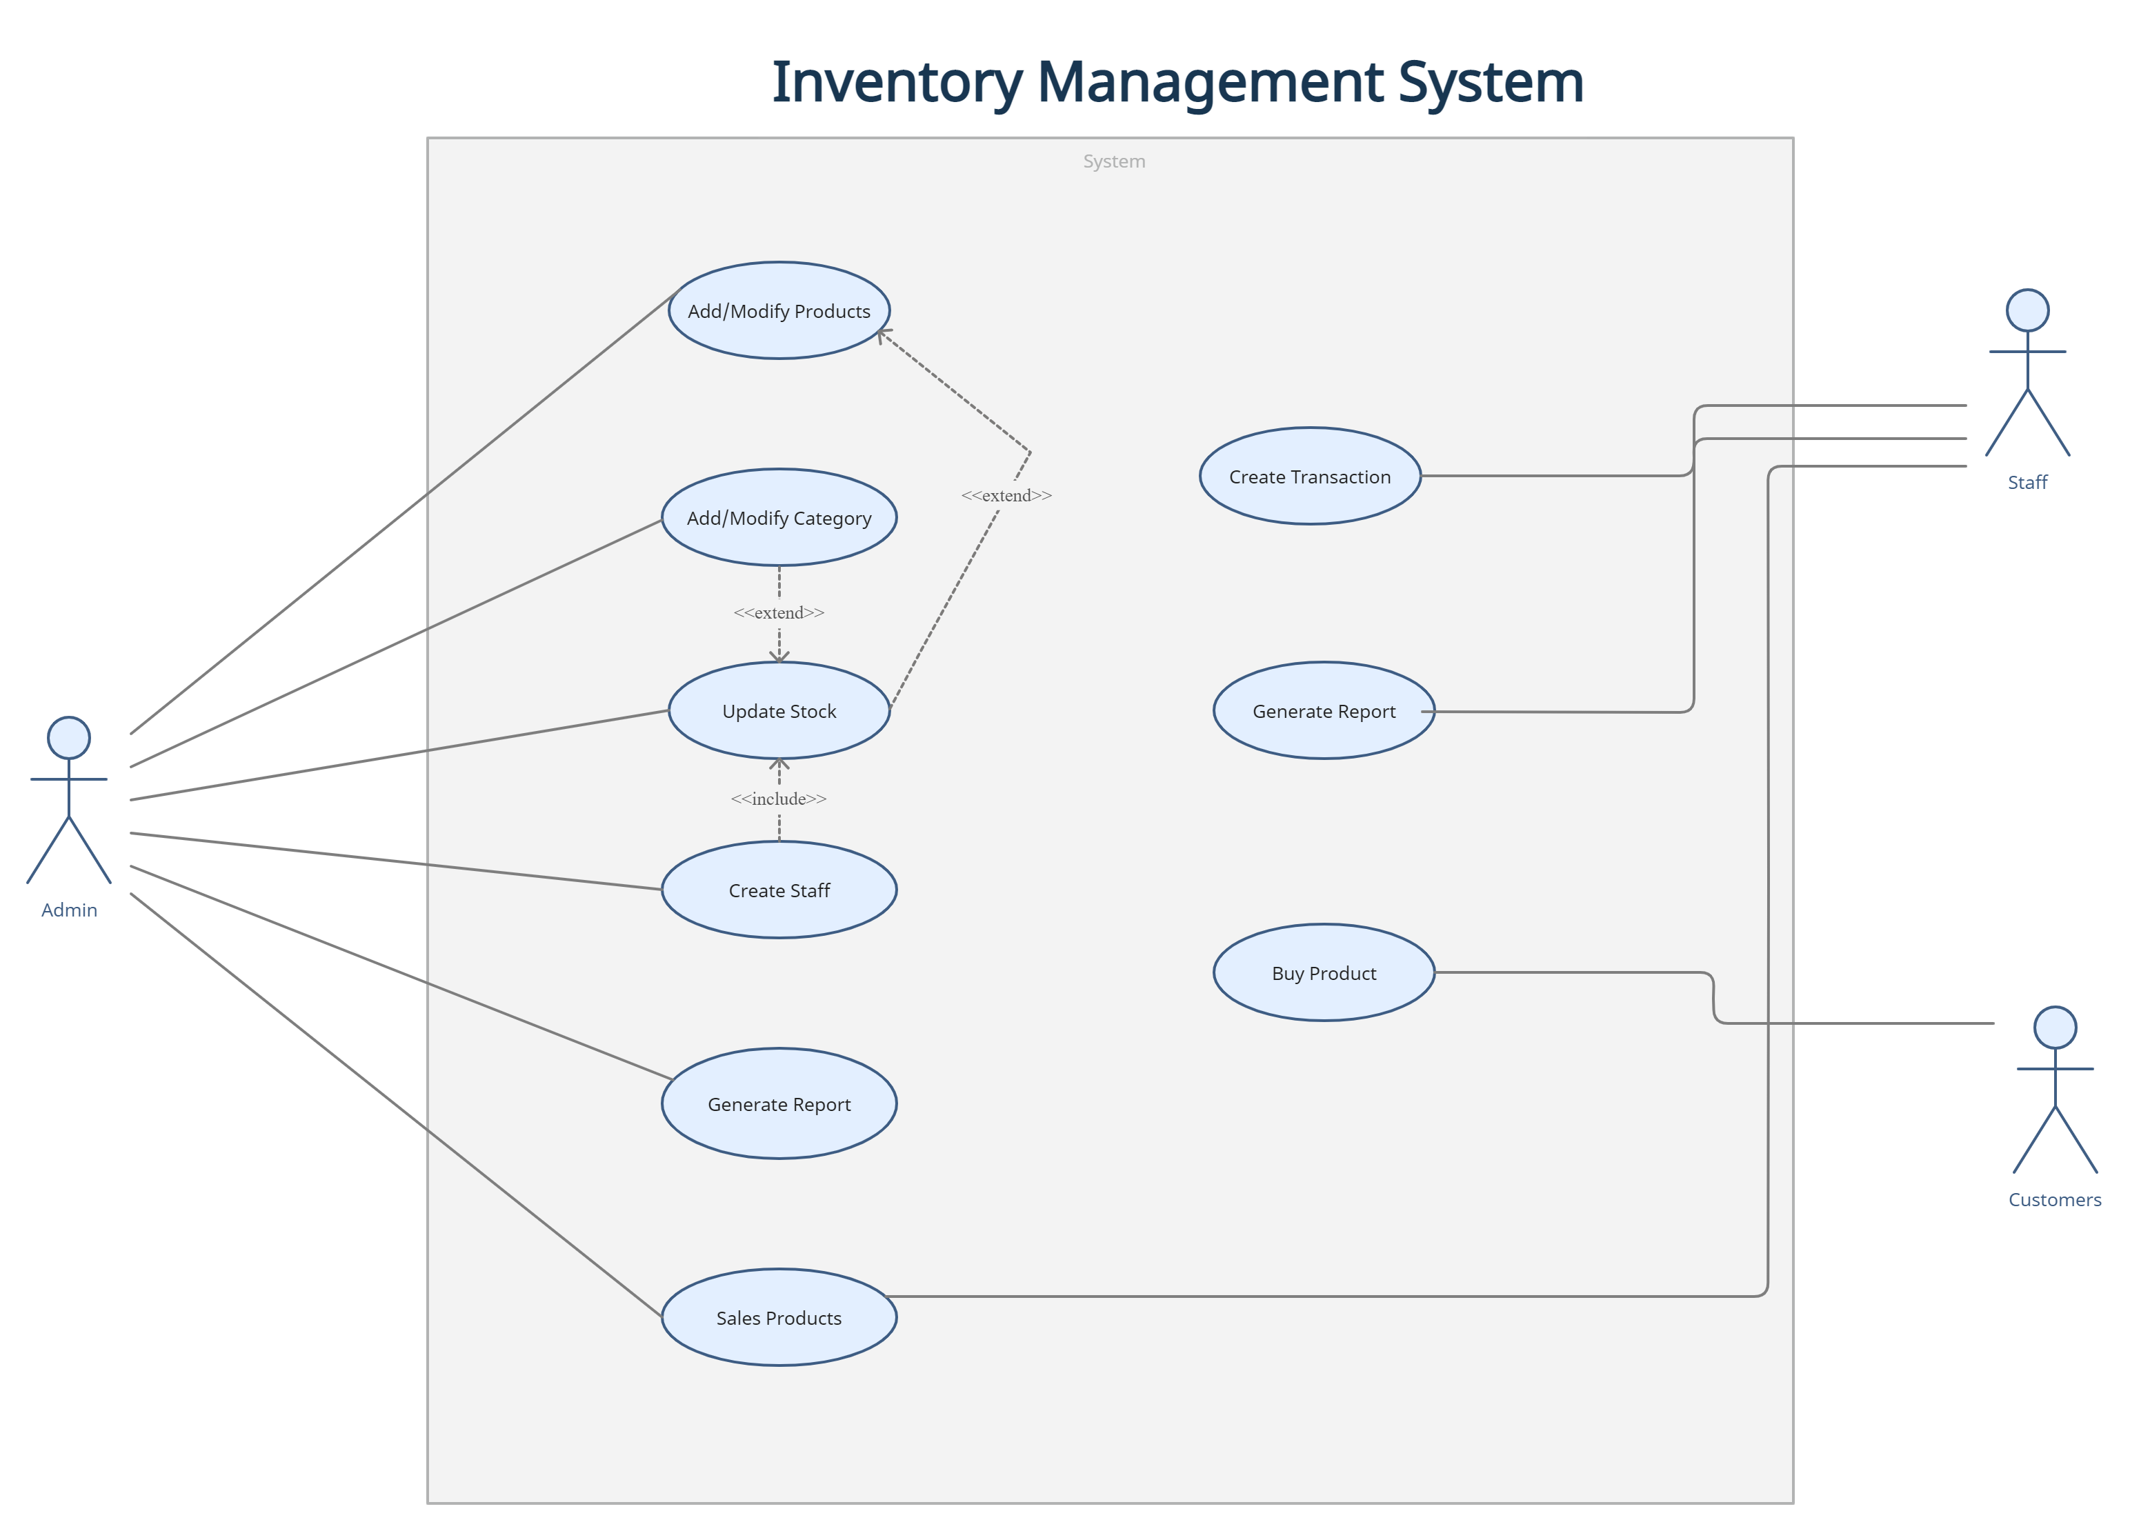
Use Case Diagram

Slide 9
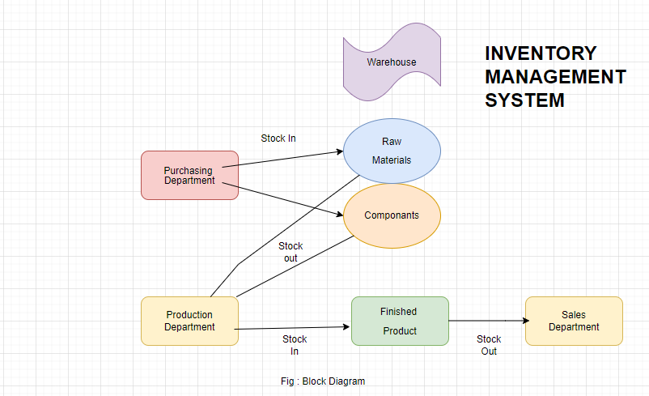
Methodology and Working Principles Contd…
Block Diagram

Slide 10
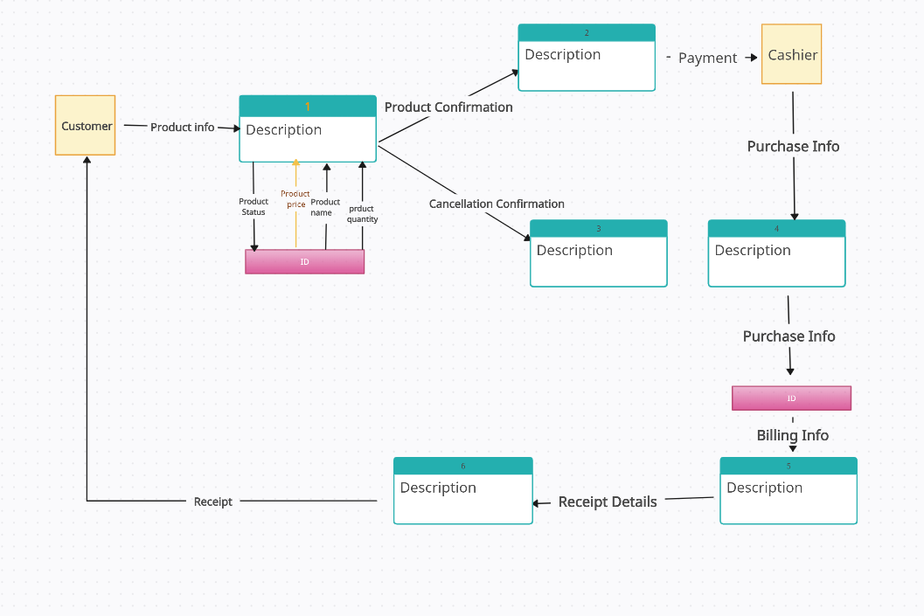
Methodology and Working Principles Contd…
Flowchart

Slide 11
Developed Application

Slide 12
Developed Application

Slide 13
Developed Application

Slide 14
Conclusions

Slide 15
Reference
"Production and Operations Management: Manufacturing and Services", R.B. Chase, N.J. Aquiline and F.R. Jacobs, Eighth Edition, 1998, pp 582-583
"Operations and Supply Chain Management: The Core", Third Edition, F. Robert Jacobs and Richard B. Chase, p 346

Slide 16


