Slide 1
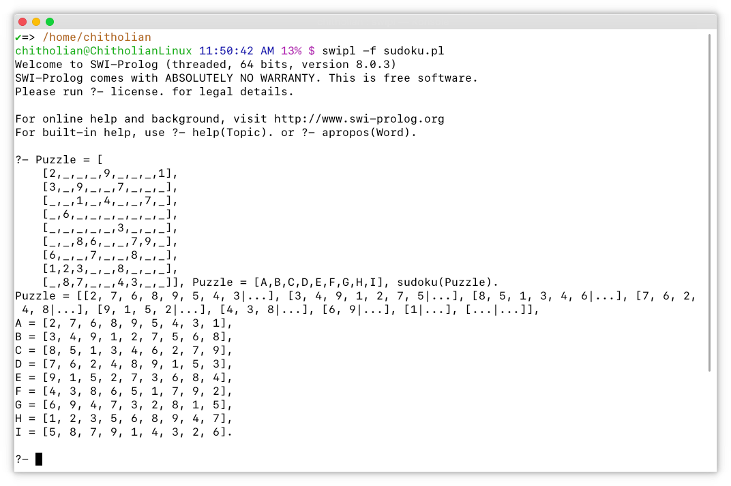
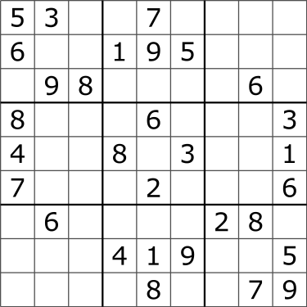
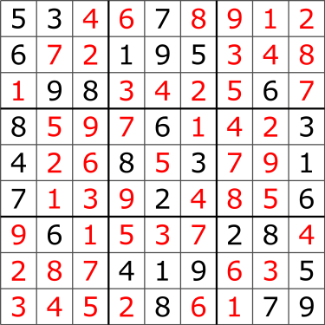
Sudoku Solver, an Expert System
ATIKUR RAHMAN : 16701016
Department of Computer Science and Engineering, University of Chittagong
Problem Statement
Design
Sample Input
Sudoku, originally called Number Place is a 9×9 grid puzzle based on logic, combinatorial number placement problem. In the grid, each box contains a number in the range 1-9 satisfying that each column, each row and each 3×3 block (i.e. the sub-blocks of the original 9×9 grid) contains all the numbers from 1-9 only once.
Solving Sudoku has been a challenging problem in the last decade. The purpose has been to develop more effective algorithm in order to reduce the computing time and utilize lower memory space.
Puzzle = [ [2,_,_,_,9,_,_,_,1], [3,_,9,_,_,7,_,_,_], [_,_,1,_,4,_,_,7,_], [_,6,_,_,_,_,_,_,_], [_,_,_,_,_,3,_,_,_], [_,_,8,6,_,_,7,9,_], [6,_,_,7,_,_,8,_,_], [1,2,3,_,_,8,_,_,_], [_,8,7,_,_,4,3,_,_]], Puzzle = [A,B,C,D,E,F,G,H,I], sudoku(Puzzle).
Percept
Input
Row, Column & Block Splitter
Output
Actuator
Constraint
Tester
Aims and Objectives
Sample Output
The general problem of solving Sudoku puzzles on n²×n² grids of n×n blocks is known to be NP-Complete. Many computer algorithms, such as backtracking and dancing-links can solve most 9×9 puzzles efficiently, but combinatorial explosion occurs as n increases, creating limits to the properties of Sudokus that can be constructed, analyzed, and solved as n increases. A Sudoku puzzle can be expressed as a graph-coloring problem. The aim is to construct a 9-coloring of a particular graph, given a partial 9-coloring.
The aim of this project is to convert the puzzle to a Constraints Satisfaction Problem (CSP). Then implement it in Prolog environment to build an expert system which will be able to solve a given sudoku puzzle.
Next Move
Generator
clpfd
Library
A = [2, 7, 6, 8, 9, 5, 4, 3, 1], B = [3, 4, 9, 1, 2, 7, 5, 6, 8], C = [8, 5, 1, 3, 4, 6, 2, 7, 9], D = [7, 6, 2, 4, 8, 9, 1, 5, 3], E = [9, 1, 5, 2, 7, 3, 6, 8, 4], F = [4, 3, 8, 6, 5, 1, 7, 9, 2], G = [6, 9, 4, 7, 3, 2, 8, 1, 5], H = [1, 2, 3, 5, 6, 8, 9, 4, 7], I = [5, 8, 7, 9, 1, 4, 3, 2, 6].
Screenshot of Execution Protocol
Conclusion
It is seen that the sudoku puzzle problem can be easily solved by making it a constraint satisfaction problem. Moreover, SWI-Prolog’s clpfd library allows us to set the constraints and get the solution at a very easy and fast way.
Finally, the source code is just around 25 lines, which is also easy to implement as well as easy to understand.

