Slide 1
“KRISHIBOT” A SMART DEVICE FOR BALCONY AND ROOFTOP PLANT IRRIGATION AND MONITORING SYSTEM USING IOT
Foysal Ahmed
171-15-9041
Saikat Mazumder
ID: 171-15-8791
Tithi Sutradhar
171-15-8695
Mr. Shah Md Tanvir Siddiquee
Assistant Professor
Department of CSE
Daffodil International University
03 June 2021

Slide 2
Content
Introduction
Motivation
Objective
Hardware Requirement
Software Requirement
Business Process Model
Circuit Diagram
Functionality
Outcome
Practical View of Device
Advantage and Limitation
Future Work
Conclusion

Slide 3
Introduction
IoT Based smart Device
Irrigation and Monitoring System
Device can be operated form anywhere.
Sending Notification on Mobile .

Slide 4
Motivation
Most of the people in the city doing gardens on their rooftops and plant trees on their corridors. Sometimes they didn't take care of the garden when going on vacation or business trips.

Slide 5
Objective
We have proposed a device IoT-based smart irrigation and plant monitoring system that names “Krishibot” using automation. As a result, we will be free from worries and will be able to know everything from anywhere.

Slide 6
Hardware Requirement
ESP 8266 Node MCU V3
DHT11
Breadboard
Jumper Wire
Soil Moisture Sensor
OLED display
2 Chanel 5V Relay Module
DC Motor PUMP
High-Pressure water Pump
5V Power Supply
12V Power Supply
Wi-Fi router

Slide 7
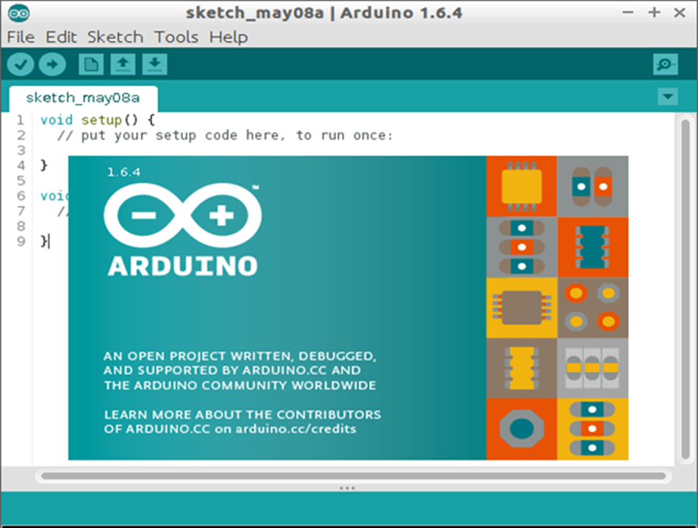

Software Requirement
Arduino IDE Android Studio

Slide 8
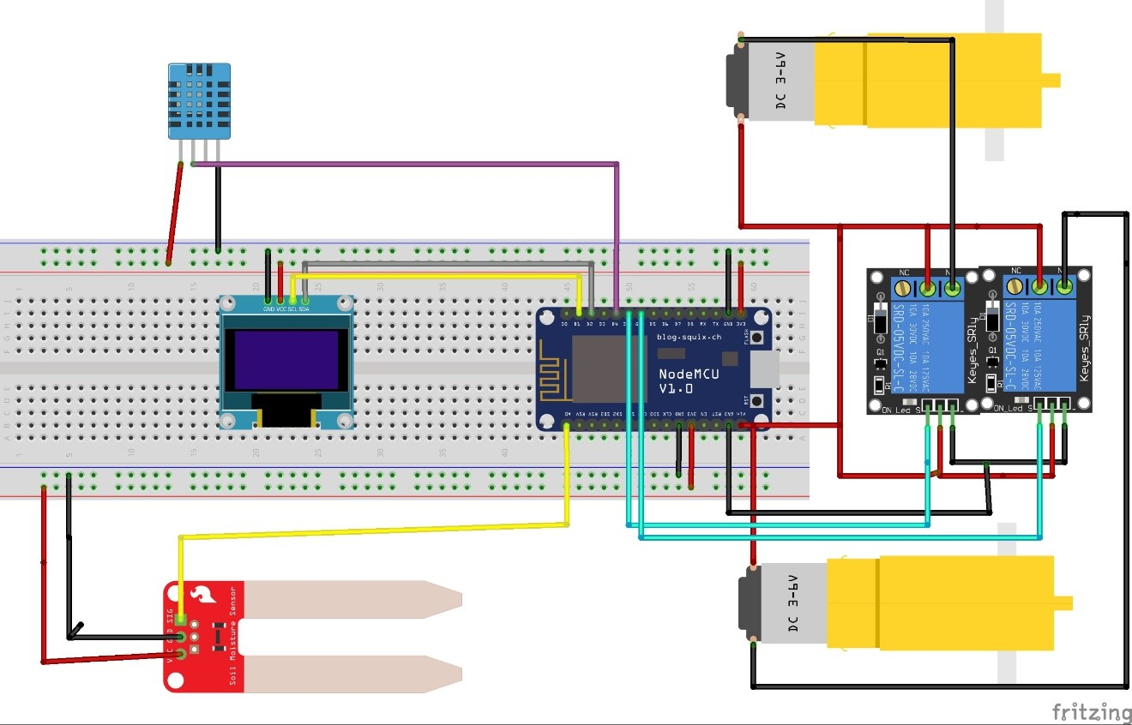
Circuit Diagram

Slide 9
Functionality
Automatic Mode:
When soil RH grater than 30% the irrigation motor turned ON automatically.
Once motor is on, it will continue a certain time.
When Soil Rh is getting lower than 30% motor is turned OFF
Manual Mode:
In manual mode user can operate this device manually.
Spray Motor is control by user manually.

Slide 10
Outcome
This device will take care of plant.
This device can be operated both manually and automatically.
It provides automatic drip irrigation on the plant.
You can control this device from anywhere on the earth over the internet using an android application.
With this device, you can monitor Soil PH, Humidity, and Temperature.
Store data on firebase's real-time database.
You can spray water and pesticides on your plant.

Slide 11
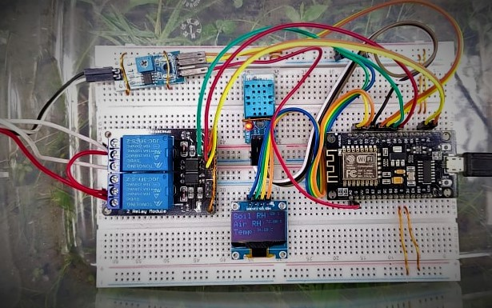
Practical View of Device

Slide 12
Advantage and Limitation
Advantage:
Portable and easy to use.
Irrigate and Monitor plant automatically.
Low power consumption.
Limitation:
Set functionality according to Plant.
Depending on internet for app control.
Monitoring via video.

Slide 13
Future Work
Device:
Add NPK sensor
Application:
Crops disease and solution by using image processing.

Slide 14
Conclusion
Every people in our country loves gardening. Hopefully, this Device will be followed in the coming days and will spread widely in the agricultural sector as a result of which many people will be interested in roof gardening. This will help maintain the balance of the environment in the future.

Slide 15
Thank You

