Slide 1

HireBuild: An Automatic Approach to History Driven Repair of Build Scripts
Foyzul Hassan
Xiaoyin Wang
University of Texas at San Antonio

Slide 2


Why Automatic Repair of Build Script?
According to TravisTorrent data-set, 29% of code commits fail to go through successful build on the integration server.
Study of Java Build system [McIntosh et al. 2012] shows 27% of source code work items require an accompanying change to the build system.
Build Failure Hampers Project Progress and It Takes Time To Fix Those Issues
Study on a project of a large software company [Kerzazi et al. 2014] found that a minimum of 900 man-hours were spent on fixing build breakage over a six month period.
At Google, 37.4% and 29.7% of C++ and Java builds fail.[Seo et al. 2014]

Slide 3
HireBuild
History-Driven Repair of Build Scripts

Slide 4

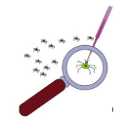

HireBuild – In Action
Automatic Build-Fix Pattern Generation
Patch Candidate Generation
Patch Evaluation
Build Log
Training
Build Logs
Build-Fix
Patterns
Fault
Localization
Patch List
Patch
Candidate
Build
Execution
Build
Evaluation
Repaired Build Script
Faulty Build Script(s)
Pass
Similar Build
Failure Logs
Fail
Build-Fix Pattern Generation
Patch Candidate Generation
Patch Evaluation

Slide 5
Automatic Build-Fix Pattern Generation
Build Log Parsing
Parse error-and-exception part, which typically accounts for only a small portion of the build log.
Similar Build Error Log Finding
Text Normalization
Stop word Removal
Stemming
TF–IDF Similarity Calculation
Generation of Build-Fix Patterns
Build-Script Differencing
Extended GumTree for Gradle Build Script Differencing
Hierarchical Build-Fix Patterns
Merge and Rank Build-Fix Patterns

Slide 6
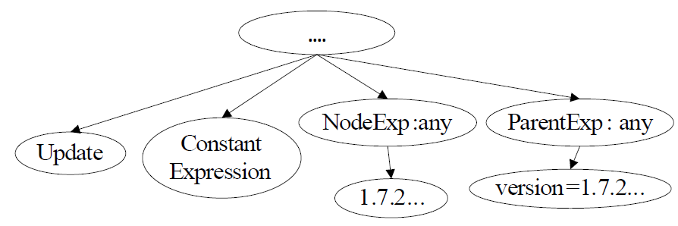
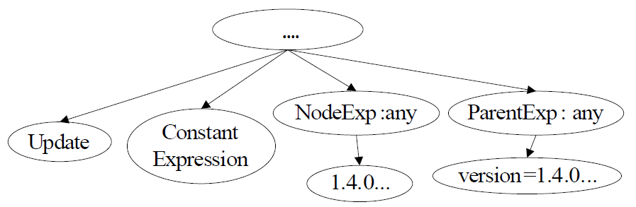
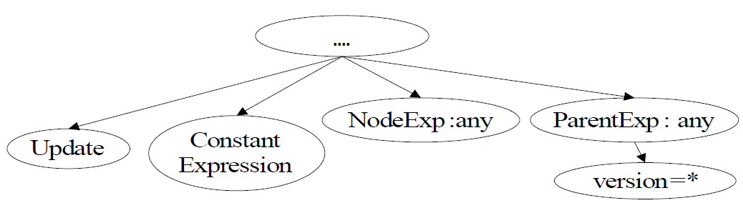
How Build-Fix Pattern Generation Works
(BuildCraft/BuildCraft: 98f7196)
- version = “1.7.2-10.12.1.1079”
+ version = “1.7.2-10.12.2.1121”
(ForgeEssentials/ForgeEssentialsMain:fcbb468)-version = “1.4.0-beta7”
+version = “1.4.0-beta8

Slide 7
Patch Candidate Generation
Fault Localization
Performed File level fault localization based on analysis of build log.
Patch List
AST Analysis of Build Script
Context Check for extracted fix patterns
Check Parent Name
Check Task Name
Patch Candidate
Edit Build Script with each Patch

Slide 8
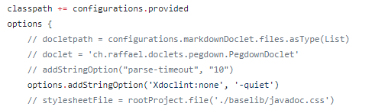
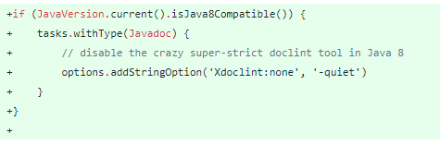
An Example of Using Training Project Fix
Evaluation Project
Training Project
Project: puniverse/quasar, ID: e7dafdc
Project: SpongePowered/SpongeForge, ID: df361ba
classpath += configurations.provided
options {
+ if(JavaVersion.current().isJava8Compatible()){
+ tasks.withType(Javadoc) {
options.addStringOption('Xdoclint:none', '-quiet’)
+ }
+ }
Repaired Script

Slide 9
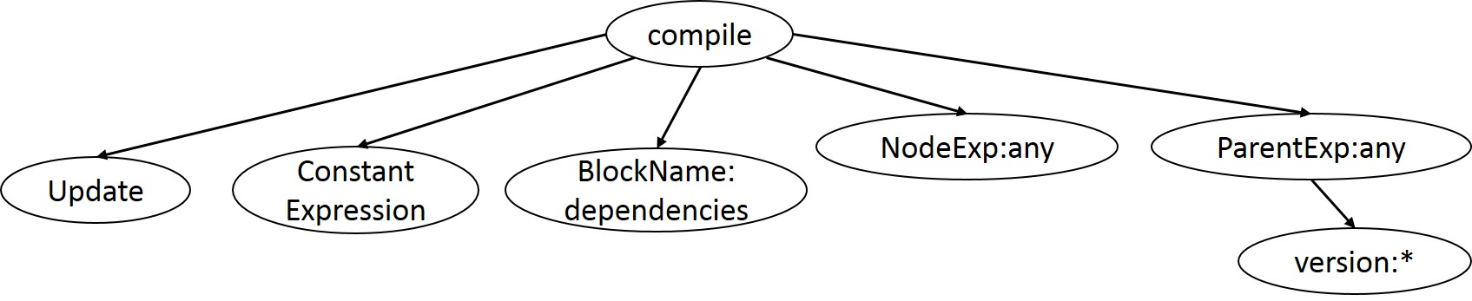
An Example of Fixing With Template
Build Log Project: aol/micro-server, ID: 9599be6
* What went wrong:
Could not resolve all dependencies for configuration ':micro-boot:compile'.
> Could not find com.aol.microservices:microserver-core:0.57
...
Fix Template
Generated Fix
dependencies {
compile 'org.springframework.boot:spring-boot:1.2.1.RELEASE'
compile 'org.springframework.boot:spring-boot-autoconfigure:1.2.1.RELEASE'
//compile project(':micro-core')
compile group: 'com.aol.microservices', name:'microserver-core', version:'0.56'
}

Slide 10

Patch Evaluation
Build Execution
After applying patch candidate, built the project.
Build Evaluation
Evaluated build outcome with following criteria:
Build process returns 0 and the build log shows build success.
All source files that are compiled in the latest successfully built version are compiled if they are not deleted in between.

Slide 11
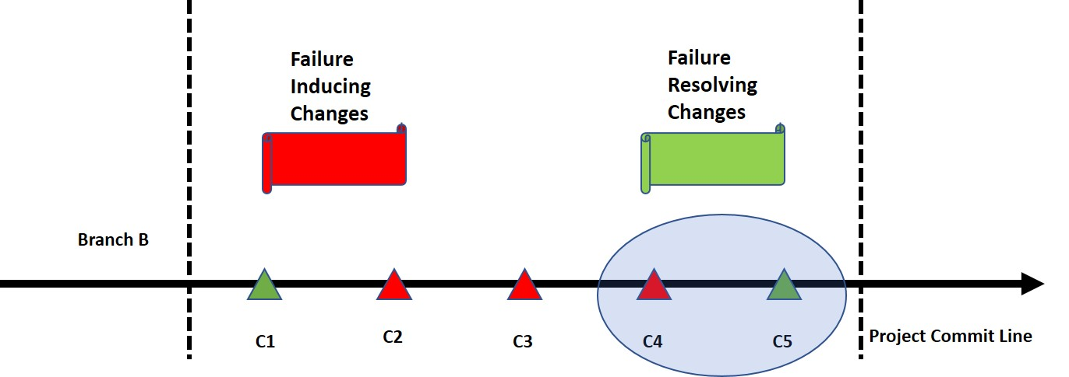
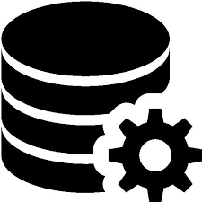
Data Selection Process and Summary
Data Selection Process
TravisTorrent
If C5 commit contains only build script change.
Data Summary

Slide 12
RQ1: # of Successfully fixed build failures
11 of 24 Reproducible Build Failures Can Be Fixed Successfully
45.83%
Manually Checked All The Automatically Generated Fixes Are Semantically Equivalent
to Manual Fixes

Slide 13
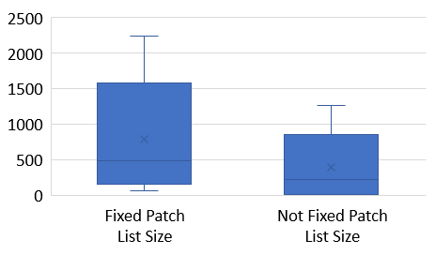
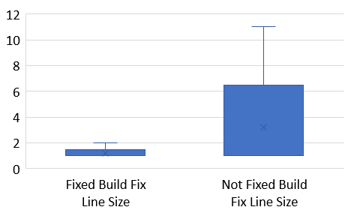
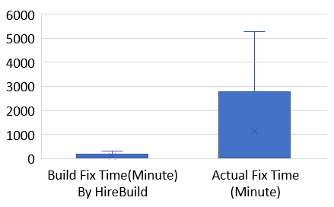
RQ2: Time Spent on Fixes & RQ3: Actual Fix Size
Fixed Build Failures: Minimum-68, Maximum-2,245, Median-486
Not Fixed Build Failures: Minimum-8, Maximum- 1,266 , Median- 223
HireBuild Fix Time: Minimum-2, Maximum-305, Median-44
Actual Fix Time: Minimum-<1, Maximum- 5,281 , Median-42
Fixed Build Failures Line Size: Minimum-1, Maximum-2, Median-1
Not Fixed Build Failures Line Size: Minimum-1, Maximum- 11, Median-1

Slide 14
RQ4: What about rest 13 build failures?
Project specific change (Netflix/Hystrix:6600947)
+ if ( dep.moduleName == ’servlet-api’ ) {
+ it.artifactId[0].text() == dep.moduleName
&&
+ asNode().dependencies[0].dependency.find{
+ ...
+ }}
+ }
Dependency resolve Issue (BuildCraft/BuildCraft:12f4f06)
- mappings = ’snapshot_20160214’
+ mappings = ’stable_22’

Slide 15

Limitations
Evaluated on Small data-set.
Our work only works on build script related fixing. But build fix might also requires source code change.
HireBuild applies one patch at a time. But actual fix can combination of multiple patches.

Slide 16
Future Work
Enhance Build Fix data set with both build script and source file change.
Apply search based technique such as genetic programming for better ranking of generated patches and apply combination of patches.
A complete tool suite to fix both build script and source file related build fix.

Slide 17

Conclusion
We propose the first approach for automatic build fix candidate patch generation for Gradle build script.
Our technique is featured with following challenges:
Build log analysis.
Build-fix-pattern templates.
Build validation.

Slide 18


Slide 19
References
1. S. McIntosh, B. Adams, and A. E. Hassan, “The evolution of java build systems,” Empirical Software Engineering, vol. 17, no. 4-5, pp. 578– 608, 2012.
2. N. Kerzazi, F. Khomh, and B. Adams, “Why do automated builds break? an empirical study.” in International Conference on Software Maintenance and Evolution. IEEE, 2014, pp. 41–50.
3. Hyunmin Seo, Caitlin Sadowski, Sebastian Elbaum, Edward Aftandilian, and Robert Bowdidge. 2014. Programmers’ Build Errors: A Case Study (at Google). In Proceedings of the 36th International Conference on Software Engineering (ICSE 2014). ACM, New York, NY, USA, 724–734.

