Slide 1
Scoping for automation in defined US SMB industries

Slide 2
Initial idea: StaffSmart," streamlines workforce management for construction projects. Key features include:
Efficient Crewing: Intelligent crew formation by matching employees to tasks based on skills and availability.
Accurate Time Tracking: Real-time attendance and geolocation tracking for precise work hours and schedule control.
Swift Replacements: Quick staff replacement and dispatching to minimize project disruptions.
Compliance Focus: Built-in features for managing regulatory compliance, minimizing legal risks.
Preliminary conclusion:
- No go. as there is no sufficient demand for stand along module, high integration required, as a result the high cost of development and implementation
New area: construction management (____)
Actions: find the construction company which is willing to discuss the requirements, Denis, May 1 (preliminary)

Slide 3
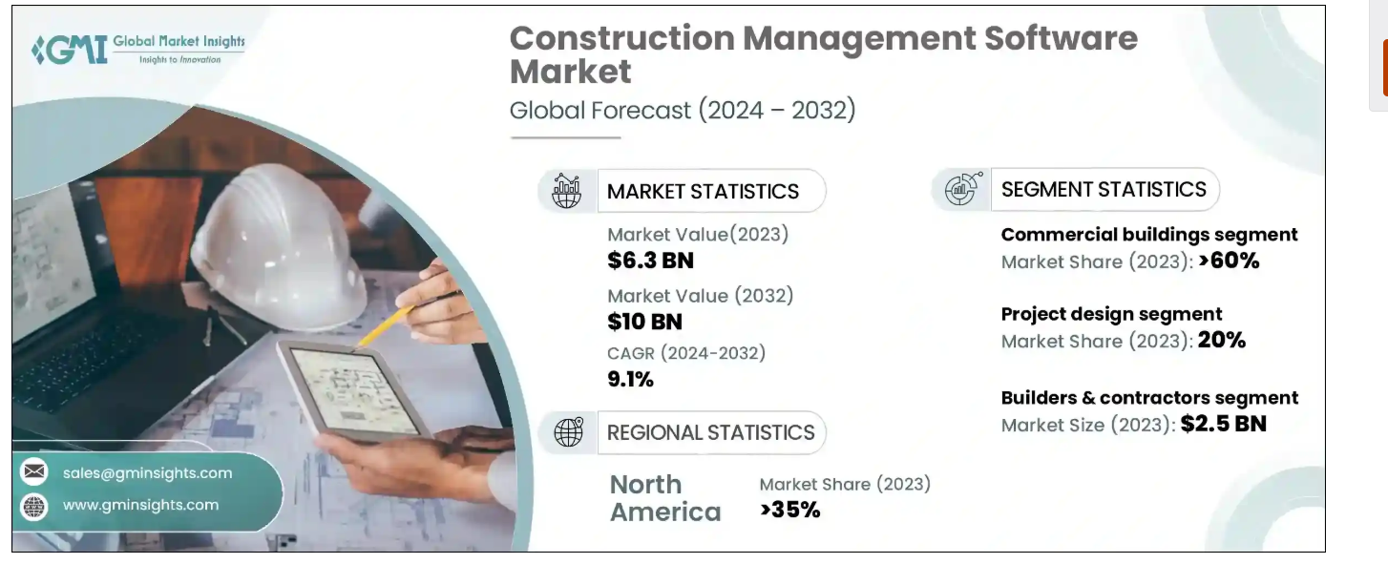
US Construction market
Is growing
has established leaders
Few new players. Source: https://www.gminsights.com/industry-analysis/construction-management-software-market

Slide 4
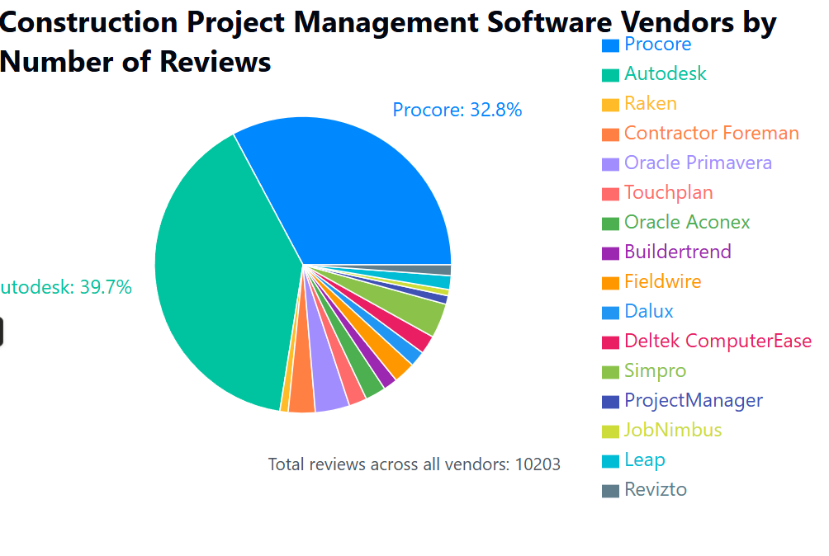
Markeshares (own research). 2 clear leaders – Autodesk and Procore
US construction automation practically is DUOPOLY

Slide 5
Duopoly (Procore vs ACC) pricing. CUSTOMERS ARE DISSATISFIED with pricing
Procore's pricing, based Annual Construction Volume (ACV), with users reporting that costs can range from around $500 to $1000 per $1 million ACV, depending on the modules and users included.
$10-14k is Procore starting plan going up to $100K and more
Autodesk Construction Cloud. Less expensive but still like $1-1,6K per seat, gives $10K for 10 seats per year at least

Slide 6
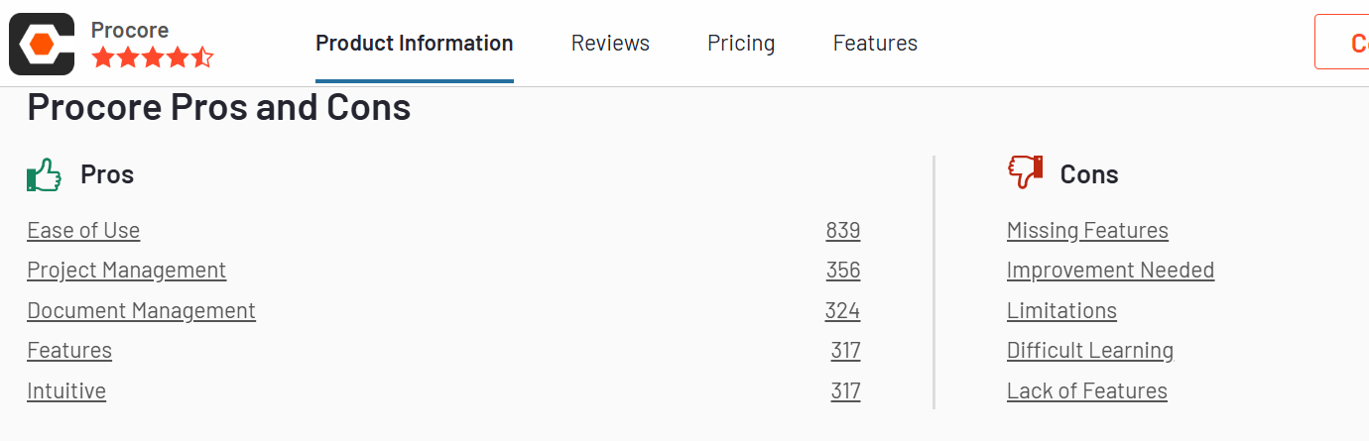
Scoping for automation in defined US SMB industries: Procore: Pros and Cons

Slide 7
Procore offers functionality that aligns with asset management, procurement management, and change orders (COs). Here's a breakdown:
1. Asset Management:
Indirectly Supported: Procore isn't a dedicated asset management system like specialized software. However, it provides capabilities that can be used to track and manage assets, especially those related to construction projects.
How it Works:
Tools: Primarily through the use of Documents, Photos, RFIs (for tracking issues related to assets), and Daily Logs.
Features:
Document Management: Store and organize manuals, warranties, and specifications for equipment and materials. Photos: Capture visual records of assets at different stages of the project. RFIs: Raise questions about assets, their installation, or performance. Daily Logs: Record the status and usage of assets on a daily basis. Cost Tracking: Track the financial aspect of the assets
Limitations:
Not Comprehensive: Lacks features such as detailed maintenance scheduling, comprehensive asset lifecycle tracking, and integration with specialized asset tracking technologies (e.g., RFID).
Workarounds: Asset management within Procore typically requires manual processes and custom workflows.
2. Procurement Management:
Directly Supported: Procore provides a robust suite of tools for managing the procurement process.
How it Works:
Tools: Bids, Purchase Orders (POs), Submittals, Budgeting, and Change Orders (COs).
Features:
Bid Management: Centralize and manage the bidding process for subcontractors and vendors.
Purchase Orders: Create and issue POs to vendors, track commitments, and manage spending.
Submittals: Manage the submittal process for materials and equipment approvals.
Budgeting: Integrate procurement with the project budget, allowing for accurate cost tracking.
Change Orders: Integral for managing changes to scope, cost, and schedule related to procurement.
Invoice Management: Ability to receive, match, and pay invoices.
Contract Management: Store contracts related to procurement process.
Strengths:
Streamlined Process: Automates key procurement tasks, improving efficiency and accuracy.
Visibility: Provides real-time visibility into project costs, commitments, and vendor performance.
Collaboration: Facilitates collaboration between project teams, vendors, and stakeholders.
Cost Control: Helps to control costs by tracking and managing spending against budgets.
In summary:
Procore is strong on Procurement Management and Change Orders, offering comprehensive tools to streamline these processes.
It has limited asset management capabilities, primarily through the use of its other tools. It does not replace dedicated asset management software.
If asset management is a core requirement for your projects, you may need to use Procore in conjunction with other specialized software, or utilize the workaround mentioned earlier. For procurement and change management, Procore is a solid choice.

Slide 8
Procore Procurement workflow
1. Project Setup & Vendor Management:
Create a Project: A new project is established within Procore.
Add Contacts and Companies: Project team members, vendors, and other relevant companies are added to the system.
Vendor Management:
Prequalification: Assess vendors based on qualifications, insurance, and other criteria.
Vendor Directory: Maintain a centralized directory of approved vendors.
2. Bid Management:
Create RFQs (Request for Quotations): Generate and send out RFQs to multiple vendors for specific scopes of work or materials.
Bid Analysis: Collect and compare bids received from vendors. Track bid due dates and vendor responses.
Bid Packages & Selection: Organize bids into bid packages and select the winning vendor.
3. Purchase Order (PO) Creation & Management:
Create POs: Generate purchase orders detailing the goods or services to be procured, pricing, and delivery instructions.
Approval Workflow: Set up approval workflows for purchase orders to ensure proper authorization based on dollar amounts or project roles.
PO Tracking: Track the status of POs, including pending approval, sent, received, and fulfilled.
PO Change Orders (COs): Issue change orders to POs if there are modifications to the scope, pricing, or delivery terms.
4. Invoice Management & Payment:
Invoice Receipt: Receive invoices from vendors, either directly within Procore or through integration with accounting systems.
Invoice Matching: Match invoices to the corresponding purchase orders and delivery receipts.
Approval Workflow: Route invoices through approval workflows for verification and payment.
Payment Processing: Integrate with accounting systems to process payments and update invoice statuses.
5. Submittals & Change Management (Related, but not solely Procurement):
Submittals: Vendors submit materials to the project, which are reviewed and approved.
Change Orders: Manage changes to the project, which can impact procurement.\
6. Closeout & Reporting:
Tracking: Track the progress of procurement activities, including materials received, payments made, and change orders.
Reporting: Generate reports on project spend, vendor performance, and other key metrics.
Closeout: Ensure all procurements are finalized at the end of the project.
Key Features Supporting the Workflow:
Document Management: Securely store and share all procurement-related documents.
Notifications & Reminders: Receive automated notifications and reminders for key tasks and deadlines.
Collaboration Tools: Communicate with project team members, vendors, and other stakeholders.
Mobile Access: Access and manage procurement activities from anywhere using the Procore mobile app.
Integrations: Integrate with accounting systems, project management software, and other third-party applications.

Slide 9
https://support.procore.com/references/workflow-diagrams

